Slide 1
Dr. Corey J. Bishop
Assistant Professor of Biomedical Engineering
Principal Investigator of the Pharmacoengineering Laboratory: pharmacoengineering.com
Dwight Look College of Engineering
Texas A&M University
Emerging Technologies Building Room 5016
College Station, TX 77843 cbishop@tamu.edu
BMOLE 452-689 – Transport
Chapter 10. Mass Transport and Biochemical Interactions
Text Book: Transport Phenomena in Biological Systems
Authors: Truskey, Yuan, Katz
Focus on what is presented in class and problems…

Slide 2


Reaction mechanisms
$$R=sign ∗kC_{A}^{a}C_{B}^{b}C_{C}^{c}$$
Generally, Rates = constant * (reactants or products)
If disappearing or appearing dictates the sign
Reaction orders of individual reactants or products (a +b +c) = overall reaction order
Is k actually a constant?
What affects k the most?
Arrhenius equation
$$k=Ae^{−\frac{E_{a}}{K_{B}T}}$$
Ea = energy of activation (Joules)
A = a constant for each chemical reaction defining the frequency of collisions in correct orientation
Units of exponent?
Units of k?
How do you know the units of k?

Slide 3

An equation for the general half-life of any nth order differential equation
$$A+…+A→B at a rate constant of k$$
$$A^{′}={−kA}^{n}$$
$$A^{′}={−kA}^{n}=\frac{dA}{dt}$$
$$−kdt=\frac{1}{A^{n}}dA$$
$$\int{−kdt}=\int{\frac{1}{A^{n}}dA}$$
$$\left(−kt+c\right)=\frac{A^{−n+1}}{−n+1}$$
$$−kt=\frac{A^{−n+1}}{−n+1}−\frac{A_{o}^{−n+1}}{−n+1}$$
$$−\left(−n+1\right)kt=A^{−n+1}−A_{o}^{−n+1}$$
$$\left(n−1\right)kt=({0.5A_{o})}^{−n+1}−A_{o}^{−n+1}$$
$$\left(n−1\right)kt={{0.5}^{−n+1}A_{o}}^{−n+1}−A_{o}^{−n+1}$$
$$\left(n−1\right)kt_{\frac{1}{2}}=({0.5}^{−n+1}−1)A_{o}^{−n+1}$$
$$t_{\frac{1}{2}}=\frac{\left({0.5}^{−n+1}−1\right)}{\left(n−1\right)kA_{o}^{n−1}}$$
$$t_{\frac{1}{2}}=\frac{\left(2^{n−1}−1\right)}{\left(n−1\right)kA_{o}^{n−1}}$$
$$t_{\frac{1}{2}}=\frac{\left(2^{n−1}−1\right)}{\left(n−1\right)kA_{o}^{n−1}}$$

Slide 4

Examples
$$for n=0; t_{\frac{1}{2}}=\frac{\left(2^{0−1}−1\right)}{\left(0−1\right)kA_{o}^{0−1}}=\frac{2}{kA_{o}}$$
For n=1
Because:
$$\frac{db^{u}}{dx}=b^{u}\ln\left(b\right)\frac{du}{dx}$$
We can say that:
$$t_{\frac{1}{2}}=\frac{\left(2^{n−1}\right)}{\left(n−1\right)kA_{o}^{1−1}}$$
$$t_{\frac{1}{2}}=\frac{\left(2^{1−1}\right)\ln\left(2\right)}{kA_{o}^{1−1}}$$
$$t_{\frac{1}{2}}=\frac{ln⁡(2)}{k}$$
$$for n=1; l^{′}Hopital^{′}s rule: t_{\frac{1}{2}}=\frac{ln\left(2\right)}{k}$$
$$for n=2; t_{\frac{1}{2}}=\frac{\left(2^{2−1}−1\right)}{\left(2−1\right)kA_{o}^{2−1}}=\frac{1}{kA_{o}}$$
$$for n=3; t_{\frac{1}{2}}=\frac{\left(2^{3−1}−1\right)}{\left(3−1\right)kA_{o}^{3−1}}=\frac{3}{2kA_{o}^{2}}$$

Slide 5
Matrix Math for Chemical Reactions
Chapter 2
Multi-Step Reactions: The methods for Analytical Solving the Direct Problem
The following slides are based on this chapter cited below…
https://link.springer.com/chapter/10.1007%2F978-3-7091-0531-3_2#page-1

Slide 6

Short-hand

Slide 7
Another example:

Slide 8
How to solve concentrations as a function of time using eigenvectors and eigenvalues
Av- λv=0
v(A- λ?)=0… not mathematically possible
v(A- λI)=0
Solve for λ and then using Av= λv solve for eigenvectors
Remember they are scalable and translatable and usually they are normalized to have a magnitude of 1 and translated to the origin

Slide 9

Matrix diagonalization
A = PDP⁻¹
P = eigenvector matrix
D = diagonalization of
Eigenvalues via Identity Matrix
i.e.,
k= xΛx⁻¹
So
Multiple by dt
Separate variables properly
integrate
Matrix diagonalization…

Slide 10

Given: K = [1 -1; 2 4]; what is D and V
Caclulate compartments CA(t) and CB(t) using:
You should know though that to make sense there should be rate constants (and/or numbers) in the matrix K but for
Simplicity to show the math process K is a function of numbers only here
Be able to get to this end stage from knowing a compartmental scheme… i.e.,
I want you to be able to know every step for a simple 2x2 matrix (use numbers instead of ks, however) to get to C(t).
I do want you to solve the rate matrix using a scheme such as the one shown…

Slide 11
A = randn(3,3);
[V,D]=eig(A); V = 3x3 and D = a diagonal 3x3 with eigenvalues on diag.
A*V = V*D and A*V(:,1)=V(:,1)*D(1,1)
If A = symmetric then there are 3 eigenvalues (not necessarily distinct) and 3 orthogonal eigenvectors…
How to from A calculate eigenvalues and eigenvectors.
To do manually:
Ex: from A= [3 0 0; 0 3 0; 0 0 3] or any A… making it simple for example…
A-lambda*I = 0; solve for lambdas; each root is a lambda i.e., (λ-3)*(λ-3)*(λ-3)=0
Then solve for V1 by A*V(:,1)=V(:,1)*D(1,1)
Then solve for V2 by A*V(:,2)=V(:,2)*D(2,2)
Then solve for V3 by A*V(:,3)=V(:,3)*D(3,3);
Now let’s convince ourselves:

Slide 12
Is this equal to exp(V*D*m*inv(D))C_{o} in matlab?
Is this equal to C_{o}exp(Kt)? Matlab won’t let you use symbolic math with t; reserved for other things…
MatLab has a hard time simplifying: V*exp(D*t)*inv(V)*C_{o}

Slide 13
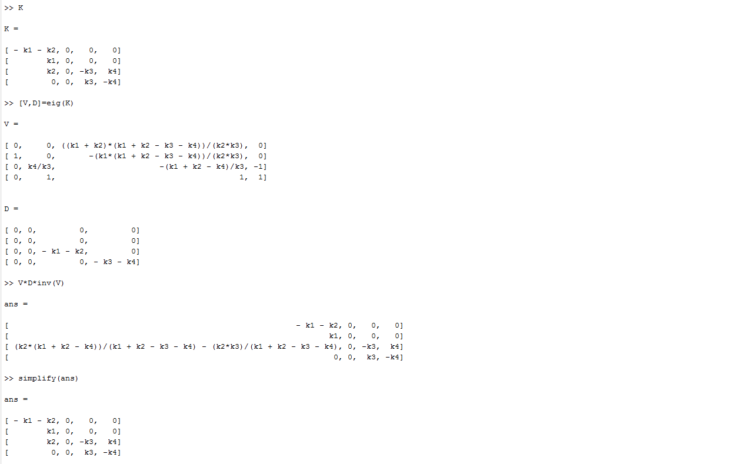
Clc
syms k1, k2, k3, k4
k*C = dC/dt
k*dt = 1/C dC
exp(kt)+constant = C(t)
exp(kt)*constant=C(t)
How do you solve for V and D manually from K?

Slide 14
Another example:
Multiple by dt
Separate variables properly
integrate

Slide 15

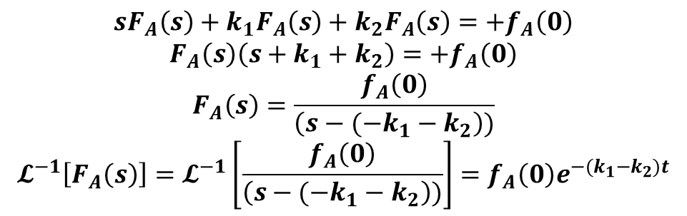

$$\frac{df_{B}}{dt}=+k_{1}f_{A}$$
$$\frac{df_{A}}{dt}=−k_{1}f_{A}−k_{2}f_{A}$$
$$\frac{df_{C}}{dt}=−k_{3}f_{c}+k_{2}f_{A}+k_{4}f_{D}$$
$$\frac{df_{D}}{dt}=+k_{3}f_{c}−k_{4}f_{D}$$
Only solve for for f_{A} and f_{B}
$$𝓛\left[\frac{df_{B}}{dt}=+k_{1}f_{A}\right]=sF_{B}\left(s\right)−f_{B}\left(0\right)=\frac{k_{1}f_{A}}{s}$$
$$𝓛\left[\frac{df_{A}}{dt}=−k_{1}f_{A}−k_{2}f_{A}\right]= sF_{A}\left(s\right)−f_{A}\left(0\right)=−k_{1}F_{A}\left(s\right)−k_{2}F_{A}\left(s\right)$$
$$𝓛^{−1}\left[F_{B}\left(s\right)\right]=f_{B}=𝓛^{−1}\left[\frac{k_{1}f_{A}}{s^{2}}+\frac{f_{B}\left(0\right)}{s}\right]=k_{1}f_{A}t+f_{B}\left(0\right)=k_{1}f_{A}\left(0\right)e^{−{(k}_{1}+k_{2})t}t+f_{B}\left(0\right)$$
$$sF_{A}\left(s\right)+k_{1}F_{A}\left(s\right)+k_{2}F_{A}\left(s\right)=+f_{A}\left(0\right)$$
$$F_{A}\left(s\right)\left(s+k_{1}+k_{2}\right)=+f_{A}\left(0\right)$$
$$F_{A}\left(s\right)=\frac{f_{A}\left(0\right)}{\left(s−(−k_{1}−k_{2}\right))}$$
$$𝓛^{−1}\left[F_{A}\left(s\right)\right]=𝓛^{−1}\left[\frac{f_{A}\left(0\right)}{\left(s−(−k_{1}−k_{2}\right))}\right]=f_{A}\left(0\right)e^{−{(k}_{1}−k_{2})t}$$

Slide 16
Pharmacokinetics (PK) and Pharmacodynamics (PD)
Difference?

Slide 17
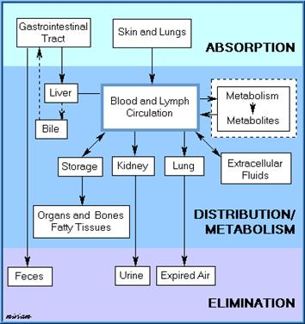
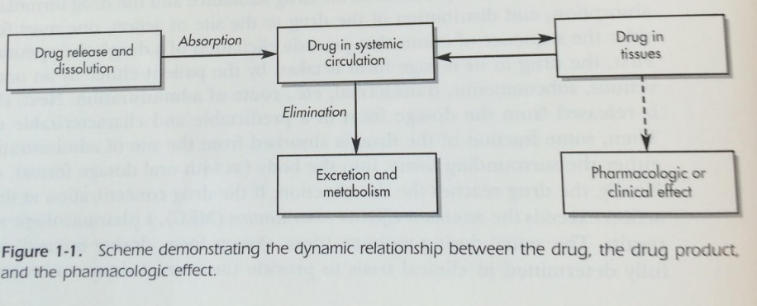
Pharmacokinetics (PK) and Pharmacodynamics (PD)
Difference?

Slide 18
Common variables for PK/PD
C_{p}=plasma concentration of drug
D_{B,} D₀=drug amount in body, initial drug concentration
Cl, Cl_{R}, Cl_{H}, Cl_{T} , Cl_{NR}=clearance, renal clearance, hepatic, total body, non-renal
V_{D}= volume distribution of drug
R = rate of infusion into systemic circulation
k, k_{m}, k_{e}, k_{a}=degradation rate, metabolism rate, excretion rate, absorption rate
AUC = area under the curve (C_{p}(t))
F= bioavailability
D_{u}= drug amount in urine
Ab = absorption

Slide 19
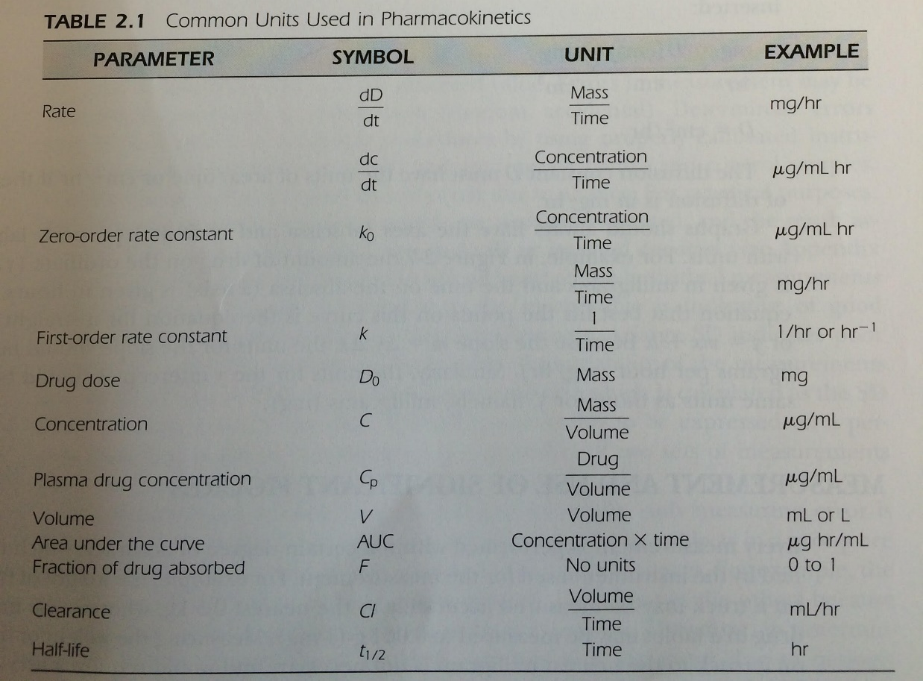
PK
Volume of dist. (Vd)?
  D_{o}/C_{p}
k_{o}
k
  Cl/Vd
    k_{renal} Cl_{renal}/Vd
  k_{metabolism}+k_{renal}+k_{hepatic}
Cl_{Hepatic, renal, total}
  Clearances also sum
    Cl_{total} = Cl_{renal} + Cl_{non-renal}

Slide 20

Cp as a function of clearance, volume of distribution, and initial drug amount
$$\frac{dC_{p}}{dt}=−kC_{p}$$
$$C_{p}=C_{p}^{o}e^{−kt}$$
$$C_{p}={\frac{D_{o}}{V_{d}}e}^{−\frac{Cl}{V_{d}}t}$$

Slide 21

Vd as a function of k, the initial drug amount, and the AUC (Cp vs t)
$$\frac{dD_{B}}{dt}=−kC_{p}V_{d}$$
$$dD_{B}=−kC_{p}V_{d}dt$$
$$\int_{0}^{D_{o}}{dD_{B}}=\int_{0}^{∞}{−kC_{p}V_{d}dt}$$
$$D_{o}=kV_{d}{\left[AUC\right]}_{o}^{∞}$$
$$\frac{D_{o}}{V_{d}}=C_{p}=k{\left[AUC\right]}_{o}^{∞}$$
$$V_{d}=\frac{D_{o}}{k{\left[AUC\right]}_{o}^{∞}}$$
Including Bioavailability: F*Do

Slide 22
Kidneys

Slide 23
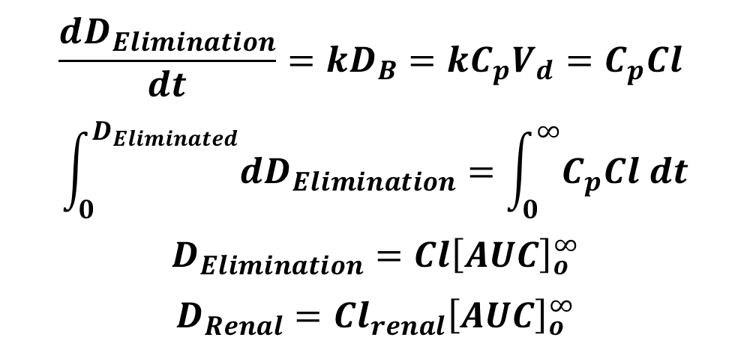
Endeavoring to use easy-access variables to characterize clearance for a patient (to cater drug regimen) or drug for healthy patients
$$\frac{dD_{Elimination}}{dt}=kD_{B}=kC_{p}V_{d}=C_{p}Cl$$
$$\int_{0}^{D_{Eliminated}}{dD_{Elimination}}=\int_{0}^{∞}{C_{p}Cl dt}$$
$$D_{Elimination}=Cl{\left[AUC\right]}_{o}^{∞}$$
$$D_{Renal}=Cl_{renal}{\left[AUC\right]}_{o}^{∞}$$
Total:
Sub-portion:

Slide 24

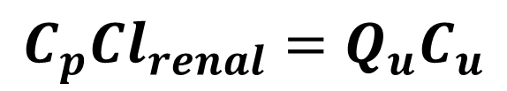
A useful, non-invasive way to quantify Cl_{renal}
$$C_{p}Cl_{renal}=Q_{u}C_{u}$$
$$D_{u}^{∞}=\frac{D_{o}k_{renal}}{k}$$

Slide 25
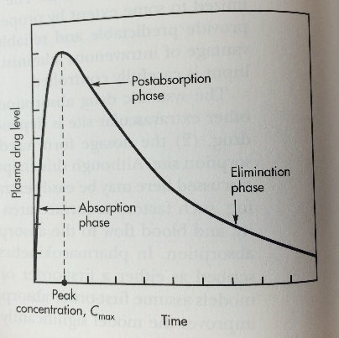
GI or Dermal
How many exponentials are describing this Cp(t) profile? How many compartments are here?
Is this for dermal or GI delivery? How would this be modified if it were IV?
How does the first-pass effect come into play?
ON BOARD LAPLACE EXAMPLE…

Slide 26
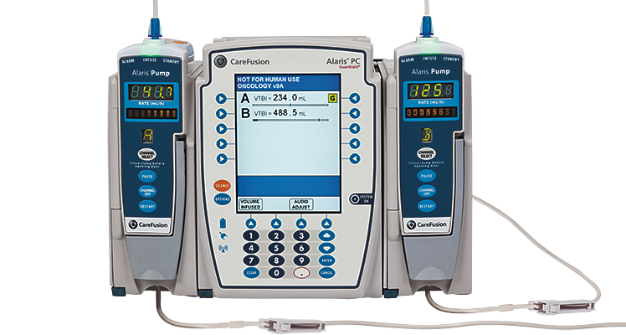
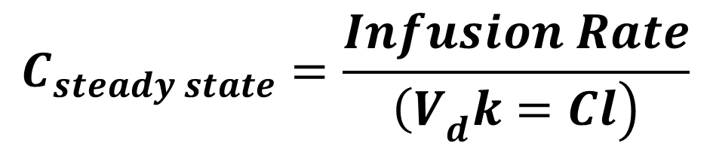
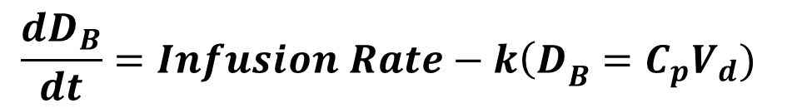
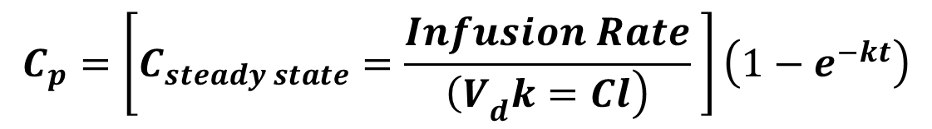
Infusion pumps
$$C_{steady state}=\frac{Infusion Rate}{\left.{\left(V\right.}_{d}k=Cl\right)}$$
$$C_{p}=\left[C_{steady state}=\frac{Infusion Rate}{\left.{\left(V\right.}_{d}k=Cl\right)} \right]\left(1−e^{−kt}\right)$$
$$\frac{dD_{B}}{dt}=Infusion Rate−k{{\left(D\right.}_{B}=C}_{p}V_{d})$$

Slide 27
Example of quantifying kinetics from my own research

Slide 28
http://www.sciencedirect.com/science/article/pii/S1742706116301325

Slide 29
http://www.sciencedirect.com/science/article/pii/S1742706116301325

Slide 30
P = plasmid # (note that volume is not taken into account); simply # of plasmids in a given compartment at any given time t.
Use: kcell, kne, kni, kbd equal to 7.5e-4, 0.72, 1.1, and 1.8 hr⁻¹
kdeg1 and kdeg2 equal to 0.62
And 0.084 hr⁻¹
Where A+B at t=2 hours is total plasmid #
in cell. i.e., 6500 plasmids
Why 2 degradation rates of plasmids (polyplex context)?
http://www.sciencedirect.com/science/article/pii/S1742706116301325

Slide 31
P = plasmid # (note that volume is not taken into account); simply # of plasmids in a given compartment at any given time t.
Use: kcell, kne, kni, kbd equal to 7.5e-4, 0.72, 1.1, and 1.8 hr⁻¹
kdeg1 and kdeg2 equal to 0.62
And 0.084 hr⁻¹
Where A+B at t=2 hours is total plasmid #
in cell. i.e., 6500 plasmids
Why 2 degradation rates of plasmids (polyplex context)?
What is the rate limiting step? Why is it what it is and not perhaps the expected
nuclear uptake step?
Why a Heaviside step function (HSSF)?
Be able to
do this
http://www.sciencedirect.com/science/article/pii/S1742706116301325

Slide 32
P = plasmid # (note that volume is not taken into account); simply # of plasmids in a given compartment at any given time t.
Use: kcell, kne, kni, kbd equal to 7.5e-4, 0.72, 1.1, and 1.8 hr⁻¹
kdeg1 and kdeg2 equal to 0.62
And 0.084 hr⁻¹
Where A+B at t=2 hours is total plasmid #
in cell. i.e., 6500 plasmids
Why 2 degradation rates of plasmids (polyplex context)?
What is the rate limiting step? Why is it what it is and not perhaps the expected
nuclear uptake step?
Why a Heaviside step function (HSSF)?
Be able to
do this
Be able to
do this
Apply Laplace to solve…
How would you do this?
How would you deal with the HSSF without
Taking the laplace of the HSSF.
http://www.sciencedirect.com/science/article/pii/S1742706116301325

Slide 33
http://www.sciencedirect.com/science/article/pii/S1742706116301325

