Slide 2
6.7.1: Diffusion in gases

Slide 3
Figure 6.10 Diffusion of two gases. The concentrations in each reservoir are kept constant such that at steady state, C_{A} = C_{Ao0} and C_{B} = C_{Bo} C_{B} = 0 at x = 0 and C_{A} = 0 and ₀at x = L.
Dilute solution?

Slide 4
Figure 6.10 Diffusion of two gases. The concentrations in each reservoir are kept constant such that at steady state, C_{A} = C_{Ao0} and C_{B} = C_{Bo} C_{B} = 0 at x = 0 and C_{A} = 0 and ₀at x = L.
Dilute solution cannot be invoked…. Flux of one induced flux of another in the absence of bulk motion.

Slide 5
Figure 6.10 Diffusion of two gases. The concentrations in each reservoir are kept constant such that at steady state, C_{A} = C_{Ao0} and C_{B} = C_{Bo} C_{B} = 0 at x = 0 and C_{A} = 0 and ₀at x = L.
$$N_{1}=−CD_{ij}∇x_{1}+x_{1}(N_{1}+N_{2})$$
Dilute solution cannot be invoked…. Flux of one induced flux of another in the absence of bulk motion.

Slide 6
Figure 6.10 Diffusion of two gases. The concentrations in each reservoir are kept constant such that at steady state, C_{A} = C_{Ao0} and C_{B} = C_{Bo} C_{B} = 0 at x = 0 and C_{A} = 0 and ₀at x = L.
$$N_{1}=−CD_{ij}∇x_{1}+x_{1}(N_{1}+N_{2})$$
Note: no chemical rxns
Dilute solution cannot be invoked…. Flux of one induced flux of another in the absence of bulk motion.

Slide 7
Figure 6.10 Diffusion of two gases. The concentrations in each reservoir are kept constant such that at steady state, C_{A} = C_{Ao0} and C_{B} = C_{Bo} C_{B} = 0 at x = 0 and C_{A} = 0 and ₀at x = L.
$$N_{1}=−CD_{ij}∇x_{1}+x_{1}(N_{1}+N_{2})$$
Note: no chemical rxns
[Gas]res.=constant
Dilute solution cannot be invoked…. Flux of one induced flux of another in the absence of bulk motion.

Slide 8
Figure 6.10 Diffusion of two gases. The concentrations in each reservoir are kept constant such that at steady state, C_{A} = C_{Ao0} and C_{B} = C_{Bo} C_{B} = 0 at x = 0 and C_{A} = 0 and ₀at x = L.
$$N_{1}=−CD_{ij}∇x_{1}+x_{1}(N_{1}+N_{2})$$
Note: no chemical rxns
[Gas]res.=constant
Constant pressure maintained throughout
Dilute solution cannot be invoked…. Flux of one induced flux of another in the absence of bulk motion.

Slide 9
Figure 6.10 Diffusion of two gases. The concentrations in each reservoir are kept constant such that at steady state, C_{A} = C_{Ao0} and C_{B} = C_{Bo} C_{B} = 0 at x = 0 and C_{A} = 0 and ₀at x = L.
$$N_{1}=−CD_{ij}∇x_{1}+x_{1}(N_{1}+N_{2})$$
Note: no chemical rxns
[Gas]res.=constant
Constant pressure maintained throughout
Fick’s 2nd Law applied:
$$\frac{{dN}_{Ax}}{dx}=0$$
$$\frac{{dN}_{Bx}}{dx}=0$$
What next?
Dilute solution cannot be invoked…. Flux of one induced flux of another in the absence of bulk motion.

Slide 10
Figure 6.10 Diffusion of two gases. The concentrations in each reservoir are kept constant such that at steady state, C_{A} = C_{Ao0} and C_{B} = C_{Bo} C_{B} = 0 at x = 0 and C_{A} = 0 and ₀at x = L.
$$N_{1}=−CD_{ij}∇x_{1}+x_{1}(N_{1}+N_{2})$$
Note: no chemical rxns
[Gas]res.=constant
Constant pressure maintained throughout
Fick’s 2nd Law applied:
$$\frac{{dN}_{Ax}}{dx}=0$$
$$\frac{{dN}_{Bx}}{dx}=0$$
What next?
Dilute solution cannot be invoked…. Flux of one induced flux of another in the absence of bulk motion.

Slide 11
$$N_{1}=−CD_{ij}∇x_{1}+x_{1}(N_{1}+N_{2})$$
$$\frac{{dN}_{Ax}}{dx}=0$$
$$\frac{{dN}_{Bx}}{dx}=0$$
What next?

Slide 12
$$N_{1}=−CD_{ij}∇x_{1}+x_{1}(N_{1}+N_{2})$$
$$\frac{{dN}_{Ax}}{dx}=0$$
$$\frac{{dN}_{Bx}}{dx}=0$$
1-D
$$N_{Ax}=−CD_{AB}\frac{dx_{A}}{dx}+x_{A}(N_{Ax}+N_{Bx})$$
$$N_{1}=−CD_{ij}∇x_{1}+x_{1}(N_{1}+N_{2})$$
$$N_{Bx}=−CD_{BA}\frac{dx_{B}}{dx}+x_{B}(N_{Ax}+N_{Bx})$$
Can assume D_{AB}=D_{BA}

Slide 13
$$N_{1}=−CD_{ij}∇x_{1}+x_{1}(N_{1}+N_{2})$$
$$\frac{{dN}_{Ax}}{dx}=0$$
$$\frac{{dN}_{Bx}}{dx}=0$$
1-D
$$N_{Ax}=−CD_{AB}\frac{dx_{A}}{dx}+x_{A}(N_{Ax}+N_{Bx})$$
$$N_{1}=−CD_{ij}∇x_{1}+x_{1}(N_{1}+N_{2})$$
$$N_{Bx}=−CD_{AB}\frac{dx_{B}}{dx}+x_{B}(N_{Ax}+N_{Bx})$$
Can assume D_{AB}=D_{BA}

Slide 14
$$N_{1}=−CD_{ij}∇x_{1}+x_{1}(N_{1}+N_{2})$$
$$\frac{{dN}_{Ax}}{dx}=0$$
$$\frac{{dN}_{Bx}}{dx}=0$$
1-D
$$N_{Ax}=−CD_{AB}\frac{dx_{A}}{dx}+x_{A}(N_{Ax}+N_{Bx})$$
$$N_{1}=−CD_{ij}∇x_{1}+x_{1}(N_{1}+N_{2})$$
$$N_{Bx}=−CD_{AB}\frac{dx_{B}}{dx}+x_{B}(N_{Ax}+N_{Bx})$$
Now what?

Slide 15
$$N_{1}=−CD_{ij}∇x_{1}+x_{1}(N_{1}+N_{2})$$
$$\frac{{dN}_{Ax}}{dx}=0$$
$$\frac{{dN}_{Bx}}{dx}=0$$
1-D
$$N_{Ax}=−CD_{AB}\frac{dx_{A}}{dx}+x_{A}(N_{Ax}+N_{Bx})$$
$$N_{1}=−CD_{ij}∇x_{1}+x_{1}(N_{1}+N_{2})$$
$$N_{Bx}=−CD_{AB}\frac{dx_{B}}{dx}+x_{B}(N_{Ax}+N_{Bx})$$
Now what? Pressure is the same everywhere so…

Slide 16
$$N_{1}=−CD_{ij}∇x_{1}+x_{1}(N_{1}+N_{2})$$
$$\frac{{dN}_{Ax}}{dx}=0$$
$$\frac{{dN}_{Bx}}{dx}=0$$
1-D
$$N_{Ax}=−CD_{AB}\frac{dx_{A}}{dx}+x_{A}(N_{Ax}+N_{Bx})$$
$$N_{1}=−CD_{ij}∇x_{1}+x_{1}(N_{1}+N_{2})$$
$$N_{Bx}=−CD_{AB}\frac{dx_{B}}{dx}+x_{B}(N_{Ax}+N_{Bx})$$
$$N_{Bx}=−N_{Ax}$$
Now what? Pressure is the same everywhere so…
Equimolar counterdiffusion
Analogous to diffusion through membrane if φ=1…

Slide 17
Figure 6.11 Evaporation of liquid A and diffusion through a stagnant layer of gas B.
Example 6.6
Is this more complex
Than the last?

Slide 18
Figure 6.11 Evaporation of liquid A and diffusion through a stagnant layer of gas B.
Is this more complex
Than the last?
Yes…
Consider this to be s.s. evaporation
Of a liquid A into a stagnant layer of gas
B. If there is a stagnant layer that
Means there is no bulk flow of the gas…
Not equimolar counterdiffusion.

Slide 19
Figure 6.11 Evaporation of liquid A and diffusion through a stagnant layer of gas B.
Is this more complex
Than the last?
Yes…
Consider this to be s.s. evaporation
Of a liquid A into a stagnant layer of gas
B. If there is a stagnant layer that
Means there is no bulk flow of the gas…
Not equimolar counterdiffusion because
Pretend there is a large
Reservoir supplying this
Concentration such that
It is constant.

Slide 20
Figure 6.11 Evaporation of liquid A and diffusion through a stagnant layer of gas B.
Is this more complex
Than the last?
Yes…
Consider this to be s.s. evaporation
Of a liquid A into a stagnant layer of gas
B. If there is a stagnant layer that
Means there is no bulk flow of the gas…
Not equimolar counterdiffusion because
B is insoluble in our fake situation…
Pressure is uniform
Pretend there is a large
Reservoir supplying this
Concentration such that
It is constant.
What next?

Slide 21
Figure 6.11 Evaporation of liquid A and diffusion through a stagnant layer of gas B.
Is this more complex
Than the last?
Yes…
Consider this to be s.s. evaporation
Of a liquid A into a stagnant layer of gas
B. If there is a stagnant layer that
Means there is no bulk flow of the gas…
Not equimolar counterdiffusion because
B is hardly soluble in our fake situation…
Pressure is uniform
Pretend there is a large
Reservoir supplying this
Concentration such that
It is constant.
What next?
What next?
Fick’s 2nd law
At s.s.

Slide 22
What next?
Fick’s 2nd law
At s.s.
$$\frac{{dN}_{Ay}}{dy}=0$$
$$\frac{{dN}_{By}}{dy}=0$$
Of note, gas is very slightly soluble and is much less than the flux due
To evaporation of the liquid A. so
B.C. N_{by} ~=0 at y=0… so…

Slide 23
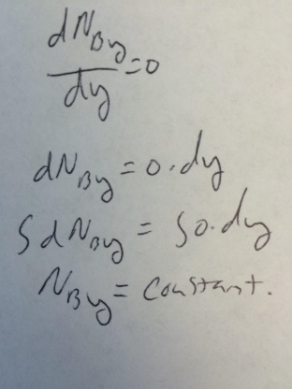
What next?
Fick’s 2nd law
At s.s.
$$\frac{{dN}_{Ay}}{dy}=0$$
$$\frac{{dN}_{By}}{dy}=0$$
Of note, gas is very slightly soluble and is much less than the flux due
To evaporation of the liquid A. so

Slide 24
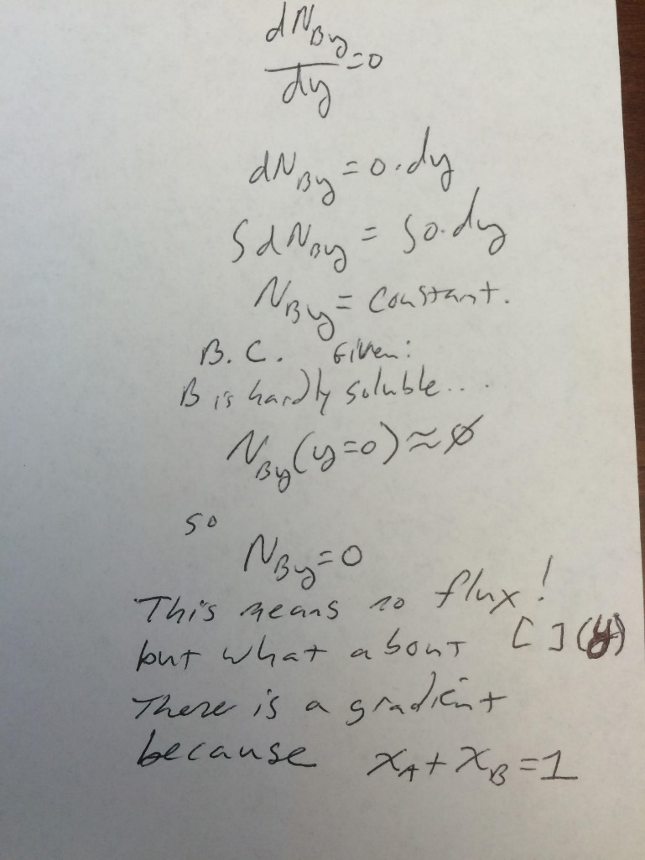
What next?
Fick’s 2nd law
At s.s.
$$\frac{{dN}_{Ay}}{dy}=0$$
$$\frac{{dN}_{By}}{dy}=0$$
Of note, gas is very slightly soluble and is much less than the flux due
To evaporation of the liquid A. so

Slide 25
What next?
Fick’s 2nd law
At s.s.
$$\frac{{dN}_{Ay}}{dy}=0$$
$$\frac{{dN}_{By}}{dy}=0$$
Of note, gas is very slightly soluble and is much less than the flux due
To evaporation of the liquid A. so

Slide 26
What next?
Fick’s 2nd law
At s.s.
$$\frac{{dN}_{Ay}}{dy}=0$$
$$\frac{{dN}_{By}}{dy}=0$$
Of note, gas is very slightly soluble and is much less than the flux due
To evaporation of the liquid A. so
Remember:
$$N_{1}=−CD_{ij}∇x_{1}+x_{1}(N_{1}+N_{2})$$

Slide 27
What next?
Fick’s 2nd law
At s.s.
$$\frac{{dN}_{Ay}}{dy}=0$$
$$\frac{{dN}_{By}}{dy}=0$$
Of note, gas is very slightly soluble and is much less than the flux due
To evaporation of the liquid A. so
Remember:
$$N_{1}=−CD_{ij}∇x_{1}+x_{1}(N_{1}+N_{2})$$
$$N_{Ay}=−CD_{AB}\frac{dx_{A}}{dy}+x_{A}(N_{Ay}+N_{By})$$

Slide 28
What next?
Fick’s 2nd law
At s.s.
$$\frac{{dN}_{Ay}}{dy}=0$$
$$\frac{{dN}_{By}}{dy}=0$$
Of note, gas is very slightly soluble and is much less than the flux due
To evaporation of the liquid A. so
Remember:
$$N_{1}=−CD_{ij}∇x_{1}+x_{1}(N_{1}+N_{2})$$
$$N_{Ay}=−CD_{AB}\frac{dx_{A}}{dy}+x_{A}(N_{Ay}+N_{By})$$
$$N_{Ay}=−CD_{AB}\frac{dx_{A}}{dy}+x_{A}N_{Ay}$$

Slide 29
What next?
Fick’s 2nd law
At s.s.
$$\frac{{dN}_{Ay}}{dy}=0$$
$$\frac{{dN}_{By}}{dy}=0$$
Of note, gas is very slightly soluble and is much less than the flux due
To evaporation of the liquid A. so
Remember:
$$N_{1}=−CD_{ij}∇x_{1}+x_{1}(N_{1}+N_{2})$$
$$N_{Ay}=−CD_{AB}\frac{dx_{A}}{dy}+x_{A}(N_{Ay}+N_{By})$$
$$N_{Ay}=−CD_{AB}\frac{dx_{A}}{dy}+x_{A}N_{Ay}$$
Now what?

Slide 30
What next?
Fick’s 2nd law
At s.s.
$$\frac{{dN}_{Ay}}{dy}=0$$
$$\frac{{dN}_{By}}{dy}=0$$
Of note, gas is very slightly soluble and is much less than the flux due
To evaporation of the liquid A. so
Remember:
$$N_{1}=−CD_{ij}∇x_{1}+x_{1}(N_{1}+N_{2})$$
$$N_{Ay}=−CD_{AB}\frac{dx_{A}}{dy}+x_{A}(N_{Ay}+N_{By})$$
$$N_{Ay}=−CD_{AB}\frac{dx_{A}}{dy}+x_{A}N_{Ay}$$
Now what? Solve for N_{Ay}
$N_{Ay}−x_{A}N_{Ay}$ = $−CD_{AB}\frac{dx_{A}}{dy}=N_{Ay}(1−x_{A})$
$N_{Ay}$ = $−\frac{CD_{AB}\frac{dx_{A}}{dy}}{1−x_{A}}$

Slide 31
What next?
Fick’s 2nd law
At s.s.
$$\frac{{dN}_{Ay}}{dy}=0$$
$$\frac{{dN}_{By}}{dy}=0$$
Of note, gas is very slightly soluble and is much less than the flux due
To evaporation of the liquid A. so
Remember:
$$N_{1}=−CD_{ij}∇x_{1}+x_{1}(N_{1}+N_{2})$$
$$N_{Ay}=−CD_{AB}\frac{dx_{A}}{dy}+x_{A}(N_{Ay}+N_{By})$$
$$N_{Ay}=−CD_{AB}\frac{dx_{A}}{dy}+x_{A}N_{Ay}$$
Now what? Solve for N_{Ay}
$N_{Ay}−x_{A}N_{Ay}$ = $−CD_{AB}\frac{dx_{A}}{dy}=N_{Ay}(1−x_{A})$
$N_{Ay}$ = $−\frac{CD_{AB}\frac{dx_{A}}{dy}}{1−x_{A}}$
Now what?

Slide 32
What next?
Fick’s 2nd law
At s.s.
$$\frac{{dN}_{Ay}}{dy}=0$$
$$\frac{{dN}_{By}}{dy}=0$$
Of note, gas is very slightly soluble and is much less than the flux due
To evaporation of the liquid A. so
Remember:
$$N_{1}=−CD_{ij}∇x_{1}+x_{1}(N_{1}+N_{2})$$
$$N_{Ay}=−CD_{AB}\frac{dx_{A}}{dy}+x_{A}(N_{Ay}+N_{By})$$
$$N_{Ay}=−CD_{AB}\frac{dx_{A}}{dy}+x_{A}N_{Ay}$$
Now what? Solve for N_{Ay}
$N_{Ay}−x_{A}N_{Ay}$ = $−CD_{AB}\frac{dx_{A}}{dy}=N_{Ay}(1−x_{A})$
$N_{Ay}$ = $−\frac{CD_{AB}\frac{dx_{A}}{dy}}{1−x_{A}}$
Now what?

Slide 33
What next?
Fick’s 2nd law
At s.s.
$$\frac{{dN}_{Ay}}{dy}=0$$
$$\frac{{dN}_{By}}{dy}=0$$
Of note, gas is very slightly soluble and is much less than the flux due
To evaporation of the liquid A. so
$\frac{{dN}_{Ay}}{dy}$ = $−\frac{d\left(\frac{CD_{AB}\frac{dx_{A}}{dy}}{1−x_{A}}\right)}{dy}=0$
Remember:
$\frac{{dN}_{Ay}}{dy}$ = $−\frac{d\left(\frac{CD_{AB}\frac{dx_{A}}{dy}}{1−x_{A}}\right)}{dy}=0$
$$N_{1}=−CD_{ij}∇x_{1}+x_{1}(N_{1}+N_{2})$$
$$N_{Ay}=−CD_{AB}\frac{dx_{A}}{dy}+x_{A}(N_{Ay}+N_{By})$$
$$\frac{d\left(\frac{CD_{AB}\frac{dx_{A}}{dy}}{1−x_{A}}\right)}{dy}=0$$
$$N_{Ay}=−CD_{AB}\frac{dx_{A}}{dy}+x_{A}N_{Ay}$$
Now what? Solve for N_{Ay}
$N_{Ay}−x_{A}N_{Ay}$ = $−CD_{AB}\frac{dx_{A}}{dy}=N_{Ay}(1−x_{A})$
$N_{Ay}$ = $−\frac{CD_{AB}\frac{dx_{A}}{dy}}{1−x_{A}}$
Now what?
Now what?

Slide 34
What next?
Fick’s 2nd law
At s.s.
$$\frac{{dN}_{Ay}}{dy}=0$$
$$\frac{{dN}_{By}}{dy}=0$$
Of note, gas is very slightly soluble and is much less than the flux due
To evaporation of the liquid A. so
$$\frac{d\left(\frac{CD_{AB}\frac{dx_{A}}{dy}}{1−x_{A}}\right)}{dy}=0$$
Now what?

Slide 35
What next?
Fick’s 2nd law
At s.s.
$$\frac{{dN}_{Ay}}{dy}=0$$
$$\frac{{dN}_{By}}{dy}=0$$
Of note, gas is very slightly soluble and is much less than the flux due
To evaporation of the liquid A. so
$$\frac{d\left(\frac{CD_{AB}\frac{dx_{A}}{dy}}{1−x_{A}}\right)}{dy}=0$$
Now what? Apply B.C.s

Slide 36
What next?
Fick’s 2nd law
At s.s.
$$\frac{{dN}_{Ay}}{dy}=0$$
$$\frac{{dN}_{By}}{dy}=0$$
Of note, gas is very slightly soluble and is much less than the flux due
To evaporation of the liquid A. so
$$\frac{d\left(\frac{CD_{AB}\frac{dx_{A}}{dy}}{1−x_{A}}\right)}{dy}=0$$
Now what? Apply B.C.s
1) X_{A}=X_{Ao} at y=0 and X_{A}=0 at y=L

Slide 37
What next?
Fick’s 2nd law
At s.s.
$$\frac{{dN}_{Ay}}{dy}=0$$
$$\frac{{dN}_{By}}{dy}=0$$
Of note, gas is very slightly soluble and is much less than the flux due
To evaporation of the liquid A. so
$$\frac{d\left(\frac{CD_{AB}\frac{dx_{A}}{dy}}{1−x_{A}}\right)}{dy}=0$$
Now what? Apply B.C.s
1) X_{A}=X_{Ao} at y=0 and X_{A}=0 at y=L
How?
Come to board…

Slide 38
What next?
Fick’s 2nd law
At s.s.
$$\frac{{dN}_{Ay}}{dy}=0$$
$$\frac{{dN}_{By}}{dy}=0$$
Of note, gas is very slightly soluble and is much less than the flux due
To evaporation of the liquid A. so
$$\frac{d\left(\frac{CD_{AB}\frac{dx_{A}}{dy}}{1−x_{A}}\right)}{dy}=0$$
Now what? Apply B.C.s
1) X_{A}=X_{Ao} at y=0 and X_{A}=0 at y=L
How?
Come to board… and try in groups…

Slide 40
Notes:
Poll Title: If you assigned equimolar counterdiffusion a partition coefficient, what would it be? https://www.polleverywhere.com/free_text_polls/m5ex31BAfzYAZ09

Slide 41
Figure 6.13 Radial diffusion through a cylindrical shell.
Example 6.7.2: Radial diffusion in cylindrical coordinates

Slide 42
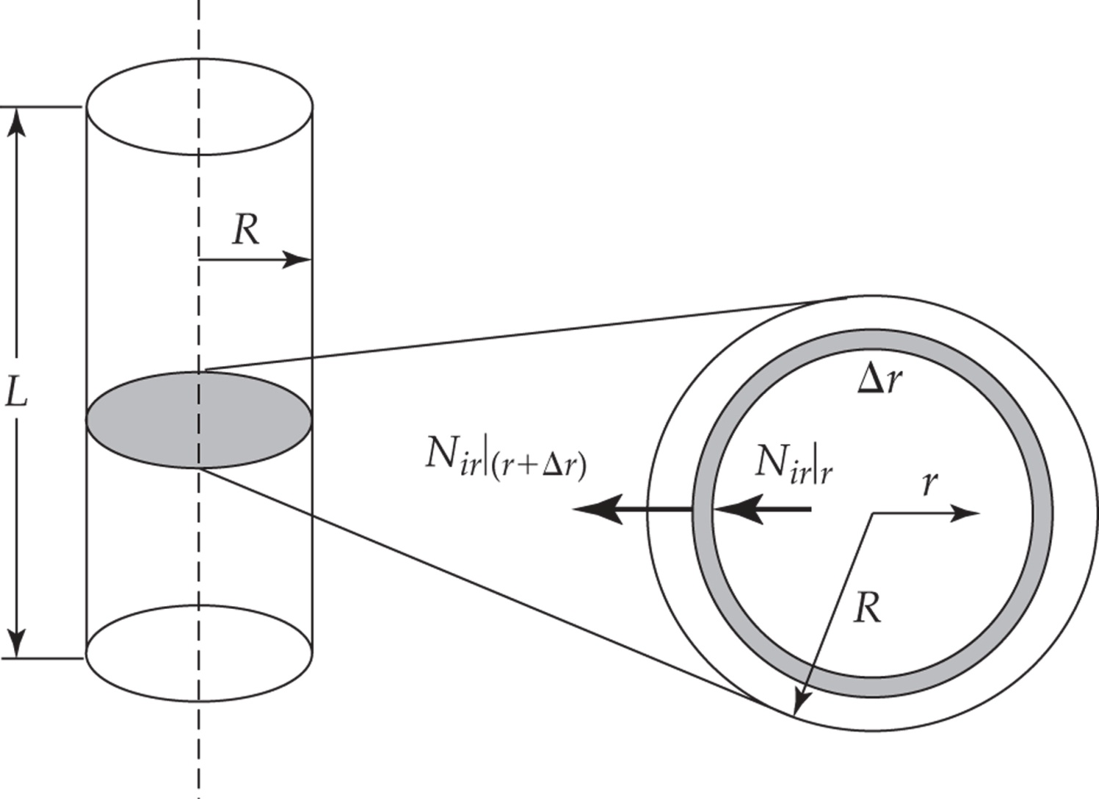
Assume no reaction
Assume steady state

Slide 43
Assume no reaction
Assume steady state
Now what?
Come to board and solve the rest
Without B.C.s (look in book for B.C.s;
Assuming you can do that…)

Slide 44
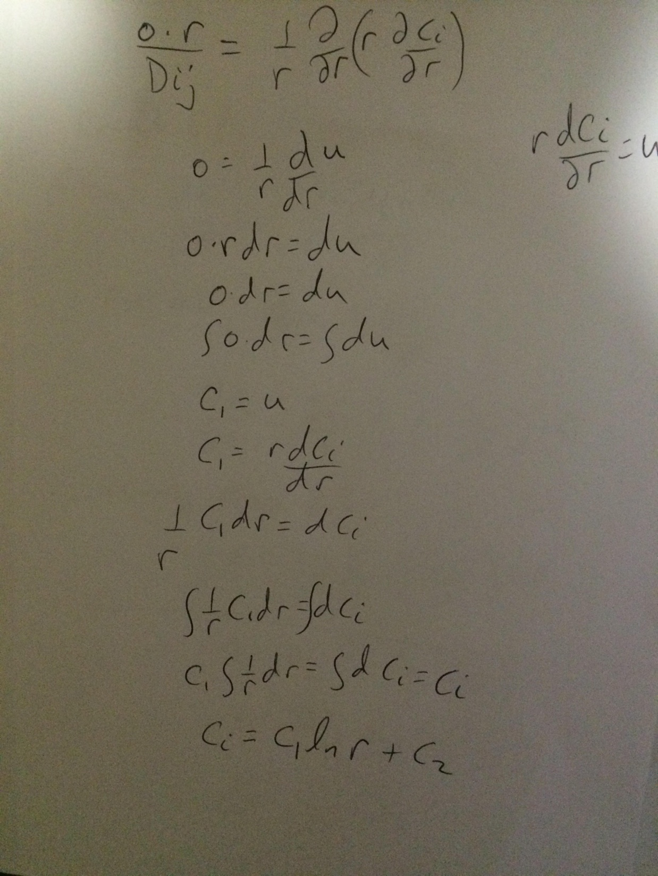

Slide 45
Skipping erf this semester for the sake of time.

Slide 46
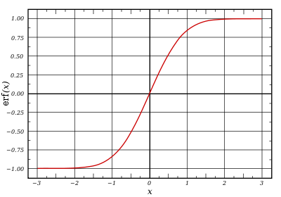
erf
What is it equal to?
What is it used for?
What does this have to
do with probability density
unctions.
http://www.bishopkingdom.com/aichatbox/id/368/

Slide 47
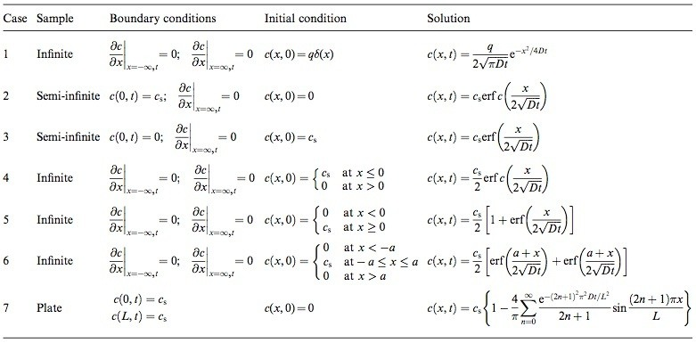
erf
What is it equal to?
What is it used for? Diff. Eq.s and diffusion
What is erfc? erfc=1-erf

Slide 48
MatLab Code
close all
x = [0:0.0000001:1];
figure1 = figure;
hold on
% Create axes
axes1 = axes('Parent',figure1);
hold(axes1,'on');
% Create multiple lines using matrix input to plot
%plot(X1,YMatrix1,'Parent',axes1);
% Create xlabel
xlabel('Distance (x)');
% Create title
title('Error function usage');
% Create ylabel
ylabel('Normalized Concentration');
% Set the remaining axes properties
%set(axes1,'FontSize',14,'FontWeight','bold');
for i = 1:2.5:35
plot(x,1-erf(x/(2*sqrt(i*10^-3))),'linewidth',3)
end

Slide 49
x = [0:0.0000001:1];
figure2 = figure;
% Create axes
axes1 = axes('Parent',figure2);
hold(axes1,'on');
% Create multiple lines using matrix input to plot
%plot(X1,YMatrix1,'Parent',axes1);
% Create xlabel
xlabel('Distance (x)');
% Create title
title('Error function usage');
% Create ylabel
ylabel('Normalized Concentration');
% Set the remaining axes properties
%set(axes1,'FontSize',14,'FontWeight','bold');
for i = 1:2.5:35
plot(x,erfc(x/(2*sqrt(i*10^-3))),'linewidth',3)
end

