Slide 1
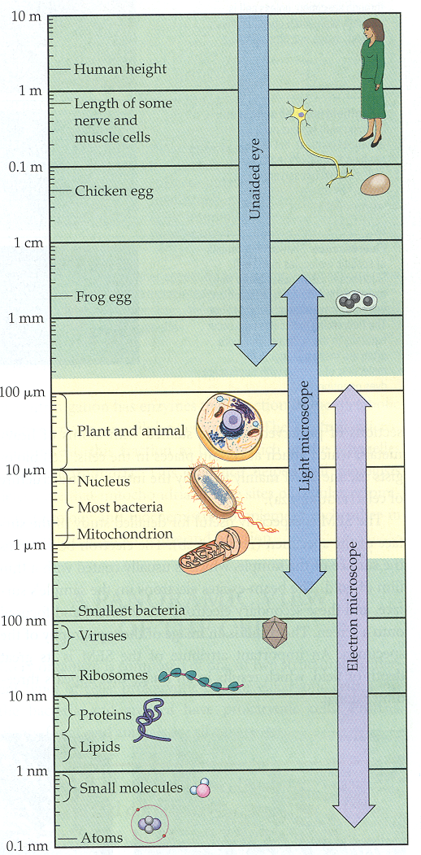
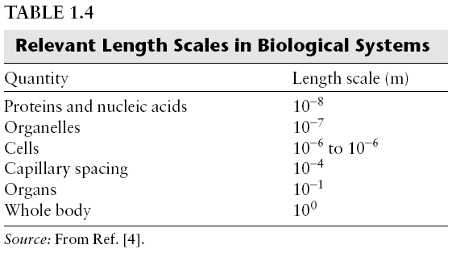
The Scale Relevant to Life
Most cells are between 1 and 100 μm. i.e. Three orders of magnitude difference in size.
Smallest bacterial cells are
mycoplasmas = 0.1 - 1.0 µm
  Bacteria = 1 - 10 µm
  Plant and animal cells = 10 - 100 µm

Slide 2
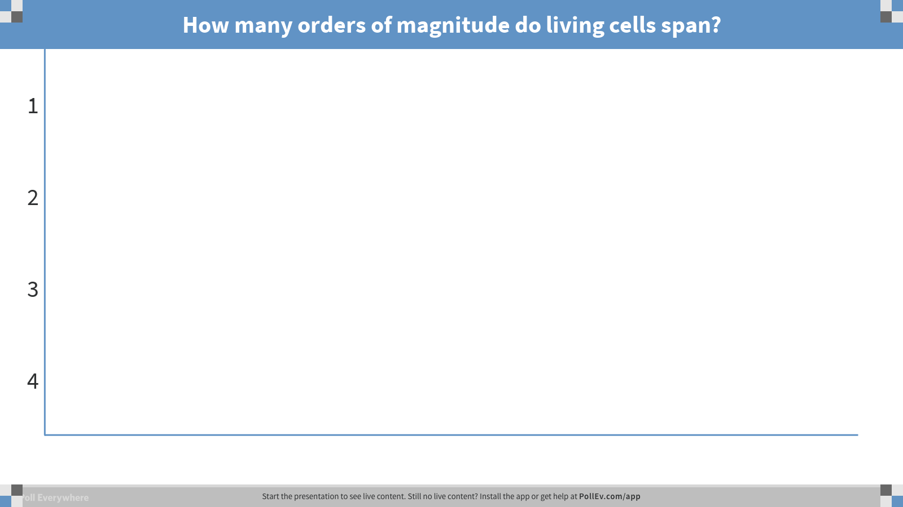
Notes:
Poll Title: How many orders of magnitude do living cells span?
https://www.polleverywhere.com/multiple_choice_polls/u5Qk1vUkGljktlV

Slide 3
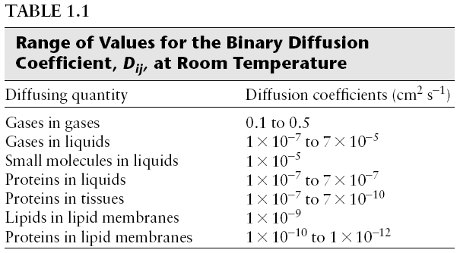
The speed with which a molecule diffuses in a fluid depends upon: size, shape, temperature, viscosity and chemistry
Be able to estimate
These values
In the x-y plane:
i solute, j solvent
What if it is 1-D?
What if it is 2-D?
What if it is 3-D?
How does the equation change?

Slide 4
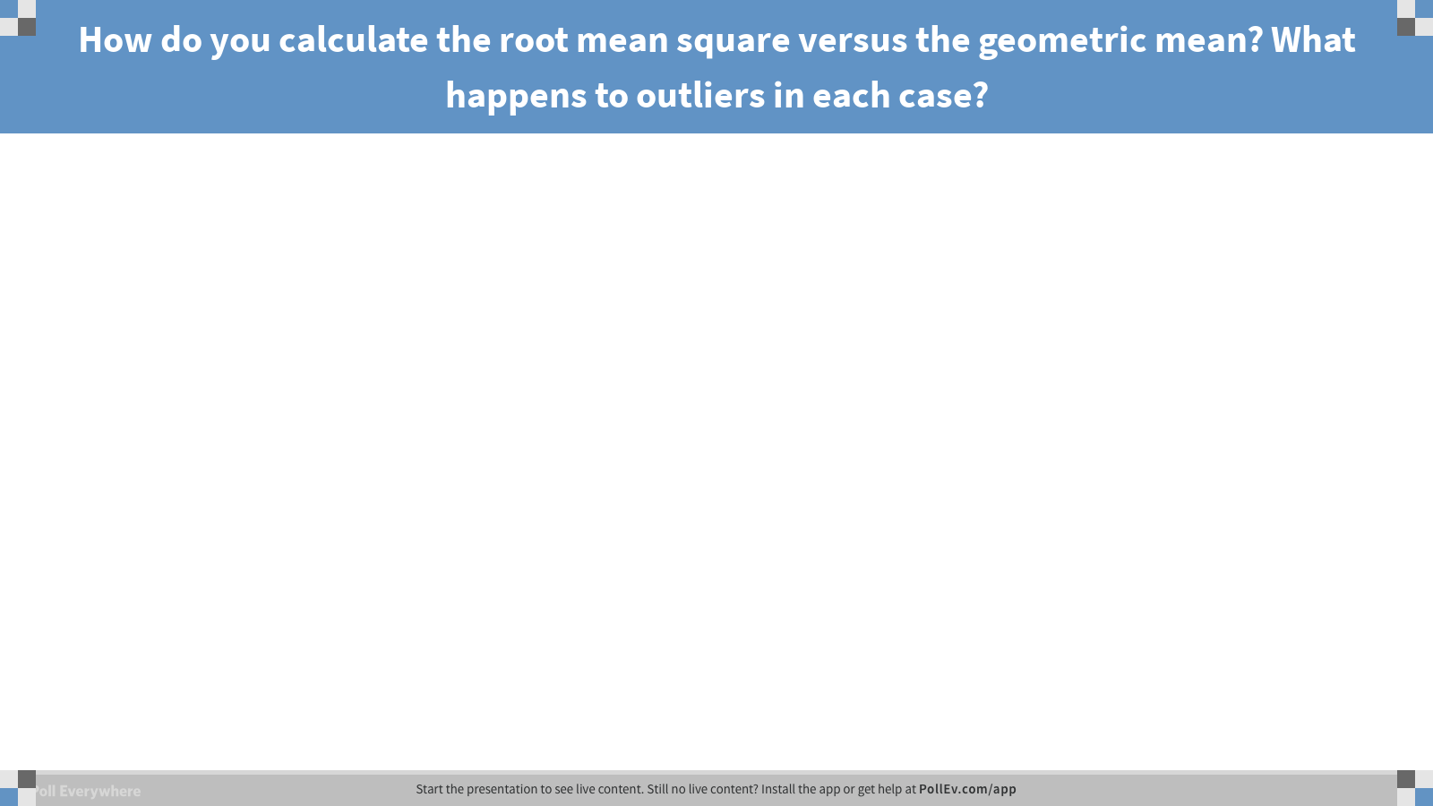
Notes:
Poll Title: How do you calculate the root mean square versus the geometric mean? What happens to outliers in each case?
https://www.polleverywhere.com/free_text_polls/QmBaLYcDLAYymng

Slide 5
Diffusion / Convection
A protein molecule of diffusion coefficient 10⁻⁷ cm² /s will diffuse from edge to center of a 20 um diameter cell in 2.5 s.
A protein molecule of diffusion coefficient 10⁻⁷ cm² /s will diffuse through 2mm thick tissue in 27.7 h.
Diffusion – short distances
  How far from blood vessel can oxygen transport by diffusion
Convection – long distances
  Do all bugs need a pumping heart?
  Are there bugs without hearts?
  What kind of hearts are there in bugs?

Slide 6
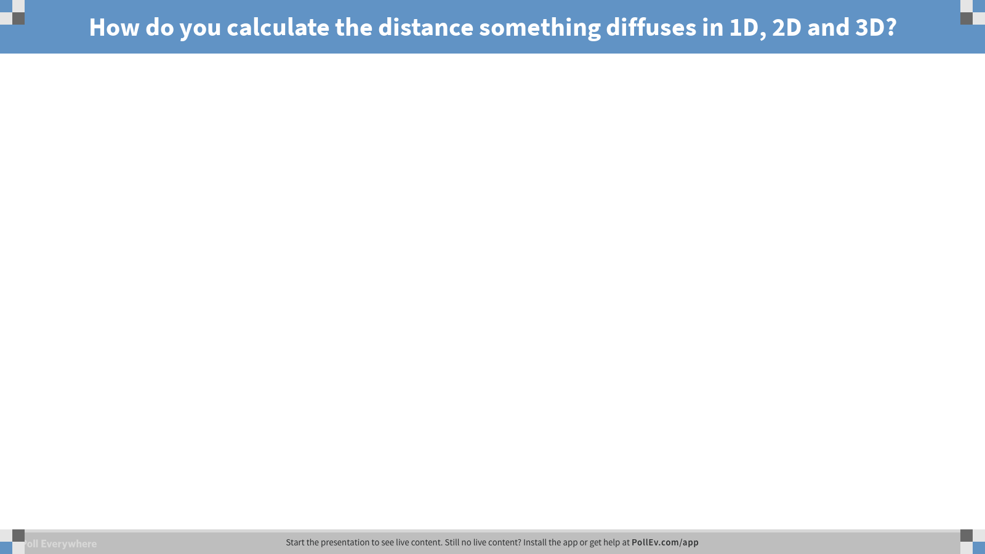
Notes:
Poll Title: How do you calculate the distance something diffuses in 1D, 2D and 3D?
https://www.polleverywhere.com/free_text_polls/bbJalOKZaNxcevD

Slide 7
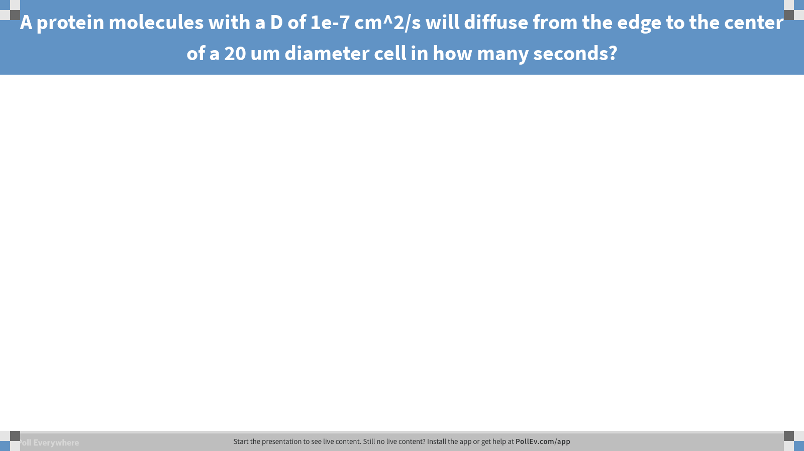
Notes:
Poll Title: A protein molecules with a D of 1e-7 cm^2/s will diffuse from the edge to the center of a 20 um diameter cell in how many seconds?
https://www.polleverywhere.com/free_text_polls/NjV1Fhf9GDNuuMV

Slide 8
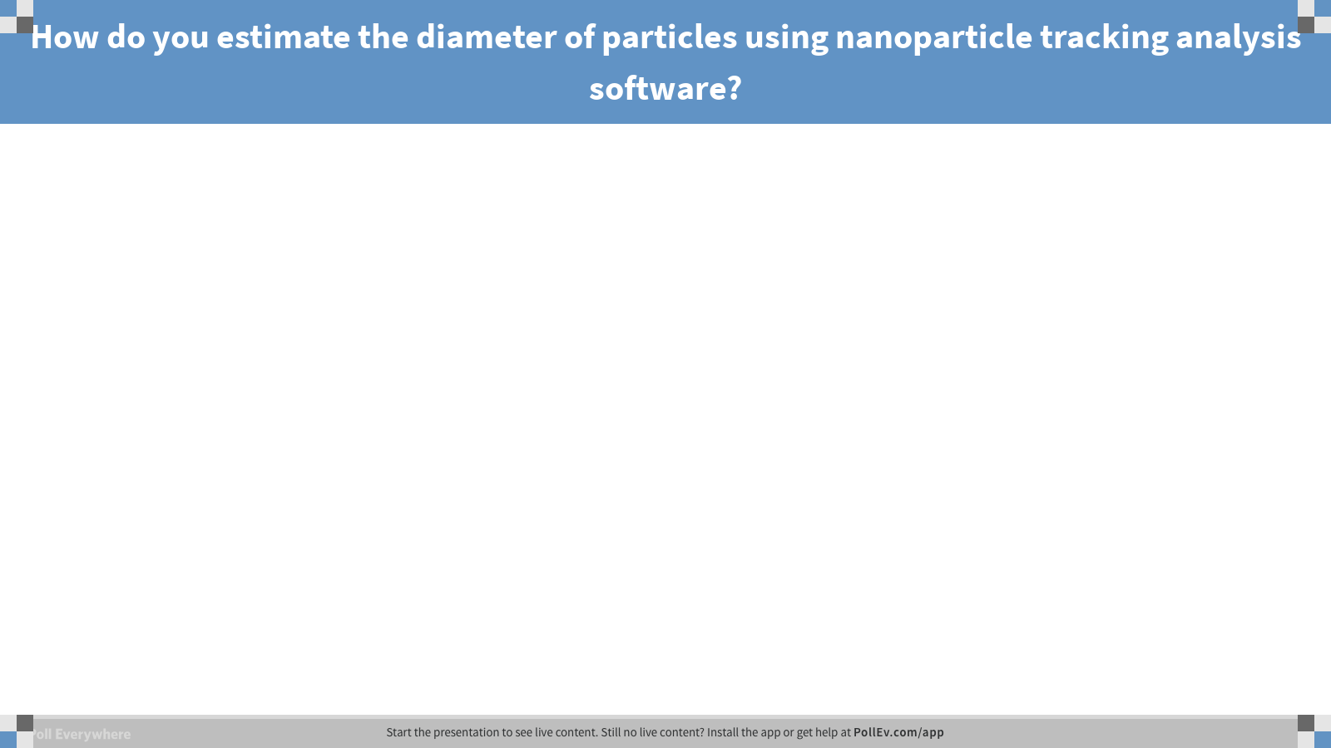
Notes:
Poll Title: How do you estimate the diameter of particles using nanoparticle tracking analysis software?
https://www.polleverywhere.com/free_text_polls/55KyG2lM3RdTHuQ

Slide 9
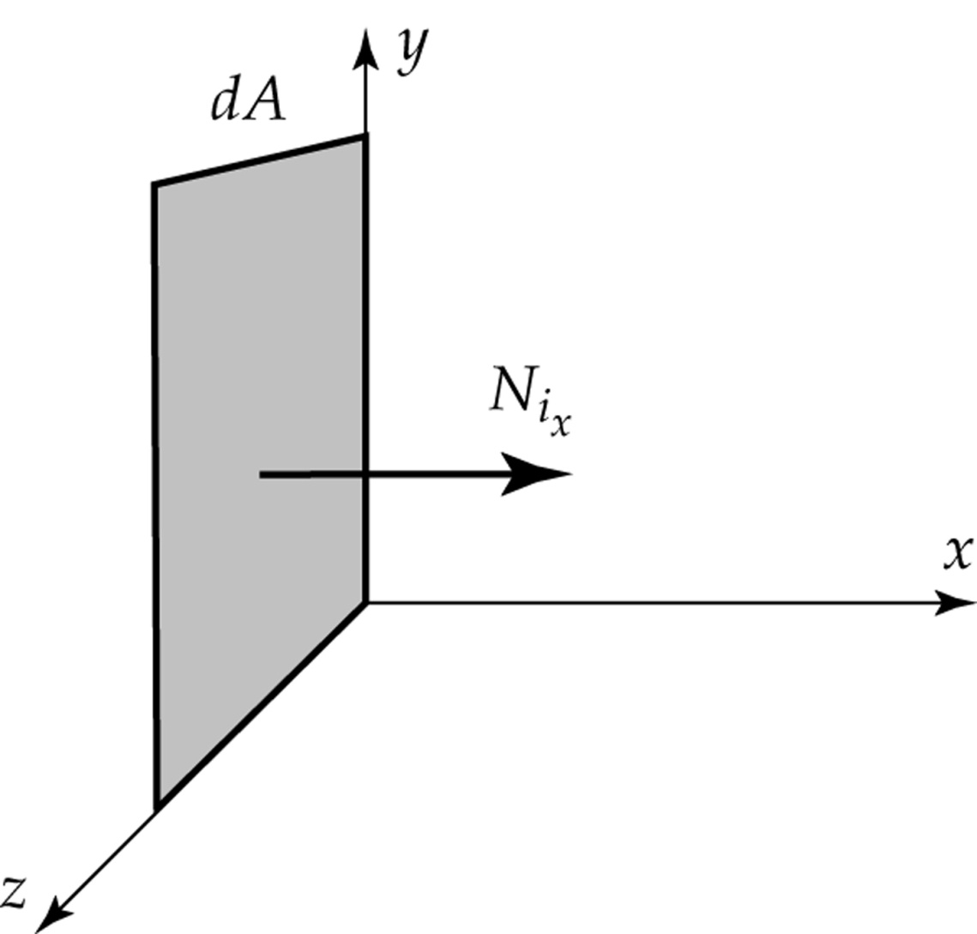
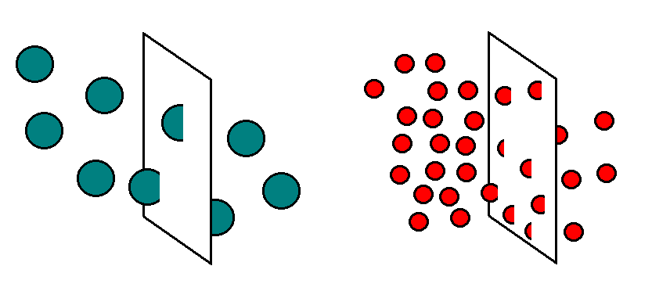
Flux of i in the x-direction.
D ≡ Ordinary diffusion
e ≡ Electrical field
P ≡ Pressure
T ≡ Temperature
These different fluxes can be used for separation purposes (i.e., ultracentrifugation, electrophoresis,
isolectric focusing, the usage of membranes)…

Slide 10
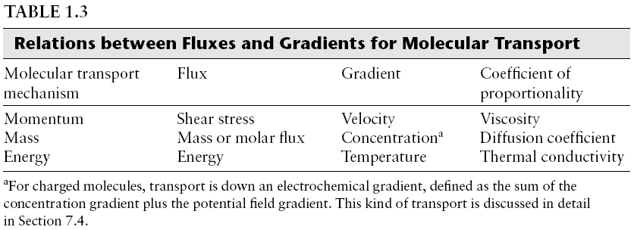
$$Flux (shear stress, molar, Energy)= −(viscosity or Diffusivity or Thermal Cond.) \frac{d (velocity or concentration or Temp)}{dx}$$
momentum
mass
Energy
8.28.18: Some of the arrows were shifted somehow on slide 10. I made sure the arrows were pointing to the correct word.

Slide 11
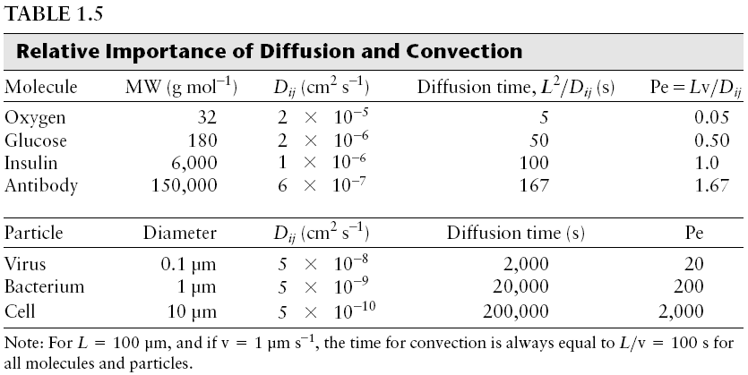
What is the i and what is the j?

Slide 12
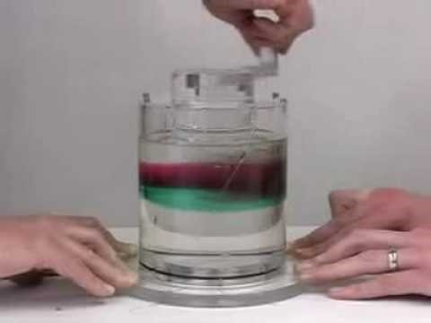
Reynold’s # = Re
$Re=\frac{inertial forces}{viscous forces}=\frac{vL}{k.v.}=\frac{vLρ}{μ}$
Units?
v = object velocity relative to flow.
k.v. = viscosity/density
Why does Re exist? To predict flow patterns
  Laminar or turbulent
  If Re < 2000 => laminar
  If Re > 4000 => turbulent
  If Re is between 2000 and 4000
  transitional flow
https://www.youtube.com/watch?v=p08_KlTKP50
Examples:
viscosity | 9.10E-03 | Poise | g/cm/s
density | 1 | g/cm^3
velocity | 1 | cm/s
L | 50 | cm
Re | 5494.51 |  | turbulent
Cell | 10 | um
cell | 1.00E-03 | cm
Re | 0.11 |  | laminar

Slide 13
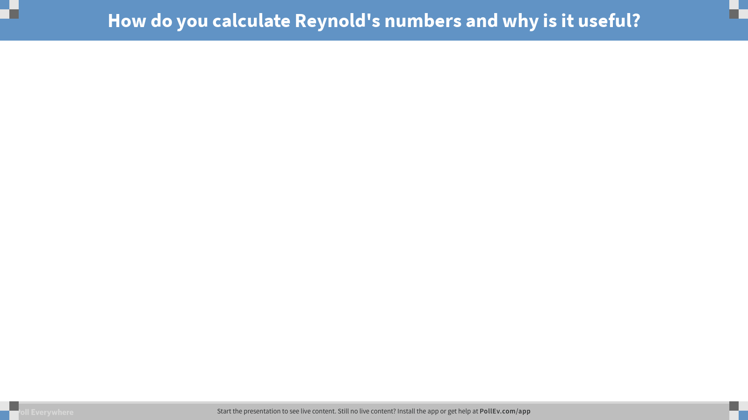
Notes:
Poll Title: How do you calculate Reynold's numbers and why is it useful?
https://www.polleverywhere.com/free_text_polls/msbltsyObDVRdhP

Slide 14
Peclet # = Pe
$Time of diffusion=\frac{L^{2}}{D_{ij}}$
$Time of convection=\frac{L}{velocity}$
$Pe=\frac{diffusion time}{convection time}=\frac{mass transport by convection}{mass transport by diffusion}=\frac{vel∗L}{D_{ij }}$
What is dominant – convection or diffusion?
Over the dimensions of a cell, diffusion is sufficiently efficient (up to 100 um)
Diffusion limited: event is limited by how many are arriving by diffusion

Slide 15
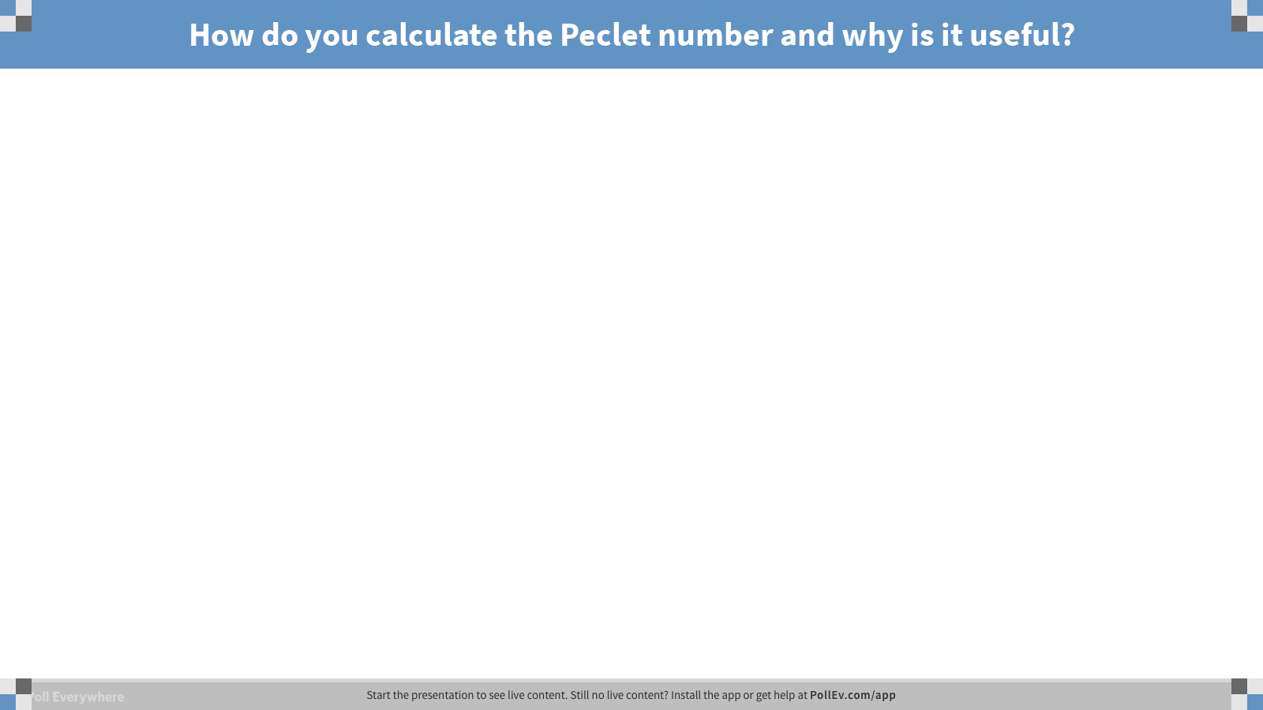
Notes:
Poll Title: How do you calculate the Peclet number and why is it useful?
https://www.polleverywhere.com/free_text_polls/NkO4CasfUp3Asjg

Slide 16
Biot #
B=Mass Transfer Across a Cell Layer/Mass Transfer by Diffusion Through Tissue = k*L/D
Numerator is non-diffusive mass transfer (not specific) component
Example of k:
First order diff. eq.
dC/dt = kC

Slide 17
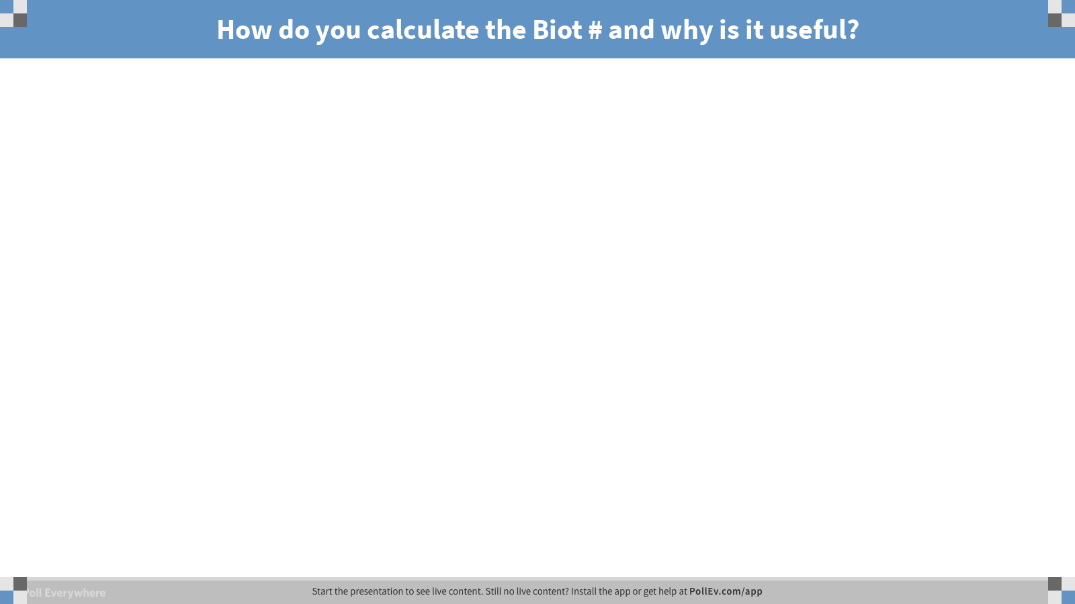
Notes:
Poll Title: How do you calculate the Biot # and why is it useful?
https://www.polleverywhere.com/free_text_polls/fTnIfvzLZmHTNyf

Slide 18
Flux and Fick’s 1st law
Flux is proportional to the gradient
What are the units of flux?
  (#or mol)/area/time or mass/area/time…
$J=−D\frac{dc}{dx}$ = -D C; what is the upside down triangle?
  Gradient
what is the expansion of the equation?
  $J=−D[\frac{dc}{dx}+\frac{dc}{dy}+\frac{dc}{dz}$]

Slide 19
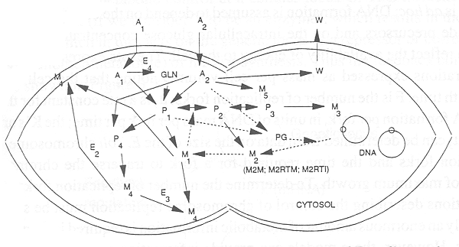
Why are cells microscopic?
1. Diffusive transport over large distances may be inadequate.
For Constant Flux steady state diffusion in one direction -
Fick’s First Law
D - diffusion coefficient (m²/s); C - kg/m³ or cm² /s and moles/l

Slide 20
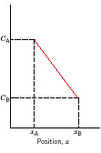
Diffusion Across Cell Membranes and within Cells
Region of the slope or driving force
D - diffusion coefficient (m²/s)
dc/dx - Driving force
Concentration (M)

Slide 21

Notes:
Poll Title: What is Fick's first law?
https://www.polleverywhere.com/free_text_polls/0LBHtZWDMbVjfwy

Slide 22
What is Fick’s second law
$\frac{dC}{dt}=DΔC;and what is the diff between Δ$ and ? $Δ$² = $Δ$
Expand this…
$\frac{dC}{dt}=D[\frac{d^{2}C}{dx^{2}}+\frac{d^{2}C}{dy^{2}}$ + $\frac{d^{2}C}{dz^{2}}$]
Notes:
Fix the triangle!

Slide 23

Notes:
Poll Title: What is Fick's 2nd law?
https://www.polleverywhere.com/free_text_polls/AgTabwQoxvy2juW

Slide 24
6.4 Constitutive Relations: 6.4.1 Fick’s First Law
Dilute;
No reactions
Producting or
Consuming
Constituents…
J_{ix} = diffusive flux of a dissolved solute in dilute solution
D_{ij} = binary diffusion coefficient of solute i in solvent j
C = concentration of reactant
Substituting into gives when convection is present…
Note, D can be a f(C)…

Slide 25
Non-Steady State Diffusion in the Solid State
Most real diffusion is non-steady state
The concentration of diffusing species is a function of both time and position C = C(x,t)
i.e., flux and driving force both change with time
In this case Fick’s Second Law is used
Solution requires specified boundary conditions

Slide 26
On board…

Slide 27
6.2.1 Dilute Solution Approximation
Most biological solutions are dilute
Concentration of the solvent must be large relative to the solute: C_{solvent} >> C_{i} or x_{s} ~= 1 >> x_{i} = mole fraction
The molar average velocity equals the mass average velocity i.e. v* ≈ v_{solvent} and v ≈ v_{solvent} so that v ≈v* and J_{i} =J_{i}*
or
becomes
=>
When N2 is solvent
Can study dilute solutions as if they were binary

Slide 28
Justification of dilute –solution problems in biological contexts
Water is 1 g/cm³. 1 mole of water is 18g and is 55.56 M.
Salt concentrations: 1 uM to 300 mM
  1.8e-8 to 0.0054 mole fractions
Protein: 1 nM to 1 mM
  1.8e-11 and 1.8e-5 mole fractions.
Exceptions: gas diffusion in the lung, purification of biological molecules in high salt concentrations (1-5M), fermentation processes

Slide 29
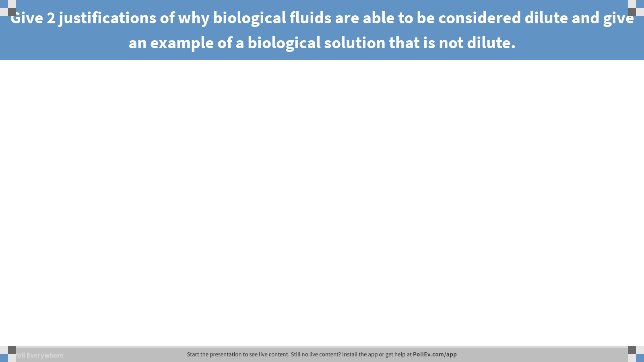
Notes:
Poll Title: Give 2 justifications of why biological fluids are able to be considered dilute and give an example of a biological solution that is not dilute.
https://www.polleverywhere.com/free_text_polls/fXZdCMRuuAsEzIS

Slide 30
6.3.2 Boundary Conditions
Useful for investigating conservation relations…
Concentrations are not necessarily constant or continuous across a fluid-fluid interface
At the gas (1) solution (2) interface, at equilibrium:
Where H_{i} is the Henry’s Law Constant
At the liquid (1) immiscible liquid (2) interface, at equilibrium:
Where Φ_{i} is the Partition Coefficient
Since the discontinuity cannot be abrupt it establishes an interphase
While concentrations may not be equal, fluxes across a fluid-fluid or liquid-liquid interphase are always equal, thus:
Where R is the reaction rate
“+” if i is produced
“-” if i is consumed

Slide 31
Boundary Conditions
a = solute activity coefficients
Dilute Solution Approximation
If the surface , e.g. solid-liquid interface, is impermeable there is no flux across its surface
Then:
If the surface , e.g. solid-liquid interface, is permeable then the flux across its surface
Where
k is the permeability
Φ_{i} is the Partition Coefficient

Slide 32
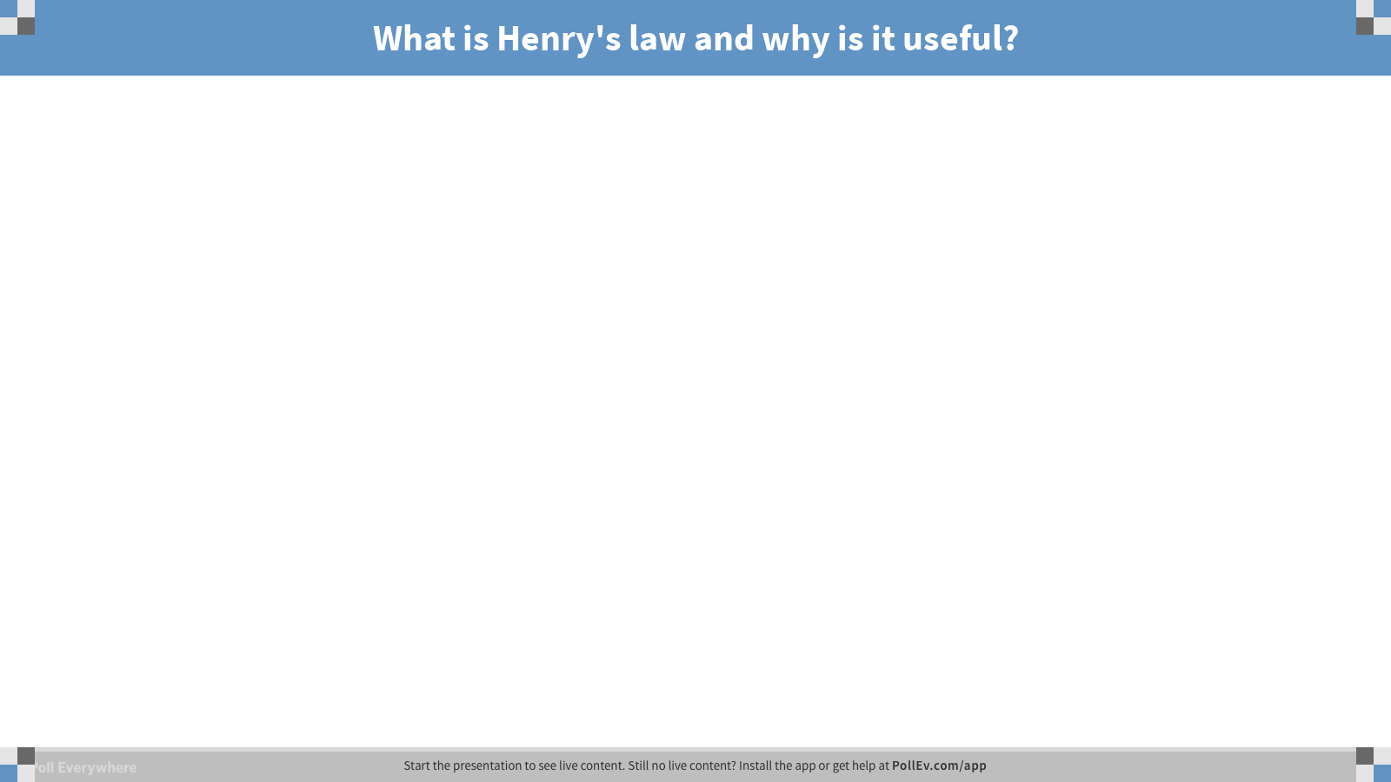
Notes:
Poll Title: What is Henry's law and why is it useful?
https://www.polleverywhere.com/free_text_polls/E09R3yKzOnb5iph

Slide 33
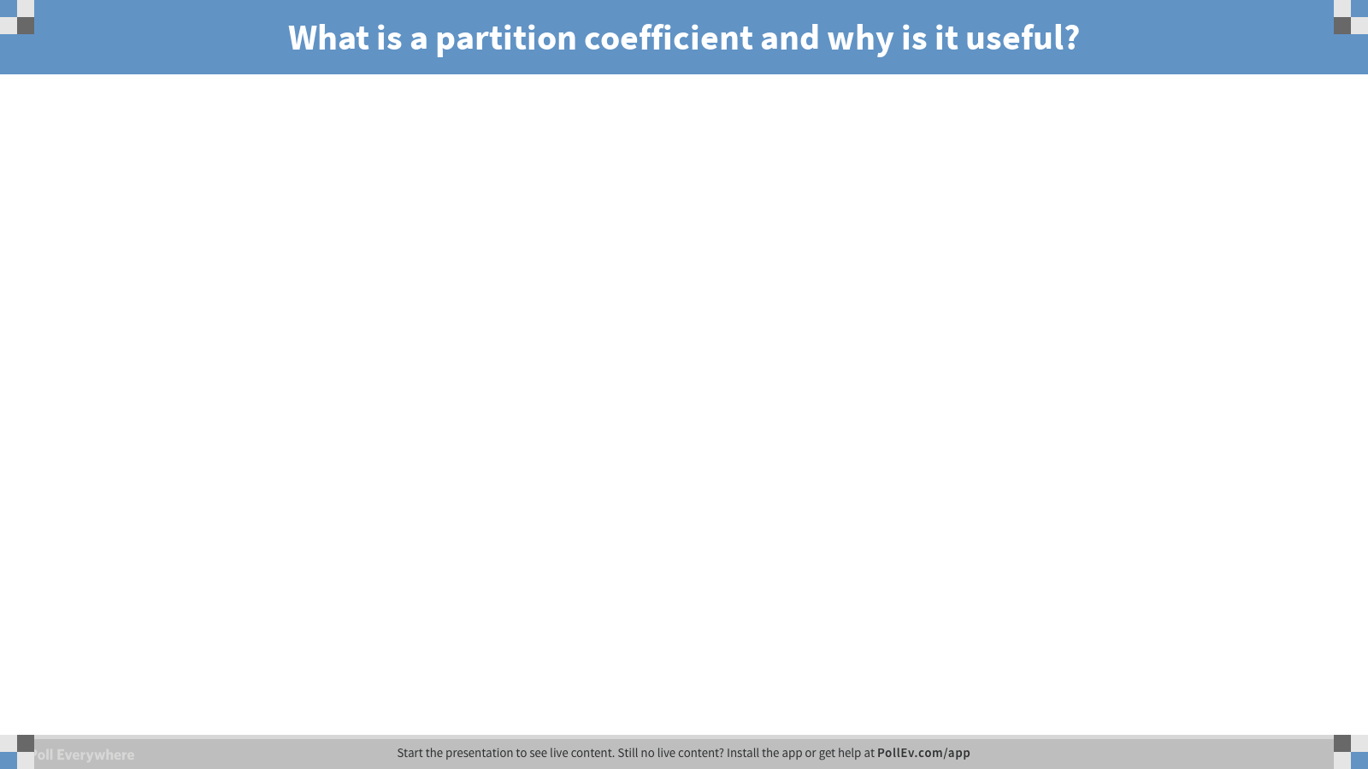
Notes:
Poll Title: What is a partition coefficient and why is it useful?
https://www.polleverywhere.com/free_text_polls/WiCCToRr9FNBYWo

Slide 34
Random Walk
<x>² = 2*dimensions*Dt; i.e., = 4Dt in 2-D…
Imagine taking a vector with various values for randoms steps an entity can take in 1-D…
RandomNums = [-1 0 1]; the value of kronecker for this is mean(RandomNums.^2)
The average distance the entity will go is directly proportional to the sqrt(number of steps taken)…
Theoretical distance = (kronecker=mean(RandomNums.^2))*sqrt(steps) (true for 1-D)
Also, the same kinetic energy will result in smaller displacement as the entity becomes larger…
How does time come into play? n = steps = t/τ where τ is the time to take a single step.

Slide 35
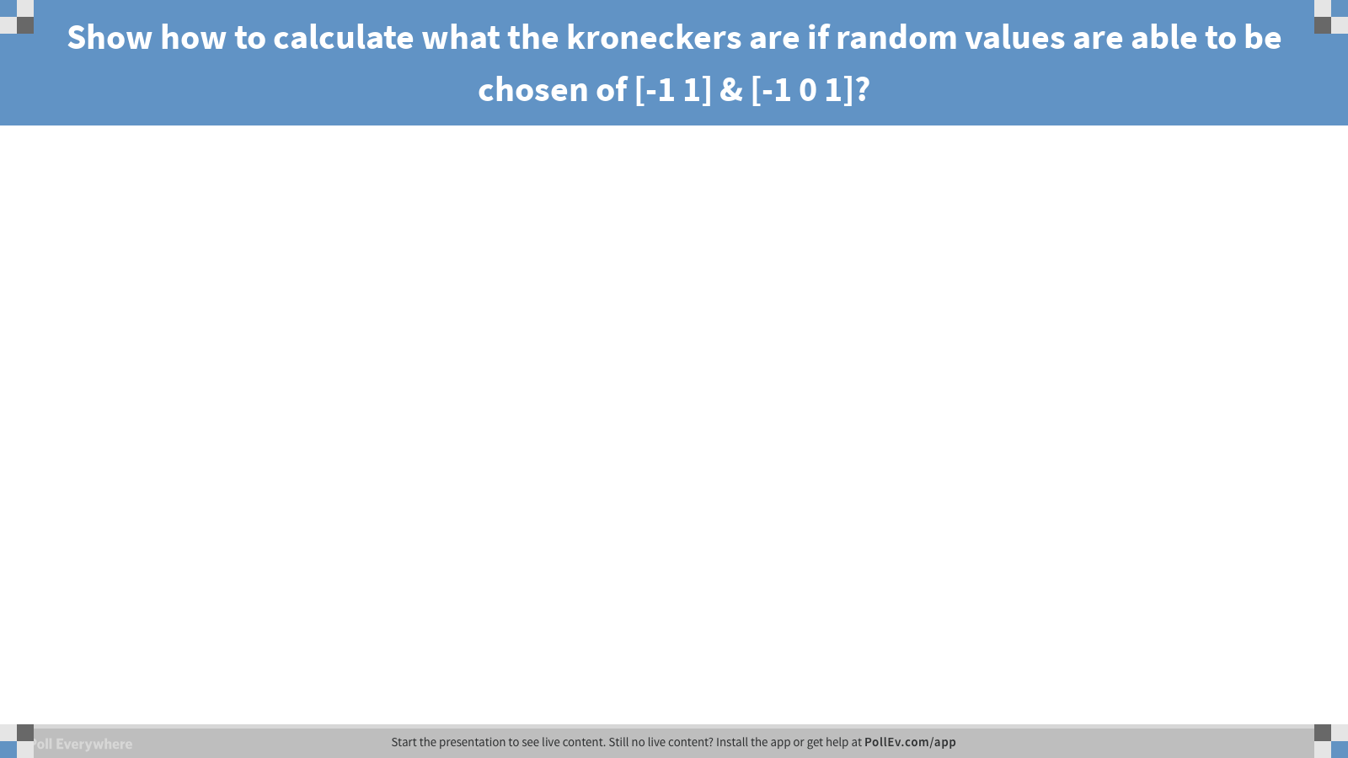
Notes:
Poll Title: Show how to calculate what the kroneckers are if random values are able to be chosen of [-1 1] & [-1 0 1]?
https://www.polleverywhere.com/free_text_polls/lKIb375eBvYxXYZ

Slide 36
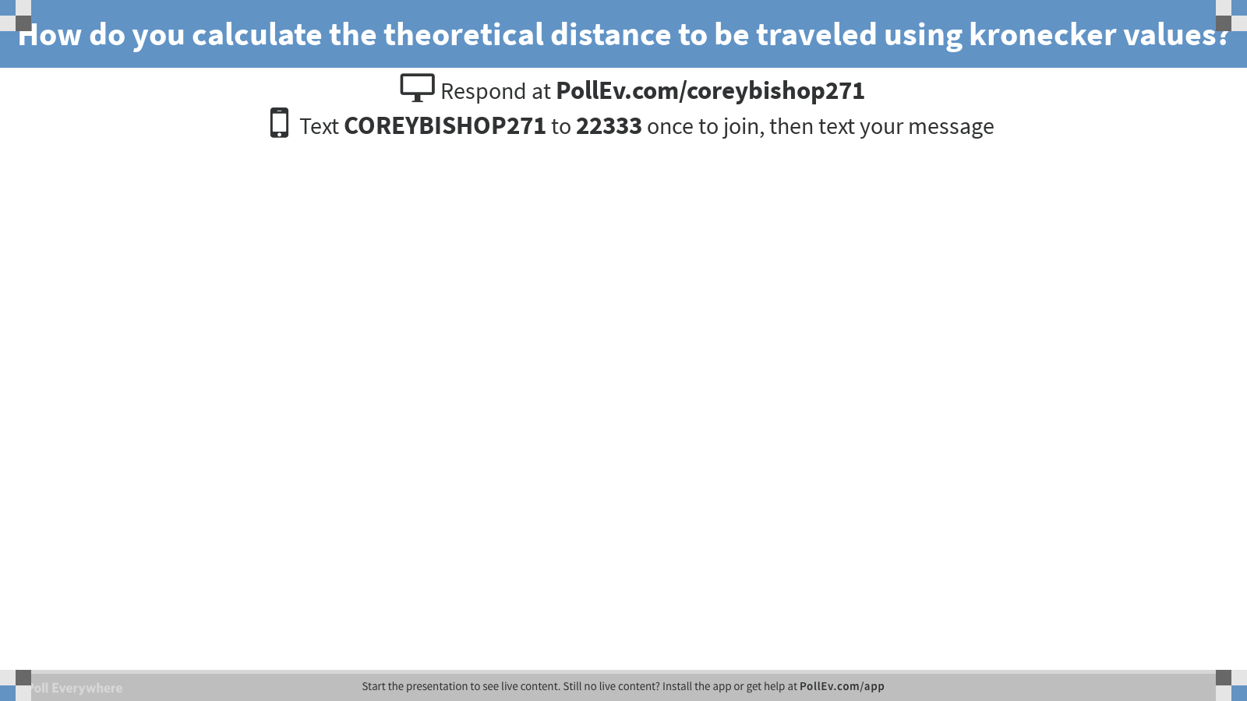
Notes:
Poll Title: How do you calculate the theoretical distance to be traveled using kronecker values?
https://www.polleverywhere.com/free_text_polls/mhnTwEzPuvKKC2C

Slide 37
Random walk
The mean-square displacement in one direction:
If we define the one-dimensional binary diffusion coefficient as D_{ij} = δ²/τ; then…
The mean-square distance sampled by a molecule increases linearly with the √t
For three dimensional random walk:

Slide 38
-1 and 1 (replicating = problem 6.3)

Slide 39
Problem 1: Objectives (1-D)
In MatLab,
Sub-figure 1: Observe in 1-D the distance traveled from the x-axis after a certain number of steps. Have the distance chosen to step be a vector of choices [-1 -1 0 1], [-1, 1], [-1, 0, 1], etc.
Sub-figure 2: Calculate the distance traveled from the x-axis after a certain number of steps; repeating this process.
Sub-figure 3: Calculate the running average of figure 2 and watch the answer converge to the theoretical answer.
Quantify the % error as it steps through this process.

Slide 40
FYI: (not going to be tested on this but) Extrapolation of principles: https://en.wikipedia.org/wiki/Rotational_diffusion

Slide 41
Diffusivity or Diffusion Coefficient and Temperature
Temperature influences manifest in the diffusion coefficient.
Hence, diffusion coefficient, D, increases with increasing T.
⎛
Q_{d}
⎞
−
D
=
D_{o}
exp
⎜
⎟
⎝
R
T
⎠
D
= diffusion coefficient [m²/s]
D_{o}
= temperature dependent pre-exponential [m²/s]
Q_{d}
= the activation energy for diffusion [J/mol or eV/atom]
R
= the molar gas constant [8.314 J/mol-K]
T
= absolute temperature, Kelvin [K]

Slide 42
Diffusivity or Diffusion Coefficient and Activation Energy
Taking logarithms:
Where
  Slope = - Q_{d} / 2.303R
  Intercept = log D_{o}

Slide 43
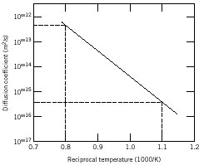
Diffusivity or Diffusion Coefficient and Activation Energy
Where
  Slope = - Q_{d} / 2.303R
  Intercept = log D_{o}
Solve for Activation Energy:
Solve for D_{o}

Slide 44
Example: At 300ºC the diffusion coefficient and activation energy for Cu in Si are
D(300ºC) = 7.8 x 10⁻¹¹ m²/s
Q_{d} = 41.5 kJ/mol
What is the diffusion coefficient at 350ºC?
D
transform data
ln D
Temp = T
1/T

Slide 45
Example (cont.)
T₁ = 273 + 300 = 573 K
T₂ = 273 + 350 = 623 K
D₂ = 15.7 x 10⁻¹¹ m²/s

Slide 46
Estimation of diffusion coefficients
Protein diffusivity in plasma is about 1e-7 cm²/s.
From edge of cell to center: 2.5 seconds
Through tissue that is 0.02 mm thick: 27.7 hours
What is a binary diffusion coefficient?
  Characterizes diffusion of one molecule in a solvent
What is Deffective?
  Incorporates: drag forces exerted by ECM and cells
1-D, 2-D, 3-D differences?

Slide 47
Notes:
Poll Title: A protein molecules with a D of 1e-7 cm^2/s will diffuse from the edge to the center of a 20 um diameter cell in how many seconds?
https://www.polleverywhere.com/free_text_polls/NjV1Fhf9GDNuuMV

Slide 48

Notes:
Poll Title: Diffusivity, D, is commonly written as Dij. What is the i and what is the j?
https://www.polleverywhere.com/free_text_polls/acWKzwa7KQ45Hyq

Slide 49
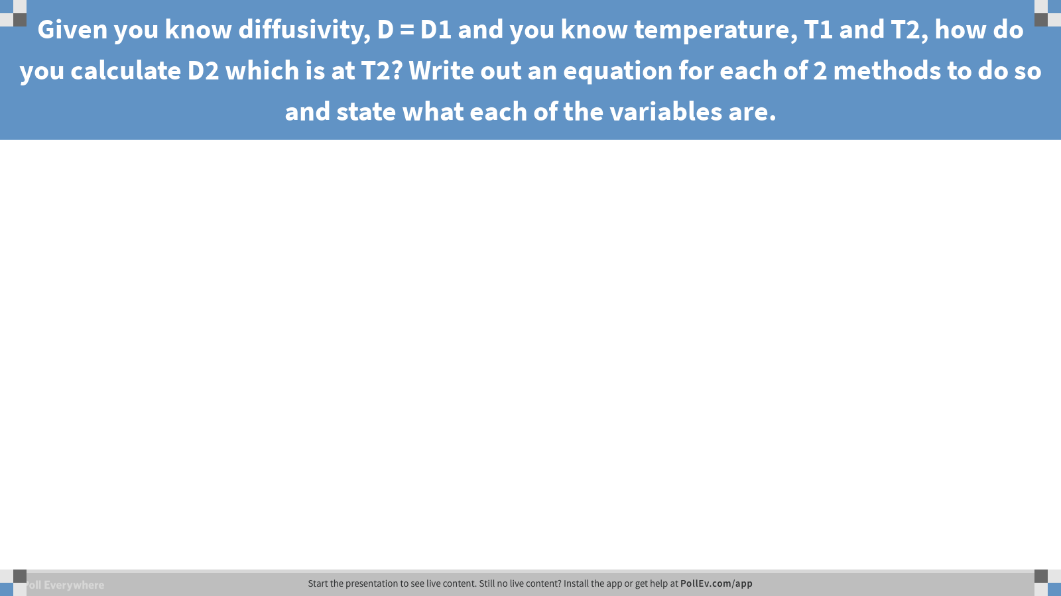
Notes:
Poll Title: Given you know diffusivity, D = D1 and you know temperature, T1 and T2, how do you calculate D2 which is at T2? Write out an equation for each of 2 methods to do so and state what each of the variables are.
https://www.polleverywhere.com/free_text_polls/qFQanMo1jImh0q9

Slide 50
6.6.5: The Wilkie-Chang
See problem 6.1.
$$D=7.4e−10\frac{T{\left(φM\right)}^{0.5}}{μV_{o}0.6};φ_{water}=2.26$$

Slide 51
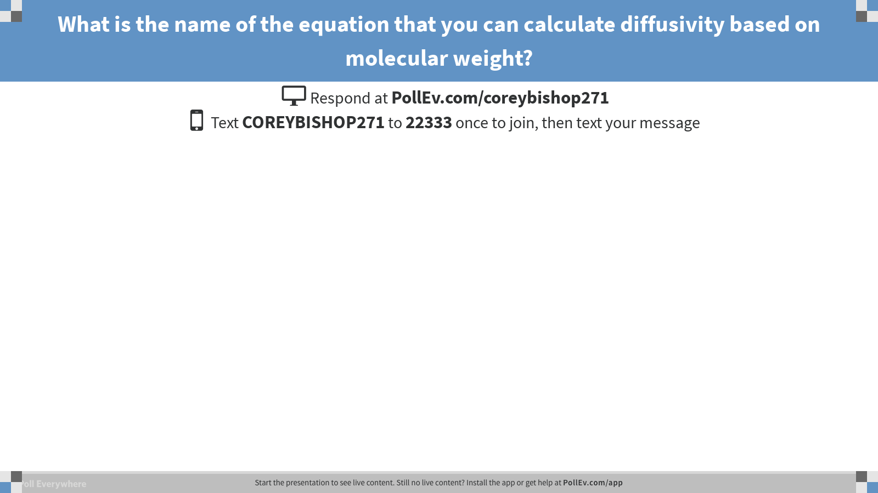
Notes:
Poll Title: What is the name of the equation that you can calculate diffusivity based on molecular weight?
https://www.polleverywhere.com/free_text_polls/m7Pa5Y74kwGYbe5

Slide 52
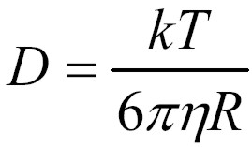
Stoke’s-Einstein Equation:
Regarding calculating D2 at T2, knowing either D1 and T1, is there another way we can do this using the SE equation?

Slide 53
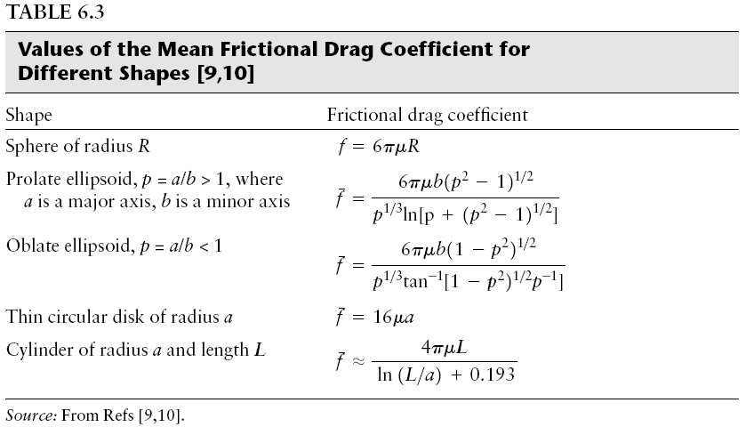
f_{bar} = denominator

Slide 54
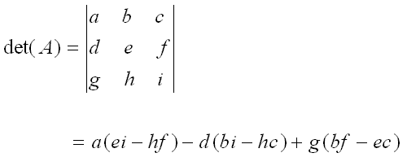
Estimation of frictional drag coefficients
8.30.18: Skip this slide for now. We will go over eigenvectors more in a future chapter.
For low Reynold‘s #s, the drag force is (K is translation tensor; v = velocity):
K is a symmetric tensor and the components thereof are friction coefficients f_{ij}
$$F_{D}=K ∗v \left(or v=K−1∗FD\right)=\frac{1}{2}∗ρ∗velocity2∗Dc∗A;Dc=drag coefficient$$
assume f11=“f1”=f22=“f2”=f33=“f3”
By solving for the fs when Det(K – fI) = 0 (f₁ =f₂ =f_{3 etc} for an isotropic body) we obtain the non-zero values.
The fs are eigenvalues.
fbar = average = the harmonic mean:
1/f_{bar} = 1/3(1/f₁ + 1/f₂ + 1/f₃ +…)
Note that for a sphere f = 6ᴫμR… sound familiar?
Eigenvectors are scalable and translatable… v(A- λ?)=0… v(A- λI)=0 (these vectors (v) are not velocity vectors)
These are the eigenvalues and are the friction coefficients. The only non-zero solutions are calc. via the det.

Slide 55
Skip this for this semester for the sake of time.
Π vs Σ?
Harmonic mean = 1/A
Geometric mean G=sqrt(AH)
Arithmetic mean = 1/H

Slide 56
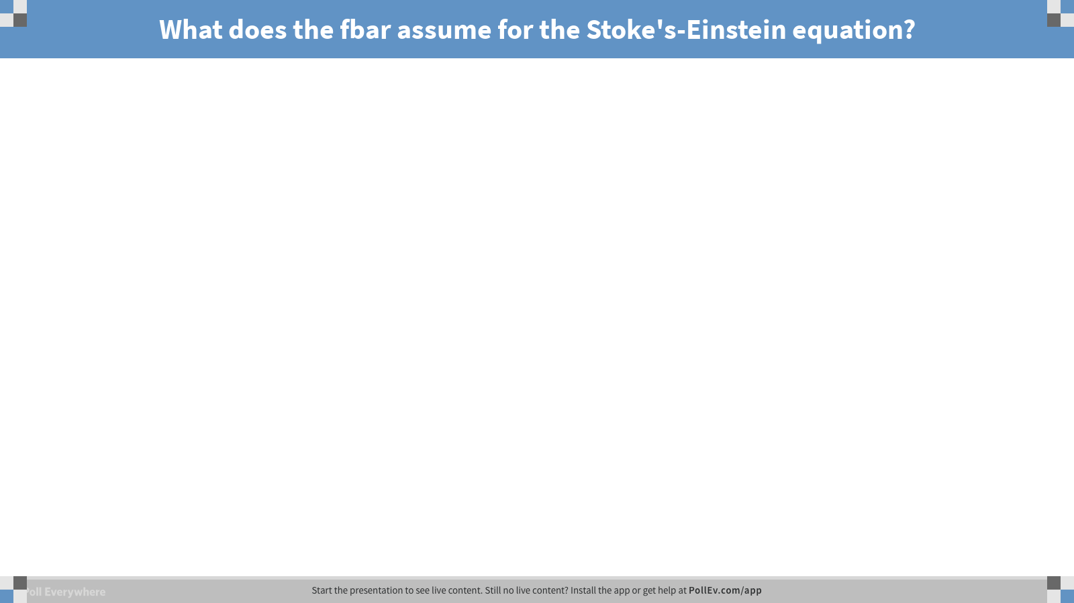
Notes:
Poll Title: What does the fbar assume for the Stoke's-Einstein equation?
https://www.polleverywhere.com/free_text_polls/ijJWWjWSXzEQFkc

Slide 57
Instrumentation using diffusion principles
Nanoparticle Tracking Analysis (NTA)
Dynamic Light Scattering (DLS)

Slide 58
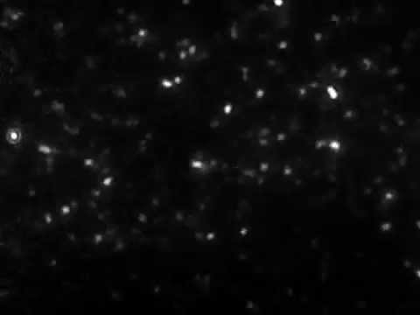
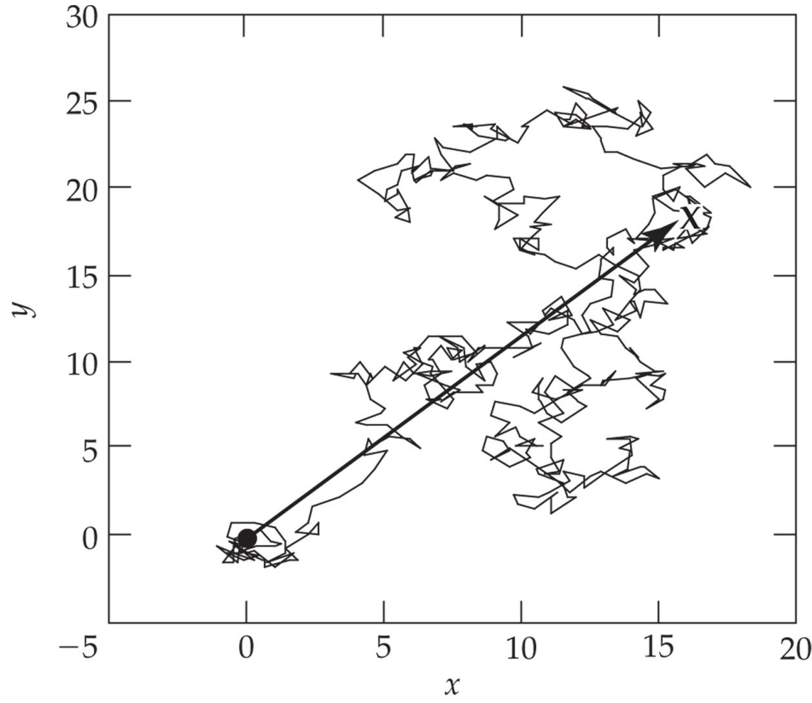
NTA
What happens if the paths cross during the video?
https://www.youtube.com/watch?v=65k3fX2X7pQ
500-step random walk.
The walk begins at coordinates x = 0, y = 0 denoted by the “●” and ends in the upper right hand quadrant denoted by “X”. The arrow represents the net displacement.

Slide 59
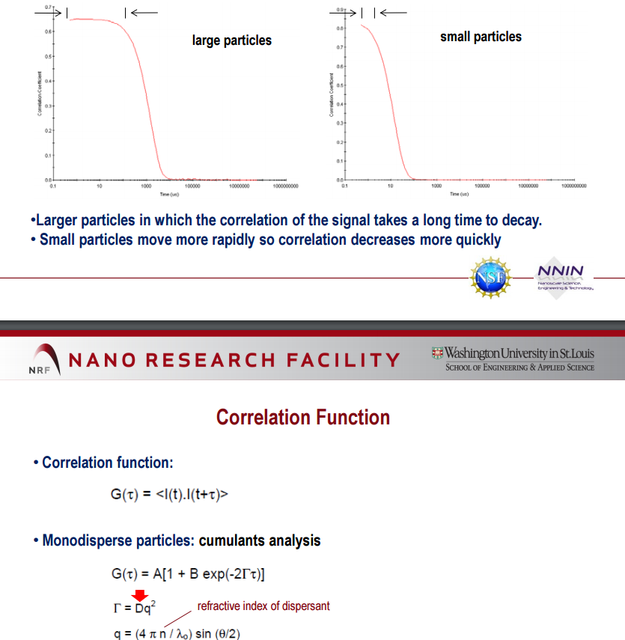
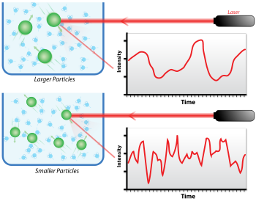
Dynamic Light Scattering: Skipping DLS this semester
Y-axis ranges from 0 to 1 (meaning of 0 and 1?)
Wikipedia.org
How do you get size out of this Information?
What is this size based on?
What limitations are there whencalculating diameters from intensities?
http://www.nano.wustl.edu/

Slide 60
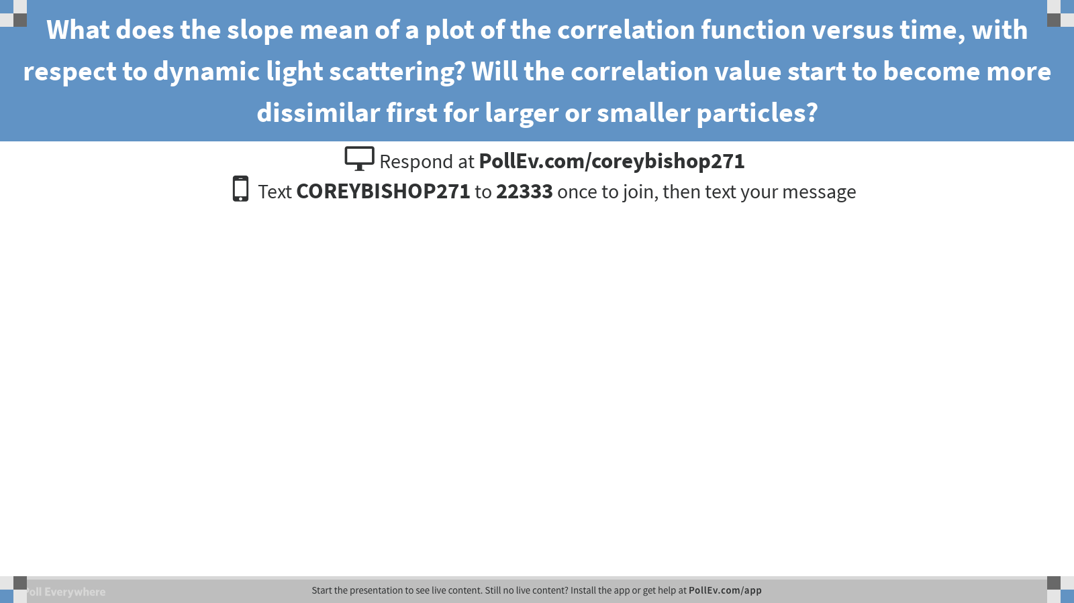
Notes:
Poll Title: What does the slope mean of a plot of the correlation function versus time, with respect to dynamic light scattering? Will the correlation value start to become more dissimilar first for larger or smaller particles?
https://www.polleverywhere.com/free_text_polls/FcojPpjXJwuUl44

Slide 61
How to calculate diameter of particles using data obtained from a video
Stokes-Einstein Equation
Raleigh Scattering
$$x_{rms}=\sqrt{\frac{1}{n}(x_{1}^{2}+x_{2}^{2}+x_{3}^{2}+x_{4}^{2}{+…+x}_{n}^{2}}$$
Root Mean Square?
Geometric mean?
$$x_{GM}=\sqrt[n]{x_{1}x_{2}x_{3}…x_{n}}$$
What happens to the outliers?
Important rhetorical questions:
If the size of the particle were much smaller than the wavelength of the light being used to see it, what happens?
What is this phenomenon called? How can you estimate the diameter of it? What does this size mean?
What if the particle being measured were actually a rod?
What if the distribution of sizes were heterogeneous (i.e., limitations?) in the context of NTA vs DLS

Slide 62
Notes:
Poll Title: How do you calculate the root mean square versus the geometric mean? What happens to outliers in each case?
https://www.polleverywhere.com/free_text_polls/QmBaLYcDLAYymng

Slide 63
Examples in book with more clarity
FYI: examples given in slides that are not “Problems” at the back of the chapter are also fair game for exams.

Slide 64
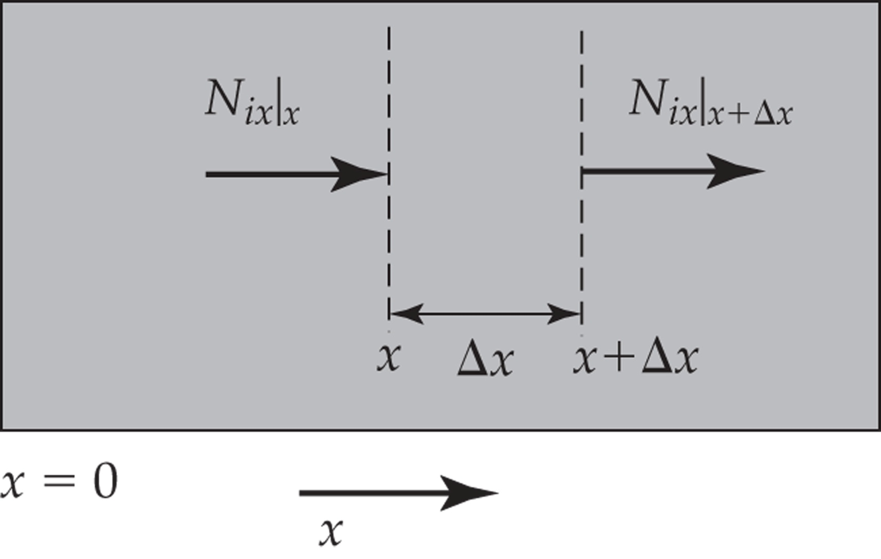
Figure 6.6 Diffusion through a small rectangular volume of area A and thickness ∆x.
6.7: Steady-state diffusion in one dimension Rectangular coordinates

Slide 65
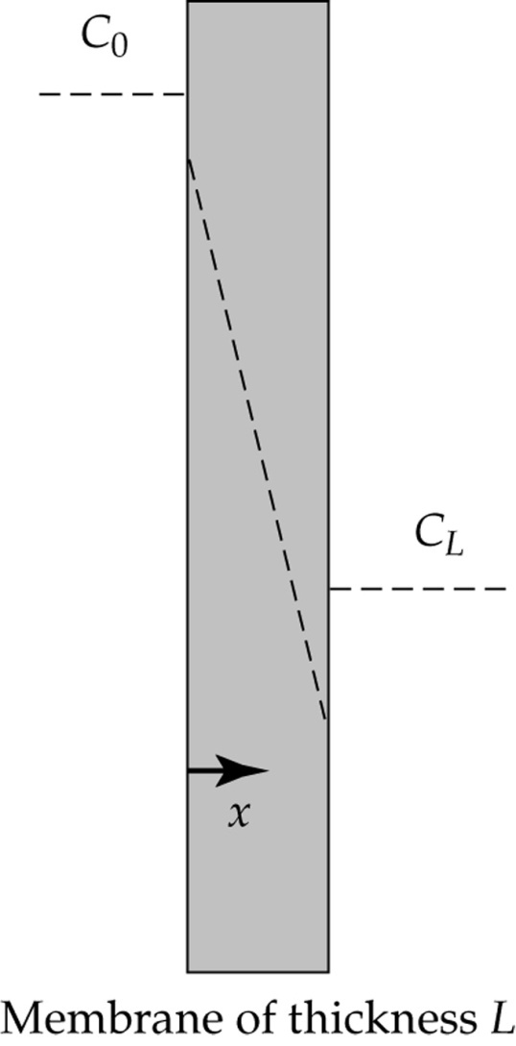
Schematic of steady diffusion across a membrane of thickness L that separates two well-mixed solutions. For this situation Φ < 1.

Slide 66
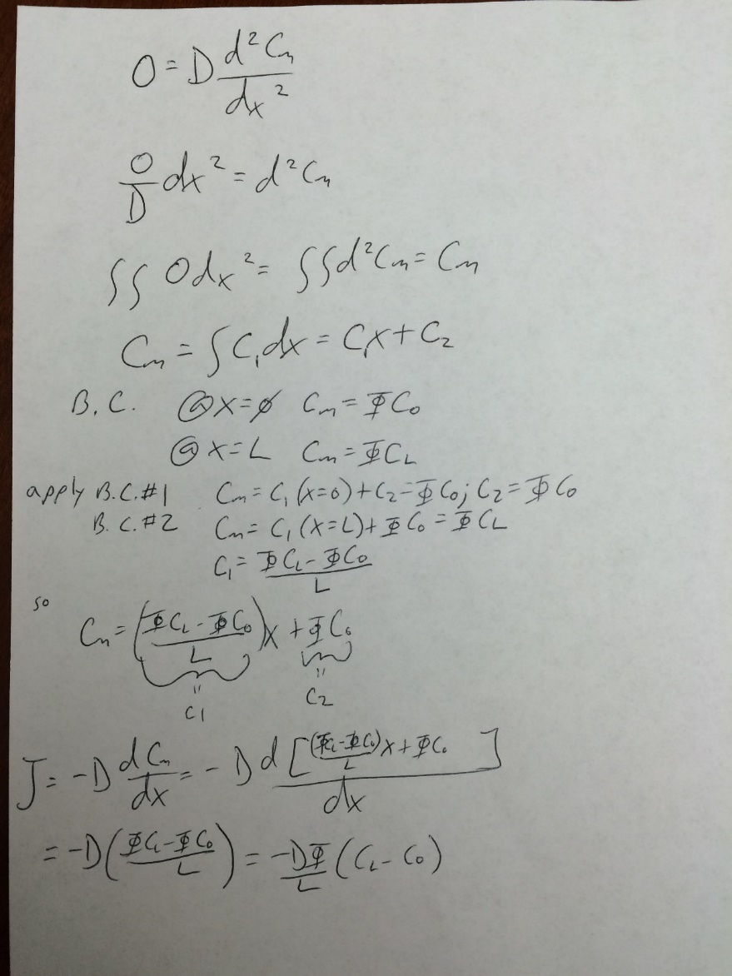
Schematic of steady diffusion across a membrane of thickness L that separates two well-mixed solutions. For this situation Φ < 1.

Slide 67
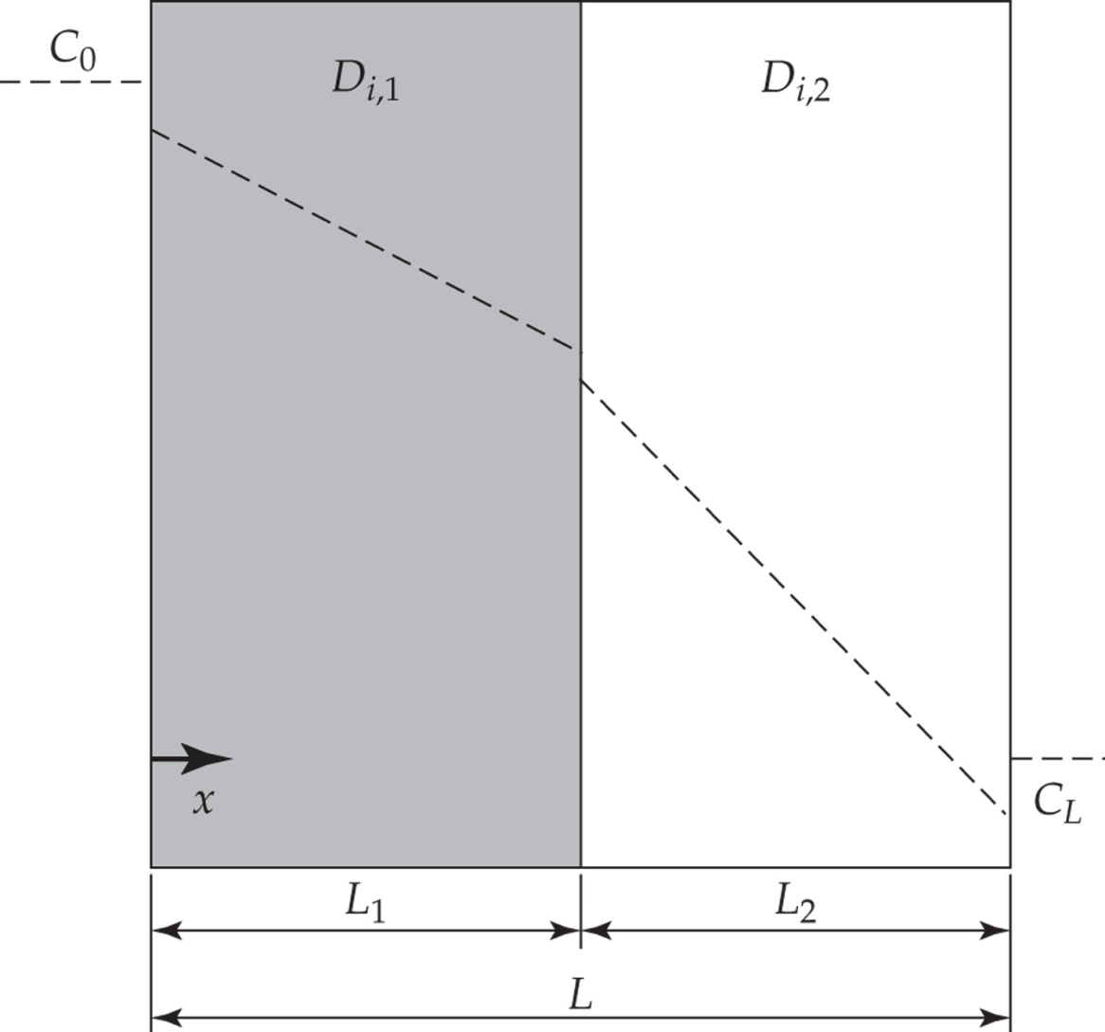
Diffusion through a two-layer laminate. Each layer is described by a separate diffusion coefficient.
Example 6.5
protein
Determine C(x)
Determine N(x)
Cellular
Smooth muscle
cell
C(x=0)=ΦCo
Acellular
Elastic artery
C(x=L)=ΦC_{L}
V_{f}
protein

Slide 68
Diffusion through a two-layer laminate. Each layer is described by a separate diffusion coefficient.
protein
Determine C(x)
Determine N(x)
Cellular
Smooth muscle
cell
Acellular
Elastic artery
protein

Slide 69
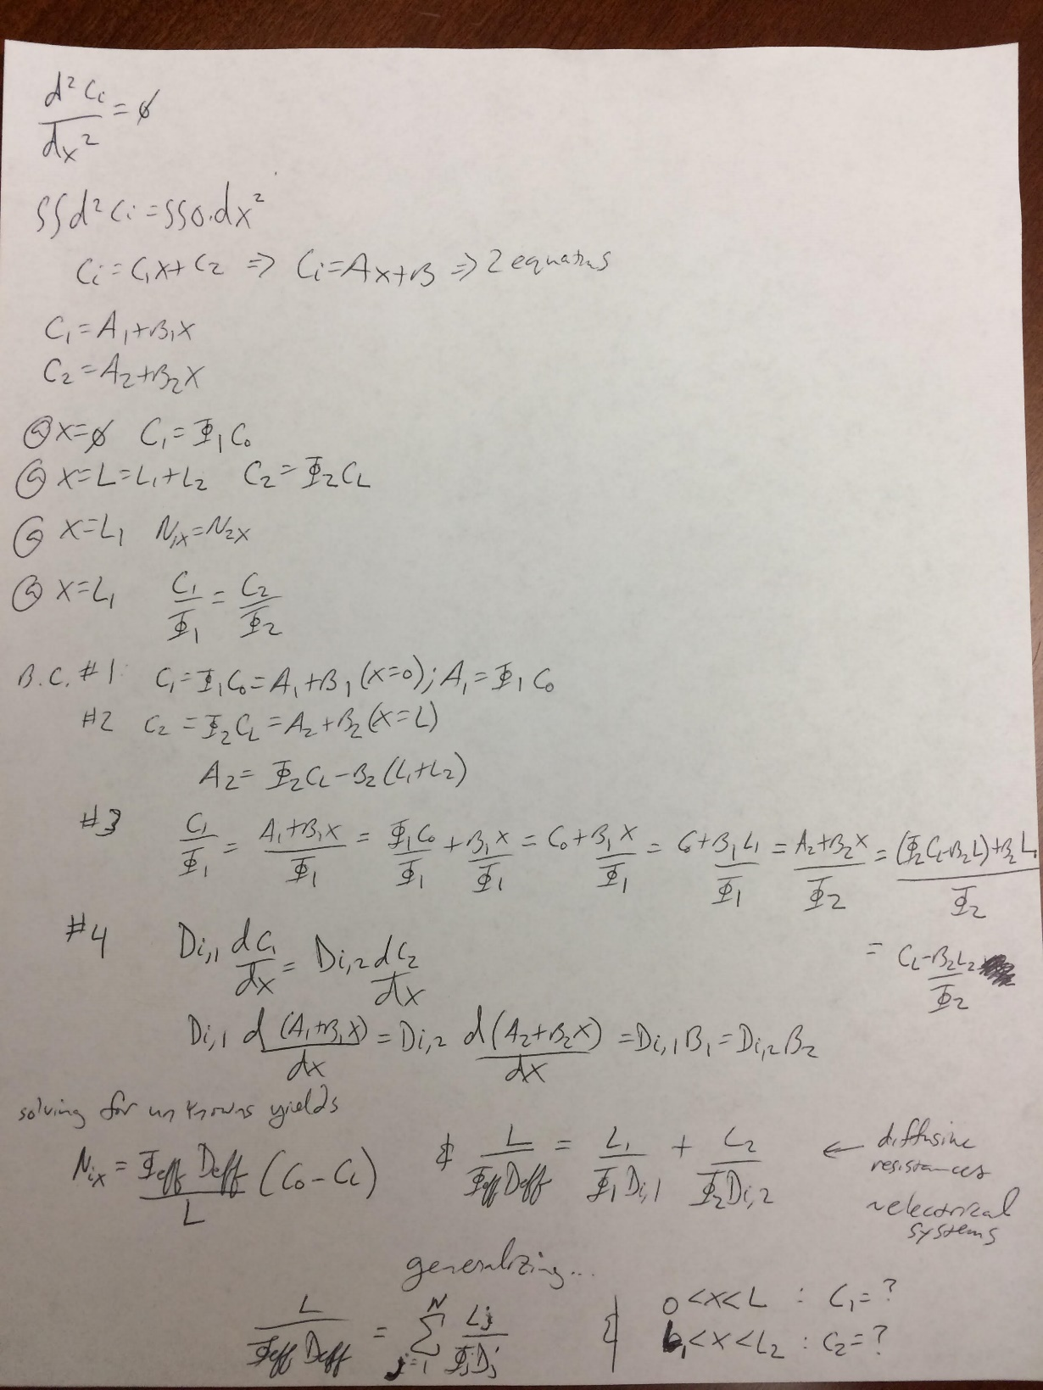

Slide 70
6.7.1: Diffusion in gases

Slide 71
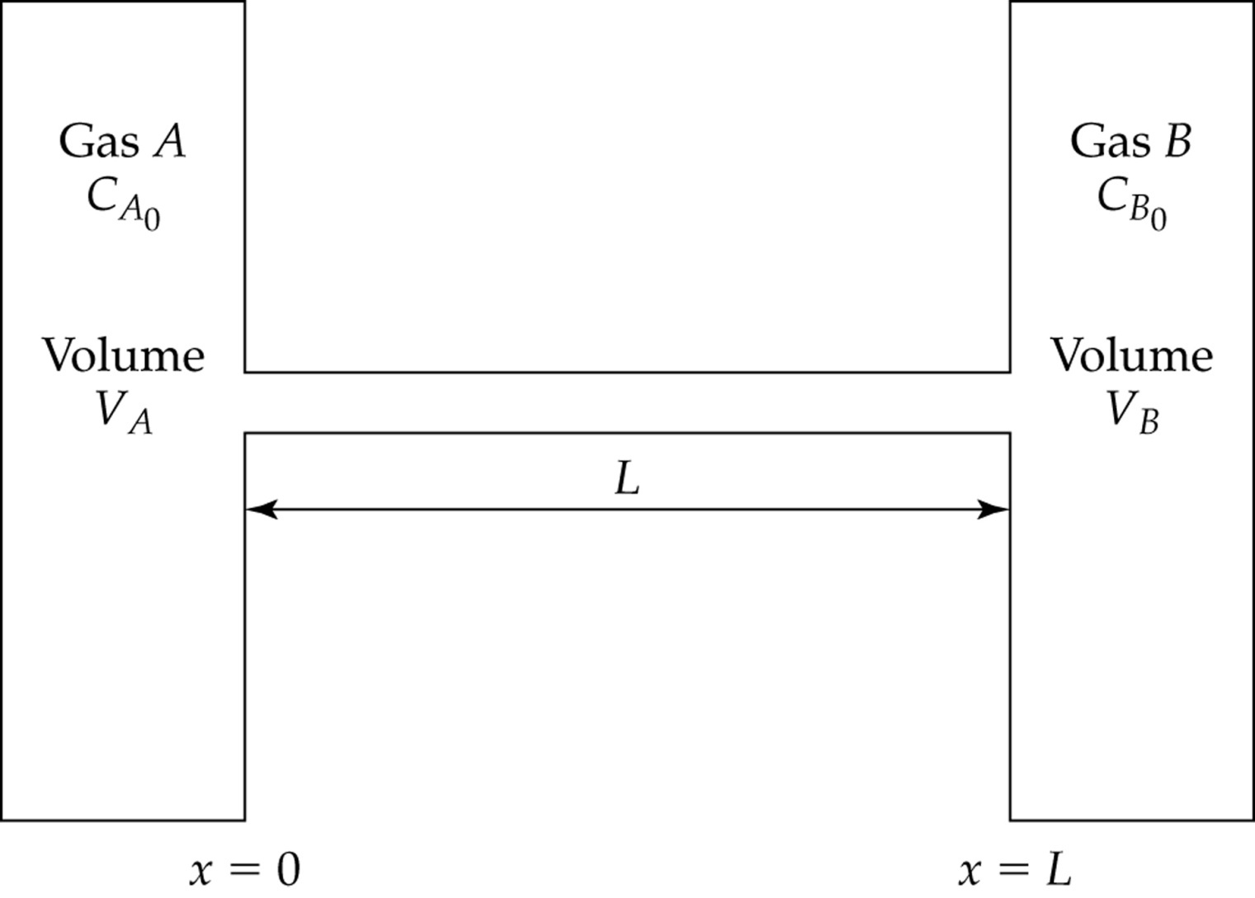
Figure 6.10 Diffusion of two gases. The concentrations in each reservoir are kept constant such that at steady state, C_{A} = C_{Ao0} and C_{B} = C_{Bo}
C_{B} = 0 at x = 0 and C_{A} = 0 and ₀at x = L.
Dilute solution?

Slide 72
Figure 6.10 Diffusion of two gases. The concentrations in each reservoir are kept constant such that at steady state, C_{A} = C_{Ao0} and C_{B} = C_{Bo}
C_{B} = 0 at x = 0 and C_{A} = 0 and ₀at x = L.
Dilute solution cannot be invoked…. Flux of one induced flux of another in the absence of bulk motion.

Slide 73
Figure 6.10 Diffusion of two gases. The concentrations in each reservoir are kept constant such that at steady state, C_{A} = C_{Ao0} and C_{B} = C_{Bo}
C_{B} = 0 at x = 0 and C_{A} = 0 and ₀at x = L.
$$N_{1}=−CD_{ij}∇x_{1}+x_{1}(N_{1}+N_{2})$$
Dilute solution cannot be invoked…. Flux of one induced flux of another in the absence of bulk motion.

Slide 74
Figure 6.10 Diffusion of two gases. The concentrations in each reservoir are kept constant such that at steady state, C_{A} = C_{Ao0} and C_{B} = C_{Bo}
C_{B} = 0 at x = 0 and C_{A} = 0 and ₀at x = L.
$$N_{1}=−CD_{ij}∇x_{1}+x_{1}(N_{1}+N_{2})$$
Note: no chemical rxns
Dilute solution cannot be invoked…. Flux of one induced flux of another in the absence of bulk motion.

Slide 75
Figure 6.10 Diffusion of two gases. The concentrations in each reservoir are kept constant such that at steady state, C_{A} = C_{Ao0} and C_{B} = C_{Bo}
C_{B} = 0 at x = 0 and C_{A} = 0 and ₀at x = L.
$$N_{1}=−CD_{ij}∇x_{1}+x_{1}(N_{1}+N_{2})$$
Note: no chemical rxns
[Gas]res.=constant
Dilute solution cannot be invoked…. Flux of one induced flux of another in the absence of bulk motion.

Slide 76
Figure 6.10 Diffusion of two gases. The concentrations in each reservoir are kept constant such that at steady state, C_{A} = C_{Ao0} and C_{B} = C_{Bo}
C_{B} = 0 at x = 0 and C_{A} = 0 and ₀at x = L.
$$N_{1}=−CD_{ij}∇x_{1}+x_{1}(N_{1}+N_{2})$$
Note: no chemical rxns
[Gas]res.=constant
Constant pressure maintained throughout
Dilute solution cannot be invoked…. Flux of one induced flux of another in the absence of bulk motion.

Slide 77
Figure 6.10 Diffusion of two gases. The concentrations in each reservoir are kept constant such that at steady state, C_{A} = C_{Ao0} and C_{B} = C_{Bo}
C_{B} = 0 at x = 0 and C_{A} = 0 and ₀at x = L.
$$N_{1}=−CD_{ij}∇x_{1}+x_{1}(N_{1}+N_{2})$$
Note: no chemical rxns
[Gas]res.=constant
Constant pressure maintained throughout
Fick’s 2nd Law applied:
$$\frac{{dN}_{Ax}}{dx}=0$$
$$\frac{{dN}_{Bx}}{dx}=0$$
What next?
Dilute solution cannot be invoked…. Flux of one induced flux of another in the absence of bulk motion.

Slide 78
Figure 6.10 Diffusion of two gases. The concentrations in each reservoir are kept constant such that at steady state, C_{A} = C_{Ao0} and C_{B} = C_{Bo}
C_{B} = 0 at x = 0 and C_{A} = 0 and ₀at x = L.
$$N_{1}=−CD_{ij}∇x_{1}+x_{1}(N_{1}+N_{2})$$
Note: no chemical rxns
[Gas]res.=constant
Constant pressure maintained throughout
Fick’s 2nd Law applied:
$$\frac{{dN}_{Ax}}{dx}=0$$
$$\frac{{dN}_{Bx}}{dx}=0$$
What next?
Dilute solution cannot be invoked…. Flux of one induced flux of another in the absence of bulk motion.

Slide 79
$$N_{1}=−CD_{ij}∇x_{1}+x_{1}(N_{1}+N_{2})$$
$$\frac{{dN}_{Ax}}{dx}=0$$
$$\frac{{dN}_{Bx}}{dx}=0$$
What next?

Slide 80
$$N_{1}=−CD_{ij}∇x_{1}+x_{1}(N_{1}+N_{2})$$
$$\frac{{dN}_{Ax}}{dx}=0$$
$$\frac{{dN}_{Bx}}{dx}=0$$
1-D
$$N_{Ax}=−CD_{AB}\frac{dx_{A}}{dx}+x_{A}(N_{Ax}+N_{Bx})$$
$$N_{1}=−CD_{ij}∇x_{1}+x_{1}(N_{1}+N_{2})$$
$$N_{Bx}=−CD_{BA}\frac{dx_{B}}{dx}+x_{B}(N_{Ax}+N_{Bx})$$
Can assume D_{AB}=D_{BA}

Slide 81
$$N_{1}=−CD_{ij}∇x_{1}+x_{1}(N_{1}+N_{2})$$
$$\frac{{dN}_{Ax}}{dx}=0$$
$$\frac{{dN}_{Bx}}{dx}=0$$
1-D
$$N_{Ax}=−CD_{AB}\frac{dx_{A}}{dx}+x_{A}(N_{Ax}+N_{Bx})$$
$$N_{1}=−CD_{ij}∇x_{1}+x_{1}(N_{1}+N_{2})$$
$$N_{Bx}=−CD_{AB}\frac{dx_{B}}{dx}+x_{B}(N_{Ax}+N_{Bx})$$
Can assume D_{AB}=D_{BA}

Slide 82
$$N_{1}=−CD_{ij}∇x_{1}+x_{1}(N_{1}+N_{2})$$
$$\frac{{dN}_{Ax}}{dx}=0$$
$$\frac{{dN}_{Bx}}{dx}=0$$
1-D
$$N_{Ax}=−CD_{AB}\frac{dx_{A}}{dx}+x_{A}(N_{Ax}+N_{Bx})$$
$$N_{1}=−CD_{ij}∇x_{1}+x_{1}(N_{1}+N_{2})$$
$$N_{Bx}=−CD_{AB}\frac{dx_{B}}{dx}+x_{B}(N_{Ax}+N_{Bx})$$
Now what?

Slide 83
$$N_{1}=−CD_{ij}∇x_{1}+x_{1}(N_{1}+N_{2})$$
$$\frac{{dN}_{Ax}}{dx}=0$$
$$\frac{{dN}_{Bx}}{dx}=0$$
1-D
$$N_{Ax}=−CD_{AB}\frac{dx_{A}}{dx}+x_{A}(N_{Ax}+N_{Bx})$$
$$N_{1}=−CD_{ij}∇x_{1}+x_{1}(N_{1}+N_{2})$$
$$N_{Bx}=−CD_{AB}\frac{dx_{B}}{dx}+x_{B}(N_{Ax}+N_{Bx})$$
Now what? Pressure is the same everywhere so…

Slide 84
$$N_{1}=−CD_{ij}∇x_{1}+x_{1}(N_{1}+N_{2})$$
$$\frac{{dN}_{Ax}}{dx}=0$$
$$\frac{{dN}_{Bx}}{dx}=0$$
1-D
$$N_{Ax}=−CD_{AB}\frac{dx_{A}}{dx}+x_{A}(N_{Ax}+N_{Bx})$$
$$N_{1}=−CD_{ij}∇x_{1}+x_{1}(N_{1}+N_{2})$$
$$N_{Bx}=−CD_{AB}\frac{dx_{B}}{dx}+x_{B}(N_{Ax}+N_{Bx})$$
$$N_{Bx}=−N_{Ax}$$
Now what? Pressure is the same everywhere so…
Equimolar counterdiffusion
Analogous to diffusion through membrane if φ=1…

Slide 85
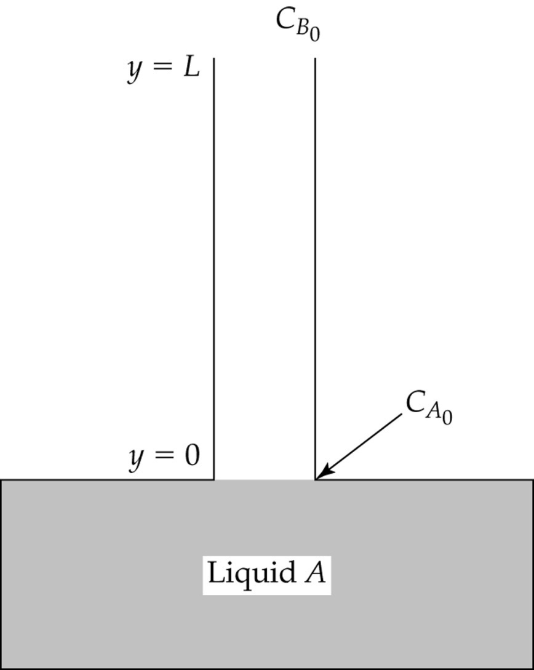
Figure 6.11 Evaporation of liquid A and diffusion through a stagnant layer of gas B.
Example 6.6
Is this more complex
Than the last?

Slide 86
Figure 6.11 Evaporation of liquid A and diffusion through a stagnant layer of gas B.
Is this more complex
Than the last?
Yes…
Consider this to be s.s. evaporation
Of a liquid A into a stagnant layer of gas
B. If there is a stagnant layer that
Means there is no bulk flow of the gas…
Not equimolar counterdiffusion.

Slide 87
Figure 6.11 Evaporation of liquid A and diffusion through a stagnant layer of gas B.
Is this more complex
Than the last?
Yes…
Consider this to be s.s. evaporation
Of a liquid A into a stagnant layer of gas
B. If there is a stagnant layer that
Means there is no bulk flow of the gas…
Not equimolar counterdiffusion because
Pretend there is a large
Reservoir supplying this
Concentration such that
It is constant.

Slide 88
Figure 6.11 Evaporation of liquid A and diffusion through a stagnant layer of gas B.
Is this more complex
Than the last?
Yes…
Consider this to be s.s. evaporation
Of a liquid A into a stagnant layer of gas
B. If there is a stagnant layer that
Means there is no bulk flow of the gas…
Not equimolar counterdiffusion because
B is insoluble in our fake situation…
Pressure is uniform
Pretend there is a large
Reservoir supplying this
Concentration such that
It is constant.
What next?

Slide 89
Figure 6.11 Evaporation of liquid A and diffusion through a stagnant layer of gas B.
Is this more complex
Than the last?
Yes…
Consider this to be s.s. evaporation
Of a liquid A into a stagnant layer of gas
B. If there is a stagnant layer that
Means there is no bulk flow of the gas…
Not equimolar counterdiffusion because
B is hardly soluble in our fake situation…
Pressure is uniform
Pretend there is a large
Reservoir supplying this
Concentration such that
It is constant.
What next?
What next?
Fick’s 2nd law
At s.s.

Slide 90


What next?
Fick’s 2nd law
At s.s.
$$\frac{{dN}_{Ay}}{dy}=0$$
$$\frac{{dN}_{By}}{dy}=0$$
Of note, gas is very slightly soluble and is much less than the flux due
To evaporation of the liquid A. so
B.C. N_{by} ~=0 at y=0… so…

Slide 91
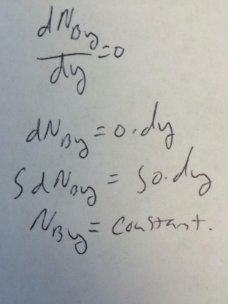
What next?
Fick’s 2nd law
At s.s.
$$\frac{{dN}_{Ay}}{dy}=0$$
$$\frac{{dN}_{By}}{dy}=0$$
Of note, gas is very slightly soluble and is much less than the flux due
To evaporation of the liquid A. so

Slide 92
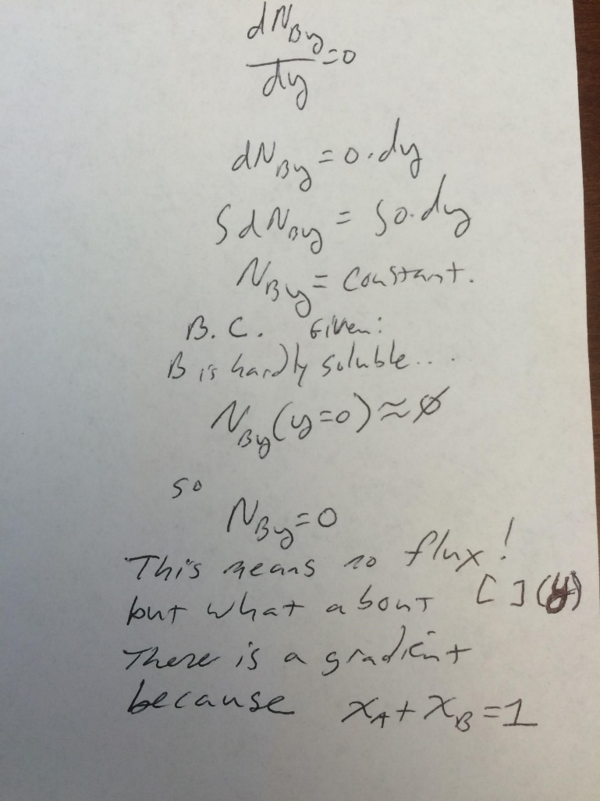
What next?
Fick’s 2nd law
At s.s.
$$\frac{{dN}_{Ay}}{dy}=0$$
$$\frac{{dN}_{By}}{dy}=0$$
Of note, gas is very slightly soluble and is much less than the flux due
To evaporation of the liquid A. so

Slide 93
What next?
Fick’s 2nd law
At s.s.
$$\frac{{dN}_{Ay}}{dy}=0$$
$$\frac{{dN}_{By}}{dy}=0$$
Of note, gas is very slightly soluble and is much less than the flux due
To evaporation of the liquid A. so

Slide 94
What next?
Fick’s 2nd law
At s.s.
$$\frac{{dN}_{Ay}}{dy}=0$$
$$\frac{{dN}_{By}}{dy}=0$$
Of note, gas is very slightly soluble and is much less than the flux due
To evaporation of the liquid A. so
Remember:
$$N_{1}=−CD_{ij}∇x_{1}+x_{1}(N_{1}+N_{2})$$

Slide 95
What next?
Fick’s 2nd law
At s.s.
$$\frac{{dN}_{Ay}}{dy}=0$$
$$\frac{{dN}_{By}}{dy}=0$$
Of note, gas is very slightly soluble and is much less than the flux due
To evaporation of the liquid A. so
Remember:
$$N_{1}=−CD_{ij}∇x_{1}+x_{1}(N_{1}+N_{2})$$
$$N_{Ay}=−CD_{AB}\frac{dx_{A}}{dy}+x_{A}(N_{Ay}+N_{By})$$

Slide 96
What next?
Fick’s 2nd law
At s.s.
$$\frac{{dN}_{Ay}}{dy}=0$$
$$\frac{{dN}_{By}}{dy}=0$$
Of note, gas is very slightly soluble and is much less than the flux due
To evaporation of the liquid A. so
Remember:
$$N_{1}=−CD_{ij}∇x_{1}+x_{1}(N_{1}+N_{2})$$
$$N_{Ay}=−CD_{AB}\frac{dx_{A}}{dy}+x_{A}(N_{Ay}+N_{By})$$
$$N_{Ay}=−CD_{AB}\frac{dx_{A}}{dy}+x_{A}N_{Ay}$$

Slide 97
What next?
Fick’s 2nd law
At s.s.
$$\frac{{dN}_{Ay}}{dy}=0$$
$$\frac{{dN}_{By}}{dy}=0$$
Of note, gas is very slightly soluble and is much less than the flux due
To evaporation of the liquid A. so
Remember:
$$N_{1}=−CD_{ij}∇x_{1}+x_{1}(N_{1}+N_{2})$$
$$N_{Ay}=−CD_{AB}\frac{dx_{A}}{dy}+x_{A}(N_{Ay}+N_{By})$$
$$N_{Ay}=−CD_{AB}\frac{dx_{A}}{dy}+x_{A}N_{Ay}$$
Now what?

Slide 98
What next?
Fick’s 2nd law
At s.s.
$$\frac{{dN}_{Ay}}{dy}=0$$
$$\frac{{dN}_{By}}{dy}=0$$
Of note, gas is very slightly soluble and is much less than the flux due
To evaporation of the liquid A. so
Remember:
$$N_{1}=−CD_{ij}∇x_{1}+x_{1}(N_{1}+N_{2})$$
$$N_{Ay}=−CD_{AB}\frac{dx_{A}}{dy}+x_{A}(N_{Ay}+N_{By})$$
$$N_{Ay}=−CD_{AB}\frac{dx_{A}}{dy}+x_{A}N_{Ay}$$
Now what? Solve for N_{Ay}
$N_{Ay}−x_{A}N_{Ay}$ = $−CD_{AB}\frac{dx_{A}}{dy}=N_{Ay}(1−x_{A})$
$N_{Ay}$ = $−\frac{CD_{AB}\frac{dx_{A}}{dy}}{1−x_{A}}$

Slide 99
What next?
Fick’s 2nd law
At s.s.
$$\frac{{dN}_{Ay}}{dy}=0$$
$$\frac{{dN}_{By}}{dy}=0$$
Of note, gas is very slightly soluble and is much less than the flux due
To evaporation of the liquid A. so
Remember:
$$N_{1}=−CD_{ij}∇x_{1}+x_{1}(N_{1}+N_{2})$$
$$N_{Ay}=−CD_{AB}\frac{dx_{A}}{dy}+x_{A}(N_{Ay}+N_{By})$$
$$N_{Ay}=−CD_{AB}\frac{dx_{A}}{dy}+x_{A}N_{Ay}$$
Now what? Solve for N_{Ay}
$N_{Ay}−x_{A}N_{Ay}$ = $−CD_{AB}\frac{dx_{A}}{dy}=N_{Ay}(1−x_{A})$
$N_{Ay}$ = $−\frac{CD_{AB}\frac{dx_{A}}{dy}}{1−x_{A}}$
Now what?

Slide 100
What next?
Fick’s 2nd law
At s.s.
$$\frac{{dN}_{Ay}}{dy}=0$$
$$\frac{{dN}_{By}}{dy}=0$$
Of note, gas is very slightly soluble and is much less than the flux due
To evaporation of the liquid A. so
Remember:
$$N_{1}=−CD_{ij}∇x_{1}+x_{1}(N_{1}+N_{2})$$
$$N_{Ay}=−CD_{AB}\frac{dx_{A}}{dy}+x_{A}(N_{Ay}+N_{By})$$
$$N_{Ay}=−CD_{AB}\frac{dx_{A}}{dy}+x_{A}N_{Ay}$$
Now what? Solve for N_{Ay}
$N_{Ay}−x_{A}N_{Ay}$ = $−CD_{AB}\frac{dx_{A}}{dy}=N_{Ay}(1−x_{A})$
$N_{Ay}$ = $−\frac{CD_{AB}\frac{dx_{A}}{dy}}{1−x_{A}}$
Now what?

Slide 101
What next?
Fick’s 2nd law
At s.s.
$$\frac{{dN}_{Ay}}{dy}=0$$
$$\frac{{dN}_{By}}{dy}=0$$
Of note, gas is very slightly soluble and is much less than the flux due
To evaporation of the liquid A. so
$\frac{{dN}_{Ay}}{dy}$ = $−\frac{d\left(\frac{CD_{AB}\frac{dx_{A}}{dy}}{1−x_{A}}\right)}{dy}=0$
Remember:
$\frac{{dN}_{Ay}}{dy}$ = $−\frac{d\left(\frac{CD_{AB}\frac{dx_{A}}{dy}}{1−x_{A}}\right)}{dy}=0$
$$N_{1}=−CD_{ij}∇x_{1}+x_{1}(N_{1}+N_{2})$$
$$N_{Ay}=−CD_{AB}\frac{dx_{A}}{dy}+x_{A}(N_{Ay}+N_{By})$$
$$\frac{d\left(\frac{CD_{AB}\frac{dx_{A}}{dy}}{1−x_{A}}\right)}{dy}=0$$
$$N_{Ay}=−CD_{AB}\frac{dx_{A}}{dy}+x_{A}N_{Ay}$$
Now what? Solve for N_{Ay}
$N_{Ay}−x_{A}N_{Ay}$ = $−CD_{AB}\frac{dx_{A}}{dy}=N_{Ay}(1−x_{A})$
$N_{Ay}$ = $−\frac{CD_{AB}\frac{dx_{A}}{dy}}{1−x_{A}}$
Now what?
Now what?

Slide 102
What next?
Fick’s 2nd law
At s.s.
$$\frac{{dN}_{Ay}}{dy}=0$$
$$\frac{{dN}_{By}}{dy}=0$$
Of note, gas is very slightly soluble and is much less than the flux due
To evaporation of the liquid A. so
$$\frac{d\left(\frac{CD_{AB}\frac{dx_{A}}{dy}}{1−x_{A}}\right)}{dy}=0$$
Now what?

Slide 103
What next?
Fick’s 2nd law
At s.s.
$$\frac{{dN}_{Ay}}{dy}=0$$
$$\frac{{dN}_{By}}{dy}=0$$
Of note, gas is very slightly soluble and is much less than the flux due
To evaporation of the liquid A. so
$$\frac{d\left(\frac{CD_{AB}\frac{dx_{A}}{dy}}{1−x_{A}}\right)}{dy}=0$$
Now what? Apply B.C.s

Slide 104
What next?
Fick’s 2nd law
At s.s.
$$\frac{{dN}_{Ay}}{dy}=0$$
$$\frac{{dN}_{By}}{dy}=0$$
Of note, gas is very slightly soluble and is much less than the flux due
To evaporation of the liquid A. so
$$\frac{d\left(\frac{CD_{AB}\frac{dx_{A}}{dy}}{1−x_{A}}\right)}{dy}=0$$
Now what? Apply B.C.s
1) X_{A}=X_{Ao} at y=0 and X_{A}=0 at y=L

Slide 105
What next?
Fick’s 2nd law
At s.s.
$$\frac{{dN}_{Ay}}{dy}=0$$
$$\frac{{dN}_{By}}{dy}=0$$
Of note, gas is very slightly soluble and is much less than the flux due
To evaporation of the liquid A. so
$$\frac{d\left(\frac{CD_{AB}\frac{dx_{A}}{dy}}{1−x_{A}}\right)}{dy}=0$$
Now what? Apply B.C.s
1) X_{A}=X_{Ao} at y=0 and X_{A}=0 at y=L
How?
Come to board…

Slide 106
What next?
Fick’s 2nd law
At s.s.
$$\frac{{dN}_{Ay}}{dy}=0$$
$$\frac{{dN}_{By}}{dy}=0$$
Of note, gas is very slightly soluble and is much less than the flux due
To evaporation of the liquid A. so
$$\frac{d\left(\frac{CD_{AB}\frac{dx_{A}}{dy}}{1−x_{A}}\right)}{dy}=0$$
Now what? Apply B.C.s
1) X_{A}=X_{Ao} at y=0 and X_{A}=0 at y=L
How?
Come to board… and try in groups…

Slide 107
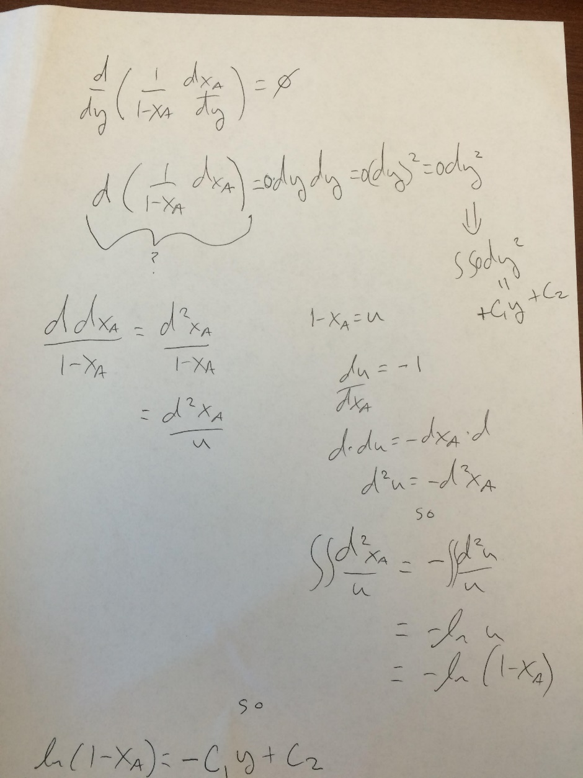

Slide 108
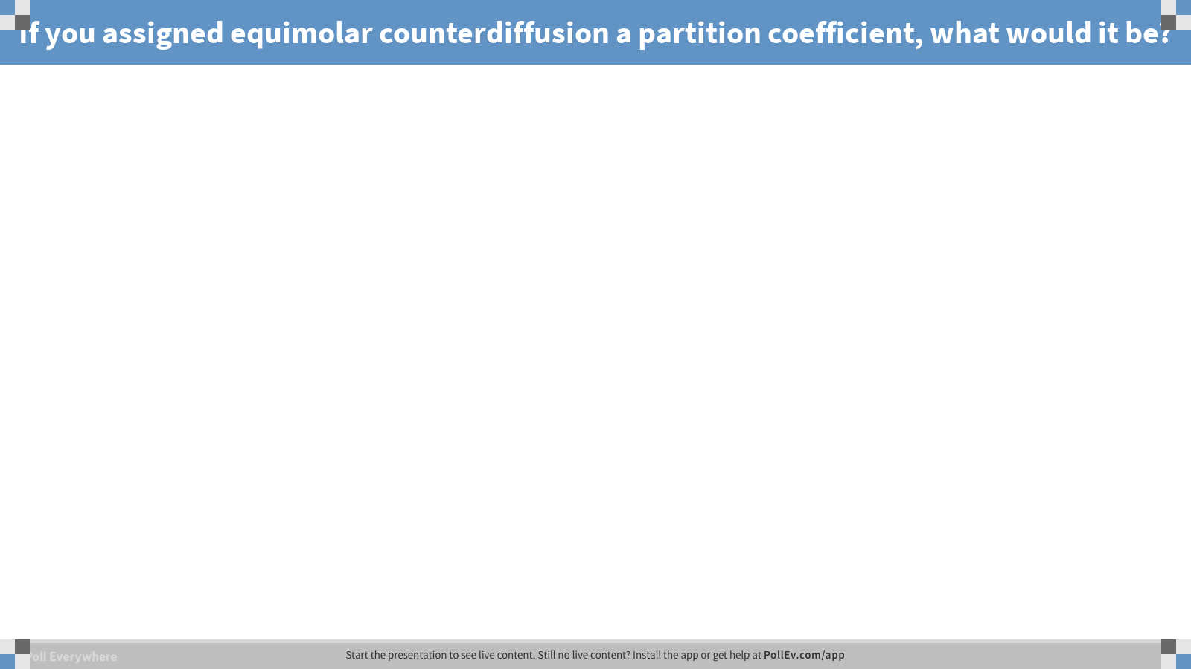
Notes:
Poll Title: If you assigned equimolar counterdiffusion a partition coefficient, what would it be?
https://www.polleverywhere.com/free_text_polls/m5ex31BAfzYAZ09

Slide 109
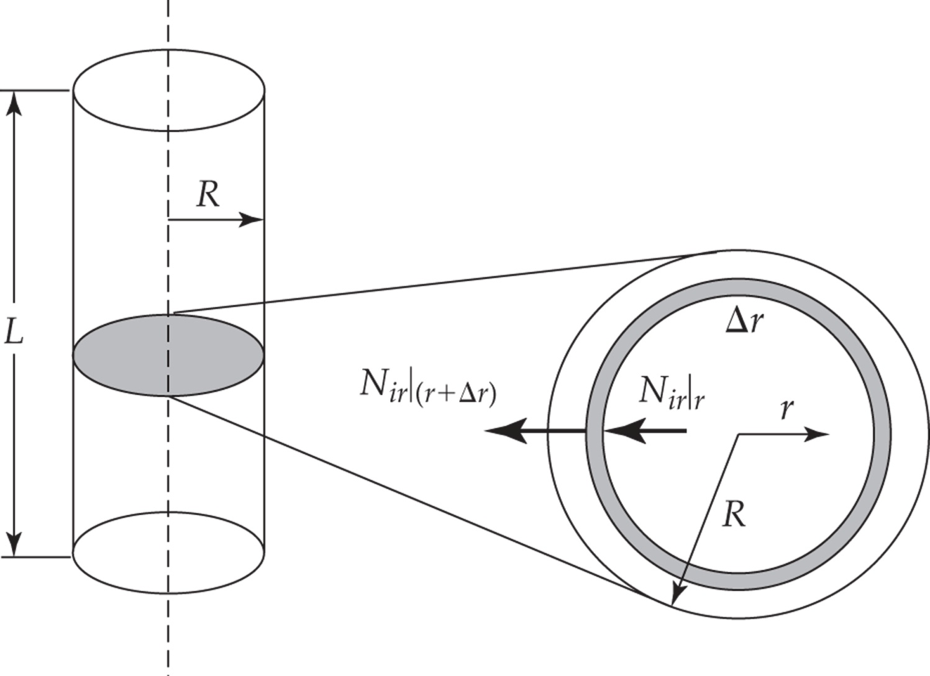
Figure 6.13 Radial diffusion through a cylindrical shell.
Example 6.7.2: Radial diffusion in cylindrical coordinates

Slide 110
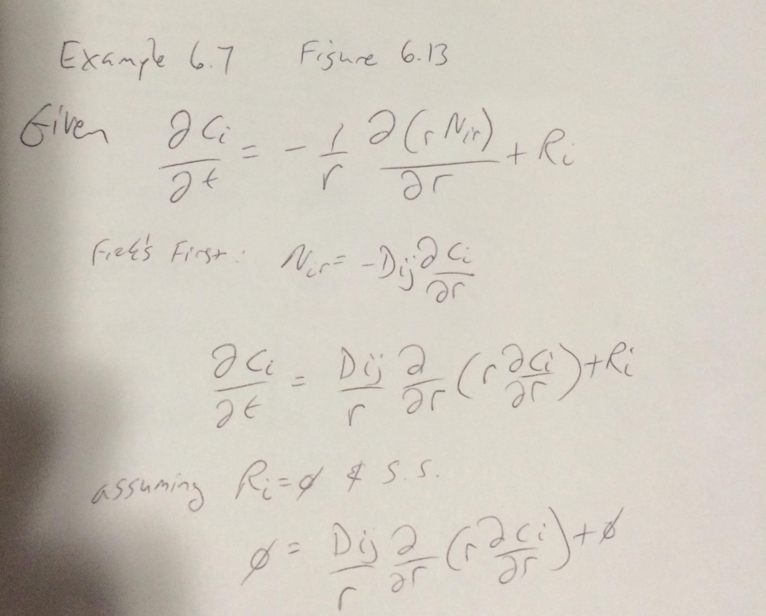
Assume no reaction
Assume steady state

Slide 111
Assume no reaction
Assume steady state
Now what?
Come to board and solve the rest
Without B.C.s (look in book for B.C.s;
Assuming you can do that…)

Slide 112
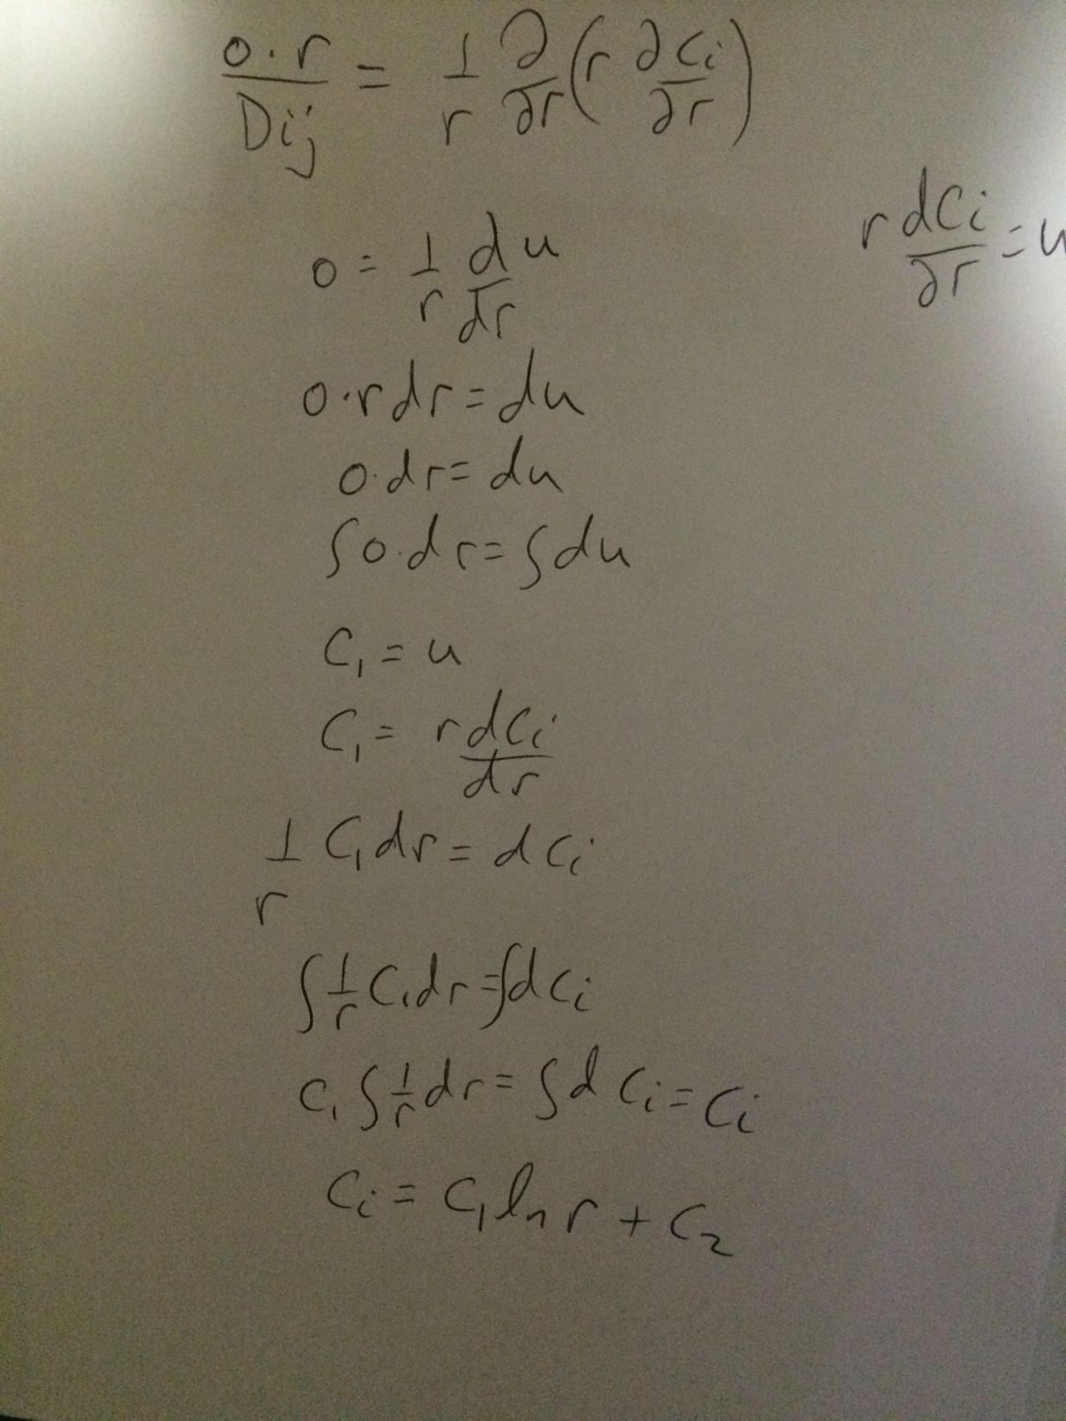

Slide 113
Skipping erf this semester for the sake of time.

Slide 114
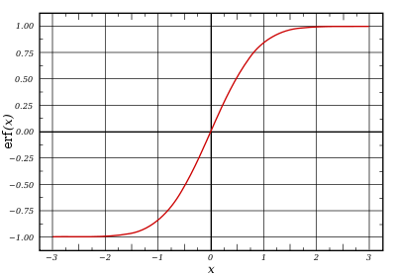
erf
What is it equal to?
What is it used for?
What does this have to
do with probability density
unctions.
http://www.bishopkingdom.com/aichatbox/id/368/

Slide 115

erf
What is it equal to?
What is it used for? Diff. Eq.s and diffusion
What is erfc? erfc=1-erf

Slide 116
MatLab Code
close all
x = [0:0.0000001:1];
figure1 = figure;
hold on
% Create axes
axes1 = axes('Parent',figure1);
hold(axes1,'on');
% Create multiple lines using matrix input to plot
%plot(X1,YMatrix1,'Parent',axes1);
% Create xlabel
xlabel('Distance (x)');
% Create title
title('Error function usage');
% Create ylabel
ylabel('Normalized Concentration');
% Set the remaining axes properties
%set(axes1,'FontSize',14,'FontWeight','bold');
for i = 1:2.5:35
plot(x,1-erf(x/(2*sqrt(i*10^-3))),'linewidth',3)
end

Slide 117
x = [0:0.0000001:1];
figure2 = figure;
% Create axes
axes1 = axes('Parent',figure2);
hold(axes1,'on');
% Create multiple lines using matrix input to plot
%plot(X1,YMatrix1,'Parent',axes1);
% Create xlabel
xlabel('Distance (x)');
% Create title
title('Error function usage');
% Create ylabel
ylabel('Normalized Concentration');
% Set the remaining axes properties
%set(axes1,'FontSize',14,'FontWeight','bold');
for i = 1:2.5:35
plot(x,erfc(x/(2*sqrt(i*10^-3))),'linewidth',3)
end

