Slide 1
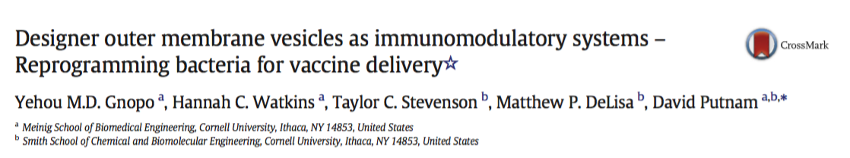
Presented by Whitney Souery
11/28/2018

Slide 2
Outline
Introduction
OMV Types and OMV Production
OMV Detoxification
Heterologous OMV Vaccines
Current adjuvants used in OMV vaccines
Routes of Administration
Conclusions

Slide 3
The problem: improving adjuvant function
What are adjuvants and why are they important?
  Most inactivated and subunit vaccines require an adjuvant to elicit the necessary immune response.
  Potential Mechanisms of Adjuvants:
    Increase antigen uptake
    Activate Antigen Presenting Cells
    Increase half-life of vaccine within the body

Slide 4
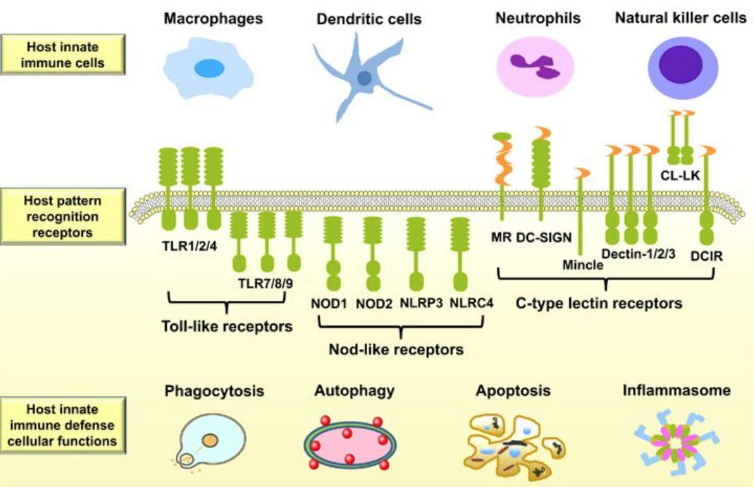
The problem: improving adjuvant function
How can adjuvant platforms be improved?
  Improved adjuvants can interact with specific Pathogen (Pattern) Recognition Receptors (PRRs) of the innate immune system to create more effective vaccines.
Taken from: https://www.nature.com/articles/cmi201788

Slide 5
The solution: use of omvs as adjuvants
What are OMVs?
  Outer Membrane Vesicles (OMVs ) are produced by bacteria for various purposes, including:
    envelope stress relaxation
    quorum sensing
    defense
    antibiotic response
    long-distance toxin transfer
How do OMVs act as adjuvants?
  OMVs are pathogen mimetic adjuvants derived from bacteria that serve to antagonize the body’s PRRs, such as:
    Toll-like Receptors (TLRS)
    NOD-like Receptors

Slide 6
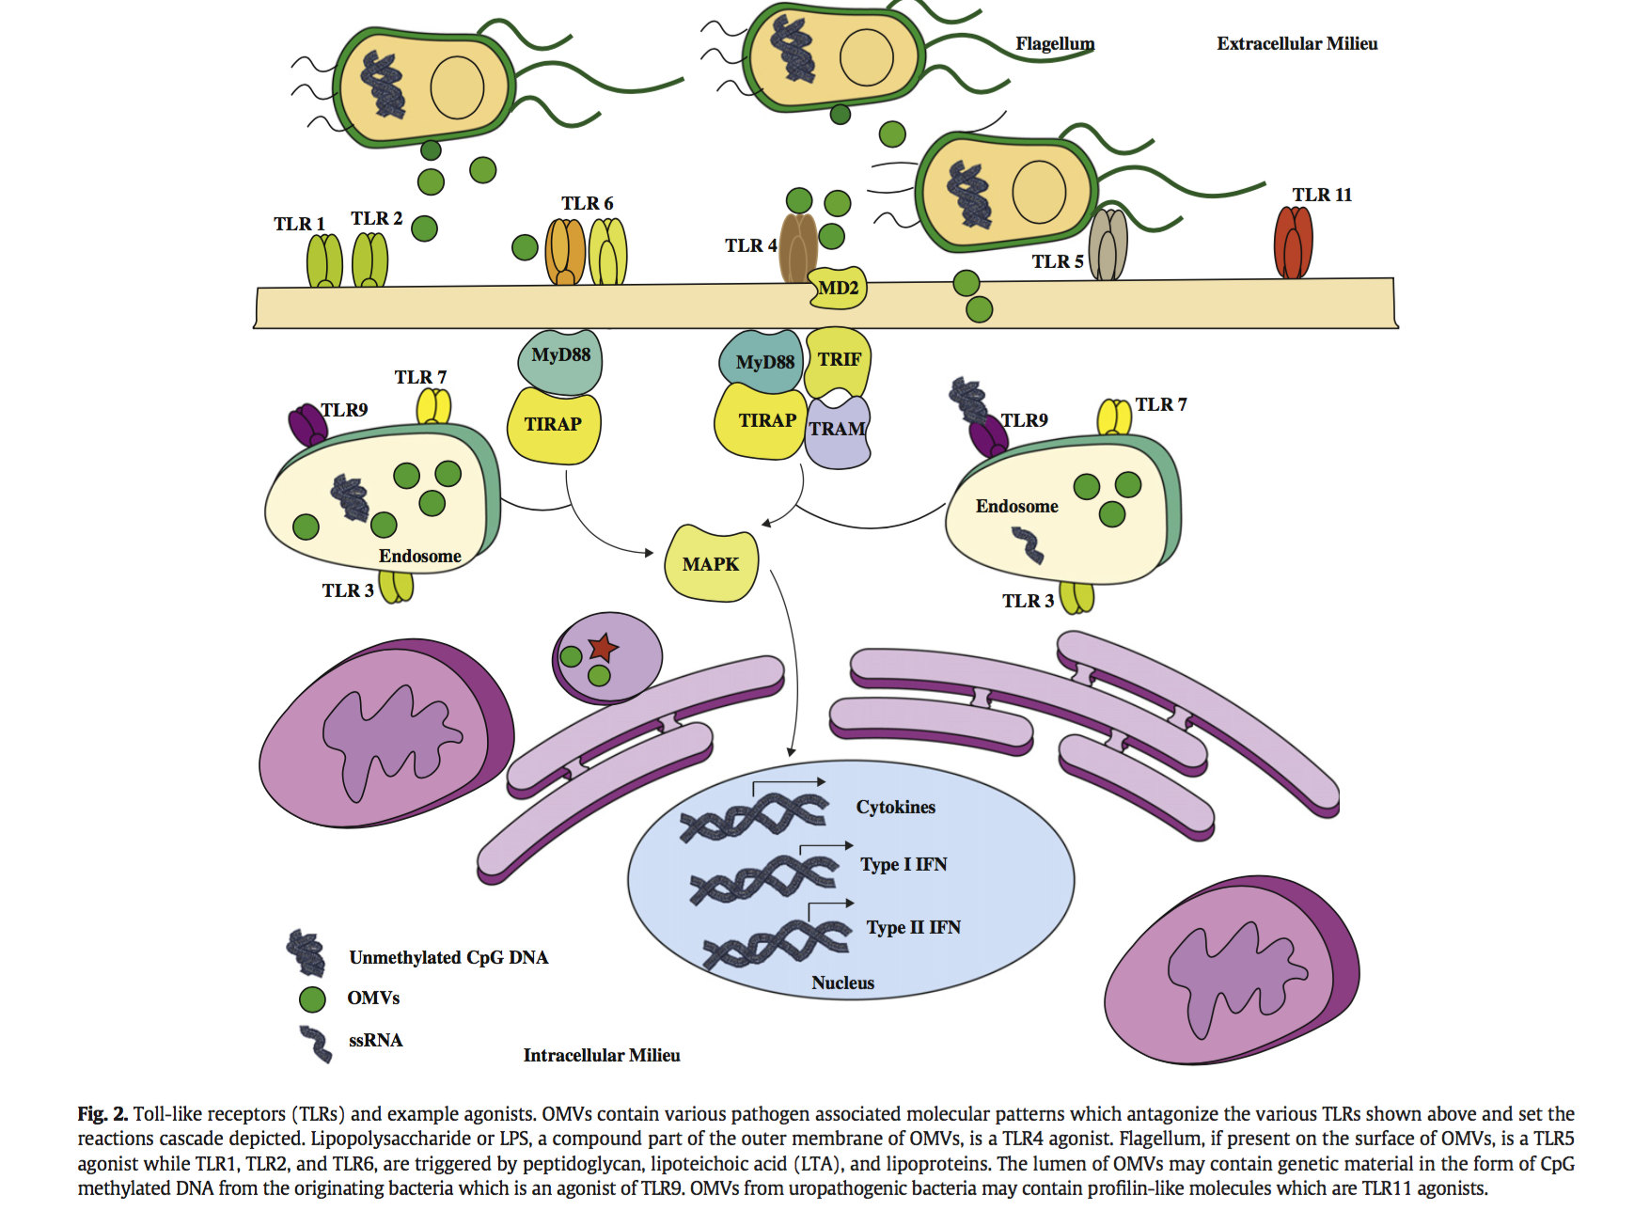
Method of omv ACTION
Release of OMVs
Activation of TLRs (flagellum, OMVs, LPS)
Upregulating gene expression involved in immune response

Slide 7
HOW ARE OMVs MADE?
Direct collection from target pathogen via budding of membrane
Engineered bacteria can express and embed homologous or heterologous antigens from different pathogens within the OMV
*allows for “designer vaccine” production

Slide 8
Outline
Introduction
OMV Types and OMV Production
  Spontaneous OMVs
  Native OMVs
  Detergent OMVs
OMV Detoxification
Heterologous OMV Vaccines
Current adjuvants used in OMV vaccines
Routes of Administration
Conclusions

Slide 9
HOW ARE OMVs PRODUCED?
NATURAL PRODUCTION
-OMVs bud off from membrane
ARTIFICIAL PRODUCTION
-OMVs can be treated with detergent and/or sonication
*OMVs produced with detergent are stripped of lipoproteins

Slide 10
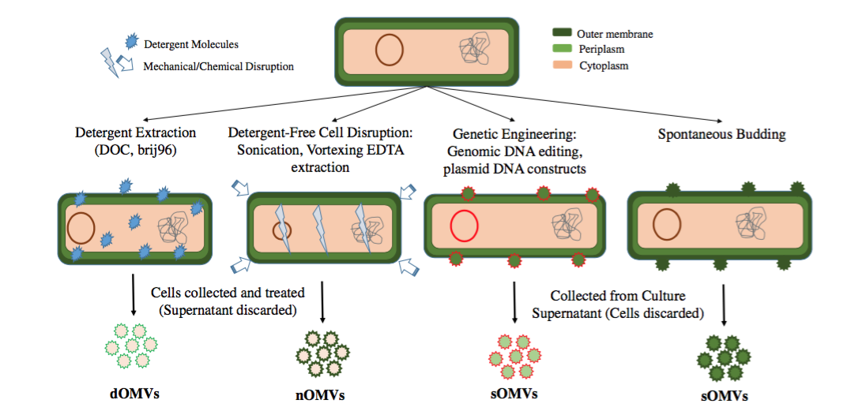
OMV CLASSIFICATIONS
Gram Negative Bacteria
Fig. 1

Slide 11
OMV CLASSIFICATIONS

Slide 12
Spotaneous OMVs
Method of Production:
  sOMVs naturally bud from the bacterial outer membrane via:
    Genetic engineering
    Spontaneous Budding
Membrane Characterization:
  sOMVs have a different protein composition than the bacterial membraåne
Harvesting Strategy:
  Grow OMV-producing bacteria over a 12-24 hr period
  Centrifuge to separate bacteria and OMV-containing supernatant
  Filter the OMV-containing supernatant
  Ultracentrifuge the supernatant to create a pellet of OMVs
  Further separation via density gradient

Slide 13
OMV CLASSIFICATIONS

Slide 14
Native OMVs
Method of Production:
  nOMVs are produced using detergent-free cell disruption techniques
    Ex: sonication, vortexing, or metal chelating agent (i.e. EDTA)
    Combinations of techniques are commonly used
Membrane Charactierization:
  nOMVs more closely resemble the membrane of the bacterial host than do sOMVs
Harvesting Strategy:
  Produce OMVs from host bacteria using detergent-free protocols
  Isolate nOMVs from bacteria by diafiltration or constant volume dialysis
  Perform final purification via ultracentrifugation

Slide 15
Spontanteous Vs. Native OMVs
Composition Differences
  nOMVs composition more closely resembles bacterial membrane than sOMVs.
Safety Differences
  Detergent-free techniques reduce endotoxin production (though not as much as detergent extraction)
    nOMVs have improved safety but reduced efficacy due to lower LPS levels
  Cytoplasmic proteins may be introduced into OMVs during centrifugation, fostering better adjuvant abilities but compromising safety

Slide 16
OMV CLASSIFICATIONS

Slide 17
Detergent OMVs
Method of Production:
  dOMVs are produced using detergent extraction techniques
  Choice of detergent is critical:
    Ionic detergents can alter protein/protein interactions
    Common choice: non-ionic surfactants
Membrane Charactierization:
  dOMVs contain bacterial outer mem. proteins and other mem. proteins.
Harvesting Strategy:
  Bacteria are isolated via centrifugation
  Cells are incubated with detergent to stimulate release of OMVs
  OMVs are isolated via ultracentrifugation of detergent-cell mixture

Slide 18
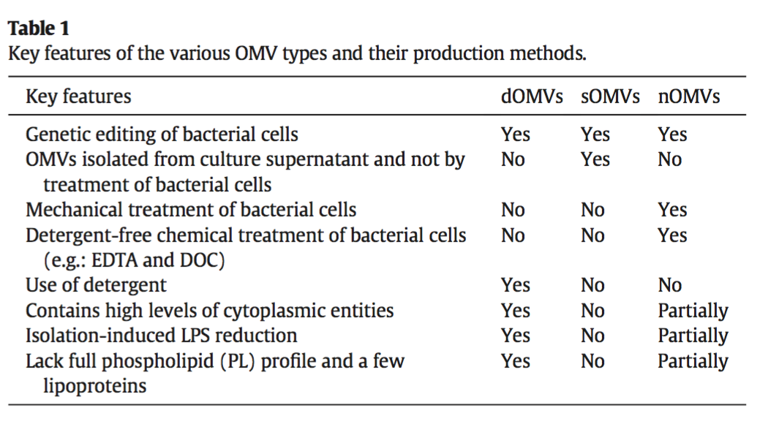
Differences between omv types

Slide 19
Outline
Introduction
OMV Types and OMV Production
OMV Detoxification
  Artificial OMV detoxification
  Engineering OMV detoxification
Heterologous OMV Vaccines
Current adjuvants used in OMV vaccines
Routes of Administration
Conclusions

Slide 20
OMV DETOXIFICATION
Why do OMVs need to be detoxified?
  Recall: OMVs are derived from gram-negative bacteria.
  Gram negative bacteria contain high levels of LPS on outer membranes -> LPS can induce inflammation and septic shock
  Therefore: it is critical to assess the safety profile of OMVs derived from gram negative bacteria.
  NOTE: vaccines are not subject to endotoxin regulations. While guidelines are specified, manufactures do not need to disclose endotoxin levels for vaccine approval.
Methods of detoxification:
  Artificial OMV Detoxification
  Engineering OMV Detoxification

Slide 21
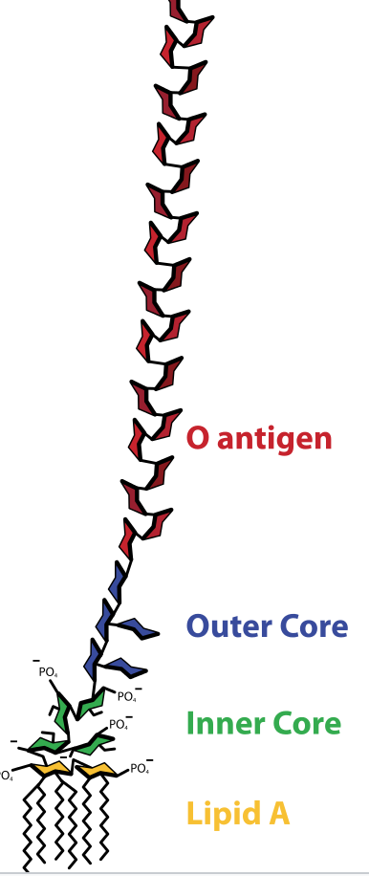
Artificial OMV Detoxification
How does artificial OMV detoxification work?
  Chemicals (i.e. non-ionic detergents) function to dissolve LPS aggregates (precursor of endotoxins)
Why are non-ionic detergents preferred?
  High affinity for lipid portion of LPS
  Mild effects on proteins
Commonly used chemicals:
  DOC (typically used with EDTA)
  Polyoxyethylene 10 oleoyl ether
Disadvantages?
  Lipoproteins and other proteins may be lost as a result of detergent usage.
    In the case of MenB vaccines: this impairs cross-protective immunity from dOMV vaccines
  Potential safety concerns about use of DOC (isolated from animal intestines)
LPS Structure:

Slide 22
Engineering OMV Detoxification: LPS modification
LPS Structure:
How is LPS modified?
  Number of acyl chains of lipid A
  Di- to monophosphorylated within lipid A region
What are the effects of LPS modification?
  Modifications to lipid A region have been shown to reduce TLR4 stimulation.
  Modified LPS allows for same degree of pathogen protection as unmodified counterpart (without pyrogens)

Slide 23
Outline
Introduction
OMV Types and OMV Production
OMV Detoxification
Heterologous OMV Vaccines
  Recombinant OMVs (rOMVs) based on CylA
  Heterologous OMVs based on other carrier proteins
  Glycosylated OMVs
Current adjuvants used in OMV vaccines
Routes of Administration
Conclusions

Slide 24
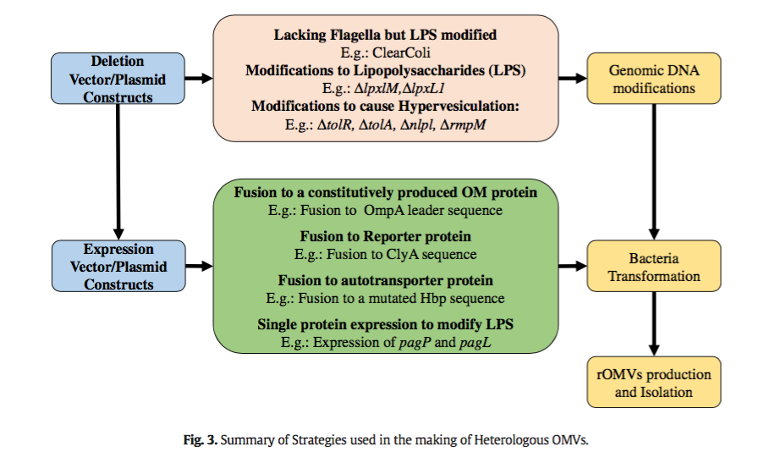
Heterologous OMV Vaccines
What are heterologous OMV vaccines?
  While OMVs can be isolated directly from pathogens, a less hazardous approach is to express proteins or synthesize carbohydrates in non-pathogenic bacteria.

Slide 25
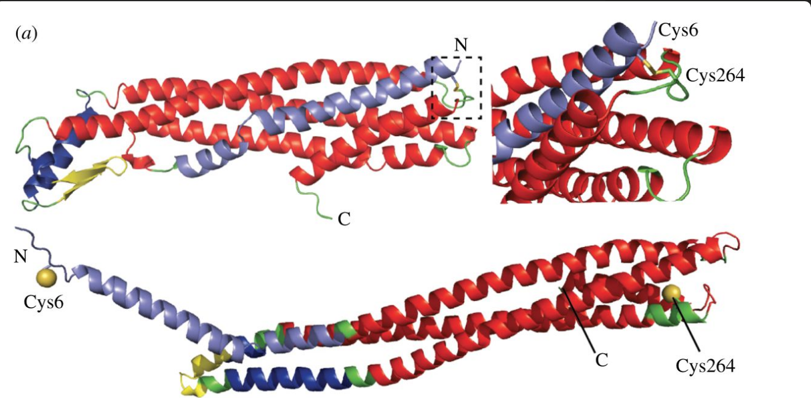
Heterologous OMV Vaccines: Recombinant omvs (romvs) based on clyA
What are rOMVs?
  rOMVs result when bacteria are engineered to display antigens on their outer membrane.
What is the role of ClyA?
  Protein Cytolysin A (ClyA) is a pore-forming toxin enriched in OMVs. Protein antigens can be fused to the C-terminal end of ClyA and produce ClyA-antigen fusion proteins that associate with OMVs.
Applications:
  Anti-viral vaccines: influenza
  Anti-bacterial vaccines: Acinetobacter baumannii
  Therapeutic vaccines: tumor targeting
Taken from: http://rstb.royalsocietypublishing.org/content/372/1726/20160211.figures-only

Slide 26
Heterologous OMV Vaccines: based on other carrier proteins
What other carrier proteins can be used to display heterologous proteins on OMVs?
  Hemoglobin protease (Hbp)
    Mechanism:
      Hbp can be mutated, which allows it to display proteins on the outer membrane
      Studies showed that a hypervesiculating E. coli and Salmonella strain could produce OMVs with recombinant proteins of interested when transformed with a plasmid containing both Hbp + antigen of interest.
  Pneumococcal surface protein A (PspA) and pneumolysin (Ply)
Additional approaches to expressing antigen content of OMVs?
  ompA leader sequences can be manipulated to display antigens of interest
  In some cases, antigen of interest may natively translocate to the outer membrane, so it may not be necessary to fuse it to a membrane protein.

Slide 27
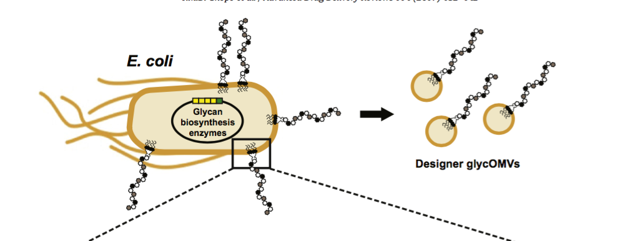
Heterologous OMV Vaccines: glycosylated omvs (glycomvs)
Strategy:
  Modify the carbohydrate portion of LPS to display heterologous oligosaccharide and polysaccharide antigens
Approach:
  Insert wbbL gene into non-pathogenic E. coli K-12 strains
    => Allows for synthesis of complete lipid A-core, without polymeric O-antigen polysaccharide structures. Lipid A-core can serve as an acceptor of engineered glycans.
  Insert genes for biosynthesis of desired glycan structure
    => Allows for synthesis of desired heterologous glycans, which is incorporated into the OMVs
LPS Structure:
Portion of Fig. 4

Slide 28
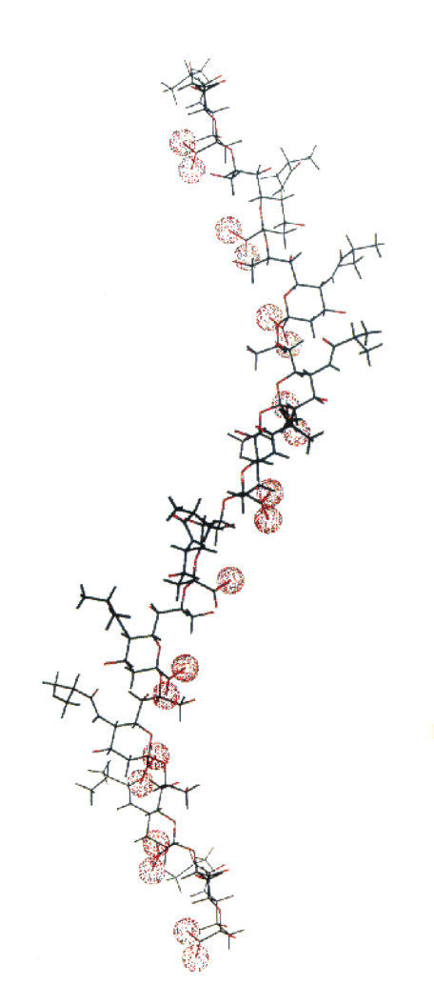
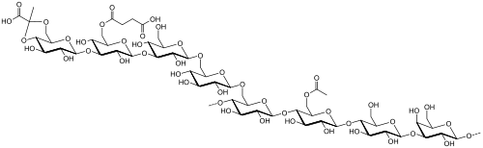
Heterologous OMV Vaccines: glycosylated omvs (glycomvs)
What surface glycans have been successfully used with this approach?
  O-antigen polysaccharide (O-PS)
  Capsular polysaccharides (CPS)
  Exopolysaccharides
  Glycans present in N- and O-glycoproteins
  Polysialic acid (PolySia) (*human glycan)
  Thomsen-Friedenreich antigen (*human glycan)
Significance of approach?
  Ultimately allows for OMVs to display hybrid LPS, which can modulate toxicity and vaccine effectiveness across a variety of disease targets.
    “designer glycotopes” displayed on lipid A -> enhances adjuvant function
Succinoglycan (an exopolysaccharide)
PolySia

Slide 29
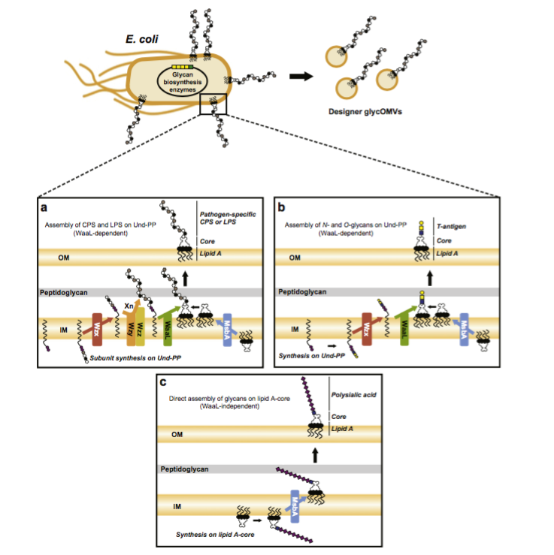
Fig. 4
Notes:
MsbA = Lipid A export ATP binding/permease protein

Slide 30
Outline
Introduction
OMV Types and OMV Production
OMV Detoxification
Heterologous OMV Vaccines
Current adjuvants used in OMV vaccines
Routes of Administration
Conclusions

Slide 31
Current adjuvants used in omv vaccines
Why do adjuvants have to be used in combination with OMVs?
  OMVs are adjuvants: however, if OMVs contain modified LPS or reduced endotoxin amounts, adjuvants are required to stimulate/enhance TLR4–mediated immunity.
What types of adjuvants have been used in OMV vaccines?
  Mineral Salts:
    Aluminum hydroxide
    Aluminum phosphate
  CpG oligodeoxynucleotides
    Mimics bacterial ummethylated CpG motifs, which are commonly found in bacterial DNA but rarely in eukaryotic DNA

Slide 32
Current adjuvants used in omv vaccines: proposed mechanisms of mineral salts
Proposed Mechanism #1: “The Depot Effect”
  Slow release of antigens following adsorbtion to aluminum salt surface -> allows for sustained antibody production
  Mechanism has lost popularity after reports that removal of alum depot did not alter immune response in homozygous DO11.10x4get mice
Proposed Mechanism #2 **most supported
  Antigen adsorbtion to aluminum salt surface -> induces inflammation via recruitment and activation of APCs -> activates NOD-like receptors (not TLRs)
Proposed Mechanism #3
  Antigen adsorbtion to aluminum salt surface -> Antigens become soluble particulates -> Antigens phagocytosed by macrophages, DCs, and B cells.
Ultimate Effect of Alum Adjuvants: humoral + cell mediated-immunity

Slide 33
Outline
Introduction
OMV Types and OMV Production
OMV Detoxification
Heterologous OMV Vaccines
Current adjuvants used in OMV vaccines
Routes of Administration
Conclusions

Slide 34
Routes of administration
What immunization routes have been used for OMV vaccines in pre-clinical studies?
  Mucosal, Subcutaneous, Intraperitoneal, Intramuscular, Intradermal
What influences choice of administration route for OMV vaccines?
  Pathogen dependent
  Human convenience
  Immunogenecity factors
Takeaways
  Mucosal immunizations result in higher IgA mucosal levels compared to other routes of administration
  Immune response across vaccinated mice includes markers of both humoral immune response + markers of cell-mediated immunity
    Humoral immune response indicators: high OMV-specific IgG, IgM, or IgA titers
    Cell-mediated immune response indicators: upregulation of regulatory T cells

Slide 35
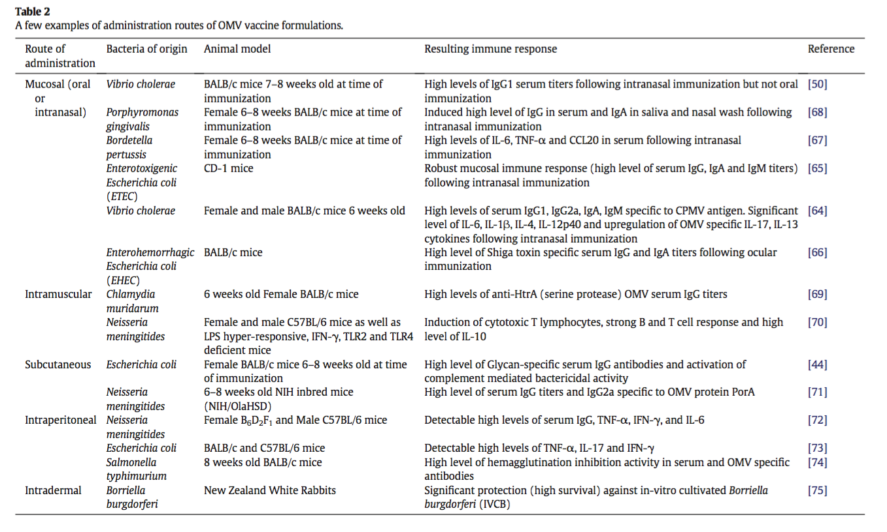

Slide 36
Outline
Introduction
OMV Types and OMV Production
OMV Detoxification
Heterologous OMV Vaccines
Current adjuvants used in OMV vaccines
Routes of Administration
Conclusions

Slide 37
conclusions
Current Progress:
  FDA approval of Bexero® in 2015
  Vaccine containing sOMVs has not yet been approved.
  Most OMVs are in small animal testing stage.
Future research needed:
  Attenuate endotoxin without completely removing it
  Produce consistent batches of sOMVs
  Expand OMVs to preventive treatment of allergies
  Explore combination treatments: couple OMV and nanoparticles to fully utilize adjuvancity and antigenic properties of OMVs for specific cell targeting

Slide 38
Comments
Progression of paper?
  Introduction.
Additional figures for clarification.
  Specifically: Section 2
Further details on classifications of OMVs.
  Differences in membrane profiles?
  Mechanisms?
Further expansion of current and future state of OMVs would have been helpful.

