Slide 1
Problems 15.7a, 15.8, 15.9, 15.10

Slide 2
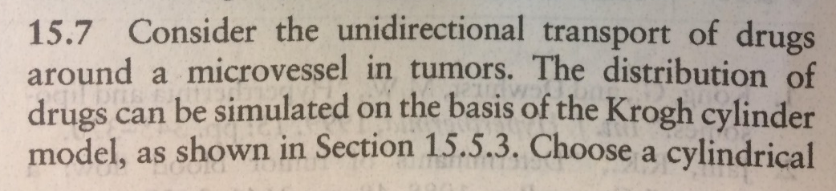
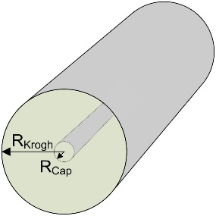
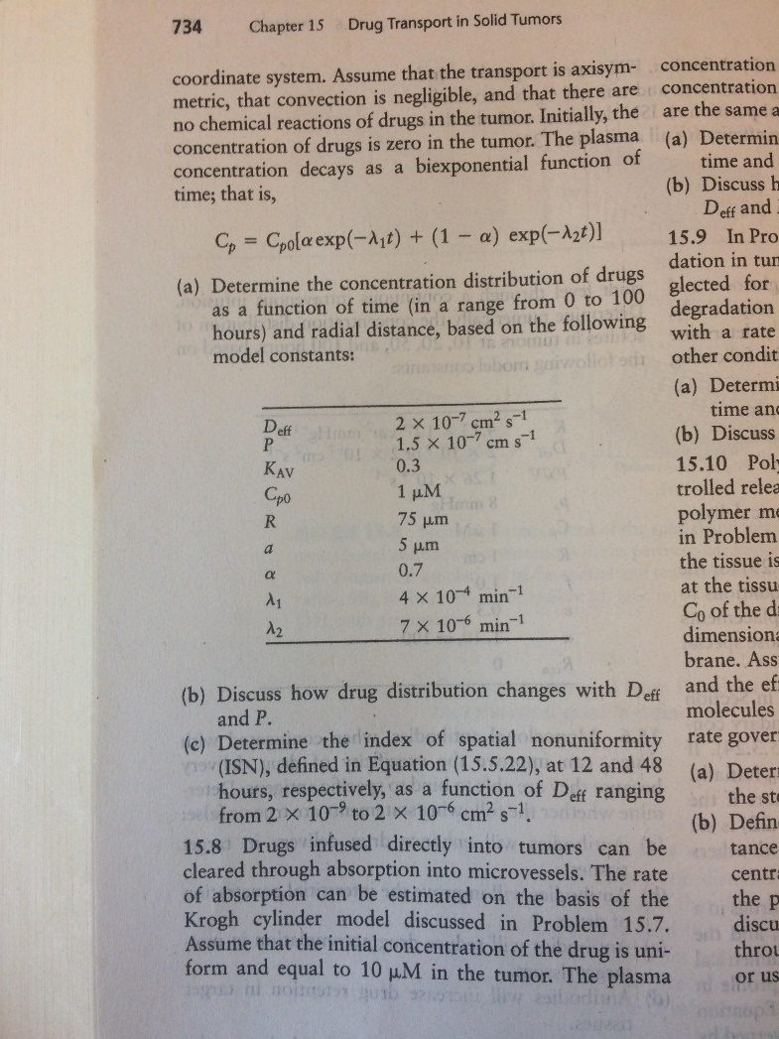
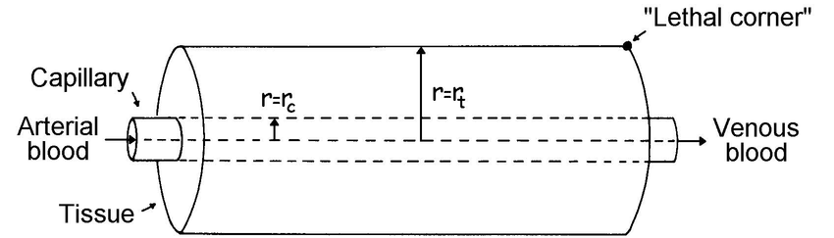
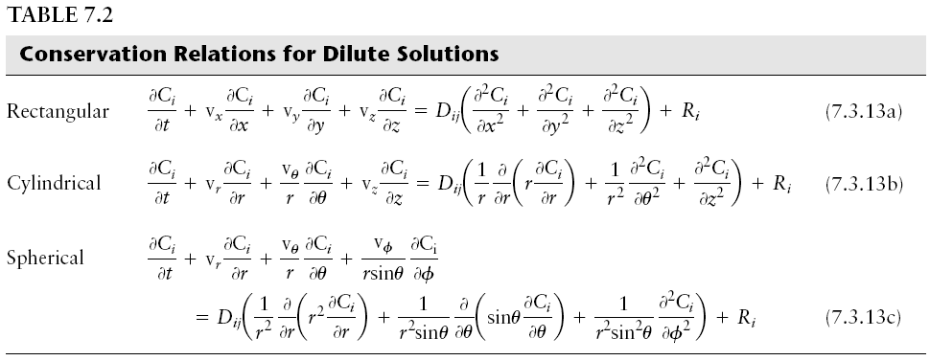
Problem 15.7a
Unrelated
Examples of
Krogh Models
Assume…
Assume…

Slide 3
Problem 15.7a
Assume convection is negligible
Assume…

Slide 4
Problem 15.7a
Assume convection is negligible
Assume no chemical reactions of drugs in the tumor

Slide 5
Problem 15.7a
Assume convection is negligible
Assume no chemical reactions of drugs in the tumor
Equation:?
r_{t}
r_{c}

Slide 6

Problem 15.7a
Assume convection is negligible
Assume no chemical reactions of drugs in the tumor
Equation:?
B.C: on vessel wall:

Slide 7


Problem 15.7a
Assume convection is negligible
Assume no chemical reactions of drugs in the tumor
Equation:?
B.C: on vessel wall:
B.C: on cylinder wall:
$$C_{p}\left(t\right)=C_{po}\left(αe^{−λ_{1}t}+\left(1−α\right)e^{−λ_{2}t}\right)$$
I.C.
$C_{p}\left(t=0\right)=$0

Slide 8
Objective: Use MatLab to solve numerically t=0:100 hr and of r up to 150 um

Slide 9
function [ output_args ] = Example5_7b( input_args )
%UNTITLED2 Summary of this function goes here
% Detailed explanation goes here
global N dr s v Deff P Kav Cp0 alpha L1 L2
%Model parameters
Deff=2e-7*60e8; %cm^2/s to um^2/min
P=1.5e-7*60e8; %cm/s to um/min
Kav=0.3;
Cp0=1; %uM
alpha = 0.7;
L1 = 4e-4; %1/min
L2 = 7e-6; %1/min
a=5; %um
R=75; %um
%Mesh definition
N=50;
dr=(R-a)/N;
drh=dr/2;
rm=a:dr:R;
r=(a+drh):dr:(R-drh);
s=zeros(N+1,1);
for i =1:N+1
s(i)=2*pi*rm(i);
end
v=zeros(N,1)
for i = 1:N
v(i) = pi*(rm(i+1)*rm(i+1)-rm(i)*rm(i));
end
c0=zeros(N,1);
tspan=[0 10 60 720 2880 6000];
[t,c]=ode15s(@func,tspan,c0);
figure;
plot(r,c(2,:),r,c(3,:),r,c(4,:),r,c(5,:),r,c(6,:));
legend('10 min','60 min','12 hr','48 hr','100 hr')
xlabel('r (\mum)','FontSize',20)
ylabel('C (\muM)','FontSize',20)
aa1=(c(4,1)*r(1)+c(4,N)*r(N))/2;
aa2=(c(5,1)*r(1)+c(5,N)*r(N))/2;
for i=2:(N-1)
aa1=aa1+c(4,i)*r(i);
aa2=aa2+c(5,i)*r(i);
end
mean12=aa1*dr*2/(R*R-a*a);
mean48=aa2*dr*2/(R*R-a*a);
aa1=0;
aa2=0;
for i =1:N
aa1=aa1+(c(4,i)-mean12)^2;
aa2=aa2+(c(5,i)-mean48)^2;
end
ISN1=sqrt(aa1)/(mean12*sqrt(N*N-1))
ISN2=sqrt(aa2)/(mean48*sqrt(N*N-1))
fid=fopen('data.txt','w');
fprintf(fid,'r,10,60,720,2880,6000/n');
for i = 1:N
fprintf(fid,'%8.4f,%8.4f,%8.4f,%8.4f,%8.4f,%8.4f\n',r(i),c(2,i),c(3,i),c(4,i),c(5,i),c(6,i));
end
fclose(fid);
function dcdt=func(t,c)
global N dr s v Deff P Kav Cp0 alpha L1 L2
Cp=Cp0*(alpha*exp(-L1*t)+(1-alpha)*exp(-L2*t));
dcdt=zeros(N,1);
dcdt(1)=1/v(1)*(P*(Cp-c(1)/Kav)*s(1)+Deff*(c(2)-c(1))/dr*s(2));
for i = 2:N-1
iu=i-1;
id=i+1;
dcdt(i)=1/v(i)*(Deff*(c(iu)-c(i))/dr*s(i)+Deff*(c(id)-c(i))/dr*s(id));
end
dcdt(N)=1/v(N)*(Deff*(c(N-1)-c(N))/dr*s(N));

Slide 10
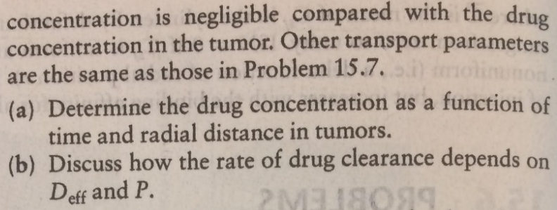
B.C. 1
B.C. 2
Assume the concentration of drug in plasma is negligible to that in tissue…
I.C.: Concentration in tumor:

Slide 11
Via numerical analysis

Slide 12
function [ output_args ] = Example5_8( input_args )
global N dr s v Deff P Kav
%Model parameters
Deff=2e-7*60e8; %cm^2/s to um^2/min
P=1.5e-7*60e8; %cm/s to um/min
Kav=0.3;
c_init=10; %uM
a=5; %um
R=150; %um
%Mesh definition
N=50;
dr=(R-a)/N;
drh=dr/2;
rm=a:dr:R;
r=(a+drh):dr:(R-drh);
s=zeros(N+1,1);
for i =1:N+1
s(i)=2*pi*rm(i);
end
v=zeros(N,1)
for i = 1:N
v(i) = pi*(rm(i+1)*rm(i+1)-rm(i)*rm(i));
end
c0=zeros(N,1);
for i=1:N
c0(i)=c_init;
tspan=[0 10 20 60 120 600];
[t,c]=ode15s(@func,tspan,c0);
end
figure;
plot(r,c(2,:),r,c(3,:),r,c(4,:),r,c(5,:),r,c(6,:));
legend('10 min','60 min','12 hr','48 hr','100 hr','Location','northwest')
xlabel('r (\mum)','FontSize',20)
ylabel('C (\muM)','FontSize',20)
fid=fopen('data.txt','w');
fprintf(fid,'r,10,20,60,120,600\n');
for i = 1:N
fprintf(fid,'%8.4f,%8.4f,%8.4f,%8.4f,%8.4f,%8.4f\n',r(i),c(2,i),c(3,i),c(4,i),c(5,i),c(6,i));
end
fclose(fid);
function dcdt=func(t,c)
global N dr s v Deff P Kav
dcdt=zeros(N,1);
dcdt(1)=1/v(1)*(-P*c(1)/Kav*s(1)+Deff*(c(2)-c(1))/dr*s(2));
for i = 2:N-1
iu=i-1;
id=i+1;
dcdt(i)=1/v(i)*(Deff*(c(iu)-c(i))/dr*s(i)+Deff*(c(id)-c(i))/dr*s(id));
end
dcdt(N)=1/v(N)*(Deff*(c(N-1)-c(N))/dr*s(N));

Slide 13
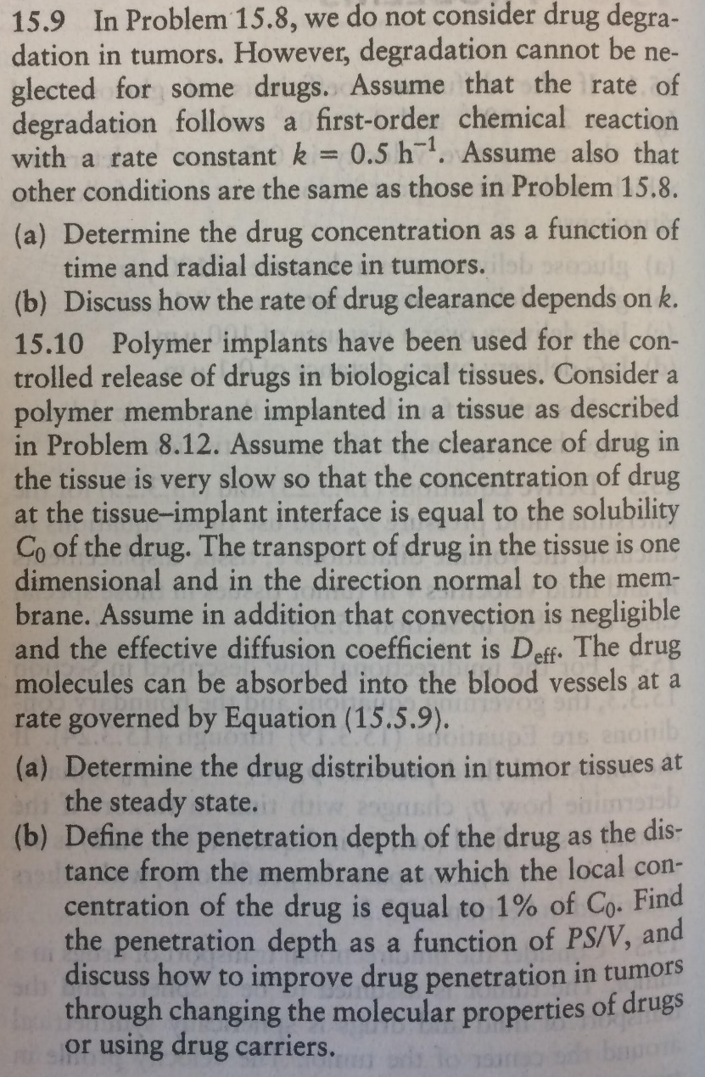
B.C. 1
B.C. 2
Assume the concentration of drug in plasma is negligible to that in tissue…
I.C.: Concentration in tumor:

Slide 14
function [ output_args ] = Example5_8( input_args )
global N dr s v Deff P Kav
%Model parameters
Deff=2e-7*60e8; %cm^2/s to um^2/min
P=1.5e-7*60e8; %cm/s to um/min
Kav=0.3;
c_init=10; %uM
a=5; %um
R=150; %um
%Mesh definition
N=50;
dr=(R-a)/N;
drh=dr/2;
rm=a:dr:R;
r=(a+drh):dr:(R-drh);
s=zeros(N+1,1);
for i =1:N+1
s(i)=2*pi*rm(i);
end
v=zeros(N,1)
for i = 1:N
v(i) = pi*(rm(i+1)*rm(i+1)-rm(i)*rm(i));
end
c0=zeros(N,1);
for i=1:N
c0(i)=c_init;
tspan=[0 10 20 60 120 600];
[t,c]=ode15s(@func,tspan,c0);
end
figure;
plot(r,c(2,:),r,c(3,:),r,c(4,:),r,c(5,:),r,c(6,:));
legend('10 min','60 min','12 hr','48 hr','100 hr','Location','northwest')
xlabel('r (\mum)','FontSize',20)
ylabel('C (\muM)','FontSize',20)
fid=fopen('data.txt','w');
fprintf(fid,'r,10,20,60,120,600\n');
for i = 1:N
fprintf(fid,'%8.4f,%8.4f,%8.4f,%8.4f,%8.4f,%8.4f\n',r(i),c(2,i),c(3,i),c(4,i),c(5,i),c(6,i));
end
fclose(fid);
function dcdt=func(t,c)
global N dr s v Deff P Kav
dcdt=zeros(N,1);
dcdt(1)=1/v(1)*(-P*c(1)/Kav*s(1)+Deff*(c(2)-c(1))/dr*s(2));
for i = 2:N-1
iu=i-1;
id=i+1;
dcdt(i)=1/v(i)*(Deff*(c(iu)-c(i))/dr*s(i)+Deff*(c(id)-c(i))/dr*s(id));
end
dcdt(N)=1/v(N)*(Deff*(c(N-1)-c(N))/dr*s(N));
What should we modify?

Slide 15
function [ output_args ] = Example5_8( input_args )
global N dr s v Deff P Kav
for k=0:5/60:50/60
%Model parameters
Deff=2e-7*60e8; %cm^2/s to um^2/min
P=1.5e-7*60e8; %cm/s to um/min
Kav=0.3;
c_init=10; %uM
a=5; %um
R=150; %um
%Mesh definition
N=50;
dr=(R-a)/N;
drh=dr/2;
rm=a:dr:R;
r=(a+drh):dr:(R-drh);
s=zeros(N+1,1);
for i =1:N+1
s(i)=2*pi*rm(i);
end
v=zeros(N,1)
for i = 1:N
v(i) = pi*(rm(i+1)*rm(i+1)-rm(i)*rm(i));
end
c0=zeros(N,1);
for i=1:N
c0(i)=c_init;
tspan=[0 10 20 60 120 600];
[t,c]=ode15s(@func,tspan,c0);
end
figure;
plot(r,c(2,:),r,c(3,:),r,c(4,:),r,c(5,:),r,c(6,:));
legend('10 min','60 min','12 hr','48 hr','100 hr','Location','northwest')
xlabel('r (\mum)','FontSize',20)
ylabel('C (\muM)','FontSize',20)
fid=fopen('data.txt','w');
fprintf(fid,'r,10,20,60,120,600\n');
for i = 1:N
fprintf(fid,'%8.4f,%8.4f,%8.4f,%8.4f,%8.4f,%8.4f\n',r(i),c(2,i),c(3,i),c(4,i),c(5,i),c(6,i));
end
fclose(fid);
end
function dcdt=func(t,c)
global N dr s v Deff P Kav
dcdt=zeros(N,1);
dcdt(1)=1/v(1)*(-P*c(1)/Kav*s(1)+Deff*(c(2)-c(1))/dr*s(2))-k*c(1);
for i = 2:N-1
iu=i-1;
id=i+1;
dcdt(i)=1/v(i)*(Deff*(c(iu)-c(i))/dr*s(i)+Deff*(c(id)-c(i))/dr*s(id)) -k*c(i);
end
dcdt(N)=1/v(N)*(Deff*(c(N-1)-c(N))/dr*s(N)) -k*c(N);

Slide 16
