Slide 1
Dr. Corey J. Bishop Assistant Professor of Biomedical Engineering Principal Investigator of the Pharmacoengineering Laboratory: pharmacoengineering.com Dwight Look College of Engineering Texas A&M University Emerging Technologies Building Room 5016 College Station, TX 77843 cbishop@tamu.edu
BMOLE 452-689 – Transport
Chapter 8. Transport in Porous Media
Text Book: Transport Phenomena in Biological Systems
Authors: Truskey, Yuan, Katz
Focus on what is presented in class and problems…
If I have seen further than other… was this humble or sticking it to them?

Slide 2
Describing Porosity, Tortuosity, and Available Volume Fraction to Characterize Porous Materials
Chapter 8, Section 2

Slide 3
Interface: border between solid and void spaces
$$Specific Surface=s=\frac{Total interface area}{Total volume}$$
Units = $\frac{1}{length}$
$$Porosity=ε=\frac{Void volume}{Total volume}$$
$ε$is dimensionless
Void volume: total volume of void space in a porous medium
To give you an idea of values:
If total volume is based on interstitial space: $ε$ is generally > 0.9
If $ε$ is generally < 0.30, cells and vessels should be considered
Note: In some tumors, $ε$ is as high as 0.6
Notes:
Example 8.1 is a simple example of calculating s and $ε$

Slide 4
Porosity ($ε$)
$$Porosity=ε=\frac{Void volume}{Total volume}$$
Context: porous medium
Does not provide information on how pores are connected or number of pores available for water and solute transport
$$ε=εi+εp+εn$$
Note: isolated pores are not accessible to external solvents and solutes: They can sometimes be considered part of the solid phase.

Slide 5
Tortuosity (T)
L_{min} is the shortest path length
L is the straight-line distance between A and B
$$T={\left(\frac{L_{min}}{L}\right)}^{2}$$
T is always greater than or equal to unity

Slide 6
Available Volume Fraction ($K_{AV}$)
Available Volume: portion of accessible volume that can be occupied by the solute.
Not all penetrable pores are accessible to solutes
$$K_{AV}=\frac{Available volume}{Total volume}$$

Slide 7
$$K_{AV}=\frac{Available volume}{Total volume}$$
$K_{AV}$ is molecule dependent and always smaller than porosity.
This can be caused by 3 scenarios:
1) Centers of the solute molecules cannot reach the solid surface in the void space
Difference between total void volume and the available volume can be estimated as
the product of the area of the surface and distance (∆) between solute and surface
2) Some of the void space is smaller than the solute molecules
3) Inaccessibility of large penetrable pores surrounded by pores smaller than the solutes
Generally, $K_{AV}$ decreases with size of solutes

Slide 8
Partition Coefficient (Φ): ratio of available volume to void volume
Measure of solute partitioning at equilibrium between external solutions and void space in porous media
$$\text{Φ}=\frac{K_{AV}}{ε}$$

Slide 9
Exclusion Volume
Some porous media are fiber matrices: space inside and near surface of fibers not available to solutes
Exclusion Volume: size of the space
$$Exclusion volume= π{\left(r_{f}+r_{s}\right)}^{2}L$$
r_{f} and r_{s} are the radii of the fiber and solute
L is the length of the fiber
N is the number of the fibers
If minimum distance between fibers is larger than 2($r_{f}+r_{s}$), such as when fiber density
is very low or when fibers are parallel:
$$Exclusion volume fraction=\frac{π{(r_{f}+r_{s})}^{2}LN}{V}=θ{\left(\frac{r_{s}}{r_{f}}+1\right)}^{2}$$
θ is the volume fraction of fibers ($ε$=1- θ when θ is much less than unity)
$$K_{AV}=1−exclusion volume fraction=1−θ{\left(\frac{r_{s}}{r_{f}}+1\right)}^{2}$$

Slide 10
When $θ{\left(1+\frac{r_{s}}{r_{f}}\right)}^{2}$ is much less than unity, Ogston Equation (eq. 8.2.24 in book) reduces to previous equation.
Porosity can be derived from the Ogston Equation by letting r_{s}=0
$$ε=exp⁡[−θ]$$
When θ is much less than unity:
$$ε=1−θ$$
Partition coefficient of solutes in liquid phase of fiber-matrix material:
$$Φ=\frac{\exp\left[−θ{\left(1+\left(\frac{r_{s}}{r_{f}}\right)\right)}^{2}\right]}{1−θ}$$

Slide 11
Darcy’s Law

Slide 12
Darcy’s Law
Flow rate is proportional to pressure gradient so rate = constant *grad(p)
Valid in many porous media
NOT valid for:
Non-Newtonian fluids (what is a Newtonian fluid?)
Newtonian liquids at high velocities
Gasses at very low and high velocities

Slide 13
Darcy’s Law
Describing fluid flow in porous media
Two Ways:
Numerically solve governing equations for fluid flow in individual pores if structure is known
Assume porous medium is a uniform material (Continuum Approach)

Slide 14
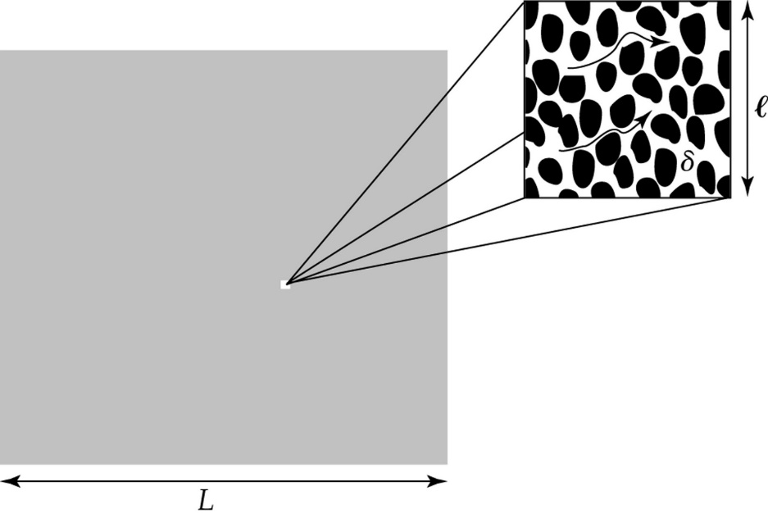
Three Length Scales
$δ=average size of pores$
L = distance which macroscopic changes of physical quantities must be considered (ie. Fluid velocity and pressure)
$l⇒$a small volume with dimension $l3$
Continuum Approach Requires:
$δ$ << $l$₀ << L

Slide 15
Darcy’s Law
$l$₀ = Representative Elementary Volume from $l$₀³ (REV)
$l$₀ << L
Total volume of REV can give the averaging over a volume value
V_{f} = fluid velocity of each fluid particle averaged in the volume of the fluid phase
V = velocity of each fluid particle averaged in the REV
V = $ε$V_{f}

Slide 16
Darcy’s Law
Law of Mass Conservation
No Fluid Production = “Source”
Fluid Consumption = “Sink”
Mass Balance with velocities
$∇ ∗v= φ$_{B} - $φ$_{L}
$∇ ∗ℰ\text{v}\text{f}= φ$_{B} - $φ$_{L}
Determined by Starling’s Law (more in chapter 9)
$φ$_{B} = volumetric flow from sources (units?)
$φ$_{L} = volumetric flow from sinks (L=lymphatic drainage)
If volume of the system is not changing or if the flow in and flow out are balanced then?

Slide 17
Darcy’s Law
Momentum Balance in Porous Media
v = -K $∇p$
$∇p=gradient of hydrostatic pressure$
K = hydraulic conductivity constant
p = average quantity within the fluid phase in the REV

Slide 18
Darcy’s Law
Substituting the Equations to form:
$∇ ∗(\text{−}\text{K} ∇p)= φ$_{B} - $φ$_{L}
Steady State:
$∇$² * p = 0

Slide 19
Brinkman Equation

Slide 20
Brinkman Equation
$k=Kμ$
k is the specific hydraulic permeability (usually units of nm²)
Darcy’s law is used when k is low: when k is much smaller than the square of L
When k is not low: Brinkman Equation
$Brinkman Equation:$
$μ∇^{2}V−\frac{1}{K}V−∇p$=0
Darcy’s Law is a special case of this equation when the first term = 0 ($V=−K∇p$)

Slide 21
The beginning of example 8.7

Slide 22
Ex 8.7

Slide 23
Ex 8.7
Flow is unidirectional in the channel and is governed by:
Mass balance
Brinkman equations
$μ∇^{2}V−\frac{1}{K}V−∇p$=0; $k=Kμ$

Slide 24
Ex 8.7
Flow is unidirectional in the channel and is governed by:
Mass balance
Brinkman equations
$μ∇^{2}V−\frac{1}{K}V−∇p$=0; $k=Kμ$
$μ∇^{2}V−\frac{μ}{k}V−∇p$=0

Slide 25
Ex 8.7
Flow is unidirectional in the channel and is governed by:
Mass balance
Brinkman equations
$μ∇^{2}V−\frac{1}{K}V−∇p$=0; $k=Kμ$
$μ∇^{2}V−\frac{μ}{k}V−∇p$=0
$$\frac{μ∇^{2}}{μ}V−\frac{μ}{kμ}V−\frac{∇p}{μ}=\frac{0}{μ}$$

Slide 26
Ex 8.7
Flow is unidirectional in the channel and is governed by:
Mass balance
Brinkman equations
$μ∇^{2}V−\frac{1}{K}V−∇p$=0; $k=Kμ$
$μ∇^{2}V−\frac{μ}{k}V−∇p$=0
$$\frac{μ∇^{2}}{μ}V−\frac{μ}{kμ}V−\frac{∇p}{μ}=\frac{0}{μ}$$
$$∇^{2}V−\frac{V}{k}=\frac{∇p}{μ}$$

Slide 27
Ex 8.7
Flow is unidirectional in the channel and is governed by:
Mass balance
Brinkman equations
$μ∇^{2}V−\frac{1}{K}V−∇p$=0; $k=Kμ$
$μ∇^{2}V−\frac{μ}{k}V−∇p$=0
$$\frac{μ∇^{2}}{μ}V−\frac{μ}{kμ}V−\frac{∇p}{μ}=\frac{0}{μ}$$
$$∇^{2}V−\frac{V}{k}=\frac{∇p}{μ}$$
$$∇^{2}V_{x}−\frac{V_{x}}{k}=\frac{∇p}{μ}=V_{x}^{′′}−\frac{V_{x}}{k}$$

Slide 28
Ex 8.7
Flow is unidirectional in the channel and is governed by:
Mass balance
Brinkman equations
$$\frac{∇p}{μ}=V_{x}^{′′}−\frac{V_{x}}{k}$$
$μ∇^{2}V−\frac{1}{K}V−∇p$=0; $k=Kμ$
$μ∇^{2}V−\frac{μ}{k}V−∇p$=0
$$\frac{μ∇^{2}}{μ}V−\frac{μ}{kμ}V−\frac{∇p}{μ}=\frac{0}{μ}$$
$$∇^{2}V−\frac{V}{k}=\frac{∇p}{μ}$$
$$∇^{2}V_{x}−\frac{V_{x}}{k}=\frac{∇p}{μ}=V_{x}^{′′}−\frac{V_{x}}{k}$$
How?

Slide 29
Solving for Example 8.7

Slide 30
Consider using
Laplace
Undetermined coefficients

Slide 31
Laplace Transformation

Slide 32
http://tutorial.math.lamar.edu/Classes/DE/Laplace_Table.aspx

Slide 33
Laplace gives you both the homog. and particular solns.

Slide 34
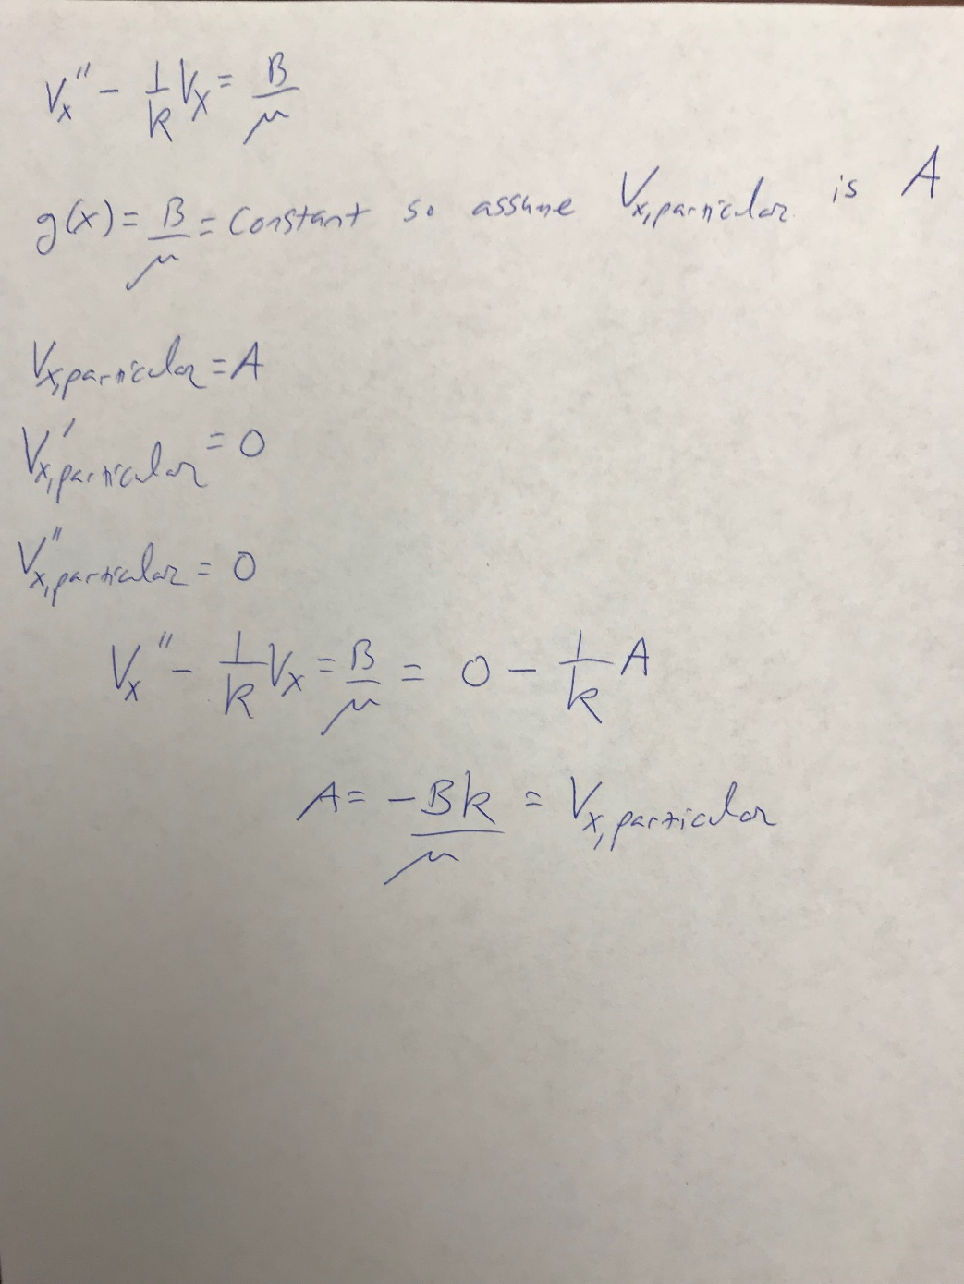
Undetermined Coefficients
This method is only for calculating the particular solution

Slide 35
This is the end of example 8.7

Slide 36
Squeeze Flow
Squeeze flow is the fluid flow caused by the relative movement of solid boundaries towards each other
Tissue deformation causes change in volume fraction of the interstitial space
Leads to fluid flow

Slide 37
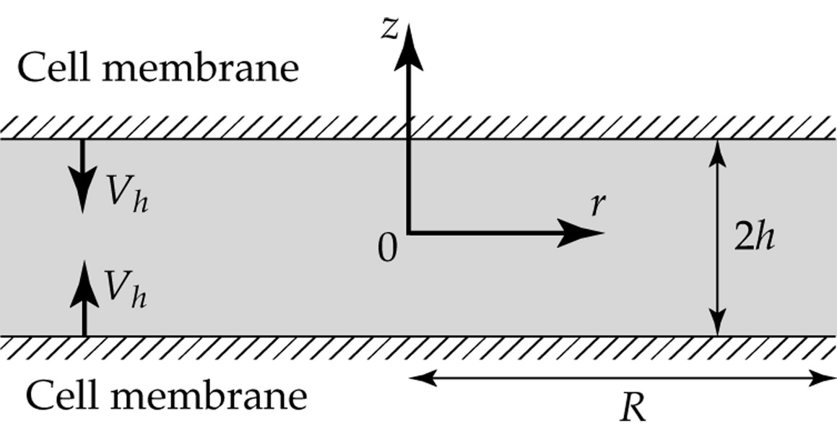
Squeeze Flow
These equations will be more useful and will make more sense in later discussions The derivation of them is in 8.3.3
Velocity profiles:
Vh is the velocity of cell membrane movement
R is the radius of the plate
z and r are cylindrical coordinates
Vr is velocity in the r direction
Vz is velocity in the z direction

Slide 38
8.4 Solute Transport in Porous Media
8.4.1-8.4.2

Slide 39
8.4.1 General Considerations
Solute Transport in Porous Media

Slide 40
8.4.1 General Considerations
There are 4 general problems using the continuum approach(Darcy’s Law) for analyzing transport of solutes through porous media
1)$D_{eff}$
1)𝐷_𝑒𝑓𝑓
2) Solute velocity
3) Dispersion
4) Boundary Conditions

Slide 41
1) $D_{eff}$
Diffusion of solutes is characterized by the effective diffusion coefficient: $D_{eff}$
$D_{eff}$ in porous media < $D_{eff}$ in solutions
Why?...

Slide 42
1) $D_{eff}$ cont.
Factor effecting Diffusion in Porous Media:
Connectedness of Pores
$$D_{eff}$$
Layer 100
Layer 1
1 100
Layer #
As we near layer 100, available space for diffusion and $D_{eff}$ decrease exponentially

Slide 43
2) Solute Velocity
Convective velocities $≠$ Solvent velocities
Solutes are hindered by porous structures
Ex: filtering coffee grounds $f= \frac{v_{s}}{v_{f}}$ = $\frac{solute velocity }{solvent velocity }$
$f$is retardation coefficient

Slide 44
2) Solvent Velocity cont.
$σ=1−f$ : reflection coefficient
Characterizes the hindrance of convective transport across a membrane
$f is dependent on:$
Fluid velocity
Solute size
Pore Structure
Flux of Convective transport across tissue: $N_{s}= v_{s}C=fv_{f}C$
Where $v_{s}$is solute velocity and $C is local concentration of solutes$

Slide 45
3) Dispersion of Solutes

Slide 46
4) Boundary Conditions
Concentrations of solutes can be discontinuous at interfases between solutions and porous media
Thus, for two regions, 1 and 2 $N_{1 }= N_{2}$ and $\frac{C_{1}}{K_{AA1}}= \frac{C_{2}}{K_{AA2}}$
N = flux
$K_{AA}=$ area fraction available at interphase for solute transport

Slide 47
When all 4 are considered…
Governing Equation for Transport of neutral molecule through porous media:
$$\frac{∂C}{∂t}+ ∇\left(fv_{f}C\right)= D_{eff}∇^{2}C+ φ_{B}−φ_{L}+Q$$
Flux of Convective Transport
Isotropic, uniform and dispersion coefficient is negligible
Solute vel.
Reaction
If we do consider dispersion coefficient: Deff = Deff + Disp. Coeff.

Slide 48
Governing Equation cont.
$$\frac{∂C}{∂t}+ ∇\left(fv_{f}C\right)= D_{eff}∇^{2}C+ φ_{B}−φ_{L}+Q$$
$$C, φ_{B}, φ_{L}, Q: \frac{avg. quantity}{unit tissue volume}$$
$$f, v_{f}, D_{eff}: \frac{avg. quantity}{unit volume of fluid phase}$$

Slide 49
8.4.2 Effective Diffusion Coefficient in Hydrogels
3 Factors effecting $D_{eff}$ of uncharged solutes in hydrogels:
1) Diffusion coefficient of solutes in WATER ${(D}_{0})$
2) Hydrodynamic Interactions between solute and surrounding solvent molecules, F
3) Tortuosity of diffusion pathways due to the steric exclusion of solutes in the matrix, S $D_{eff}= D_{0}FS$ So, how do we solve for F and S?

Slide 50
Hydrodynamic Interactions, F
F is a ratio:
$$F= \frac{friction coeff. of solute in porous media}{friction coeff. of solute in water}$$
F measures the enhancement of drag on solute molecule due to presence of polymeric fibers in water
$→$Friction coeff. in water = $6πμr_{s}$
$$μ=viscocity$$
$r_{s}=radius of molecule$

Slide 51
Hydrodynamic Interactions, F cont.
1) Effective-medium or Brinkman-medium
2) 3-D space with cylindrical fibers model
Two approaches to determining F:

Slide 52
1) Effective-Medium or Brinkman-Medium
Assumptions:
Hydrogel is a uniform medium
Spherical solute molecule
Constant velocity
Movement governed by Brinkman Equation $F= {\left[1+\frac{r_{s}}{\sqrt{k}}+\frac{1}{9}{\left(\frac{r_{s}}{\sqrt{k}}\right)}^{2}\right]}^{−1}$ where $φ_{B}= φ_{L}=0$

Slide 53
2) 3-D space with cylindrical fibers model
Assumptions:
Hydrogel is modeled as 3-D spaces filled with water and randomly placed cylindrical fibers
Movement of spherical particles is determined by Stokes-Einstein Equation $F\left(α,θ\right)=exp⁡(−a_{1}θ^{a_{2}})$ pg. 426 $→$done after normalization of $6πμr_{s}$

Slide 54
2) 3-D space with cylindrical fibers model cont.
$F\left(α,θ\right)=exp⁡(−a_{1}θ^{a_{2}})$
Depends on:
$α= \frac{fiber radii}{solute radii}$
$θ= \frac{fiber volume}{hydrogel volume}$
Where: $a_{1}=3.272 −2.460α+0.822α^{2}$ $a_{2}=0.358+0.366α−0.0939α^{2}$

Slide 55
Tortuosity Factor, S
Depends on $f_{a}$ $f_{a}={(1+\frac{1}{α})}^{2}$
$f_{a}$ is the excluded volume fraction of solute in hydrogel if:
Low fiber density
Fibers arranged in parallel manner
If $f_{a}<0.7$ $S\left(α,θ\right)=exp\left[−0.84{f_{a}}^{1.09}\right]$

Slide 56
Effective Diffusion Coefficient: In Liquid-Filled Pore and Biological Tissue
Chapter 8: Section 4.3-4.4

Slide 57
Effective Diffusion Coefficient in a Liquid-Filled Pore
Depends on diffusion coefficient D₀ of solutes in water, hydrodynamic interactions between solute and solvent molecules, and steric exclusion of solutes near the walls of pores
Assume entrance effect is negligible:
v_{z} is the axial fluid velocity
v_{m} is the mean velocity in the pore
r is the radial coordinate
R is the radii of the cylinder
$$v_{z}=2v_{m}{(1−\frac{r}{R})}^{2}$$

Slide 58
Assume the volume fraction of spherical solutes is less than $\frac{2λ}{3}$
Solute-Solute interactions become negligible
When $λ$ ->0, solute-pore interactions are negligible
$$λ=\frac{a}{R}$$
a is the radii of the solute
R is the radii of the cylinder
$$N_{z}=−D_{0}\frac{∂C}{∂z}+Cv_{z}$$
N_{z} is the flux
D₀ is the diffusion coefficient
C is the solute concentration
z is the axial coordinate
$$C=\left\{\begin{aligned}C\left(z\right) 0≤r≤R−a \\ 0 R−a<r≤R\end{aligned}\right.$$

Slide 59
When $λ$ does not approach 0:
$$N_{s}=−\frac{D_{0}}{K}\frac{dC}{dz}+GCv_{z}$$
K is the enhanced friction coefficient
G is the lag coefficient
K and G are functions of $λ$ and r/R
Flux averaged over the entire cross-sectional area:
$${\overline{N}}_{s}=\frac{2}{R^{2}}\int_{0}^{R}{N_{s}rdr}$$
Integrating the top flux equation:
$${\overline{N}}_{s}=−HD_{0}\frac{dC}{dz}+WCv_{m}$$

Slide 60
H and W are called hydrodynamic resistance coefficients
$$H=\frac{2}{R^{2}}\int_{0}^{R−a}{\frac{1}{K}rdr}$$
$$W=\frac{4}{R^{2}}\int_{0}^{R−a}{G\left[1−{\left(\frac{r}{R}\right)}^{2}\right]rdr}$$
$$D_{eff}=HD_{0}$$
Centerline approximation: assume all spheres are distributed on the centerline position in the pore
For $λ<0.4$:
$$K^{−1}\left(λ,0\right)=1−2.1044λ+2.089λ^{3}−0.948λ^{5}$$
$$G\left(λ,0\right)=1−\frac{2}{3}λ^{2}−0.163λ^{3}$$

Slide 61
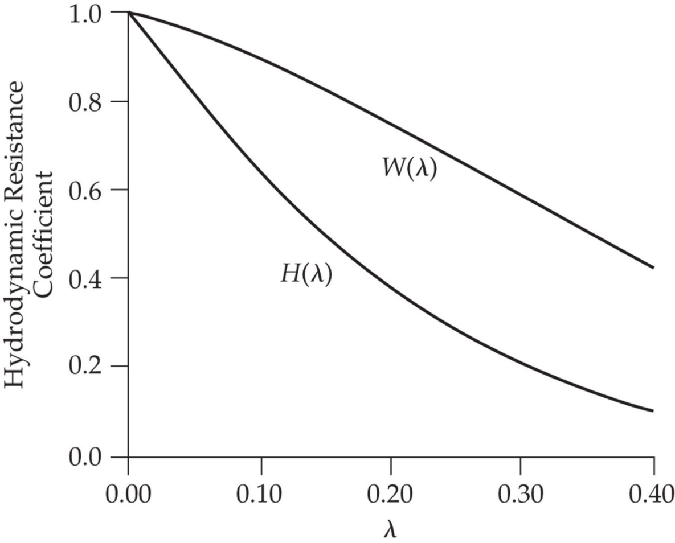
$$H\left(λ\right)=Φ\left(1−2.1044λ+2.089λ^{3}−0.948λ^{5}\right)$$
$$W\left(λ\right)=Φ\left(2−Φ\right)\left(1−\frac{2}{3}λ^{2}−0.163λ^{3}\right)$$
Partition coefficient of solute in the pore:
$$Φ={\left(1−λ\right)}^{2}$$
For $λ>0.4$:

Slide 62
Diffusion of spherical molecules between parallel plates:
$${\overline{N}}_{s}=−HD_{0}\frac{dC}{dz}+WCv_{m}$$
$${\overline{N}}_{s}=\frac{1}{h}\int_{0}^{h}{N_{s}dy}$$
$$H=\frac{1}{h}\int_{0}^{h−a}{\frac{1}{K}dy}$$
$$W=\frac{3}{2h}\int_{0}^{h−a}{G\left[1−{\left(\frac{y}{h}\right)}^{2}\right]dy}$$
h is the half-width of the slit
$$D_{eff}=HD_{0}$$
K and G depend on $λ$ and y/h
$$H\left(λ\right)=Φ\left[1−1.004λ+0.418λ^{3}+0.21λ^{4}−0.169λ^{5}+Oλ^{6}\right]$$
$$Φ=1−λ$$
$$W\left(λ\right)=\frac{Φ}{2}\left(3−Φ^{2}\right)\left[1−\frac{1}{3}λ^{2}+Oλ^{3}\right]$$

Slide 63
Effective Diffusion Coefficient in Biological Tissues
$$D_{eff}=b_{1}{\left(M_{r}\right)}^{−b_{2}}$$
M_{r} is the molecular weight of the solutes
b₁ and b₂ are functions of charge and shape of solutes, and structures of tissues
The effects of tissue structures on D_{eff} increases with the size of solutes

Slide 64
Fluid Transport in Poroelastic Materials
Section 8.5

Slide 65
Biological Tissues:
Deformable
Deformation can be linear or nonlinear
"Extreme softness of brain matter in simple shear"”
Notes:
https://www.youtube.com/watch?v=qp7DdJfECXg
http://www.umich.edu/~bme332/ch8poroelasticity/bme332consteqporoelasticity.htm
http://web.mit.edu/16.20/homepage/3_Constitutive/Constitutive_files/module_3_no_solutions.pdf
http://www.brown.edu/Departments/Engineering/Courses/En221/Notes/Tensors/Tensors.htm
http://clas.sa.ucsb.edu/staff/alex/VCFAQ/GDC/GDC.htm

Slide 66
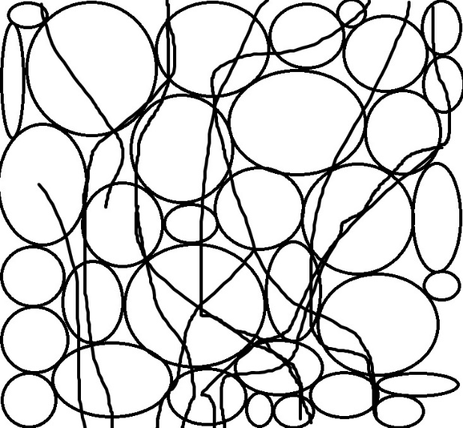
Poroelastic Response
$$σ_{yy}$$
$$σ_{xy}$$
Porosity, ε
$$y$$
Pore Fluid Pressure, $p$
$$x$$
$$σ_{xx}$$
$$σ_{xx}$$
Total Stress = Effective Stress + Pore Pressure
$$σ_{yy}$$
$$σ= τ+pI$$

Slide 67
Understanding the linear function of Stress
If,
$$I=\left[\begin{aligned}1 0 0 \\ 0 1 0 \\ 0 0 1\end{aligned}\right]$$
then,
$σ=\left[\begin{aligned}τ_{xx}{ τ}_{xy}{ τ}_{xz} \\ τ_{yx}{ τ}_{yy}{ τ}_{yz} \\ τ_{zx}{ τ}_{zy}{ τ}_{zz}\end{aligned}\right]$ + $\left[\begin{aligned}p 0 0 \\ 0 p 0 \\ 0 0 p\end{aligned}\right]=2μ_{G}E+ μ_{λ}eI+pI$
Must be describing stresses that are NOT pore pressure related

Slide 68
Understanding the linear Function of Stress
$σ=2μ_{G}E+ μ_{λ}eI+pI$
We know this is pore pressure, and this is the only force happening INTERNALLY, right?
Then, these two terms must be describing the forces EXTERNALLY. How many external forces are there? Shear and Normal. Which term is which?
We must look at the Lamé constants…

Slide 69
LamÉ Constants
Named after French Mathematician, Gabriel Lamé
Two constants which relate stress to strain in isotropic, elastic material
Depend on the material and its temperature
$$μ_{λ}=K−2/3μ_{G}$$
$μ_{λ}$ : first parameter (related to bulk modulus)
$μ_{G}$: second parameter (related to shear modulus)
$$μ_{G}=\frac{τ}{γ}=\frac{\frac{∆F}{A}}{\frac{∆L}{L}}$$

Slide 70
Understanding the linear Function of Stress
$σ=2μ_{G}E+ μ_{λ}eI+pI$
Describes INTERNAL FORCES
Describes EXTERNAL SHEAR FORCES
Describes EXTERNAL BULK FORCES
Now we need to understand E and e…

Slide 71
Understanding the linear Function of Stress
$$E=\frac{1}{2}[∇u+{\left(∇u\right)}^{T}]$$
E = strain tensor (vector gradient)
$${(∇u)}^{T}=\left({\frac{∂u_{x}}{∂x} \atop \begin{aligned}\frac{∂u_{y}}{∂y} \\ \frac{∂u_{z}}{∂z}\end{aligned}}\right)$$
$$E=\frac{1}{2}\left[\begin{matrix}2\frac{∂u_{x}}{∂x} & \frac{∂u_{y}}{∂y}+\frac{∂u_{x}}{∂x} & \frac{∂u_{z}}{∂z}+\frac{∂u_{x}}{∂x} \\ \frac{∂u_{x}}{∂x}+\frac{∂u_{y}}{∂y} & 2\frac{∂u_{y}}{∂y} & \frac{∂u_{z}}{∂z}+\frac{∂u_{y}}{∂y} \\ \frac{∂u_{x}}{∂x}+\frac{∂u_{z}}{∂z} & \frac{∂u_{y}}{∂y}+\frac{∂u_{z}}{∂z} & 2\frac{∂u_{z}}{∂z}\end{matrix}\right]$$
$$∇u=\left(\frac{∂u_{x}}{∂x},\frac{∂u_{y}}{∂y},\frac{∂u_{z}}{∂z}\right)$$
e = volume dilation (scalar divergence)
$$e=Tr\left(E\right)=∇∙u$$
$$e=∇∙u=\frac{∂u_{x}}{∂x}+\frac{∂u_{y}}{∂y}+\frac{∂u_{z}}{∂z}$$

Slide 72
Understanding the linear Function of Stress
So now we understand this:
$σ=2μ_{G}E+ μ_{λ}eI+pI$
A scalar quantity that’s multiplied by the identify matrix to make a tensor in units of pressure
A tensor that’s in units of stress
A scalar quantity that’s multiplied by the identify matrix to make a tensor in units of stress
Now we can reduce mass conservation equations to get an equation we can use to solve problems like these! ☺

Slide 73
Deriving mass and Momentum equations
mass conservation in the fluid phase is this:
$$\frac{∂(ρ_{f}ε)}{∂t}+∇∙\left(ρ_{f}εv_{f}\right)=ρ_{f}(φ_{B}−φ_{L})$$
mass conservation in the solid phase is this:
$$\frac{∂[ρ_{s}\left(1−ε\right)]}{∂t}+∇∙\left(ρ_{s}(1−ε)\frac{∂u}{∂t} \right)=0$$

Slide 74
Deriving mass and Momentum equations
Summing the two equations together:
$$\frac{∂(ρ_{f}ε)}{∂t}+∇∙\left(ρ_{f}εv_{f}\right)−ρ_{f}\left(φ_{B}−φ_{L}\right)=\frac{∂[ρ_{s}\left(1−ε\right)]}{∂t}+∇∙\left(ρ_{s}(1−ε)\frac{∂u}{∂t} \right)$$
$$\frac{∂(ρ_{f}ε)}{∂t}+∇∙\left(ρ_{f}εv_{f}\right)−∇∙\left(ρ_{s}\left(1−ε\right)\frac{∂u}{∂t} \right)=\frac{∂\left[ρ_{s}\left(1−ε\right)\right]}{∂t}+ρ_{f}\left(φ_{B}−φ_{L}\right)$$
$$∇∙\left(\left(εv_{f}\right)−\left(\left(1−ε\right)\frac{∂u}{∂t} \right)\right)=\left(φ_{B}−φ_{L}\right)$$

Slide 75
Biot Law
According to a paper written in 1984 (that I do not have access too):
Zienkiewicz, O. C., and T. Shiomi. "Dynamic behaviour of saturated porous media; the generalized Biot formulation and its numerical solution." International journal for numerical and analytical methods in geomechanics 8.1 (1984): 71-96.
$$ε\left(\left(v_{f}\right)−\left(\frac{∂u}{∂t} \right)\right)=−K∇p$$
$$∇∙σ=0$$

Slide 76
Using BIOTS law to substitute…
$∇∙σ=μ_{G}∇^{2}u+ {(μ_{G}+μ}_{λ})∇e+∇p=0$
${(2μ_{G}+μ}_{λ})∇^{2}e=∇^{2}p$

Slide 77
If volume dilation and hydraulic conductivity are homogenous
$$ε\left(\left({∇∙v}_{f}\right)−\left(\frac{∂e}{∂t} \right)\right)=−K∇^{2}p$$
$$\frac{∂e}{∂t}=K∇^{2}p+\left(φ_{B}−φ_{L}\right)$$
$$\frac{∂e}{∂t}=K{(2μ_{G}+μ}_{λ})∇^{2}e+\left(φ_{B}−φ_{L}\right)$$
Coefficient of consolidation

