Slide 1
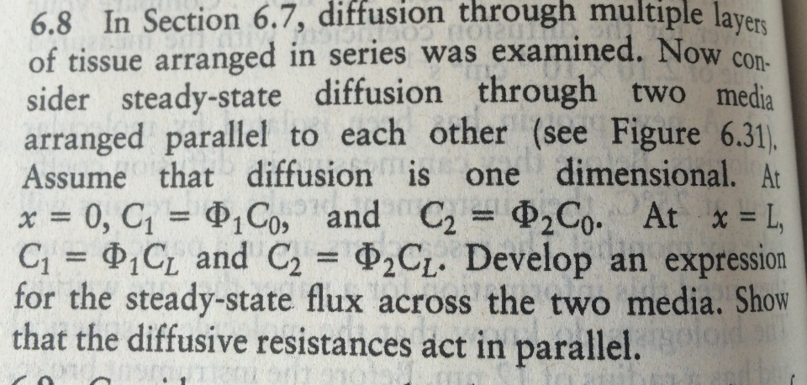
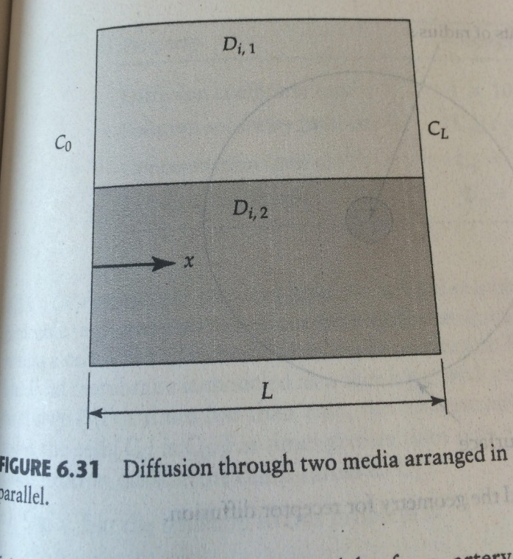
Problem 6.8
A₁
A₂
Assuming what about the concentration? It’s dilute…

Slide 2
Problem 6.8
A₁
A₁ and C₁
A₂
A₂ and C₂
What are the conservation relations for each phase?

Slide 3
Problem 6.8
A₁
A₁ and C₁
A₂
A₂ and C₂
What are the conservation relations for each phase?
What does this mean physically?

Slide 4
Problem 6.8
A₁
A₁ and C₁
A₂
A₂ and C₂
What are the conservation relations for each phase?
What does this mean physically?
C(x) changes linearly with x or C(x) = 0… when would C(x)=0?

Slide 5
Problem 6.8
A₁
A₁ and C₁
A₂
A₂ and C₂
What are the conservation relations for each phase?
What does this mean physically?
C(x) changes linearly with x or C(x) = 0… when would C(x)=0… for long time t (>5tau)
So what does this mean for our solutions of this problem in terms of C(x)?

Slide 6
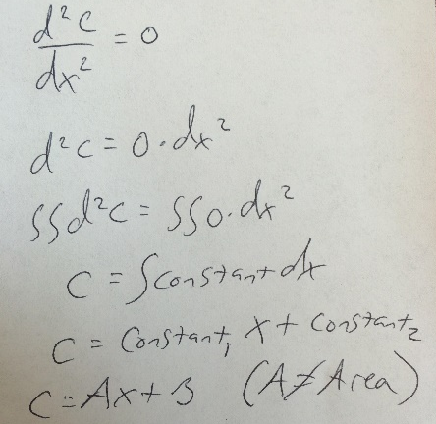
Problem 6.8
A₁
A₁ and C₁
A₂
A₂ and C₂
What are the conservation relations for each phase?
What does this mean physically?
C(x) changes linearly with x or C(x) = 0… when would C(x)=0… for long time t (>5tau)
So what does this mean for our solutions of this problem in terms of C(x)?
C₁=A₁x+B₁ and C₂=A₂x+B₂ but let’s actually show this mathematically…
Now what?

Slide 7
Problem 6.8
A₁
A₁ and C₁
A₂
A₂ and C₂
What are the conservation relations for each phase?
What does this mean physically?
C(x) changes linearly with x or C(x) = 0… when would C(x)=0… for long time t (>5tau)
So what does this mean for our solutions of this problem in terms of C(x)?
C₁=A₁x+B₁ and C₂=A₂x+B₂ but let’s actually show this mathematically…
Now what? Apply B.C.s

Slide 8
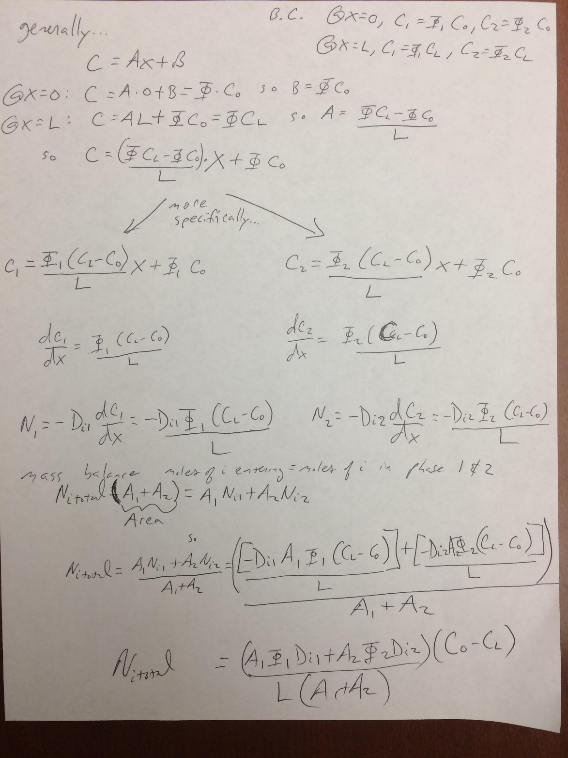
Problem 6.8
What is
Conductance of
Each phase?

Slide 9
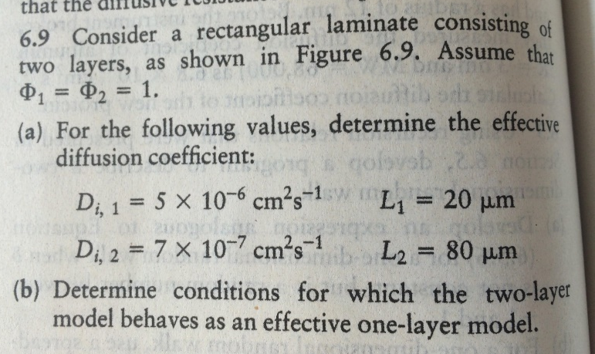
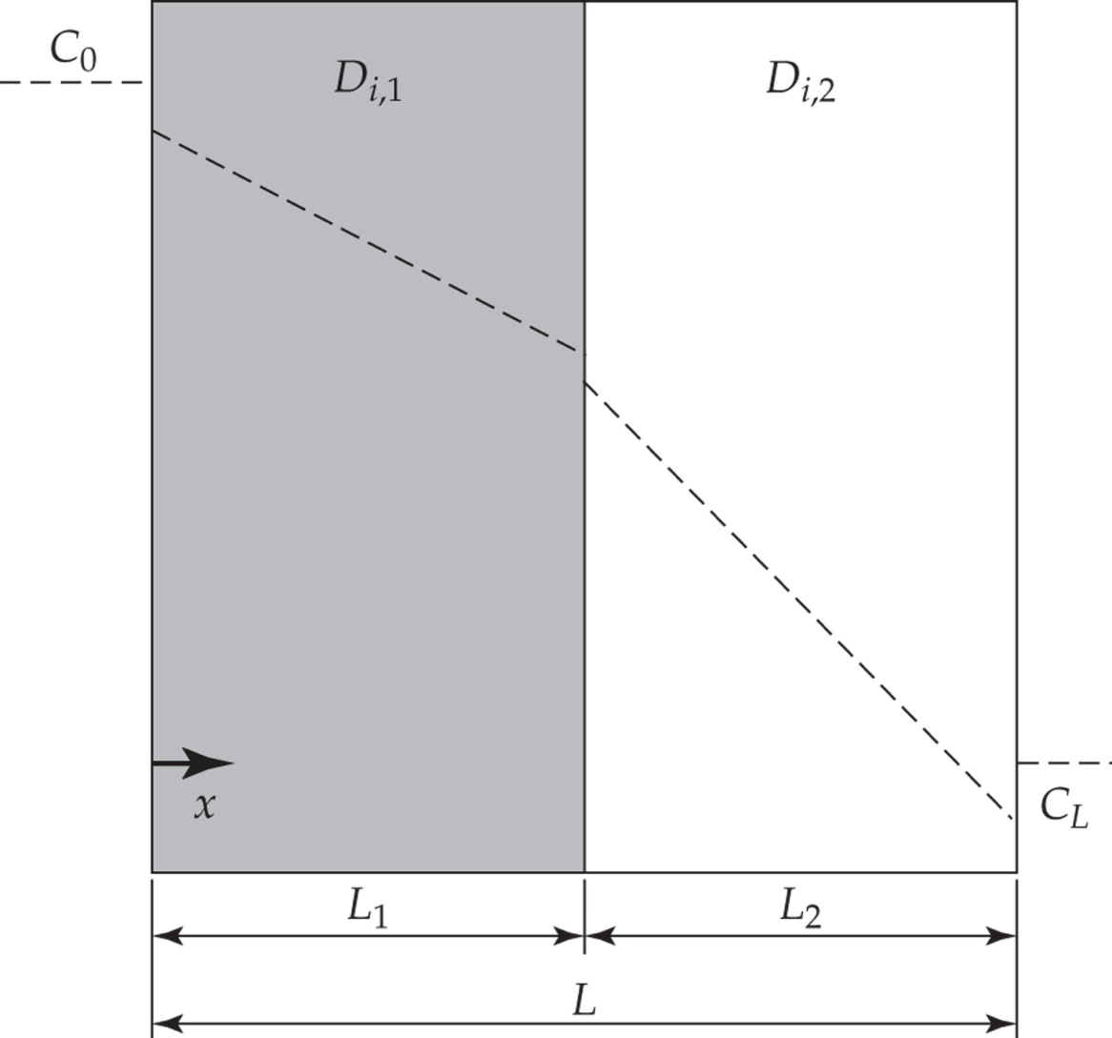
Problem 6.9
How?

Slide 10
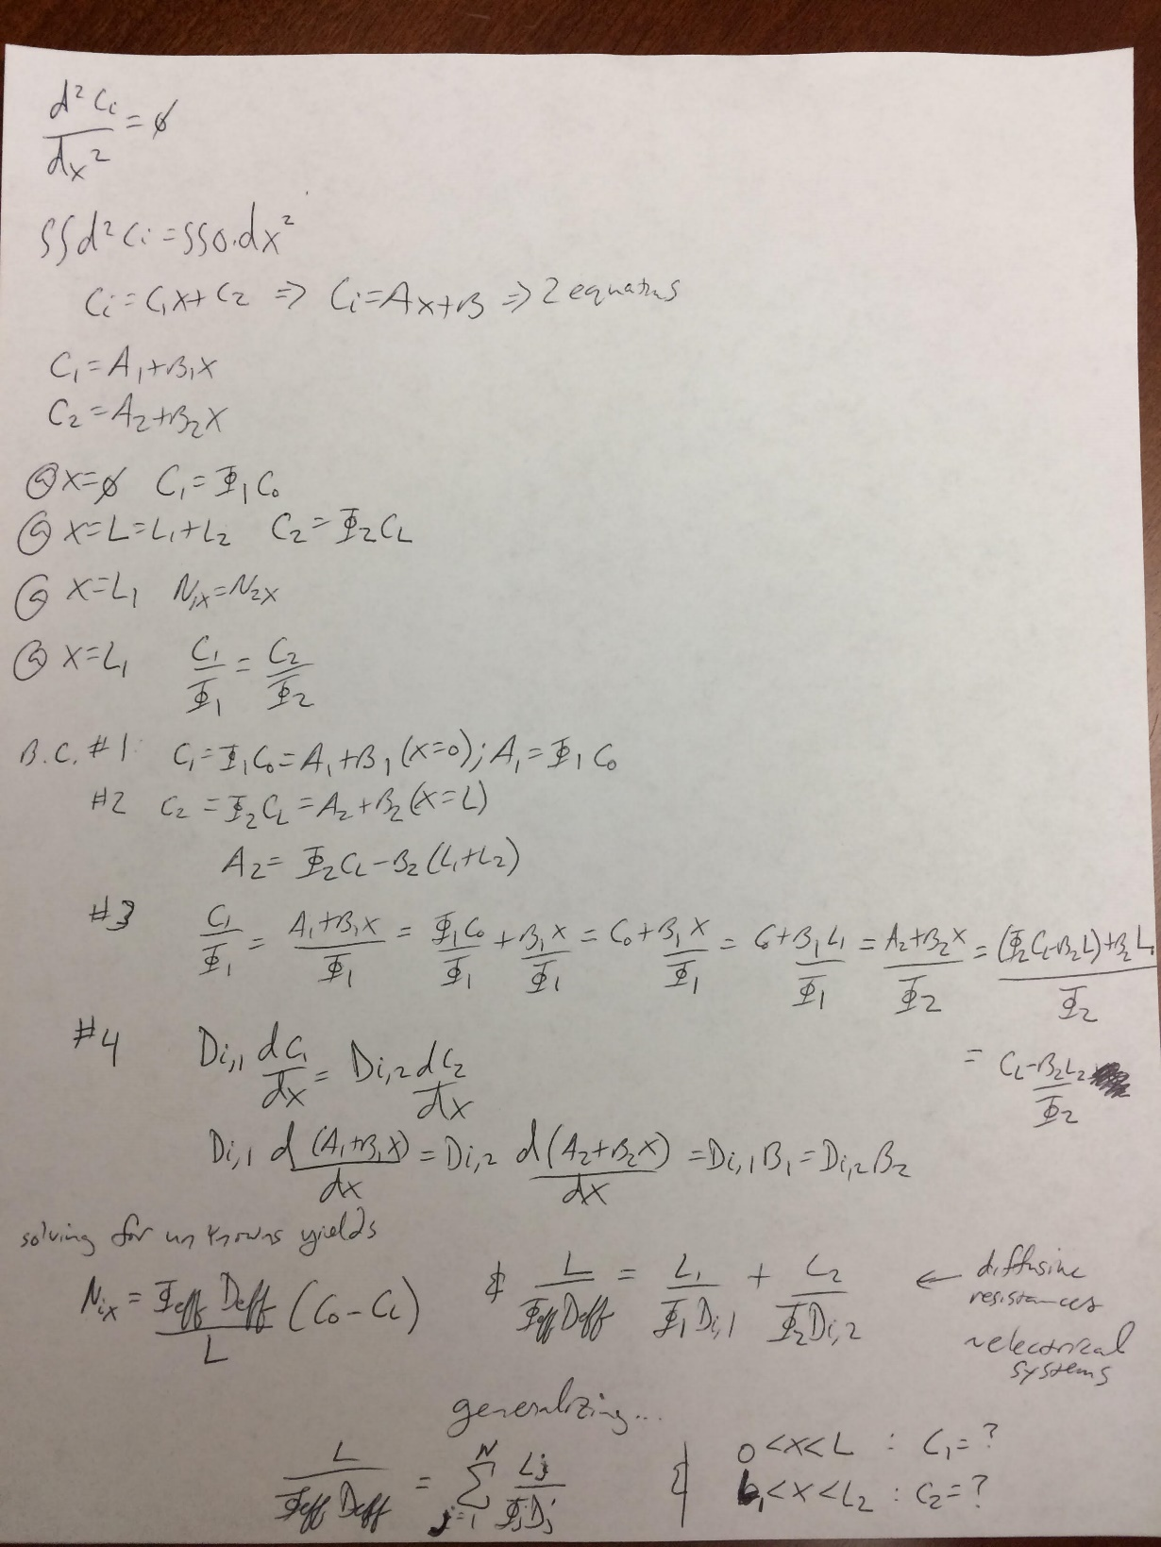
This is from an earlier problem
to remind you of the solution,
as it is helpful for you for 6.9.

Slide 11
Problem 6.9
How?
How?

Slide 12
Problem 6.9
How?
Function of L?

Slide 13
Problem 6.9
How?
Function of L?
How?

Slide 14
Problem 6.9
How?
Function of L?
Phi.s and D.s must
Be equal…
How?

Slide 15
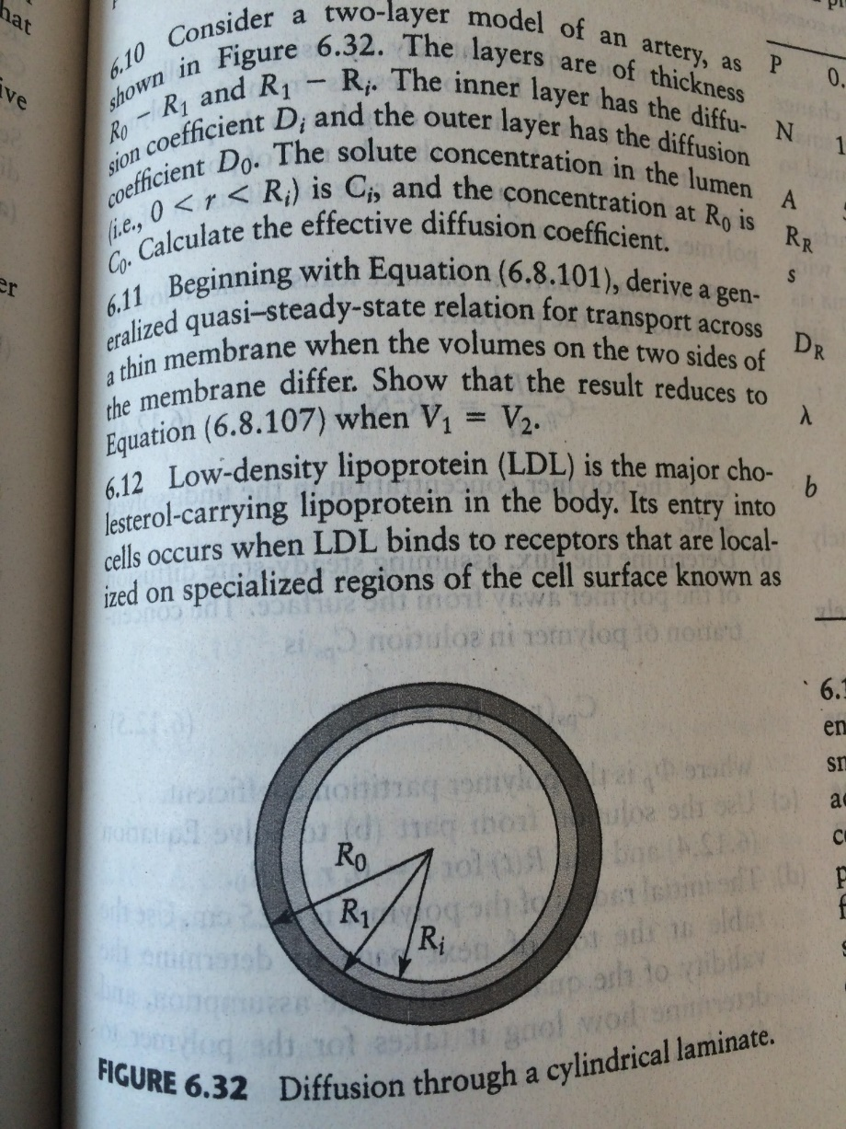
Problem 6.10
Where to start?

Slide 16
Problem 6.10
Where to start?
ss? Using r, it is how many
Dimensions?

Slide 17
Problem 6.10
Where to start?
ss? Using r, it is how many
Dimensions?

Slide 18
Problem 6.10
Where to start?
ss? Using r, it is how many
Dimensions?
1-D

Slide 19
Problem 6.10
Where to start?
ss? Using r, it is how many
Dimensions?
1-D
What’s the equation:

Slide 20
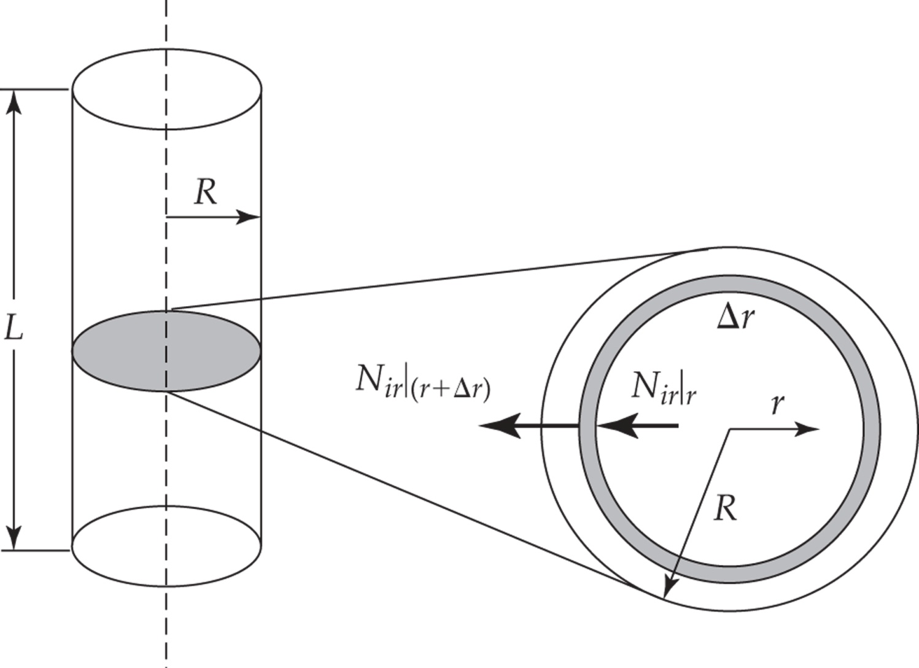
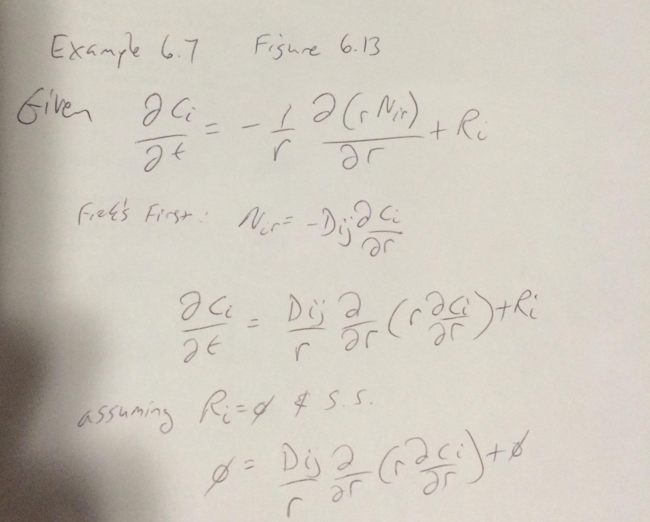
Problem 6.10
Where to start?
ss? Using r, it is how many
Dimensions?
1-D
What’s the equation:
Remember?
How is this situation different?

Slide 21
Problem 6.10
Where to start?
ss? Using r, it is how many
Dimensions?
1-D
What’s the equation:
Remember?
How is this situation different?
What do we need to modify

Slide 23
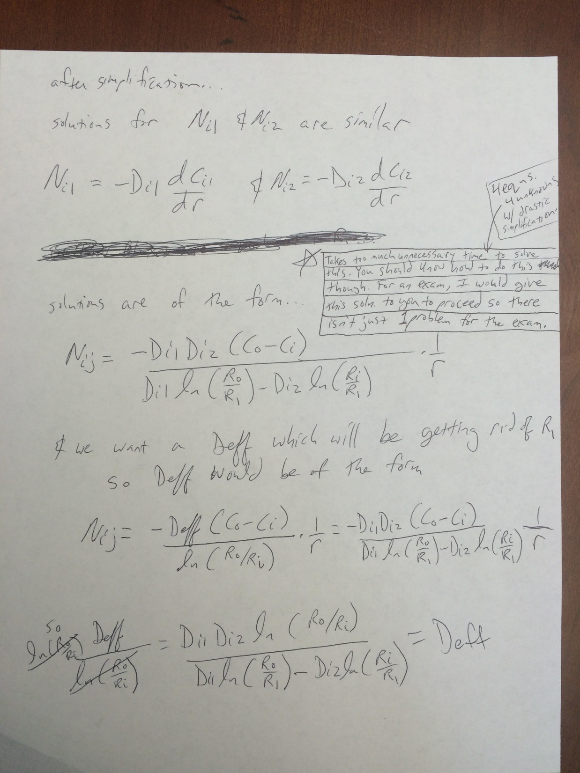
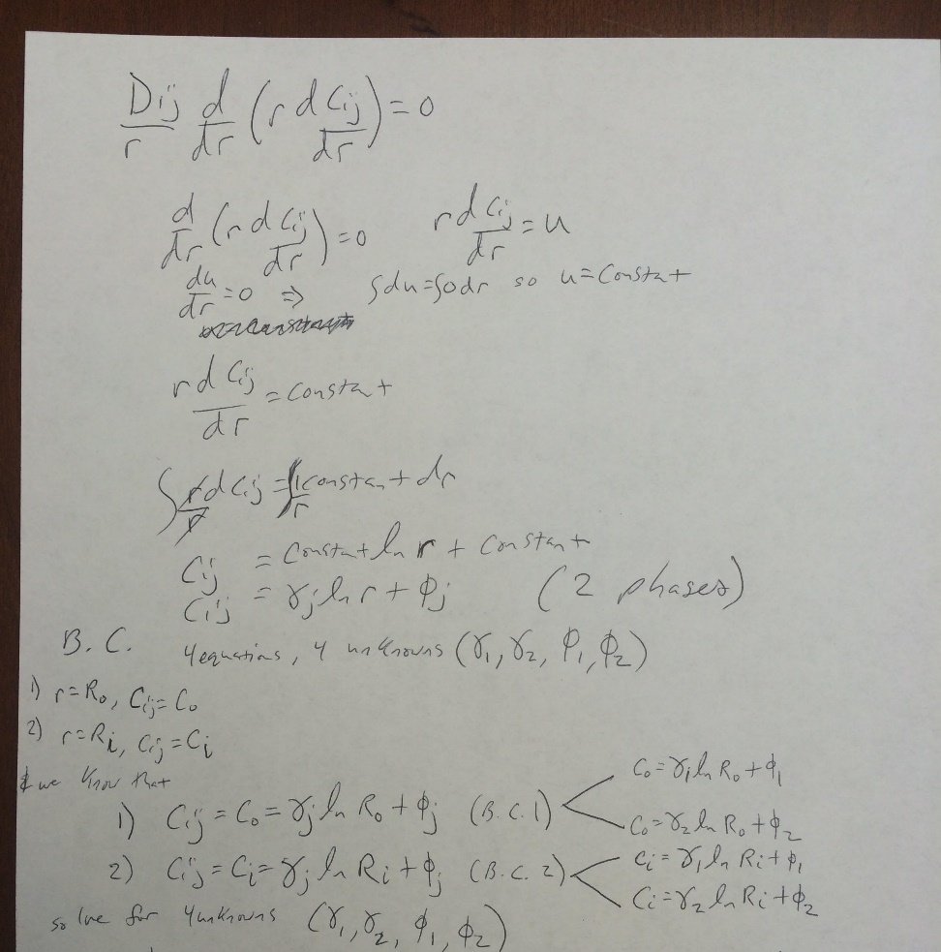

Slide 24
Problem 6.11
Moles of solute leaving side 1 per unit time = moles of solute transported across membrane
Diff. statement
6.8.102
Diff. statement
6.8.103
If Vm<<V2 and Vm<<V1 then…

Slide 25
Problem 6.11
Moles of solute leaving side 1 per unit time = moles of solute transported across membrane
Diff. statement
6.8.102
Diff. statement
6.8.103
If Vm<<V2 and Vm<<V1 then…
$$C_{2}=−\frac{v_{1}C_{o}}{V2}+Cx;Cx=\frac{V_{1}C_{o}}{V2} so C_{2}=−\frac{v_{1}C_{o}}{V2}+\frac{V_{1}C_{o}}{V2} so C_{2}=−\frac{v_{1}}{v_{2}}\left(C_{1}−C_{o}\right)$$

Slide 26
Put C2 into 6.8.102
Solve this for C1: hint: there are exponentials in the solution…
Hint 2: Use integration factor: know how to convert a first order differential equation and
Solve using the integration factor method…covering on 2.6.17

Slide 27
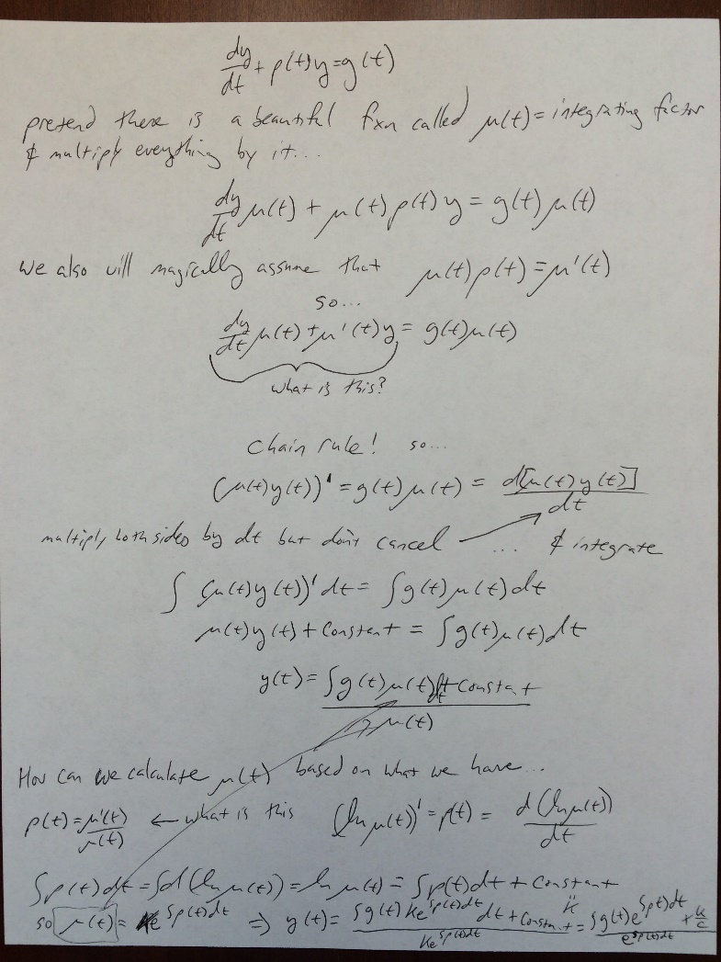

Slide 28
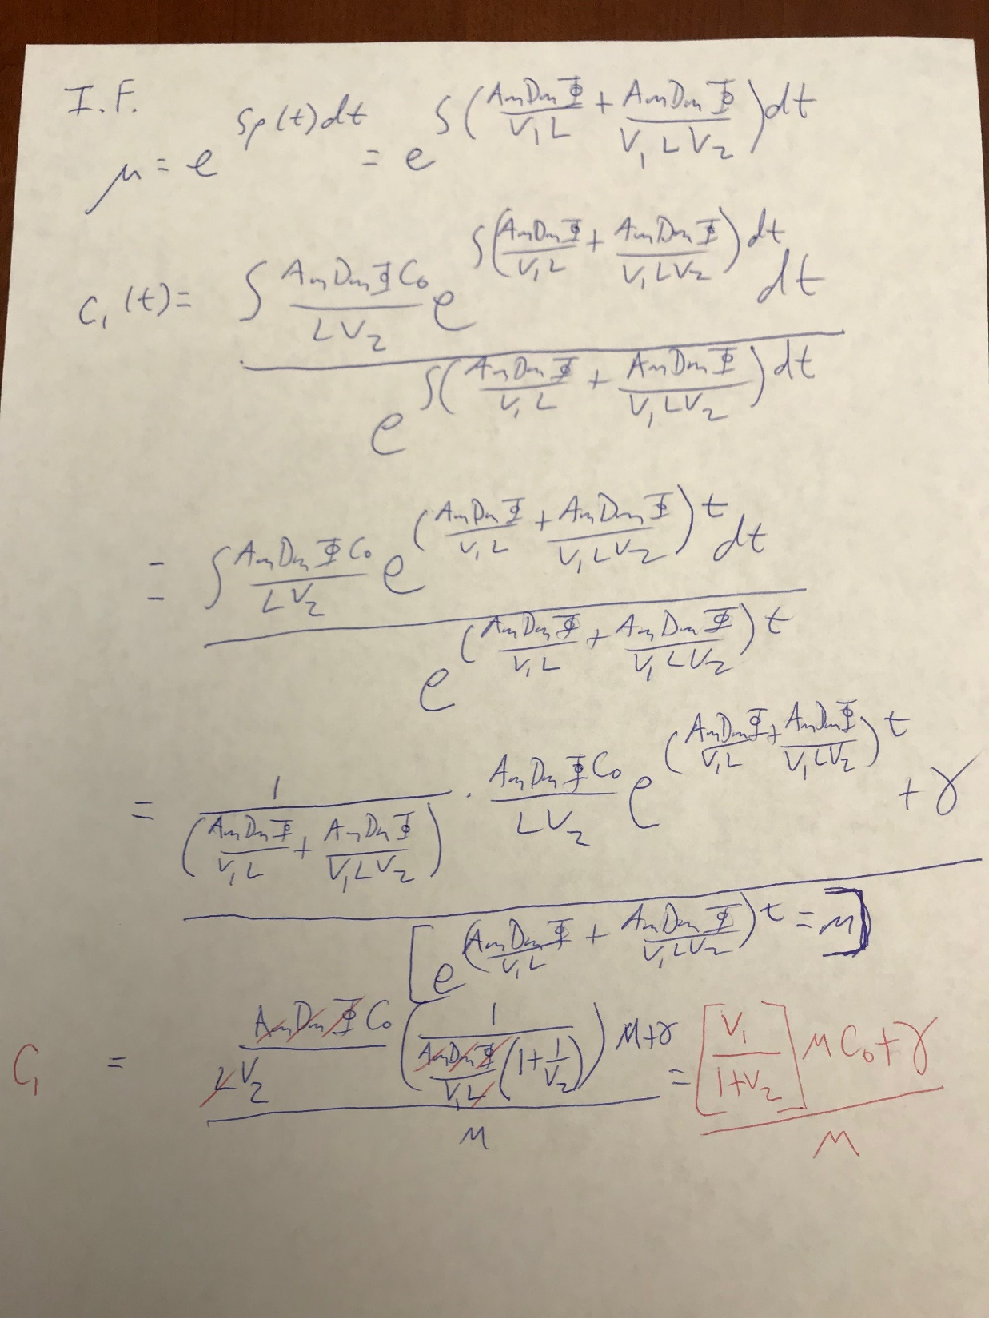
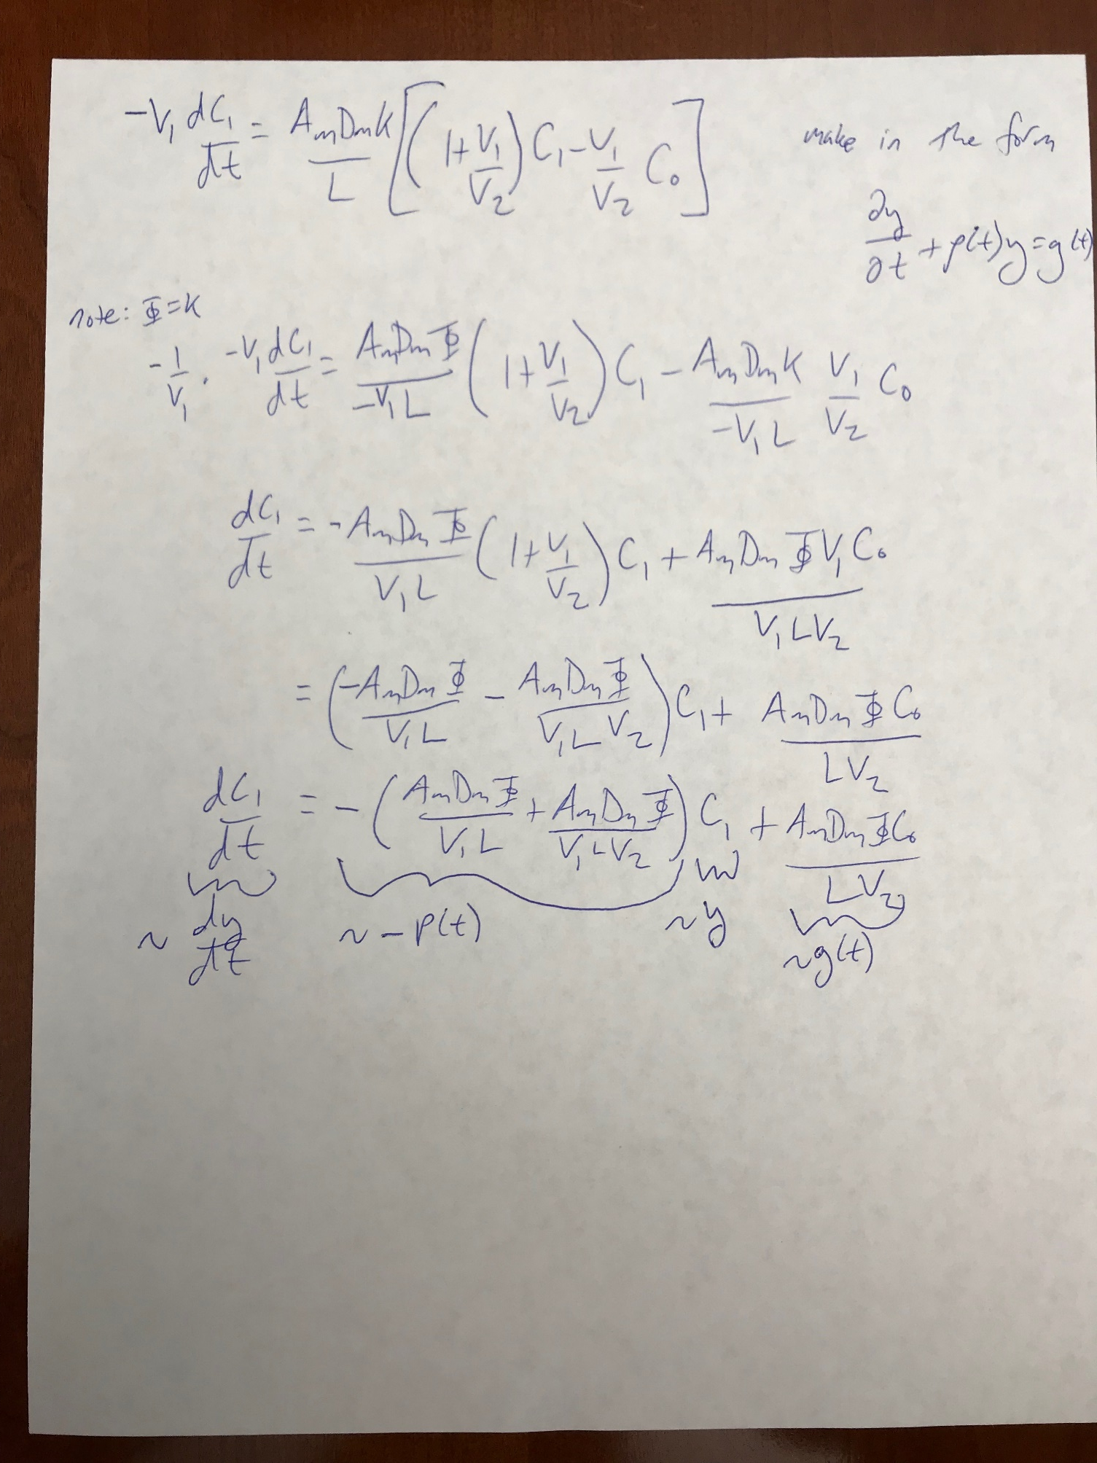

Slide 29
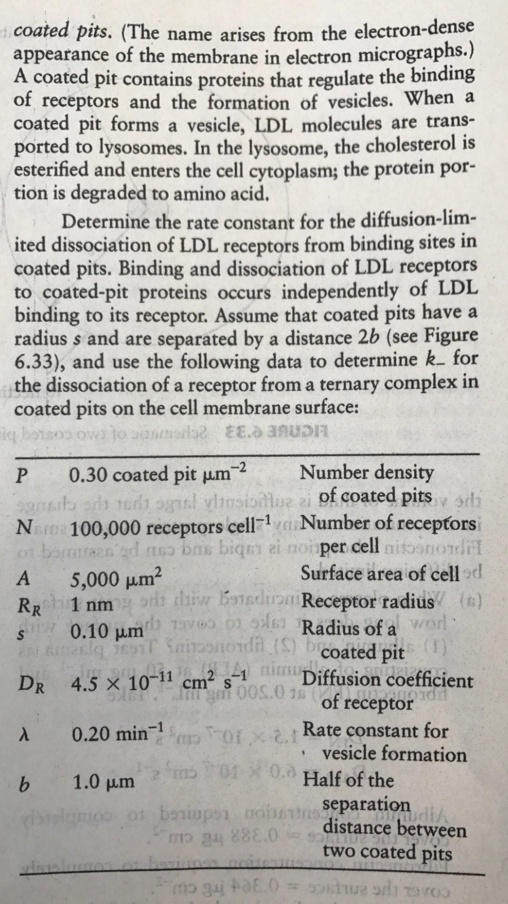
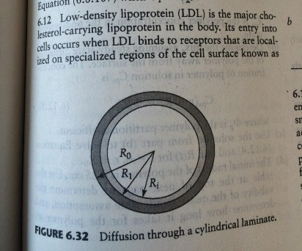

$k_{−}=\frac{2D_{L}}{R_{R}^{2}\ln\left(\frac{b}{R_{R}}\right)}$

Slide 30
$k_{−}=\frac{2D_{L}}{R_{R}^{2}\ln\left(\frac{b}{R_{R}}\right)}$
Would a ligand and receptor be more likely to dissociate if the complex were free floating in solution versus on the surface of the cell?
What does entropy (of what?) have to do with 2 spherical entities in water (i.e., 2 air bubbles or 2 hydrophobic nanoparticles) combining to be one? Why are two bubbles coming together favorable in certain cases?

