Slide 1
Dr. Corey J. Bishop
Assistant Professor of Biomedical Engineering
Principal Investigator of the Pharmacoengineering Laboratory: pharmacoengineering.com
Dwight Look College of Engineering
Texas A&M University
Emerging Technologies Building Room 5016
College Station, TX 77843 cbishop@tamu.edu
BMOLE 452-689 – Transport
Chapter 6. Mass Transport in Biological Systems
Text Book: Transport Phenomena in Biological Systems
Authors: Truskey, Yuan, Katz
Focus on what is presented in class and problems…
Which was Tesla’s favorite number?

Slide 2
Non-steady State Diffusion
Sample Problem: An FCC iron-carbon alloy initially containing 0.20 wt% C is carburized at an elevated temperature and in an atmosphere that gives a surface carbon concentration constant at 1.0 wt%. If after 49.5 h the concentration of carbon is 0.35 wt% at a position 4.0 mm below the surface, determine the temperature at which the treatment was carried out.
Solution: use Eqn.

Slide 3
  t = 49.5 h x = 4 x 10⁻³ m
  C_{x} = 0.35 wt% C_{s} = 1.0 wt%
  C_{o} = 0.20 wt%
∴ erf(z) = 0.8125

Slide 4
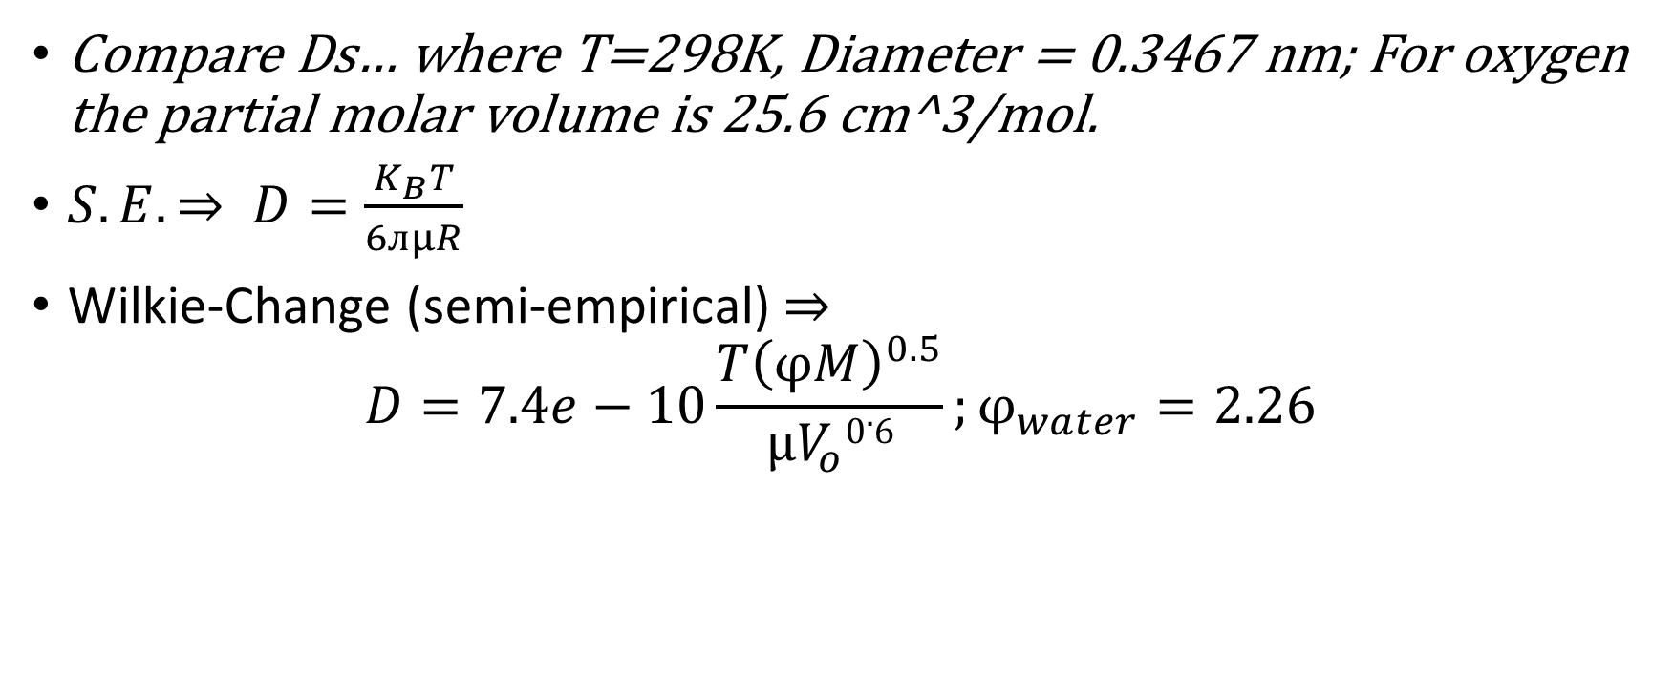
Problem 6.1
Compare Ds… where T=298K, Diameter = 0.3467 nm; For oxygen the partial molar volume is 25.6 cm^3/mol.
$S.E. ⇒ D=\frac{K_{B}T}{6ᴫμR}$
Wilkie-Change (semi-empirical)$⇒$
$$D=7.4e−10\frac{T{\left(φM\right)}^{0.5}}{μV_{o}0.6};φ_{water}=2.26$$

Slide 5
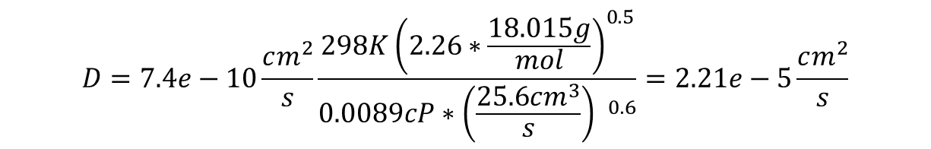
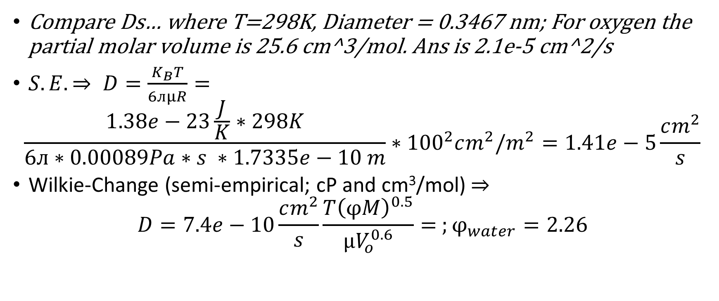
Problem 6.1
Compare Ds… where T=298K, Diameter = 0.3467 nm; For oxygen the partial molar volume is 25.6 cm^3/mol. Ans is 2.1e-5 cm^2/s
$S.E. ⇒ D=\frac{K_{B}T}{6ᴫμR}=$
$$\frac{1.38e−23\frac{J}{K}∗298K}{6ᴫ∗0.00089Pa∗s ∗1.7335e−10 m}∗{100}^{2}cm^{2}/m^{2}=1.41e−5\frac{cm^{2}}{s}$$
Wilkie-Change (semi-empirical; cP and cm³/mol)$⇒$
$$D=7.4e−10\frac{cm^{2}}{s}\frac{T{\left(φM\right)}^{0.5}}{μV_{o}^{0.6}}= ;φ_{water}=2.26$$
Abs(ans-guess)*100/ans = 32.6% error
$$D=7.4e−10\frac{cm^{2}}{s}\frac{298K{\left(2.26∗\frac{18.015g}{mol}\right)}^{0.5}}{0.0089cP∗{\left(\frac{25.6cm^{3}}{s}\right) }^{0.6}}=2.21e−5\frac{cm^{2}}{s}$$
5.22% error

Slide 6
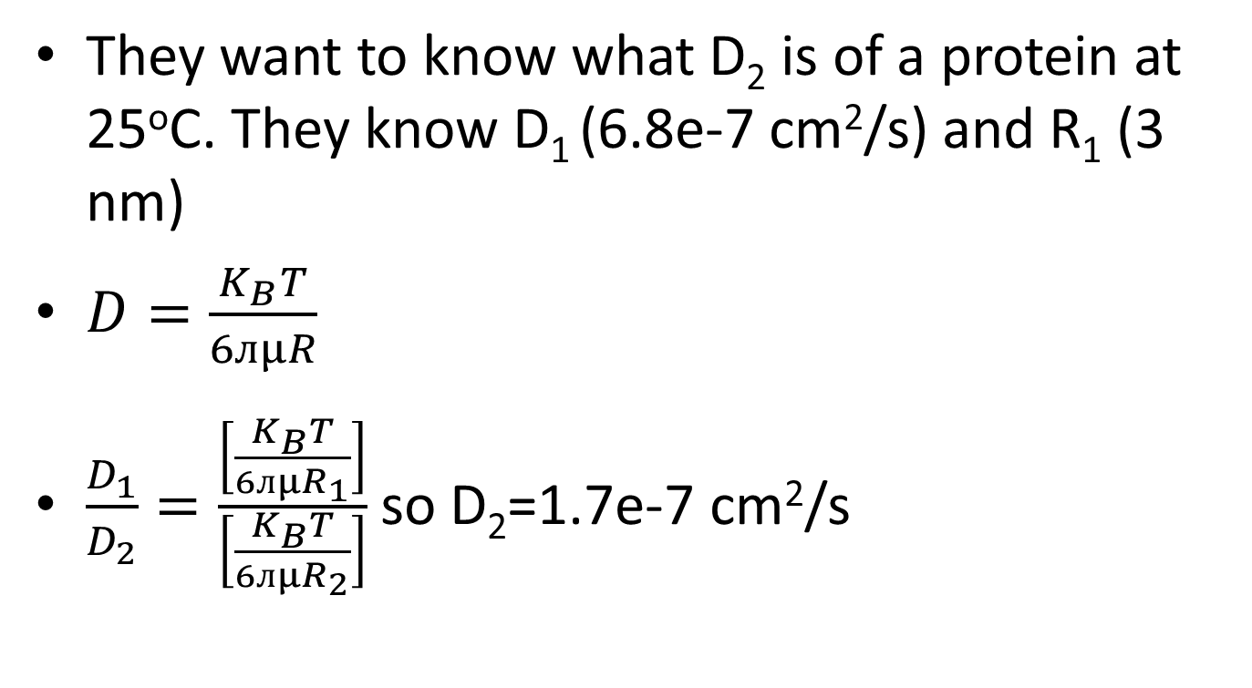
Problem 6.2
They want to know what D₂ is of a protein at 25ºC. They know D₁ (6.8e-7 cm²/s) and R₁ (3 nm)
$D=\frac{K_{B}T}{6ᴫμR}$
$\frac{D_{1}}{D_{2}}=\frac{\left[\frac{K_{B}T}{6ᴫμR_{1}}\right]}{\left[\frac{K_{B}T}{6ᴫμR_{2}}\right]}$ so D₂=1.7e-7 cm²/s

Slide 7

Problem 6.3
MatLab:
Using recursion relations:
$$r_{i}=r_{i−1 }+ δ$$

Slide 8
Matlab “RandomWalk.m”
Create a program that you can input either [-1 0 1] or [-1 1] with any number of steps and have it calculate the error% for each run up to a specified value…

Slide 9

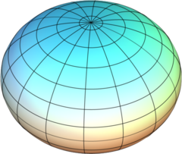
Problem 6.4
Fibrinogen
Estimate D if
A) a prolate ellipsoid
B) a cylindrical rod

Slide 10
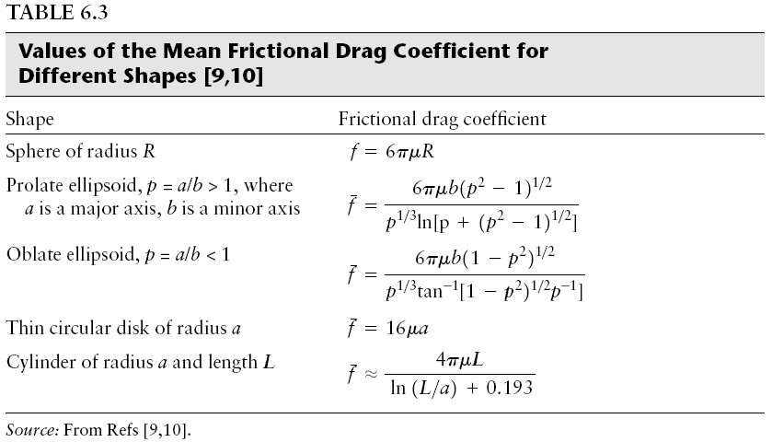
Note: p^0.333 is close to 1 when a and b are similar. Can remove in some cases.

Slide 11

Problem 6.4 (compare to table 6.4)
Note that Table 6.4 should be 2x10⁻⁷ cm²/s not positive 7…
Fibrinogen 47.5x9 nm
Estimate D if
A) a prolate ellipsoid
B) a cylindrical rod
$$S.E. ⇒ D=\frac{K_{B}T}{f_{bar}};f_{bar}based on geometry$$

Slide 12
Problem 6.4
 | prolate ellipsoid |  |  |  | cylinder
 | Kb | 1.38E-23 | J/K |  | Kb | 1.38E-23 | J/K
 | T | 298 | K |  | T | 298 | K
 | u | 0.00089 | Pa*s |  | u | 0.00089 | Pa*s
a>b | a | 4.75E-08 | m |  | L | 4.75E-08 | m
 | a radius | 2.38E-08 | m |  | D | 9.00E-09 | m
 | b | 9.00E-09 | m |  | r | 4.50E-09 | m
 | b radius | 4.50E-09 | m
 | a/b | 5.28E+00 |  |  | fbar num | 0.000000001
 | fbar num | 3.91E-10 |  |  | fbar denom | 6.13E+00
 | fbar denom | 2.347553949 |  |  | fbar | 1.73E-10
 | fbar | 1.67E-10 |  |  | D | 2.37E-07
 | D | 2.47E-07 | cm^2/s |  | D table 6.4 | 2.00E-07 | cm^2/s
 | D table 6.4 | 2.00E-07 | cm^2/s |  | Error% | 18.69 | %
 | Error% | 23.44 | %

Slide 13
Problem 6.6
NO = potent vasodilator for treating newborns who have pulmonary hypertension
Examine transport of gas through an aveolus and into the capillaries.
Gas is added at a [] < 100 ppm.
Alveolus is modeled as a sphere of radius R_{a}

Slide 14
6.6
100 ppm => mole fraction of 0.001. The maximum level of error in the flux is also on this level.
1-x_{i} =0.9999.
_{So…}
Time to reach steady state is R²/D_{ij} .
Radius of alveolus = 50 um = 1e-2 cm; Diffusivity = 0.2 cm²/s. so Time_{ss} = 1.25e-4 s
Gas concentration in blood is = 0.
Average breath is 5 seconds.

Slide 15
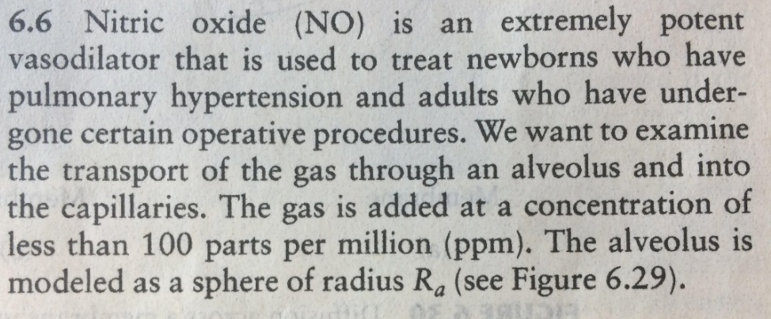
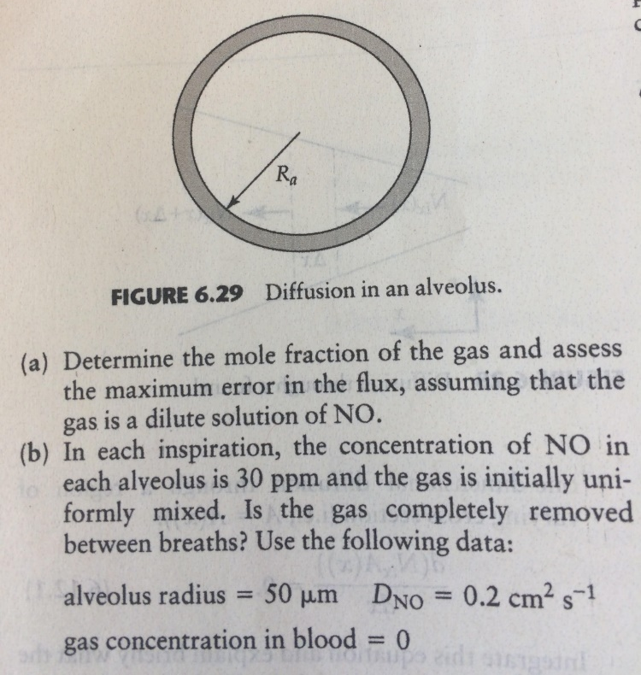
Problem 6.6
Mole fraction: ?

Slide 16
Problem 6.6
Mole fraction: 100 parts/million = 100e-6 = 1e-4
The error is thus?

Slide 17
Problem 6.6
Mole fraction: 100 parts/million = 100e-6 = 1e-4
The error is thus? On this level as well….

Slide 18
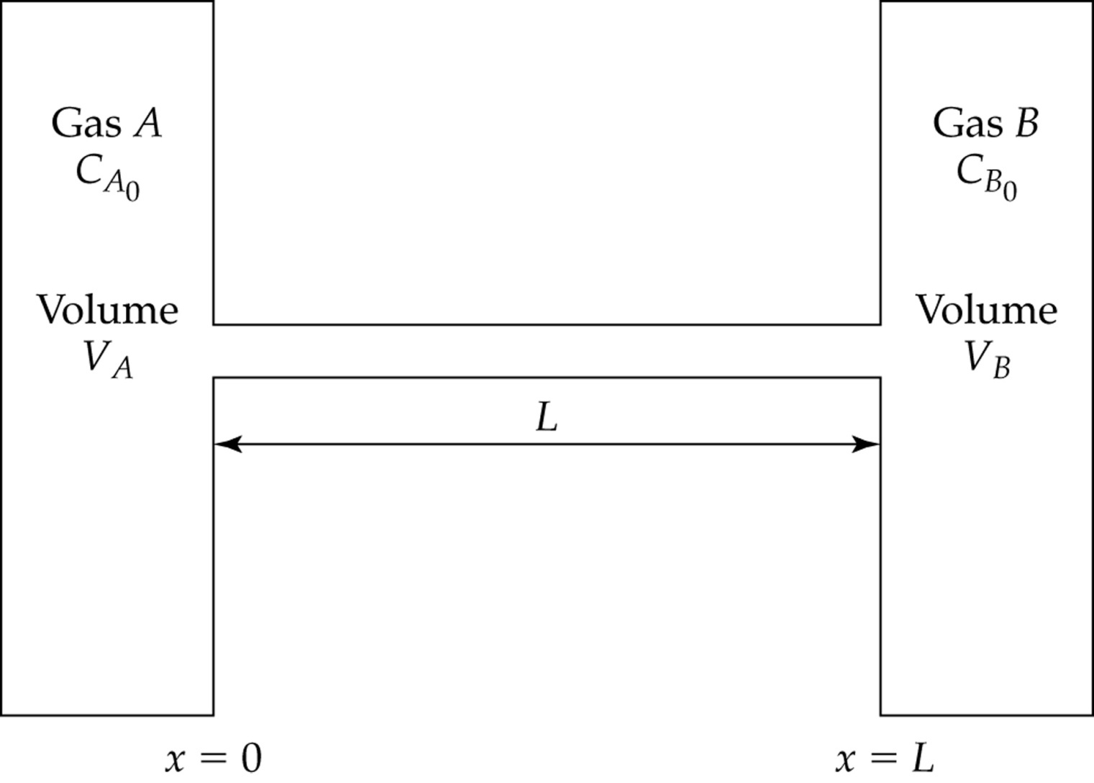

Problem 6.6
Mole fraction: 100 parts/million = 100e-6 = 1e-4
The error is thus? On this level as well….
Since it is dilute we can assume what?
And flux is what?
$$N_{1}=−CD_{ij}∇x_{1}+x_{1}(N_{1}+N_{2})$$

Slide 19
Problem 6.6
Mole fraction: 100 parts/million = 100e-6 = 1e-4
The error is thus? On this level as well….
Since it is dilute we can assume what?
And flux is what?
$$N_{1}=−CD_{ij}∇x_{1}+x_{1}(N_{1}+N_{2})$$

Slide 20
Problem 6.6
Mole fraction: 100 parts/million = 100e-6 = 1e-4
The error is thus? On this level as well….
Since it is dilute we can assume what?
And flux is what?
=?

Slide 21
Problem 6.6
Mole fraction: 100 parts/million = 100e-6 = 1e-4
The error is thus? On this level as well….
Since it is dilute we can assume what?
And flux is what?
=0.9999 initially and grows because 0.0001 gets smaller(t)…
So…

Slide 22
Problem 6.6
Mole fraction: 100 parts/million = 100e-6 = 1e-4
The error is thus? On this level as well….
Since it is dilute we can assume what?
And flux is what?
=0.9999 initially and grows because 0.0001 gets smaller(t)…
So…
Proceed to calculate flux from here if that is the objective

Slide 23
Problem 6.6
Mole fraction: 100 parts/million = 100e-6 = 1e-4
The error is thus? On this level as well….
Since it is dilute we can assume what?
And flux is what?
Mole fraction (ans to part a)
=0.9999 initially and grows because 0.0001 gets smaller(t)…
So…
Proceed to calculate flux from here if that is the objective

Slide 24
Problem 6.6
Mole fraction: 100 parts/million = 100e-6 = 1e-4
The error is thus? On this level as well….
Since it is dilute we can assume what?
And flux is what?
Mole fraction (ans to part a)
=0.9999 initially and grows because 0.0001 gets smaller(t)…
So…
Part b.
How long to reach steady state?
R²/D_{ij}= 1.25e-4 s and is much shorter
5 seconds so yes, the gas is completely
Removed between breaths…
Proceed to calculate flux from here if that is the objective

Slide 25
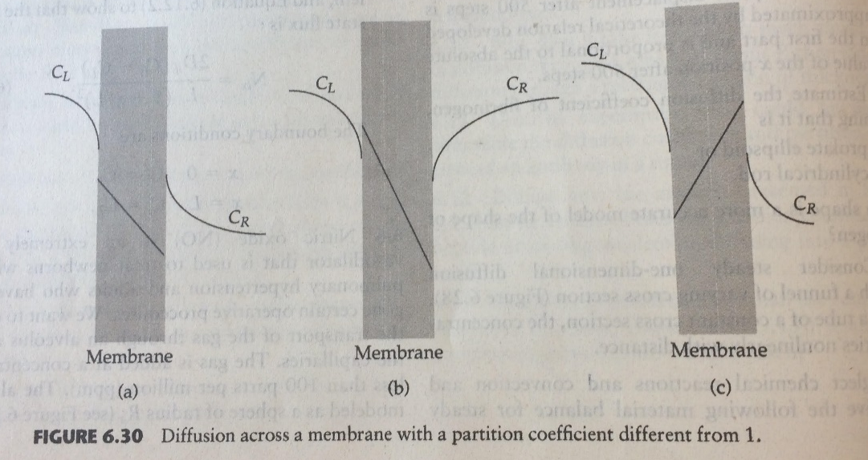
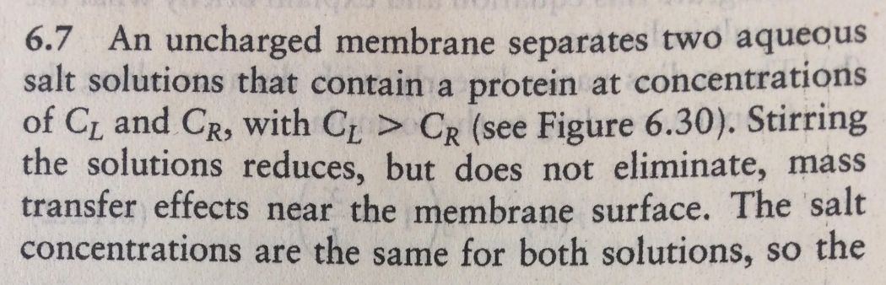
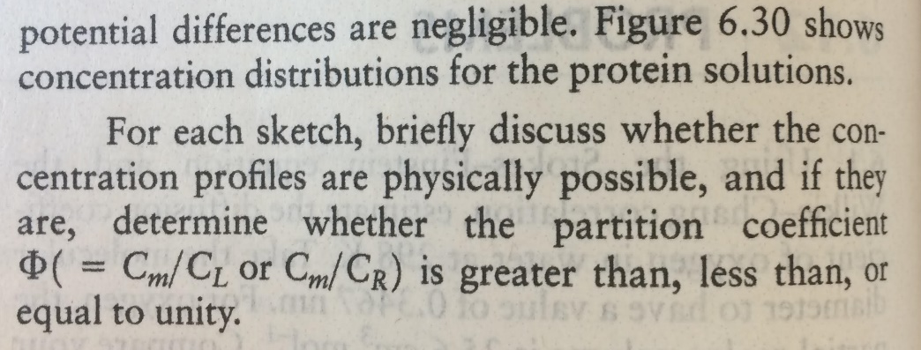
Problem 6.7
We know flow is occurring from left to right:
Needs to hold true:
Reason 1: CL is coming from a source and is expected to be higher on the far left. It also needs to be higher than CR and CR needs to continue to drop as you go more to the right.
Reason 2: We know that the partition coefficient is the same on the left side and the right side of the membrane. Thus if the concentration on the far left of the membrane is lower than CL at the membrane, then the concentration of the membrane also needs to be lower than CR on the far right of the membrane. Similarly, if the concentration on the far left of the membrane is higher than CL at the membrane, then the concentration of the membrane also needs to be higher than CR on the far right of the membrane.
Left figure:
Reason 1 and 2 are satisfied.
Middle figure:
Reasons 1 and 2 are not satisfied.
Right figure:
Reason 2 is not satisfied.

Slide 26
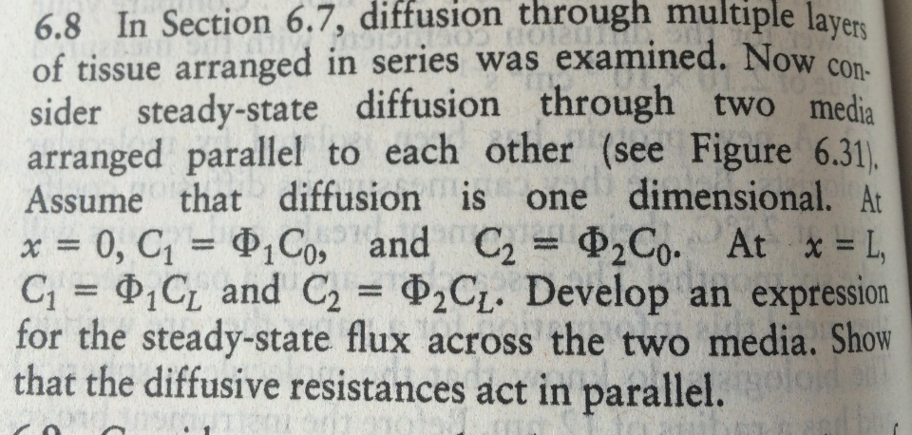
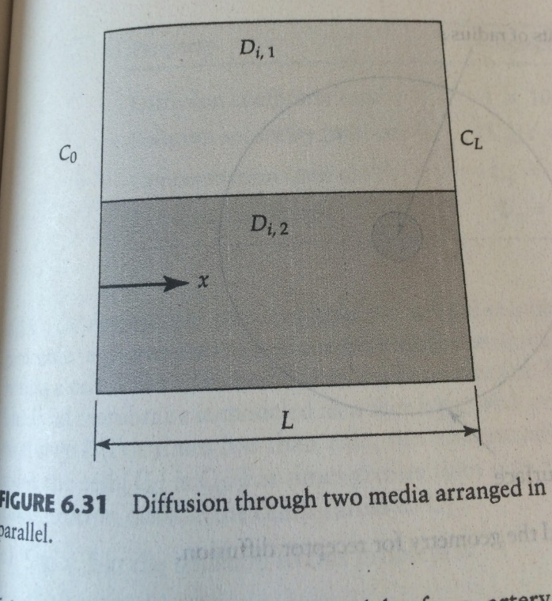
Problem 6.8
What is your assumption based on the previous result the prob.
Is referring to?

Slide 27
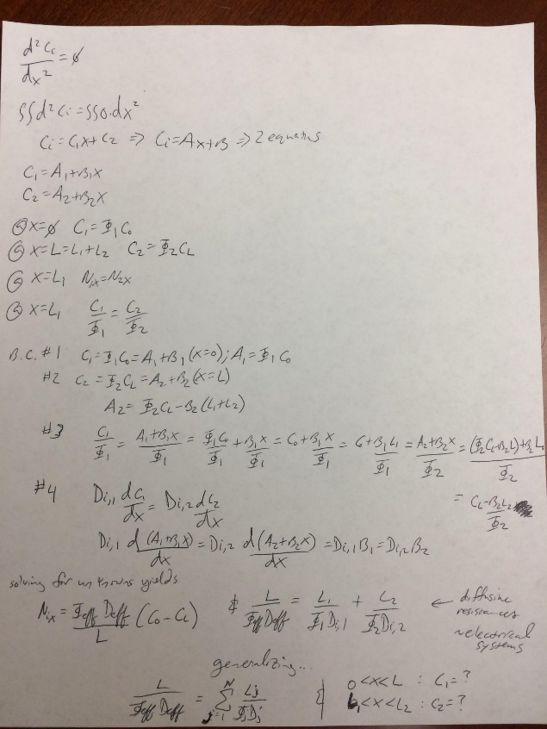
Problem 6.8
What is your assumption based on the previous result the prob.
Is referring to?
Reminiscent of resistors in electrical systems!

Slide 28
Problem 6.8
What variables do we need not shown here?

Slide 29
Problem 6.8
What variables do we need not shown here?

Slide 30
Problem 6.8
A₁ and C₁(x)
A₂ and C₂(x)
Assuming what about the concentration?

