Slide 1
Polymeric-based Therapeutics for Gene Delivery Against Cancer
Corey J. Bishop, Ph.D.
Principal Investigator of the Pharmacoengineering Laboratory
www.pharmacoengineering.com
April 20, 2018

Slide 2
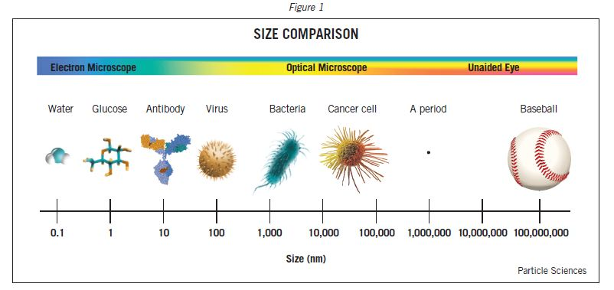
Nanomedicine
http://www.particlesciences.com/images/tb/size-comparison.jpg

Slide 3
Nanomedicine
http://www.particlesciences.com/images/tb/size-comparison.jpg

Slide 4
Nanomedicine
http://www.particlesciences.com/images/tb/size-comparison.jpg

Slide 5
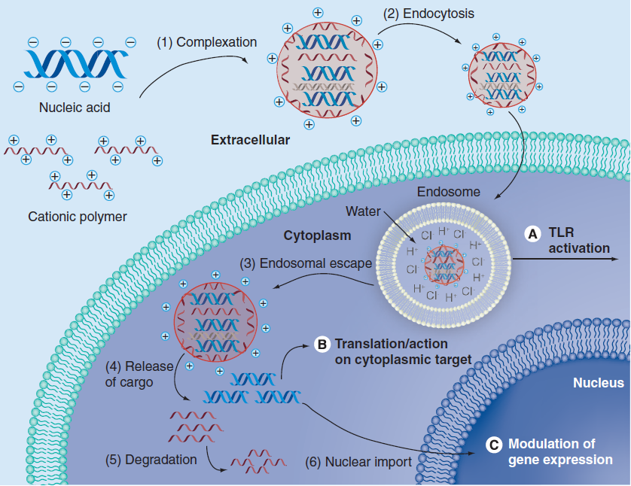
Gene Therapy is Challenging
Regulatory Approvals for Gene Therapy
CFDA (2003)
EMA (2012)
U.S. FDA (2017)
Viruses vs. non-viral
gene delivery vectors
Effective vs. safe
Sunshine, Bishop, Green, Ther. Delivery 2011
Notes:
“The area of nanomedicine I am most interested in is”…
HNSCC: head and neck squamous cell carcinoma
LPL: lipoprotein lipase for hypertriglyceridemia
EMA: european medicines agency
Regulatory Bodies
CFDA in China in 2003
Adenovirus-P53 for HNSCC
EMA in EU in 2012
Assoc-Adenovirus LPL into muscle cells
Need safer
more effective
vectors
Discuss mechanism

Slide 6
Advantages and Disadvantages of Non-viral and Viral Gene Delivery Vectors
Non-viral vectors
Viral vectors
Pros
Less insertional mutagenesis
Less immunogenicity
Easy to scale synthesis up
Easy to chemically modify
Relatively cheaper
Cons
Less effective
Temporary expression (Pro?)
Pros
More effective
Permanent expression
Cons
More insertional mutagenesis
More immunogenicity
Difficult to scale synthesis up
Relatively expensive

Slide 7
Gene Therapy: Promising
Root cause of many inheritable diseases and cancer is genetic Treatment

Slide 8
Gene Therapy: Promising
Root cause of many inheritable diseases and cancer is genetic Treatment
Central Dogma:
DNA mRNA Protein
Function:
Pro-apoptotic or Pro-inflammatory
(i.e., TRAIL, HSV-TK, IL-2,4,12, IFNβ, GM-CSF)

Slide 9
Gene Therapy: Promising
Root cause of many inheritable diseases and cancer is genetic Treatment
Central Dogma:
DNA mRNA Protein
siRNA mRNA Protein
RISC
Function:
Pro-apoptotic or Pro-inflammatory
(i.e., TRAIL, HSV-TK, IL-2,4,12, IFNβ, GM-CSF)
Anti-function:
Anti-growth factor or anti-migratory
(anti-EGF, anti-Robo)

Slide 10
Notes:
Re-show what I did initially and then move on.

Slide 11
Sub-Aim A
Notes:
Re-show what I did initially and then move on.

Slide 12
Sub-Aim A
Binding
Notes:
Re-show what I did initially and then move on.

Slide 13
Sub-Aim A
Diameter
Binding
Notes:
Re-show what I did initially and then move on.

Slide 14
Sub-Aim A
Diameter
Zeta potential
Binding
Notes:
Re-show what I did initially and then move on.

Slide 15
Sub-Aim A
Diameter
Zeta potential
Binding
Expression
Viability
Notes:
Re-show what I did initially and then move on.

Slide 16
Sub-Aim C
Mn, Mw, PDI, DP, B:S, B, S, B+S, BP, MP, CV, GFE, LogP, MR, HtF, tPSA
Expression
Viability
Uptake
Notes:
Re-show what I did initially and then move on.

Slide 17
Sub-Aim A
Aim: Quantifying how poly(beta-amino ester) (PBAE) structural properties affect polymer/DNA binding thermodynamics and gene delivery
Control Function
High throughput vs Design
Structure-Function Relationship
Further mechanistic understanding
Improve polymeric materials
Notes:
polymer/DNA binding thermodynamics and

Slide 18
Structure-Function Assessment
Notes:
Point out the amine for charge for complexation and buffering and ester for hydrolytic degradation
Explicitly state that b and sX are the number of carbons in the monomer.

Slide 19
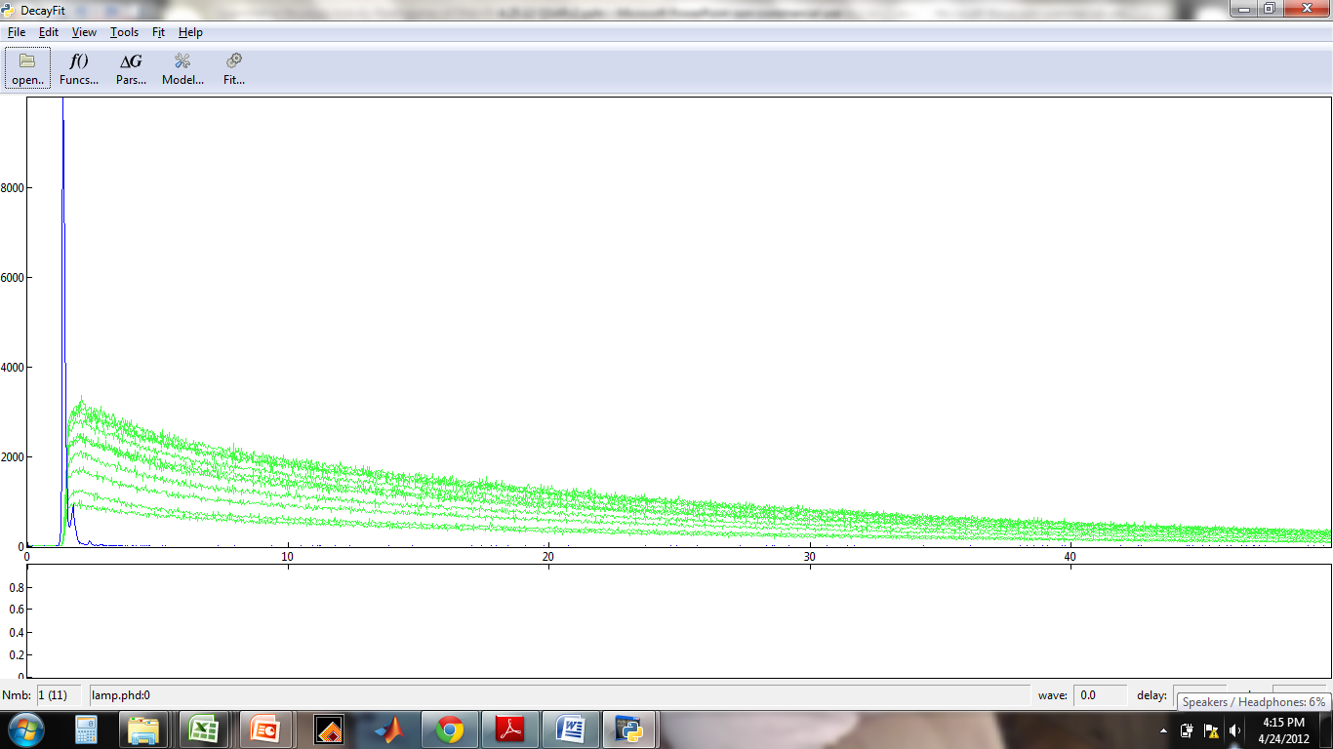
Time-correlated single photon counting: ethidium bromide
Lamp (background)
# of Counts
Time (ns)
Notes:
Point out this is a histogram
What you are looking at here is the emission responses of ethidium bromide at different wavelengths. We are able to fit 2 exponential terms summed to the responses observed which are associated with the 2 different fluorescing entities namely ethidium bromide bound and unbound to DNA. If all of the ETB were bound or unbound to DNA we would only have 1 term.

Slide 20
Time-correlated single photon counting: ethidium bromide
Curve Fitting: Global decay constants;
Amplitude varies with wavelength (560-670 nm)
Lamp (background)
# of Counts
Time (ns)
Notes:
Point out this is a histogram
What you are looking at here is the emission responses of ethidium bromide at different wavelengths. We are able to fit 2 exponential terms summed to the responses observed which are associated with the 2 different fluorescing entities namely ethidium bromide bound and unbound to DNA. If all of the ETB were bound or unbound to DNA we would only have 1 term.

Slide 21
Decay-Associated Spectra
DNA Bound ETB
Unbound ETB

Slide 22
Decay-Associated Spectra
A₂
DNA Bound ETB
Unbound ETB
A₁

Slide 23
Decay-Associated Spectra
A₂
DNA Bound ETB
Unbound ETB
A₁

Slide 24
Decay-Associated Spectra
A₂
DNA Bound ETB
Unbound ETB
A₁
Hill Equation:

Slide 25
Binding constants
(A), backbone (B), sidechain (C), and endcaps (D).
One-way ANOVA / Tukey post-hoc²
Notes:
“average bc” - mao

Slide 26
MDA-MB-231 Cells
Glioblastoma Cells

Slide 27
Conclusions
Binding constants 1-6E4 M⁻¹ for PBAEs are optimal in both human cancer cell lines tested and biphasic with respect to transfection efficacy
Binding constant in this range is necessary but not sufficient for effective transfection
Binding affinity is tunable
No strong trends between diameter/ZP and transfection
Bishop, et al. J. Am. Chem. Soc. 2013, 135, 6951-6957.
Ketola, Hanzlikova, Leppanen, Ravina, Bishop, et al. J. Phys.Chem. B. 2013, 117, 10405-13.

Slide 28
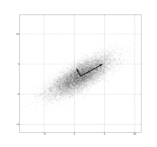
Principal Component Analysis: Sub-Aim C
Reduces complex data => linearly uncorrelated orthogonal components
Typically: Av = λv

Slide 29
Principal Component Analysis
Reduces complex data => linearly uncorrelated orthogonal components
Typically: Av = λv
(A – 11^{T}A(1/n) = C)^{T}C = M
M = variance-covariance matrix
Mv = λv; v = eigenvectors; λ = eigenvalues
Mv = scores: inter-variable correlations
v = coefficients rank variables’ contributions

Slide 30
Normalized Variables
Physico-chemical properties:
Mn, Mw (MW*), PDI, DP, B:S, B, S, B+S
Joback/Crippen’s Fragmentation method: BP*, MP*, CV*, GFE*, LogP*, MR*, HtF*, tPSA
* = repeating unit (vs full polymer)
Cellular function
Viability, uptake, transfection

Slide 31
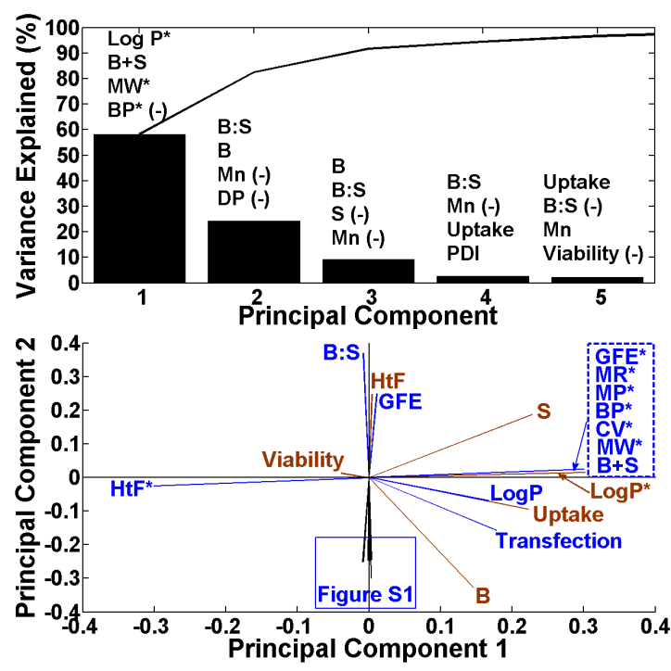
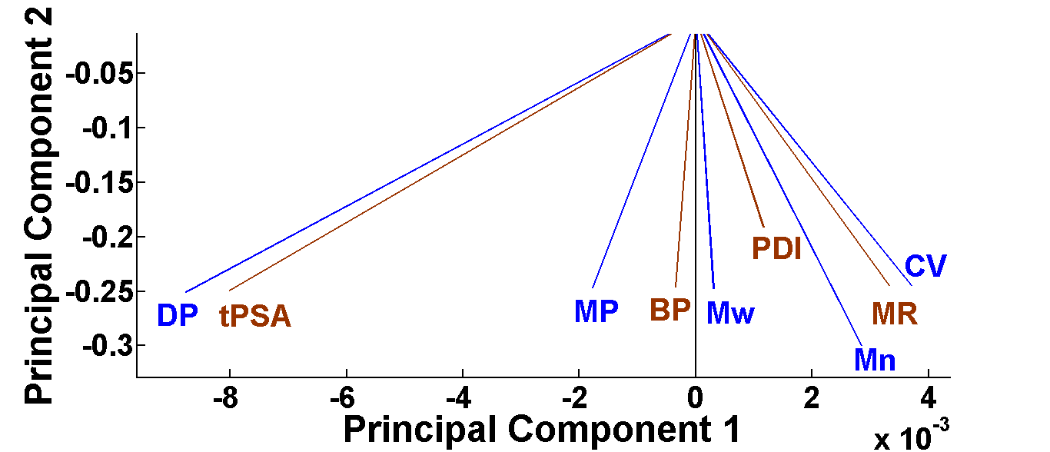
Figure S1
Figure 1. Top: the variances are explained for the first5 PCs. The top 4 variables of the 27 are ranked by the degree to which they contribute to the PCs
according to their associated coefficients and listed above the variances. The “(-)” indicates a negative contribution; Bottom: The loading plot of all of the
variables showing relative correlations.
Notes:
Mention some variables line up with PC1 and other variables line up with PC2 and some are in between.

Slide 32
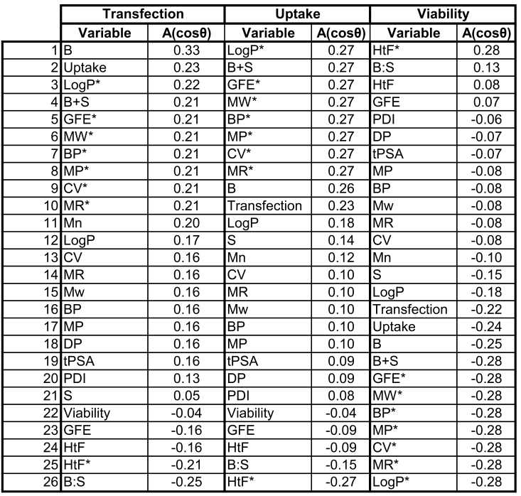
Variables driving function
Ranking of variables: Acos(Θ) = correlation strength
E number index was most neutral in all cases: 0.02, 0.01, -0.01.

Slide 33
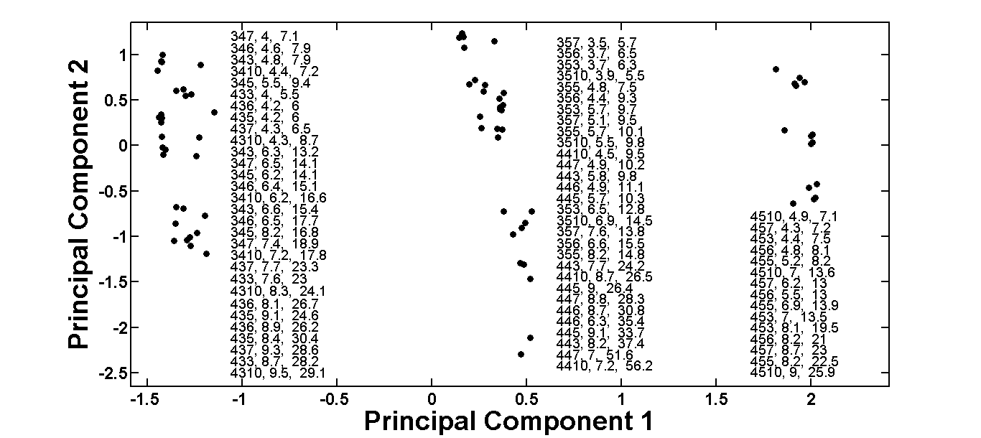
Scores Plot
M_{n}
M_{w}
B+S
Notes:
“Self-assembled”

Slide 34
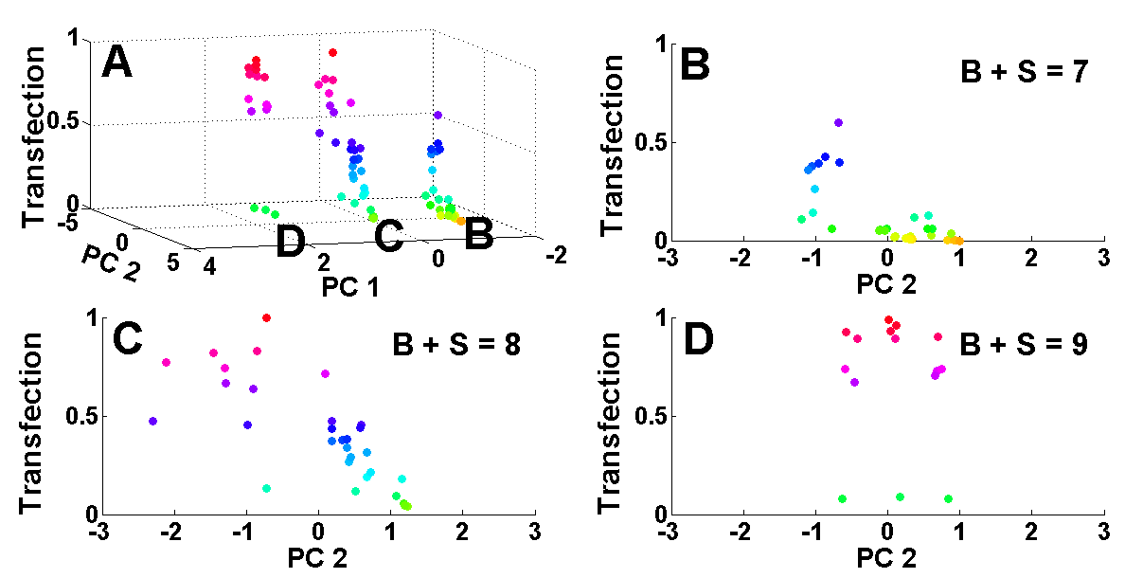
Red = highest transfection level
The scores plot versus transfection efficacy with red being the highest level of transfection; B: region B of 3A with a B+S (sum of carbons in backbone and sidechain) value of 7;
C: region C of 3A with a B+S value of 8; D: region D of 3A with a B+S value of 9.
Notes:
“Self-assembled”

Slide 35
Conclusions
(+)-correlations:
Transfection
B, uptake, LogP*, B+S
Uptake
LogP*, B+S, GFE*, MW*
Viability
HtF*, B:S, HtF, GFE
(-)-correlations:
Transfection
GFE, HtF, HtF*, B:S
Uptake
GFE, HtF, B:S, HtF*
Viability
MP*, CV*, MR*, LogP*
LogP*, B+S drive uptake/transfection
PCA is a useful tool for helping elucidate which and to what degree structural properties drive cell-based function
Bishop, et al. Chemical Communications. 2015. 51, 12134-12137.

Slide 36
Acknowledgements: Thank You!
Green Lab
Dr. Jordan Green
Dr. Stephany Tzeng
Dr. Joel Sunshine
Dr. Nupura Bhise
Dr. Ron Shmueli
Kristen Kozielski
Jay Kim
Randall Meyer
David Wilson
Toni Guiriba
Rebecca Majewski
Richard “Josh” Murdock
Allen Liu
David Lee
Evan Smith
Thesis Committee
Dr. Jordan J. Green
Dr. Hai-Quan Mao
Dr. Warren Grayson
Dr. Kevin Yarema
Collaborators
Dr. Tiia Ketola
Dr. Elina Vuorimaa
Dr. Marjo Yliperttula
Dr. Ting Wang
Dr. Gregg Semenza
Langer Lab
Dr. Bob S. Langer
Dr. Adam M. Behrens
Dr. Kevin J. McHugh
Dr. Ana Jaklenec
Xiao Le
Dr. Thanh Nguyen
Dr. Stephany Tzeng
Dr. Shiran Ferber
Funding:
NSF GRF to CB: DGE-0707427
NIH: 1R01EB016721,
R21CA152473
Tekes PrinCell II 40050/09 FI
Wilmer Core Grant: EY001765,
P30-EY001865
Gates’ Foundation

Slide 37
Overview
Specific Aim: Elucidate structure-function relationships of a polymeric non-viral gene delivery system used for glioblastoma and triple-negative breast cancer applications:
Sub-Aim 1: Polyplex binding correlations in cancer (Bishop, et al. JACS)
Sub-Aim 2: Structure-function elucidation via PCA (Bishop, et al. Chemical Commun.)
Sub-Aim 3: Cellular and nuclear uptake rates and differential equation modeling in cancer (Bishop, et al. Acta Biomaterialia)

Slide 38
Sub-Aim B
k_{cell}
Notes:
Re-show what I did initially and then move on.

Slide 39
Sub-Aim B
k_{cell}
k_{ne}
Notes:
Re-show what I did initially and then move on.

Slide 40
Sub-Aim B
k_{cell}
k_{ni}
k_{ne}
Notes:
Re-show what I did initially and then move on.

Slide 41
Sub-Aim B
k_{cell}
k_{bd}
k_{ni}
k_{ne}
Notes:
Re-show what I did initially and then move on.

Slide 42
Sub-Aim B
k_{cell}
Structure
k_{bd}
k_{ni}
k_{ne}
Notes:
Re-show what I did initially and then move on.

Slide 43
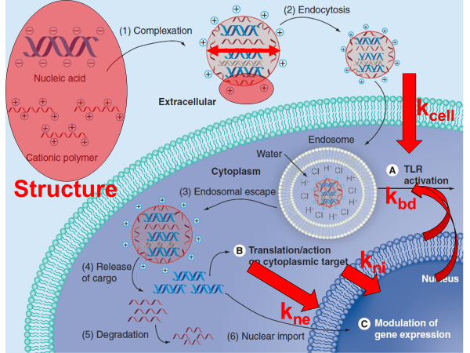
Sub-Aim C
k_{cell}
Mn, Mw, PDI, DP, B:S, B, S, B+S, BP, MP, CV, GFE, LogP, MR, HtF, tPSA
k_{bd}
k_{ni}
k_{ne}
Notes:
Re-show what I did initially and then move on.

