Slide 1
Any of this is fair game for the exam…

Slide 2
Problem 15.1
If the diffusion coefficients of glucose and IgG are 2e-6 and 2e-8 cm²s⁻¹ and the convective velocity is 0.5 μm/s, determine which mode of transport is dominant.
Glucose delivery over a distance of 100 μm
Glucose delivery over a distance of 0.1 μm
IgG delivery over a distance of 100 μm
IgG delivery over a distance of 0.1 μm
How: ?

Slide 3
Problem 15.1
If the diffusion coefficients of glucose and IgG are 2e-6 and 2e-8 cm²s⁻¹ and the convective velocity is 0.5 μm/s, determine which mod of transport is dominant.
Glucose delivery over a distance of 100 μm
Glucose delivery over a distance of 0.1 μm
IgG delivery over a distance of 100 μm
IgG delivery over a distance of 0.1 μm
How: Peclet #: ?

Slide 4
Problem 15.1
If the diffusion coefficients of glucose and IgG are 2e-6 and 2e-8 cm²s⁻¹ and the convective velocity is 0.5 μm/s, determine which mod of transport is dominant.
Glucose delivery over a distance of 100 μm
Glucose delivery over a distance of 0.1 μm
IgG delivery over a distance of 100 μm
IgG delivery over a distance of 0.1 μm
How: Peclet #: vL/D
How do you know if convection or diffusion dominates?

Slide 5
Problem 15.1
If the diffusion coefficients of glucose and IgG are 2e-6 and 2e-8 cm²s⁻¹ and the convective velocity is 0.5 μm/s, determine which mod of transport is dominant.
Glucose delivery over a distance of 100 μm; Pe = 0.25
Glucose delivery over a distance of 0.1 μm; Pe = 0.00025
IgG delivery over a distance of 100 μm; Pe = 25
IgG delivery over a distance of 0.1 μm; Pe = 0.025
How: Peclet #: vL/D
Diffusion dominates when Pe<1
Convection dominates when Pe>1

Slide 6
Problem 15.2
Barriers to systemic delivery of drugs that target a specific gene in tissues?
Book says: microvascular wall, extracellular matrix, plasma membrane of cells, cytoskeleton, nuclear envelope.
Free DNA half-life in circulatory system (CpG)
Glomerular filtration (for <5.5-6 nm)
Reticuloendothelial system (RES)
Phagocyte system
Hepatic clearance
i.e., first-pass metabolism or first pass effect
at times necessary for pro-drug activation.
Nucleases (DNases, RNases)
Which is more stable?
What is each for?
plasmids, shRNA, ncRNA, RNA aptamers, siRNA vs RNAi, isRNA, saRNA, agRNA
Localization (active vs passive targeting), cellular uptake, endosomal escape,
nuclear uptake (DNA-targeted sequences – stolen from viruses)
Intracellular half-life of plasmid?

Slide 7
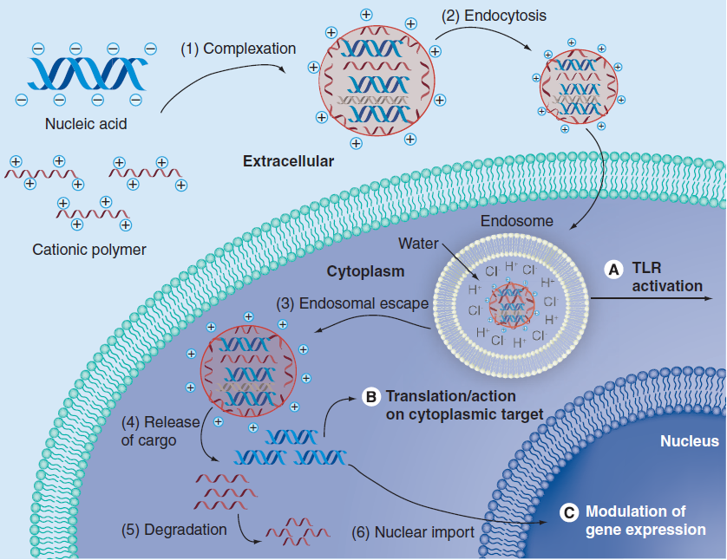
Sunshine, Bishop, Green, Ther. Delivery 2011

Slide 8
Problem 15.3
Derive equations 15.3.25 and 15.3.29 for p_{i}. Use these equations to calculate the volume dilatations e, tissue displacements μ, and fluid velocities v in tumor tissues.
Involving a step increase in microvascular pressure:
An abrupt stop in the transvascular exchange of fluid

Slide 9
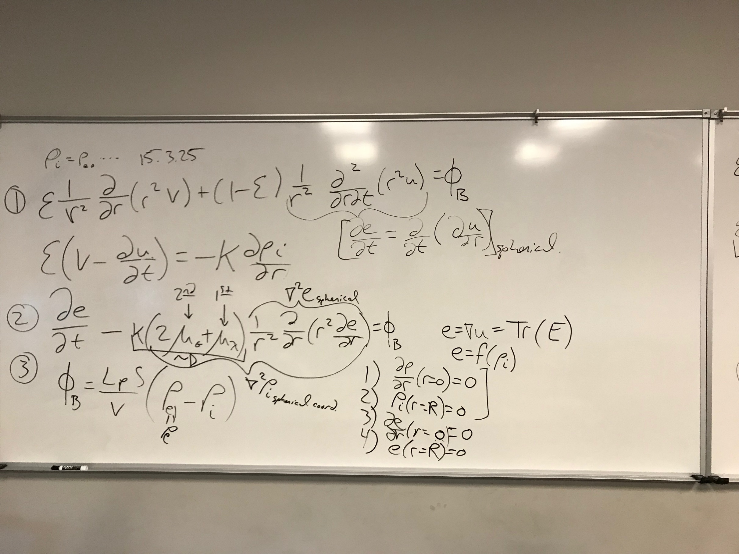

Slide 10
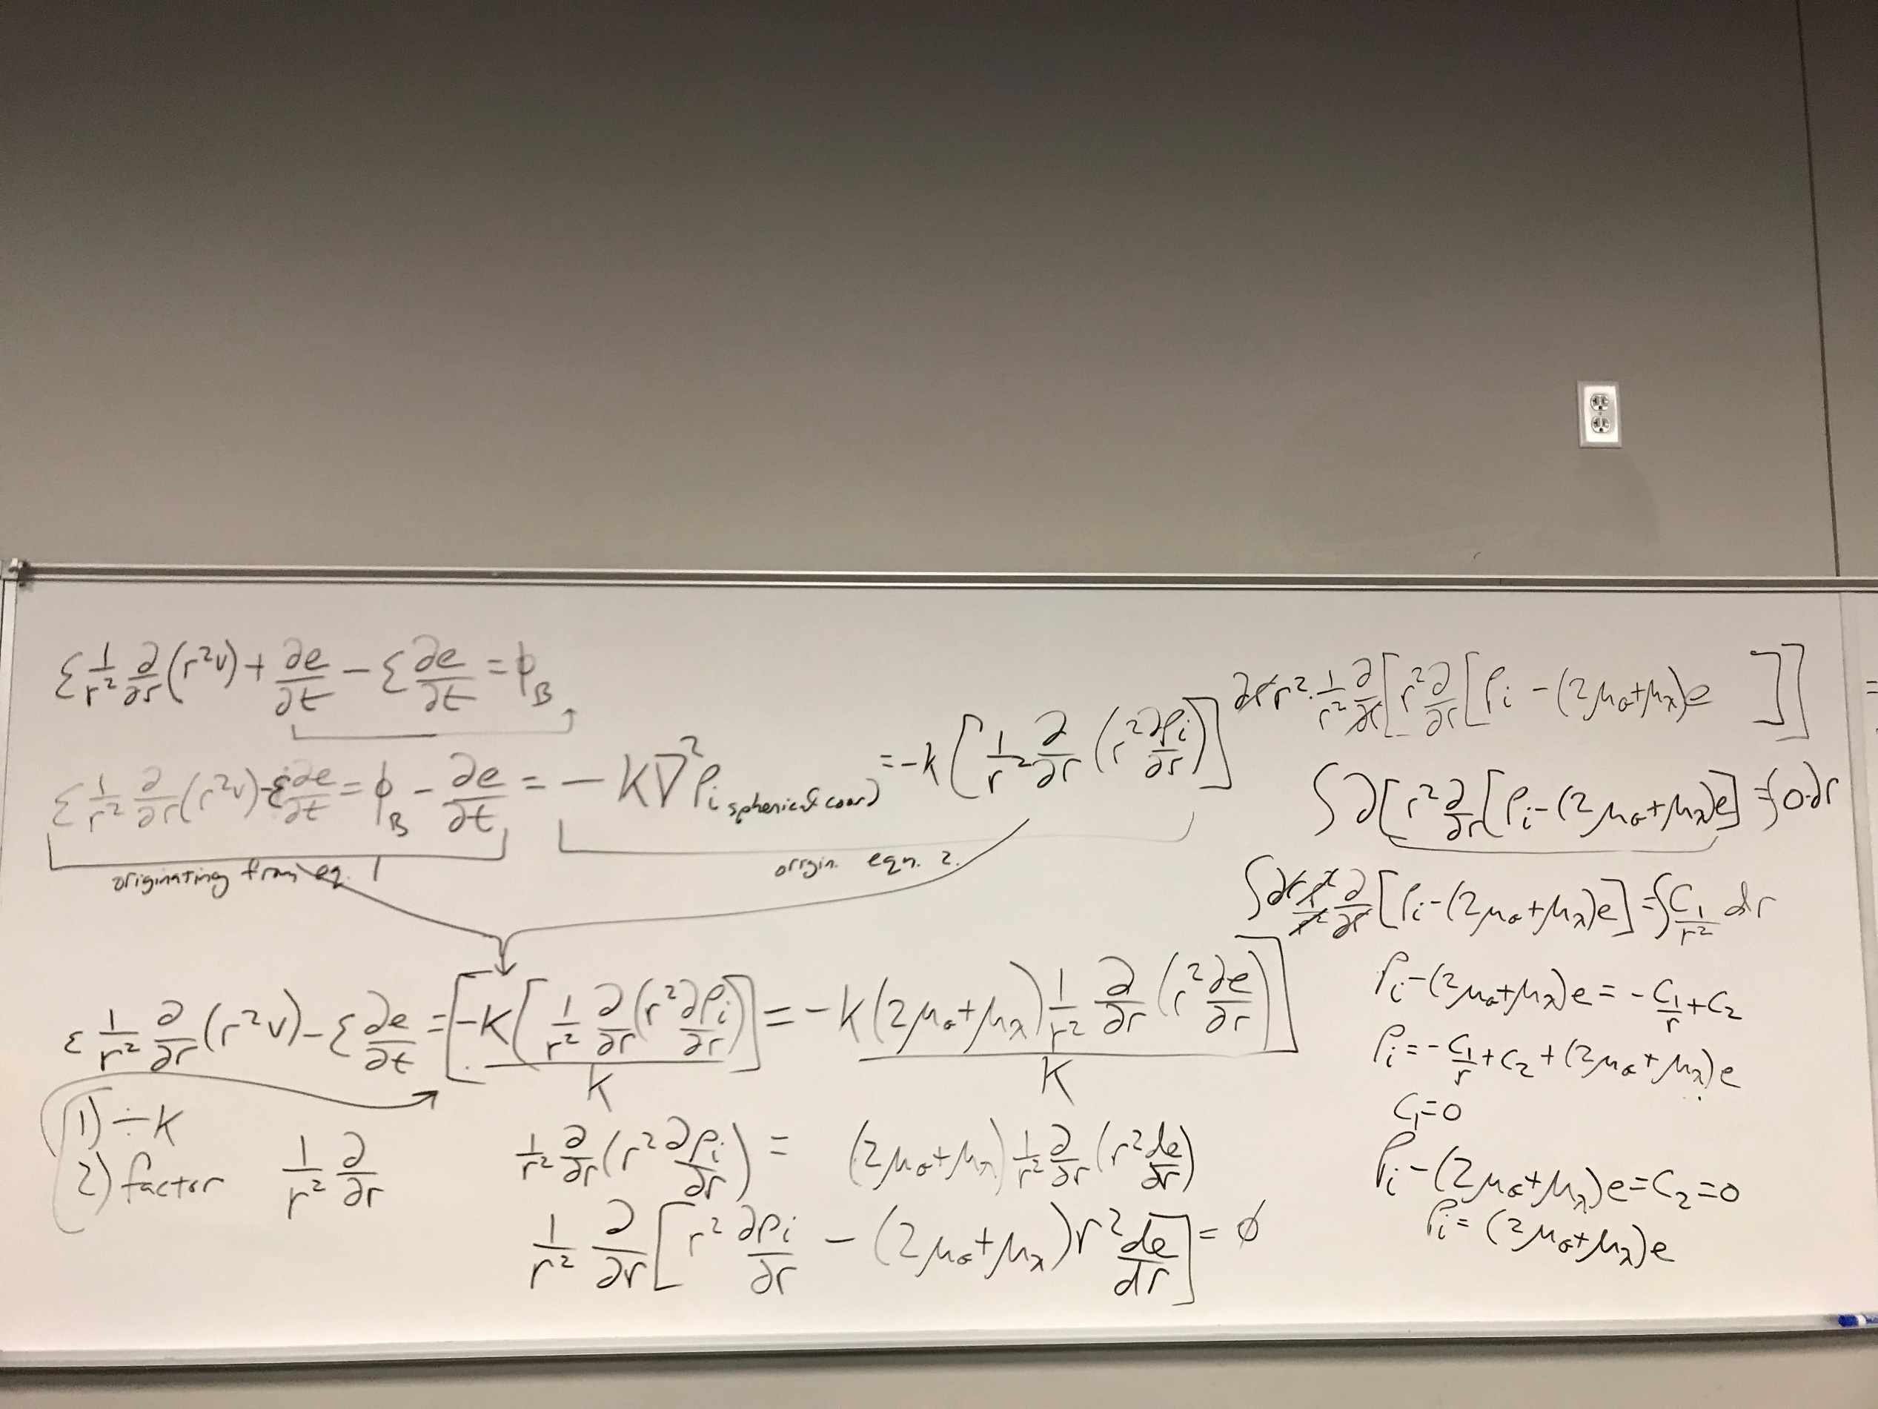

Slide 11
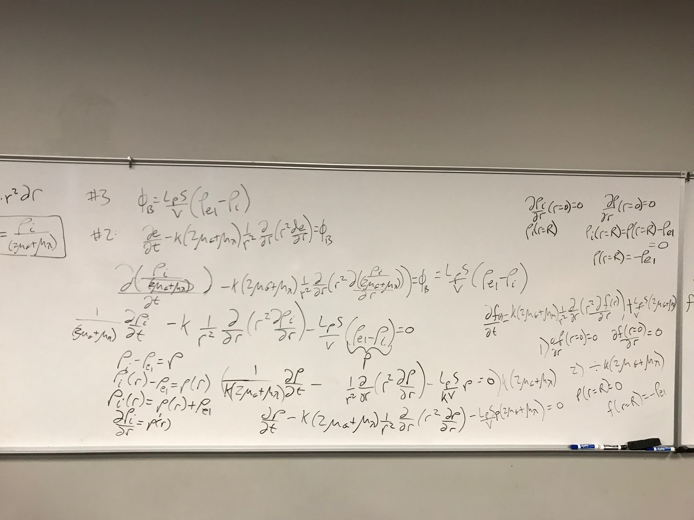

Slide 12
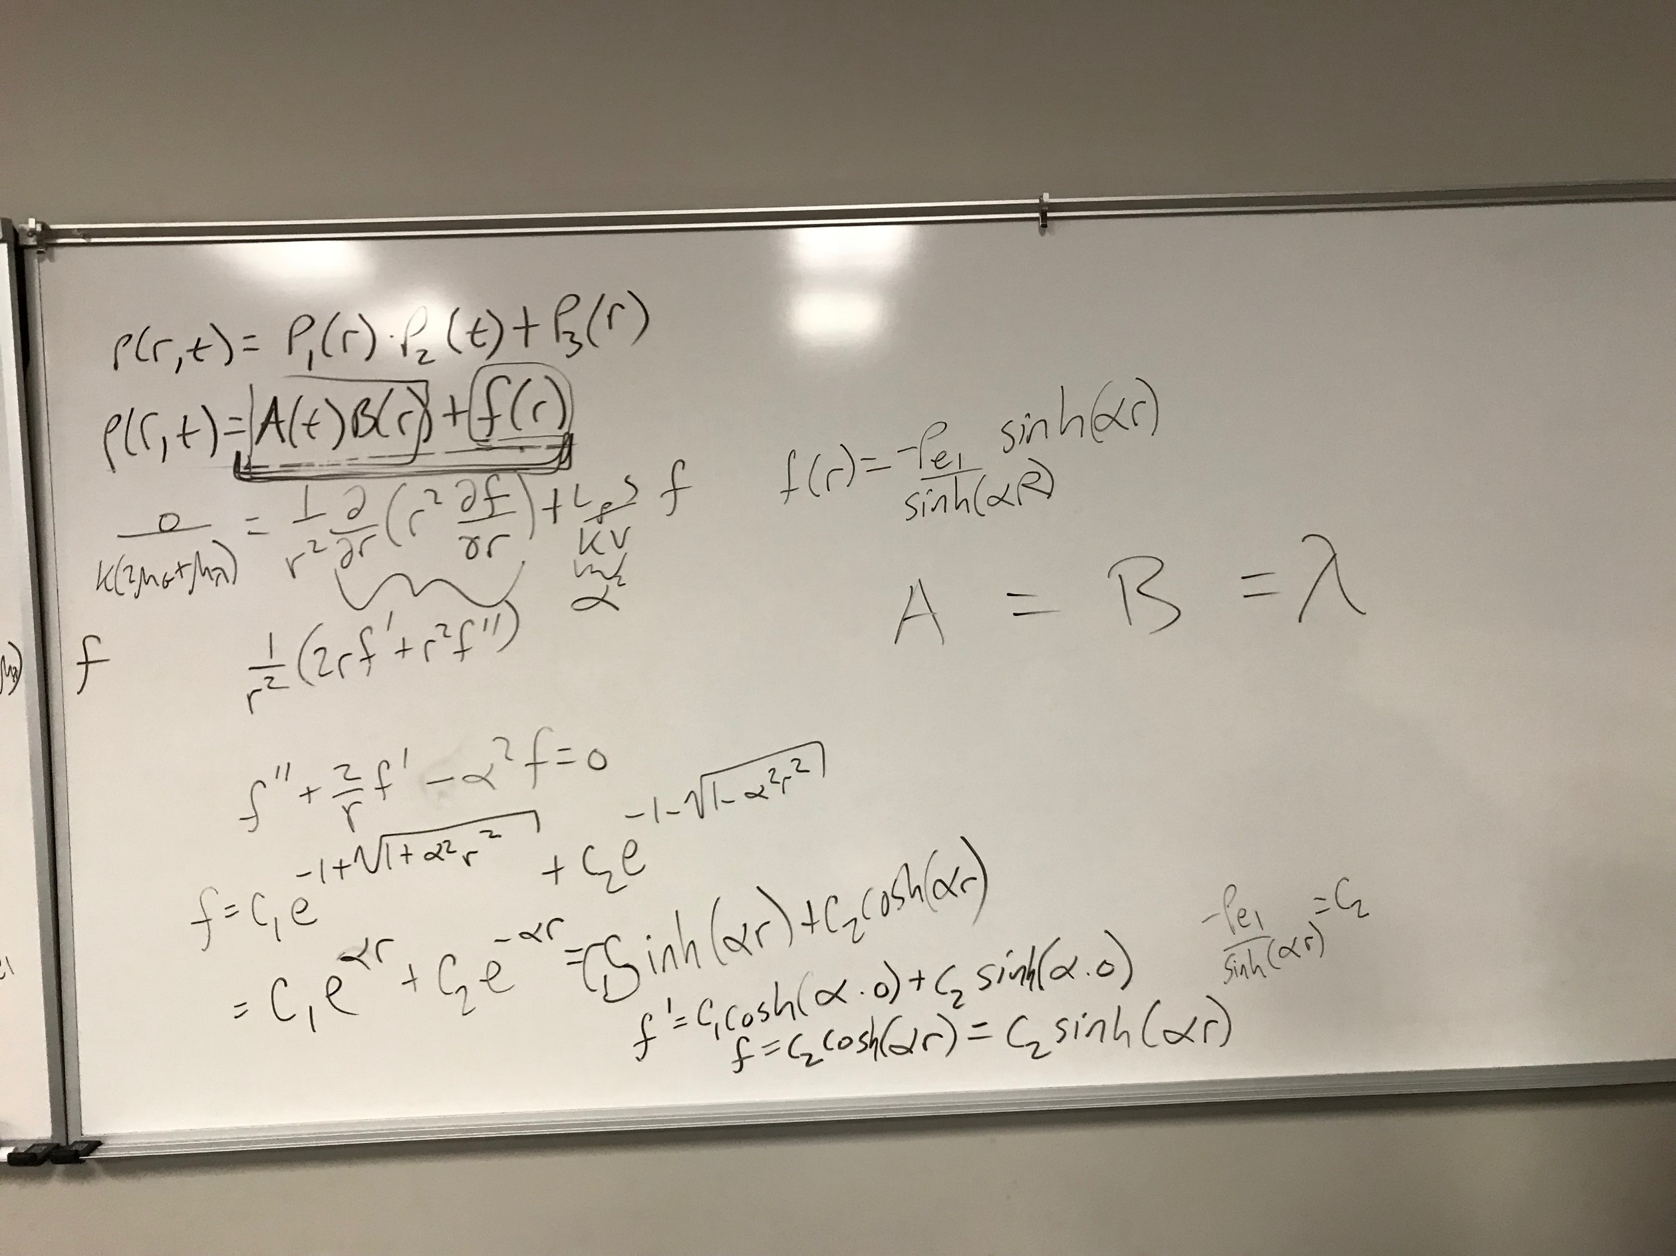

Slide 13
Assume 0
w.r.t: r&t
What are we assuming about X?

Slide 14

Assume 0
w.r.t: r&t
What are we assuming about X?
$$X=A\left(t\right)B(r)$$

Slide 15
Assume 0
w.r.t: r&t
What are we assuming about X?
$$X=A\left(t\right)B(r)$$
Now what?

Slide 16
Assume 0
w.r.t: r&t
What are we assuming about X?
$$X=A\left(t\right)B(r)$$
Now what? Plug it in.
$$\frac{∂\left[A\left(t\right)B\left(r\right)\right]}{∂t}=Kγ\frac{1}{r^{2}}\frac{∂}{∂r}\left[\frac{r^{2}∂\left[A\left(t\right)B\left(r\right)\right]}{∂r}\right]−\frac{L_{p}S}{V}γ A\left(t\right)B\left(r\right);where γ=\left(2μ_{G}+μ_{γ}\right)$$

Slide 17
Assume 0
w.r.t: r&t
What are we assuming about X?
$$X=A\left(t\right)B(r)$$
Now what? Plug it in.
$$\frac{∂\left[A\left(t\right)B\left(r\right)\right]}{∂t}=Kγ\frac{1}{r^{2}}\frac{∂}{∂r}\left[\frac{r^{2}∂\left[A\left(t\right)B\left(r\right)\right]}{∂r}\right]−\frac{L_{p}S}{V}γ A\left(t\right)B\left(r\right);where γ=\left(2μ_{G}+μ_{γ}\right)$$

Slide 18
Assume 0
w.r.t: r&t
What are we assuming about X?
$$X=A\left(t\right)B(r)$$
Now what? Plug it in.
$$\frac{∂\left[A\left(t\right)B\left(r\right)\right]}{∂t}=Kγ\frac{1}{r^{2}}\frac{∂}{∂r}\left[\frac{r^{2}∂\left[A\left(t\right)B\left(r\right)\right]}{∂r}\right]−\frac{L_{p}S}{V}γ A\left(t\right)B\left(r\right);where γ=\left(2μ_{G}+μ_{γ}\right)$$
How can we simplify this further?

Slide 19
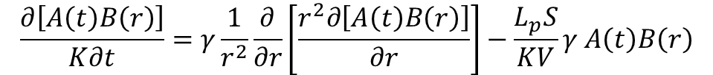
Assume 0
w.r.t: r&t
What are we assuming about X?
$$X=A\left(t\right)B(r)$$
Now what? Plug it in.
$$\frac{∂\left[A\left(t\right)B\left(r\right)\right]}{∂t}=Kγ\frac{1}{r^{2}}\frac{∂}{∂r}\left[\frac{r^{2}∂\left[A\left(t\right)B\left(r\right)\right]}{∂r}\right]−\frac{L_{p}S}{V}γ A\left(t\right)B\left(r\right);where γ=\left(2μ_{G}+μ_{γ}\right)$$
How can we simplify this further? Divide everything by K
$$\frac{∂\left[A\left(t\right)B\left(r\right)\right]}{K∂t}=γ\frac{1}{r^{2}}\frac{∂}{∂r}\left[\frac{r^{2}∂\left[A\left(t\right)B\left(r\right)\right]}{∂r}\right]−\frac{L_{p}S}{KV}γ A\left(t\right)B\left(r\right)$$

Slide 20
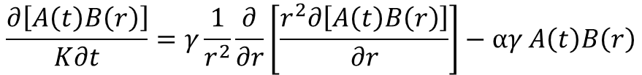
Assume 0
w.r.t: r&t
What are we assuming about X?
$$X=A\left(t\right)B(r)$$
Now what? Plug it in.
$$\frac{∂\left[A\left(t\right)B\left(r\right)\right]}{∂t}=Kγ\frac{1}{r^{2}}\frac{∂}{∂r}\left[\frac{r^{2}∂\left[A\left(t\right)B\left(r\right)\right]}{∂r}\right]−\frac{L_{p}S}{V}γ A\left(t\right)B\left(r\right);where γ=\left(2μ_{G}+μ_{γ}\right)$$
How can we simplify this further? Divide everything by K
$$\frac{∂\left[A\left(t\right)B\left(r\right)\right]}{K∂t}=γ\frac{1}{r^{2}}\frac{∂}{∂r}\left[\frac{r^{2}∂\left[A\left(t\right)B\left(r\right)\right]}{∂r}\right]−\frac{L_{p}S}{KV}γ A\left(t\right)B\left(r\right)$$
$$\frac{∂\left[A\left(t\right)B\left(r\right)\right]}{K∂t}=γ\frac{1}{r^{2}}\frac{∂}{∂r}\left[\frac{r^{2}∂\left[A\left(t\right)B\left(r\right)\right]}{∂r}\right]−αγ A\left(t\right)B\left(r\right)$$

Slide 21
Assume 0
w.r.t: r&t
What are we assuming about X?
$$X=A\left(t\right)B(r)$$
Now what? Plug it in.
$$\frac{∂\left[A\left(t\right)B\left(r\right)\right]}{∂t}=Kγ\frac{1}{r^{2}}\frac{∂}{∂r}\left[\frac{r^{2}∂\left[A\left(t\right)B\left(r\right)\right]}{∂r}\right]−\frac{L_{p}S}{V}γ A\left(t\right)B\left(r\right);where γ=\left(2μ_{G}+μ_{γ}\right)$$
How can we simplify this further? Divide everything by K
$$\frac{∂\left[A\left(t\right)B\left(r\right)\right]}{K∂t}=γ\frac{1}{r^{2}}\frac{∂}{∂r}\left[\frac{r^{2}∂\left[A\left(t\right)B\left(r\right)\right]}{∂r}\right]−\frac{L_{p}S}{KV}γ A\left(t\right)B\left(r\right)$$
$$\frac{∂\left[A\left(t\right)B\left(r\right)\right]}{K∂t}=γ\frac{1}{r^{2}}\frac{∂}{∂r}\left[\frac{r^{2}∂\left[A\left(t\right)B\left(r\right)\right]}{∂r}\right]−αγ A\left(t\right)B\left(r\right)$$

Slide 22
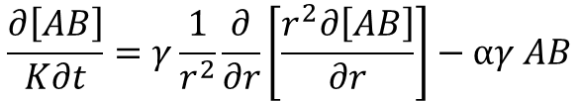
Assume 0
w.r.t: r&t
What are we assuming about X?
$$X=A\left(t\right)B(r)$$
Now what? Plug it in.
$$\frac{∂\left[A\left(t\right)B\left(r\right)\right]}{∂t}=Kγ\frac{1}{r^{2}}\frac{∂}{∂r}\left[\frac{r^{2}∂\left[A\left(t\right)B\left(r\right)\right]}{∂r}\right]−\frac{L_{p}S}{V}γ A\left(t\right)B\left(r\right);where γ=\left(2μ_{G}+μ_{γ}\right)$$
How can we simplify this further? Divide everything by K
$$\frac{∂\left[A\left(t\right)B\left(r\right)\right]}{K∂t}=γ\frac{1}{r^{2}}\frac{∂}{∂r}\left[\frac{r^{2}∂\left[A\left(t\right)B\left(r\right)\right]}{∂r}\right]−\frac{L_{p}S}{KV}γ A\left(t\right)B\left(r\right)$$
$$\frac{∂\left[A\left(t\right)B\left(r\right)\right]}{K∂t}=γ\frac{1}{r^{2}}\frac{∂}{∂r}\left[\frac{r^{2}∂\left[A\left(t\right)B\left(r\right)\right]}{∂r}\right]−αγ A\left(t\right)B\left(r\right)$$
$$\frac{∂\left[AB\right]}{K∂t}=γ\frac{1}{r^{2}}\frac{∂}{∂r}\left[\frac{r^{2}∂\left[AB\right]}{∂r}\right]−αγ AB$$

Slide 23

Assume 0
w.r.t: r&t
What are we assuming about X?
$$X=A\left(t\right)B(r)$$
Now what? Plug it in.
$$\frac{∂\left[A\left(t\right)B\left(r\right)\right]}{∂t}=Kγ\frac{1}{r^{2}}\frac{∂}{∂r}\left[\frac{r^{2}∂\left[A\left(t\right)B\left(r\right)\right]}{∂r}\right]−\frac{L_{p}S}{V}γ A\left(t\right)B\left(r\right);where γ=\left(2μ_{G}+μ_{γ}\right)$$
How can we simplify this further? Divide everything by K
$$\frac{∂\left[A\left(t\right)B\left(r\right)\right]}{K∂t}=γ\frac{1}{r^{2}}\frac{∂}{∂r}\left[\frac{r^{2}∂\left[A\left(t\right)B\left(r\right)\right]}{∂r}\right]−\frac{L_{p}S}{KV}γ A\left(t\right)B\left(r\right)$$
$$\frac{∂\left[A\left(t\right)B\left(r\right)\right]}{K∂t}=γ\frac{1}{r^{2}}\frac{∂}{∂r}\left[\frac{r^{2}∂\left[A\left(t\right)B\left(r\right)\right]}{∂r}\right]−αγ A\left(t\right)B\left(r\right)$$
$$\frac{BA′}{K}=γ\frac{1}{r^{2}}\left[r^{2}AB^{′′}+2rAB′\right]−αγ AB$$
$$\frac{∂\left[AB\right]}{K∂t}=γ\frac{1}{r^{2}}\frac{∂}{∂r}\left[\frac{r^{2}∂\left[AB\right]}{∂r}\right]−αγ AB$$

Slide 24

Assume 0
w.r.t: r&t
What are we assuming about X?
$$X=A\left(t\right)B(r)$$
Now what? Plug it in.
$$\frac{∂\left[A\left(t\right)B\left(r\right)\right]}{∂t}=Kγ\frac{1}{r^{2}}\frac{∂}{∂r}\left[\frac{r^{2}∂\left[A\left(t\right)B\left(r\right)\right]}{∂r}\right]−\frac{L_{p}S}{V}γ A\left(t\right)B\left(r\right);where γ=\left(2μ_{G}+μ_{γ}\right)$$
How can we simplify this further? Divide everything by K
$$\frac{∂\left[A\left(t\right)B\left(r\right)\right]}{K∂t}=γ\frac{1}{r^{2}}\frac{∂}{∂r}\left[\frac{r^{2}∂\left[A\left(t\right)B\left(r\right)\right]}{∂r}\right]−\frac{L_{p}S}{KV}γ A\left(t\right)B\left(r\right)$$
$$\frac{∂\left[A\left(t\right)B\left(r\right)\right]}{K∂t}=γ\frac{1}{r^{2}}\frac{∂}{∂r}\left[\frac{r^{2}∂\left[A\left(t\right)B\left(r\right)\right]}{∂r}\right]−αγ A\left(t\right)B\left(r\right)$$
$$\frac{A′}{KA}=\frac{γB^{′′}}{B}+\frac{2B^{′}γ}{rB}−αγ$$
$$\frac{BA′}{K}=γ\frac{1}{r^{2}}\left[r^{2}AB^{′′}+2rAB′\right]−αγ AB$$
$$\frac{∂\left[AB\right]}{K∂t}=γ\frac{1}{r^{2}}\frac{∂}{∂r}\left[\frac{r^{2}∂\left[AB\right]}{∂r}\right]−αγ AB$$

Slide 25

Assume 0
w.r.t: r&t
What are we assuming about X?
$$X=A\left(t\right)B(r)$$
Now what? Plug it in.
$$\frac{∂\left[A\left(t\right)B\left(r\right)\right]}{∂t}=Kγ\frac{1}{r^{2}}\frac{∂}{∂r}\left[\frac{r^{2}∂\left[A\left(t\right)B\left(r\right)\right]}{∂r}\right]−\frac{L_{p}S}{V}γ A\left(t\right)B\left(r\right);where γ=\left(2μ_{G}+μ_{γ}\right)$$
How can we simplify this further? Divide everything by K
$$\frac{∂\left[A\left(t\right)B\left(r\right)\right]}{K∂t}=γ\frac{1}{r^{2}}\frac{∂}{∂r}\left[\frac{r^{2}∂\left[A\left(t\right)B\left(r\right)\right]}{∂r}\right]−\frac{L_{p}S}{KV}γ A\left(t\right)B\left(r\right)$$
$$\frac{∂\left[A\left(t\right)B\left(r\right)\right]}{K∂t}=γ\frac{1}{r^{2}}\frac{∂}{∂r}\left[\frac{r^{2}∂\left[A\left(t\right)B\left(r\right)\right]}{∂r}\right]−αγ A\left(t\right)B\left(r\right)$$
$$\frac{A′}{KA}=\frac{γB^{′′}}{B}+\frac{2B^{′}γ}{rB}−αγ=λ$$
$$\frac{BA′}{K}=γ\frac{1}{r^{2}}\left[r^{2}AB^{′′}+2rAB′\right]−αγ AB$$
$$\frac{∂\left[AB\right]}{K∂t}=γ\frac{1}{r^{2}}\frac{∂}{∂r}\left[\frac{r^{2}∂\left[AB\right]}{∂r}\right]−αγ AB$$

Slide 26
Assume 0
w.r.t: r&t
What are we assuming about X?
$$X=A\left(t\right)B(r)$$
Now what? Plug it in.
$$\frac{∂\left[A\left(t\right)B\left(r\right)\right]}{∂t}=Kγ\frac{1}{r^{2}}\frac{∂}{∂r}\left[\frac{r^{2}∂\left[A\left(t\right)B\left(r\right)\right]}{∂r}\right]−\frac{L_{p}S}{V}γ A\left(t\right)B\left(r\right);where γ=\left(2μ_{G}+μ_{γ}\right)$$
How can we simplify this further? Divide everything by K
$$\frac{∂\left[A\left(t\right)B\left(r\right)\right]}{K∂t}=γ\frac{1}{r^{2}}\frac{∂}{∂r}\left[\frac{r^{2}∂\left[A\left(t\right)B\left(r\right)\right]}{∂r}\right]−\frac{L_{p}S}{KV}γ A\left(t\right)B\left(r\right)$$
$$\frac{∂\left[A\left(t\right)B\left(r\right)\right]}{K∂t}=γ\frac{1}{r^{2}}\frac{∂}{∂r}\left[\frac{r^{2}∂\left[A\left(t\right)B\left(r\right)\right]}{∂r}\right]−αγ A\left(t\right)B\left(r\right)$$
$$\frac{A′}{KA}=\frac{γB^{′′}}{B}+\frac{2B^{′}γ}{rB}−αγ=λ$$
$$\frac{BA′}{K}=γ\frac{1}{r^{2}}\left[r^{2}AB^{′′}+2rAB′\right]−αγ AB$$
$$\frac{∂\left[AB\right]}{K∂t}=γ\frac{1}{r^{2}}\frac{∂}{∂r}\left[\frac{r^{2}∂\left[AB\right]}{∂r}\right]−αγ AB$$
Solve for λ=0, λ<0, λ>0

Slide 27



$$\frac{A′}{KA}=\frac{γB^{′′}}{B}+\frac{2B^{′}γ}{rB}−αγ=λ$$
Solve for λ=0, λ<0, λ>0
$$\frac{A′}{KA}=λ$$
$$\frac{γB^{′′}}{B}+\frac{2B^{′}γ}{rB}−αγ=λ$$
Board…

Slide 28
Problems 15.7a, 15.8, 15.9, 15.10

Slide 29
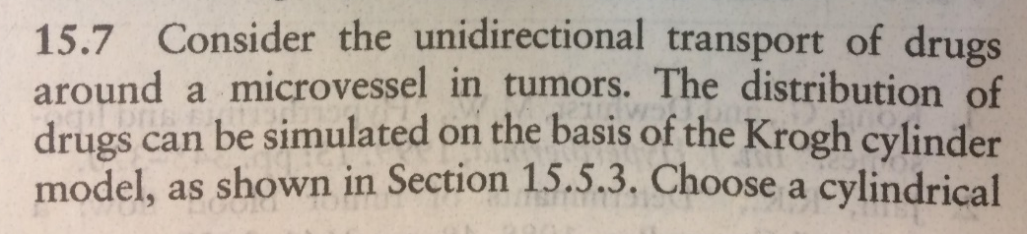
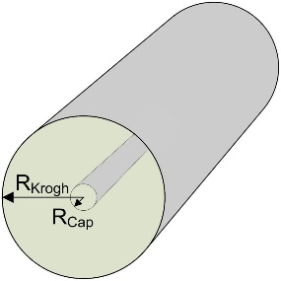
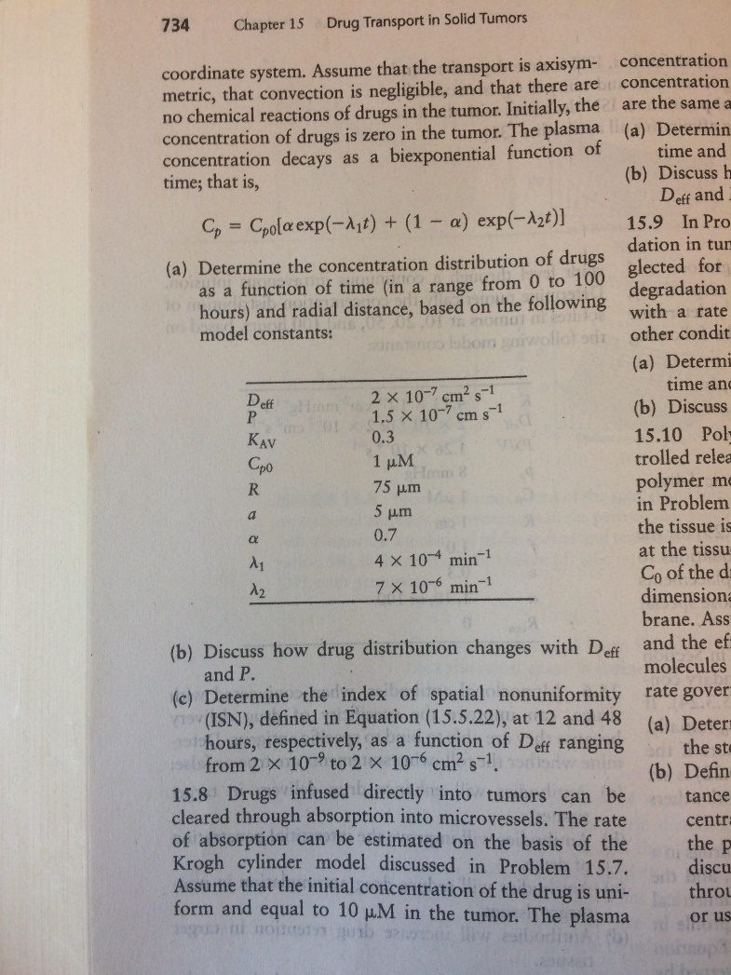
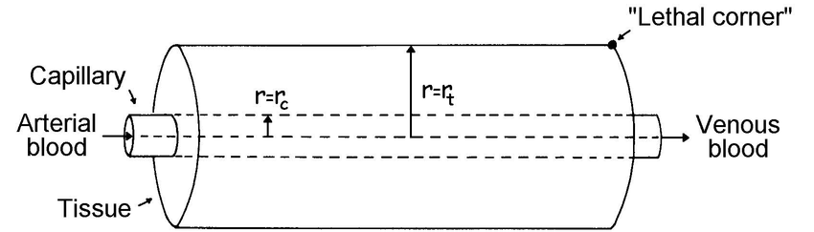
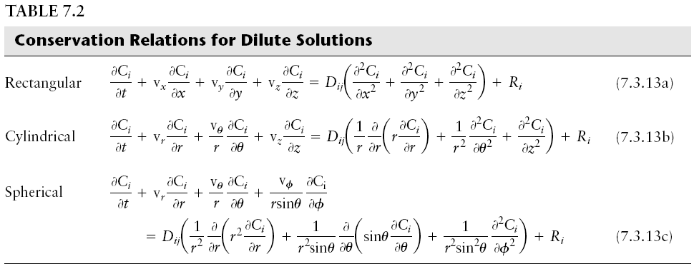
Problem 15.7a
Unrelated
Examples of
Krogh Models
Assume…
Assume…

Slide 30
Problem 15.7a
Assume convection is negligible
Assume…

Slide 31
Problem 15.7a
Assume convection is negligible
Assume no chemical reactions of drugs in the tumor

Slide 32
Problem 15.7a
Assume convection is negligible
Assume no chemical reactions of drugs in the tumor
Equation:?
r_{t}
r_{c}

Slide 33

Problem 15.7a
Assume convection is negligible
Assume no chemical reactions of drugs in the tumor
Equation:?
B.C: on vessel wall:

Slide 34


Problem 15.7a
Assume convection is negligible
Assume no chemical reactions of drugs in the tumor
Equation:?
B.C: on vessel wall:
B.C: on cylinder wall:
$$C_{p}\left(t\right)=C_{po}\left(αe^{−λ_{1}t}+\left(1−α\right)e^{−λ_{2}t}\right)$$
I.C.
$C_{p}\left(t=0\right)=$0

Slide 35
Objective: Use MatLab to solve numerically t=0:100 hr and of r up to 150 um

Slide 36
function [ output_args ] = Example5_7b( input_args )
%UNTITLED2 Summary of this function goes here
% Detailed explanation goes here
global N dr s v Deff P Kav Cp0 alpha L1 L2
%Model parameters
Deff=2e-7*60e8; %cm^2/s to um^2/min
P=1.5e-7*60e8; %cm/s to um/min
Kav=0.3;
Cp0=1; %uM
alpha = 0.7;
L1 = 4e-4; %1/min
L2 = 7e-6; %1/min
a=5; %um
R=75; %um
%Mesh definition
N=50;
dr=(R-a)/N;
drh=dr/2;
rm=a:dr:R;
r=(a+drh):dr:(R-drh);
s=zeros(N+1,1);
for i =1:N+1
s(i)=2*pi*rm(i);
end
v=zeros(N,1)
for i = 1:N
v(i) = pi*(rm(i+1)*rm(i+1)-rm(i)*rm(i));
end
c0=zeros(N,1);
tspan=[0 10 60 720 2880 6000];
[t,c]=ode15s(@func,tspan,c0);
figure;
plot(r,c(2,:),r,c(3,:),r,c(4,:),r,c(5,:),r,c(6,:));
legend('10 min','60 min','12 hr','48 hr','100 hr')
xlabel('r (\mum)','FontSize',20)
ylabel('C (\muM)','FontSize',20)
aa1=(c(4,1)*r(1)+c(4,N)*r(N))/2;
aa2=(c(5,1)*r(1)+c(5,N)*r(N))/2;
for i=2:(N-1)
aa1=aa1+c(4,i)*r(i);
aa2=aa2+c(5,i)*r(i);
end
mean12=aa1*dr*2/(R*R-a*a);
mean48=aa2*dr*2/(R*R-a*a);
aa1=0;
aa2=0;
for i =1:N
aa1=aa1+(c(4,i)-mean12)^2;
aa2=aa2+(c(5,i)-mean48)^2;
end
ISN1=sqrt(aa1)/(mean12*sqrt(N*N-1))
ISN2=sqrt(aa2)/(mean48*sqrt(N*N-1))
fid=fopen('data.txt','w');
fprintf(fid,'r,10,60,720,2880,6000/n');
for i = 1:N
fprintf(fid,'%8.4f,%8.4f,%8.4f,%8.4f,%8.4f,%8.4f\n',r(i),c(2,i),c(3,i),c(4,i),c(5,i),c(6,i));
end
fclose(fid);
function dcdt=func(t,c)
global N dr s v Deff P Kav Cp0 alpha L1 L2
Cp=Cp0*(alpha*exp(-L1*t)+(1-alpha)*exp(-L2*t));
dcdt=zeros(N,1);
dcdt(1)=1/v(1)*(P*(Cp-c(1)/Kav)*s(1)+Deff*(c(2)-c(1))/dr*s(2));
for i = 2:N-1
iu=i-1;
id=i+1;
dcdt(i)=1/v(i)*(Deff*(c(iu)-c(i))/dr*s(i)+Deff*(c(id)-c(i))/dr*s(id));
end
dcdt(N)=1/v(N)*(Deff*(c(N-1)-c(N))/dr*s(N));

Slide 37
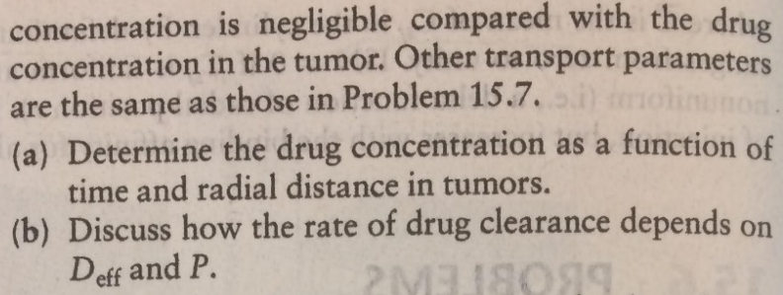
B.C. 1
B.C. 2
Assume the concentration of drug in plasma is negligible to that in tissue…
I.C.: Concentration in tumor:

Slide 38
Via numerical analysis

Slide 39
function [ output_args ] = Example5_8( input_args )
global N dr s v Deff P Kav
%Model parameters
Deff=2e-7*60e8; %cm^2/s to um^2/min
P=1.5e-7*60e8; %cm/s to um/min
Kav=0.3;
c_init=10; %uM
a=5; %um
R=150; %um
%Mesh definition
N=50;
dr=(R-a)/N;
drh=dr/2;
rm=a:dr:R;
r=(a+drh):dr:(R-drh);
s=zeros(N+1,1);
for i =1:N+1
s(i)=2*pi*rm(i);
end
v=zeros(N,1)
for i = 1:N
v(i) = pi*(rm(i+1)*rm(i+1)-rm(i)*rm(i));
end
c0=zeros(N,1);
for i=1:N
c0(i)=c_init;
tspan=[0 10 20 60 120 600];
[t,c]=ode15s(@func,tspan,c0);
end
figure;
plot(r,c(2,:),r,c(3,:),r,c(4,:),r,c(5,:),r,c(6,:));
legend('10 min','60 min','12 hr','48 hr','100 hr','Location','northwest')
xlabel('r (\mum)','FontSize',20)
ylabel('C (\muM)','FontSize',20)
fid=fopen('data.txt','w');
fprintf(fid,'r,10,20,60,120,600\n');
for i = 1:N
fprintf(fid,'%8.4f,%8.4f,%8.4f,%8.4f,%8.4f,%8.4f\n',r(i),c(2,i),c(3,i),c(4,i),c(5,i),c(6,i));
end
fclose(fid);
function dcdt=func(t,c)
global N dr s v Deff P Kav
dcdt=zeros(N,1);
dcdt(1)=1/v(1)*(-P*c(1)/Kav*s(1)+Deff*(c(2)-c(1))/dr*s(2));
for i = 2:N-1
iu=i-1;
id=i+1;
dcdt(i)=1/v(i)*(Deff*(c(iu)-c(i))/dr*s(i)+Deff*(c(id)-c(i))/dr*s(id));
end
dcdt(N)=1/v(N)*(Deff*(c(N-1)-c(N))/dr*s(N));

Slide 40
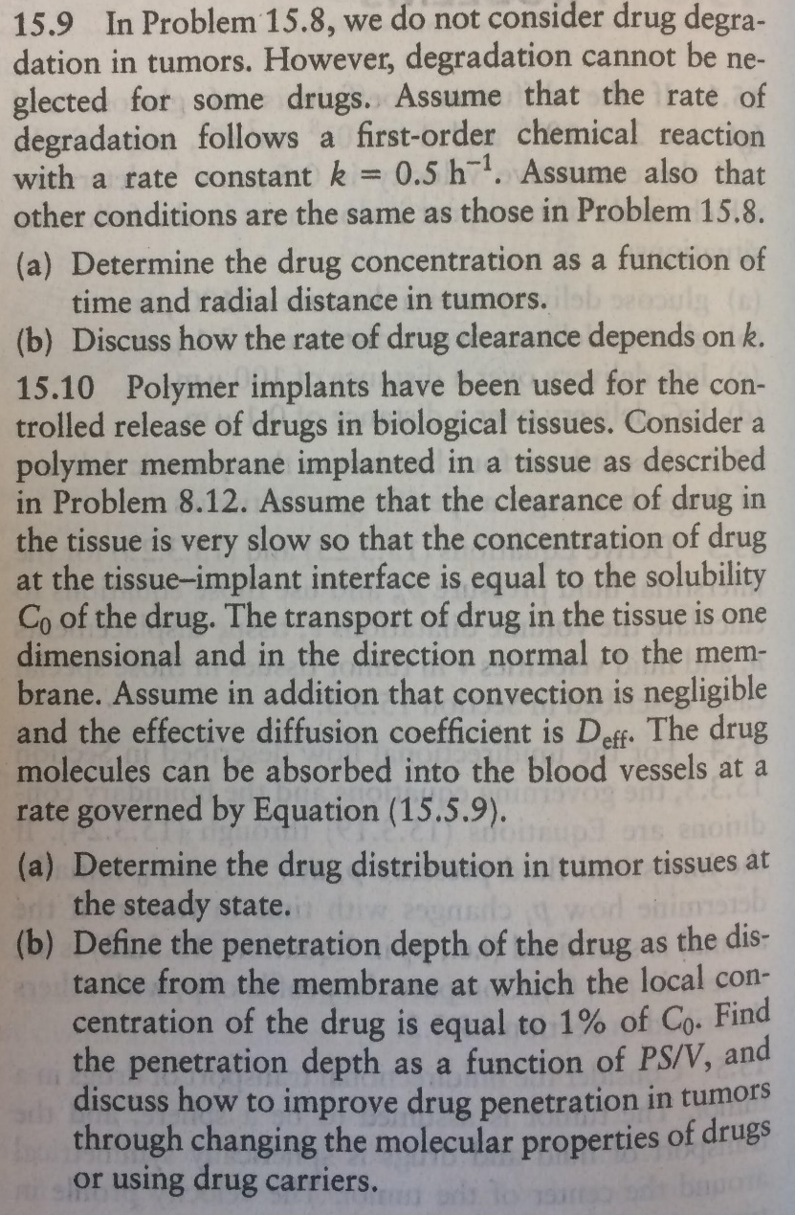
B.C. 1
B.C. 2
Assume the concentration of drug in plasma is negligible to that in tissue…
I.C.: Concentration in tumor:

Slide 41
function [ output_args ] = Example5_8( input_args )
global N dr s v Deff P Kav
%Model parameters
Deff=2e-7*60e8; %cm^2/s to um^2/min
P=1.5e-7*60e8; %cm/s to um/min
Kav=0.3;
c_init=10; %uM
a=5; %um
R=150; %um
%Mesh definition
N=50;
dr=(R-a)/N;
drh=dr/2;
rm=a:dr:R;
r=(a+drh):dr:(R-drh);
s=zeros(N+1,1);
for i =1:N+1
s(i)=2*pi*rm(i);
end
v=zeros(N,1)
for i = 1:N
v(i) = pi*(rm(i+1)*rm(i+1)-rm(i)*rm(i));
end
c0=zeros(N,1);
for i=1:N
c0(i)=c_init;
tspan=[0 10 20 60 120 600];
[t,c]=ode15s(@func,tspan,c0);
end
figure;
plot(r,c(2,:),r,c(3,:),r,c(4,:),r,c(5,:),r,c(6,:));
legend('10 min','60 min','12 hr','48 hr','100 hr','Location','northwest')
xlabel('r (\mum)','FontSize',20)
ylabel('C (\muM)','FontSize',20)
fid=fopen('data.txt','w');
fprintf(fid,'r,10,20,60,120,600\n');
for i = 1:N
fprintf(fid,'%8.4f,%8.4f,%8.4f,%8.4f,%8.4f,%8.4f\n',r(i),c(2,i),c(3,i),c(4,i),c(5,i),c(6,i));
end
fclose(fid);
function dcdt=func(t,c)
global N dr s v Deff P Kav
dcdt=zeros(N,1);
dcdt(1)=1/v(1)*(-P*c(1)/Kav*s(1)+Deff*(c(2)-c(1))/dr*s(2));
for i = 2:N-1
iu=i-1;
id=i+1;
dcdt(i)=1/v(i)*(Deff*(c(iu)-c(i))/dr*s(i)+Deff*(c(id)-c(i))/dr*s(id));
end
dcdt(N)=1/v(N)*(Deff*(c(N-1)-c(N))/dr*s(N));
What should we modify?

Slide 42
function [ output_args ] = Example5_8( input_args )
global N dr s v Deff P Kav
for k=0:5/60:50/60
%Model parameters
Deff=2e-7*60e8; %cm^2/s to um^2/min
P=1.5e-7*60e8; %cm/s to um/min
Kav=0.3;
c_init=10; %uM
a=5; %um
R=150; %um
%Mesh definition
N=50;
dr=(R-a)/N;
drh=dr/2;
rm=a:dr:R;
r=(a+drh):dr:(R-drh);
s=zeros(N+1,1);
for i =1:N+1
s(i)=2*pi*rm(i);
end
v=zeros(N,1)
for i = 1:N
v(i) = pi*(rm(i+1)*rm(i+1)-rm(i)*rm(i));
end
c0=zeros(N,1);
for i=1:N
c0(i)=c_init;
tspan=[0 10 20 60 120 600];
[t,c]=ode15s(@func,tspan,c0);
end
figure;
plot(r,c(2,:),r,c(3,:),r,c(4,:),r,c(5,:),r,c(6,:));
legend('10 min','60 min','12 hr','48 hr','100 hr','Location','northwest')
xlabel('r (\mum)','FontSize',20)
ylabel('C (\muM)','FontSize',20)
fid=fopen('data.txt','w');
fprintf(fid,'r,10,20,60,120,600\n');
for i = 1:N
fprintf(fid,'%8.4f,%8.4f,%8.4f,%8.4f,%8.4f,%8.4f\n',r(i),c(2,i),c(3,i),c(4,i),c(5,i),c(6,i));
end
fclose(fid);
end
function dcdt=func(t,c)
global N dr s v Deff P Kav
dcdt=zeros(N,1);
dcdt(1)=1/v(1)*(-P*c(1)/Kav*s(1)+Deff*(c(2)-c(1))/dr*s(2))-k*c(1);
for i = 2:N-1
iu=i-1;
id=i+1;
dcdt(i)=1/v(i)*(Deff*(c(iu)-c(i))/dr*s(i)+Deff*(c(id)-c(i))/dr*s(id)) -k*c(i);
end
dcdt(N)=1/v(N)*(Deff*(c(N-1)-c(N))/dr*s(N)) -k*c(N);

