Slide 1
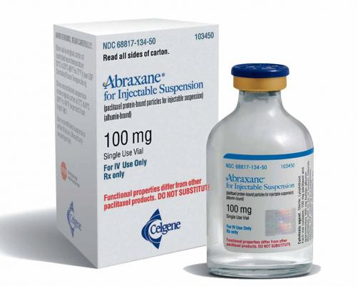
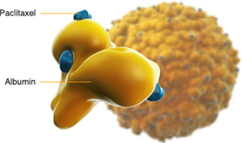
Molecular Engineering - Examples
Celgene: Abraxane (nearly ~$1B per year)
Paclitaxel (small molecules) associated with albumin

Slide 2
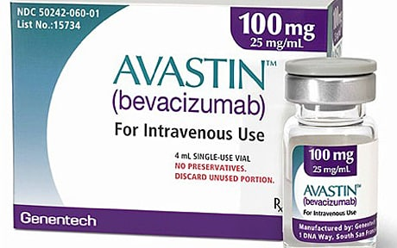
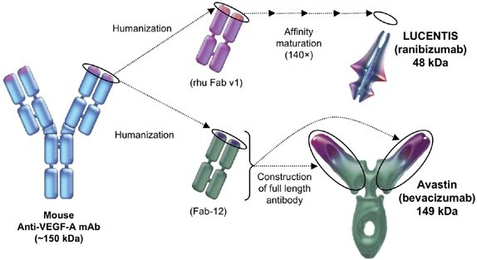
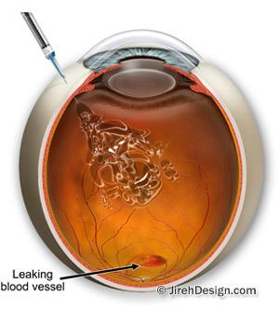
Molecular Engineering - Examples
Genentech: Antibody engineering
i.e., KBI Biopharma, etc., etc.
Avastin versus Lucentis
Eylea

Slide 3
NexImmune
Antigen-specific immunomodulatory therapies (i.e., stimulating DC proliferation)

Slide 4
Juno Therapeutics

Slide 5
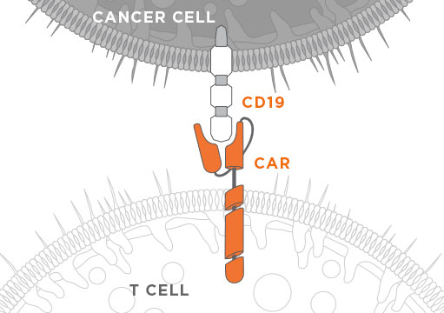
Juno Therapeutics

Slide 6
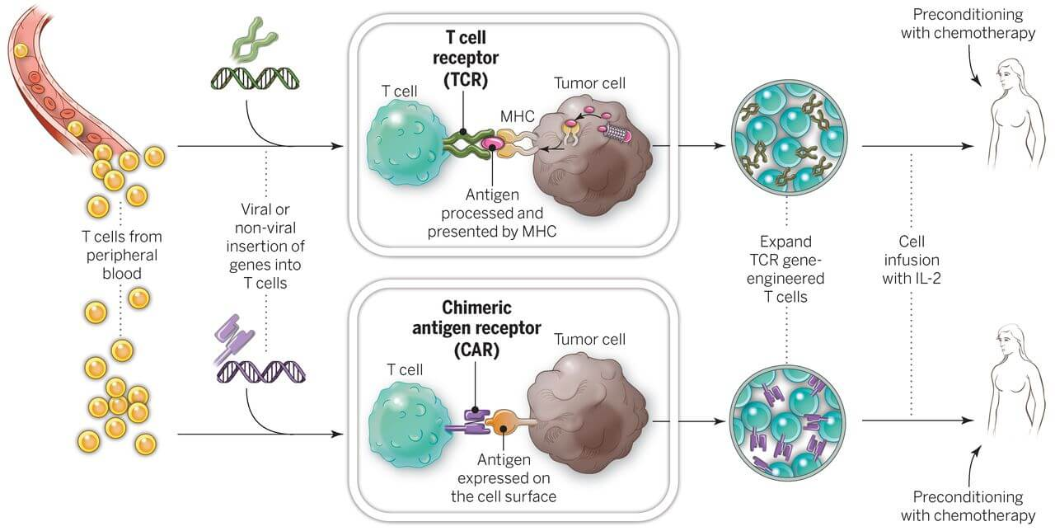
Juno Therapeutics

Slide 7
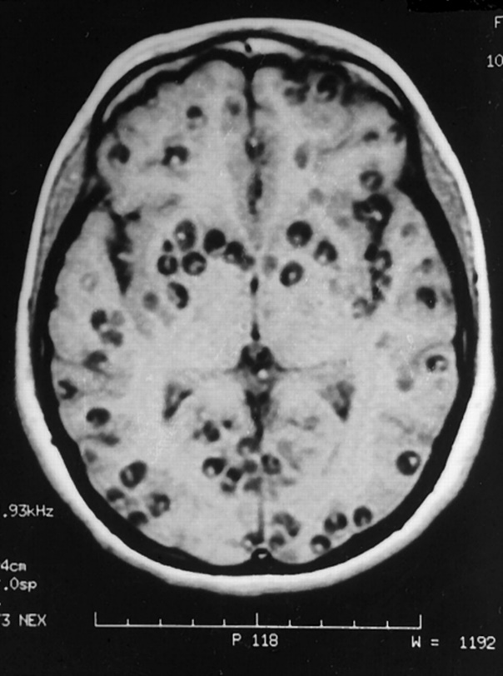
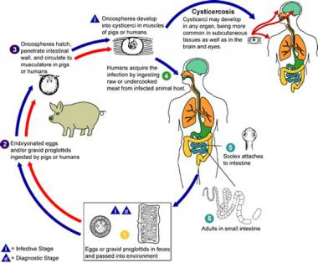
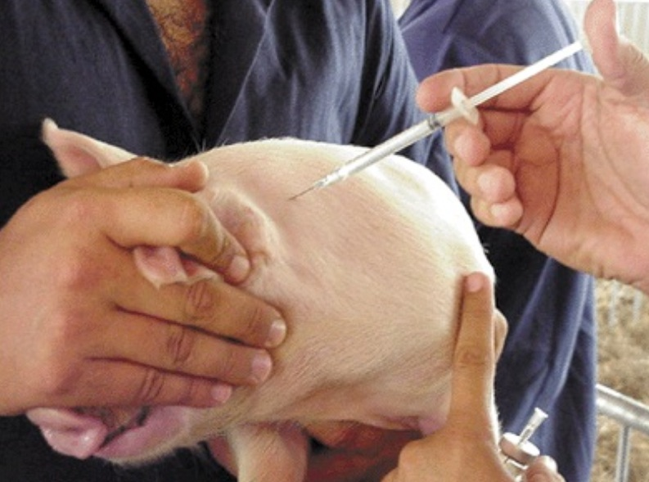
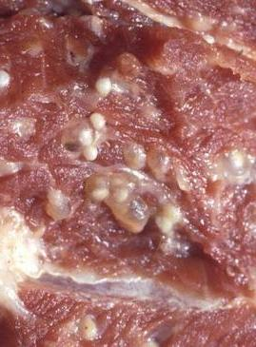
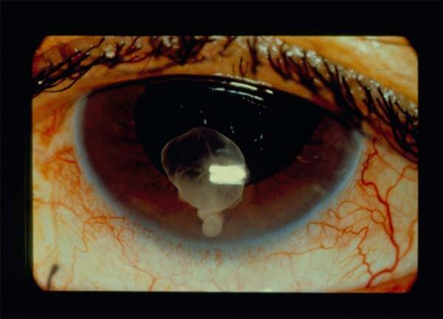
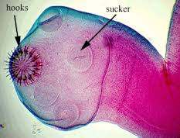
TSOL18 (via DNA recombinant technology)

Slide 8
Exciting News!
http://www.cnn.com/2017/08/30/health/fda-first-gene-therapy-leukemia/index.html
U.S. FDA announces first US gene therapy approval for cancer treatment
Gene therapy for HNSCC in China approved
Gene therapy for LPL deficiency in EU

Slide 9
Cellular Engineering: Examples
Juno Therapeutics ($565 million): cancer therapeutics; chimeric antigen presenting T cells therapies
Activartis: DC-based cancer immunotherapy
Adaptimmune: T cell cancer therapy
Adheren: Cancer immunotherapy
Adverum Biotechnologies: AAV-based gene therapy
Cells used as factories for biomolecules (i.e., antibodies)
Cells to eat oil (oceanic oil spills; BP: 100 sextillion microbial cells of ethane-consuming Colwellia) and clean up land (abandoned gas stations)
Transgenic cows to secrete insulin in their milk and transgenic plants for antigen production (high yield)

Slide 10
Other cell-based companies - international
Others: Anagenesis Anges, Animal Cell Therapies, apceth, Aposcience, Ascend Biopharmaceuticals, Astarte Biologics, Asterias Biotherapeutics, Asymmetrex, Athersys, Avita Medical, AVM Biotechnology, AVROBIO, Axiogenesis, AxoGen, Bellicum Pharmaceuticals, BioCardia, BioRestorative Therapies, Bone Therapeutics, BrainStorm Cell Therapeutics, Bullet Biotechnology, Caladrius Biosciences, Capricor, CardioCell, Celdara, Cell Line Genetics, Cell Medica, Cell Surgical Network, Cell Therapy, Cell2B, Cellartis, CellProthera, CellResearchCorp, CellTherapies, Cellular Biomedicine, Cellsense, Celther Polska, Celvive, Celyad, ChromoCell, CiMaas, Cook General BioTechnology, Cynata Therapeutics, Cytori Therapeutics, DanDrit Biotechnology, DaVinci Biosciences, DiscGenics, DNAVEC, Dompe, Fibrocell Science, Galileo Research, Gamida Cell, Histogen, Human Longevity, I-stem, Immatics Biotechnology, Immune Therapeutics, Immusoft, Inform Genomics, Intercytex, International Stem Cell, Invitrx Therapeutics, InvivoGen Therapeutics, Kadimastem, Kiadis, Lion Biotechnologies, Living Cell Technologies, Macrocure, MBC Pharma, MEDIPOST, Mesoblast, Metaclipse Therapeutics, MirImmune, MolMed, Morphogenesis, NantCell, Neon Therapeutics, Neuralstem, Neurogeneration, Neurona Therapeutics, Neuronascent, NewLink Genetics, NexImmune, Nohla Therapeutics, Nupotential, Okairos, OncoMed Pharmaceuticals, Opexa Therapeuticals, Orgenesis, ORIG3N, Orthocyte, Osiris Therapeutics, OvaScience, Pathfinder Cell Therapy, Personal Cell Sciences, PharmaCell, Plureon, PluriCell, Promethera Biosciences, Regen BioPharma, Regeneus, Regenicin, RegenoCELL Therapeutics, ReNeuron, RepliCel Life Sciences, RhinoCyte, Roslin Cells, Rubius Therapeutics, SanBio Co Ltd, Saneron CCEL Therapeutics, Semma Therapeutics, SpherIngenics, StemBioSys, Stemedica Cell Technologies, StemGenex, StemGenn Therapeutics, Stemline Therapeutics, Stempeutics, Stratatech, Taiga Biotechnologies, TaiwanBio, Talisman Therapeutics, Targazyme, Tempo Bioscience, Tissue Genesis, TissueGene, Trevigen, Trillium Therapeutics, TxCell, U.S. Stem Cell, Universal Cells, Unum Therapeutics, Vericel, VetStem Biopharma, ViaCord (Perkin Elmer), ViaCyte, VistaGen Therapeutics, Vital Therapies, Vor BioPharma, Xcelthera, ZenBio, Ziopharm Oncology

