Slide 1
Solving for Example 8.7

Slide 2
Consider using
Laplace
Undetermined coefficients

Slide 3
Laplace Transformation

Slide 4
http://tutorial.math.lamar.edu/Classes/DE/Laplace_Table.aspx

Slide 5
Laplace gives you both the homog. and particular solns.

Slide 6
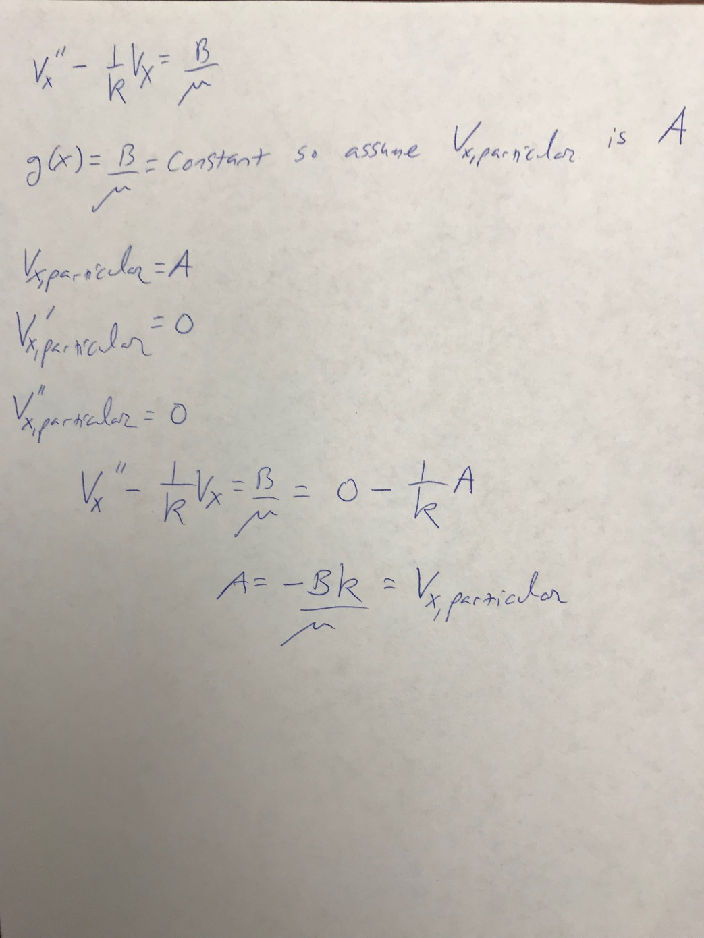
Undetermined Coefficients
This method is only for calculating the particular solution

