Slide 1
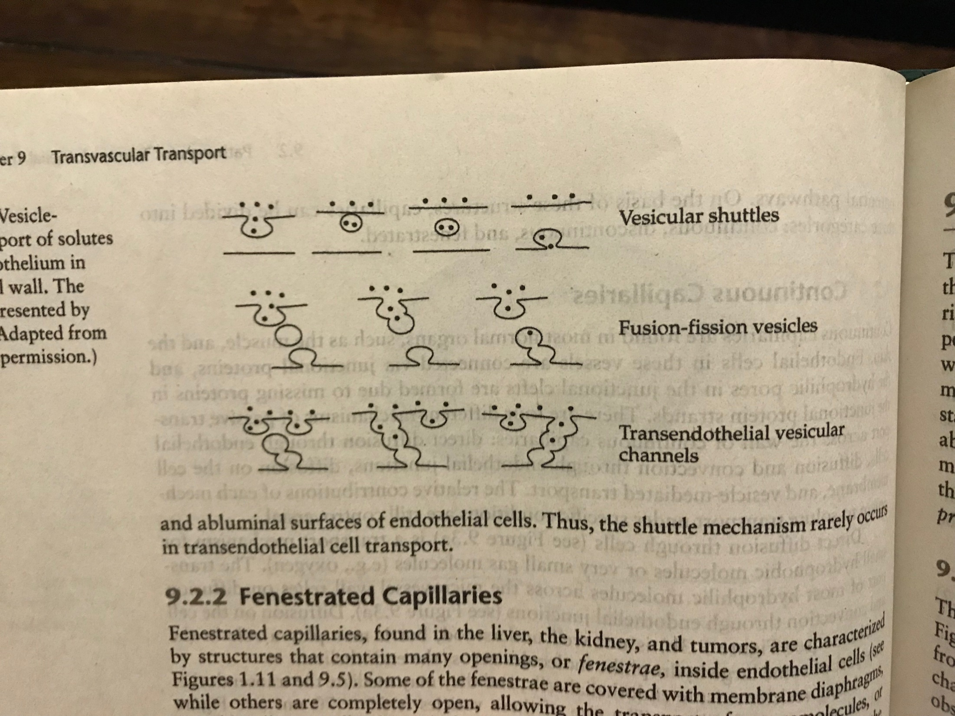

Slide 2
HW Solutions for Ch. 9
Problems 9.2, 9.4

Slide 3
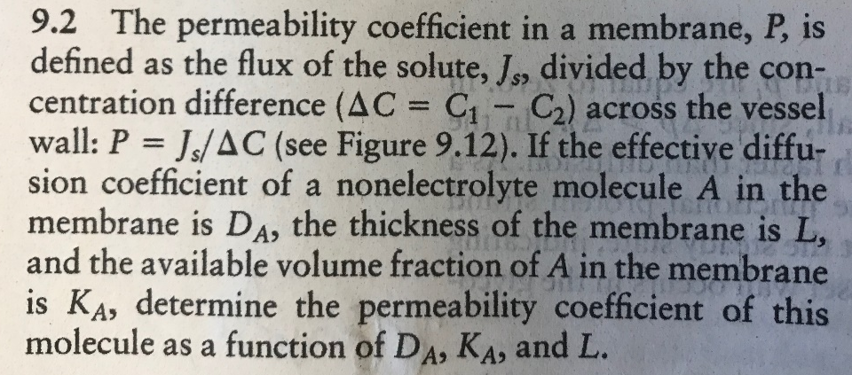

Slide 4
The thickness of a membrane is very small. The transport of solute reaches s.s. quickly. The flux of solute in the membrane can be calculated based on s.s. mass balance equation.

Slide 5
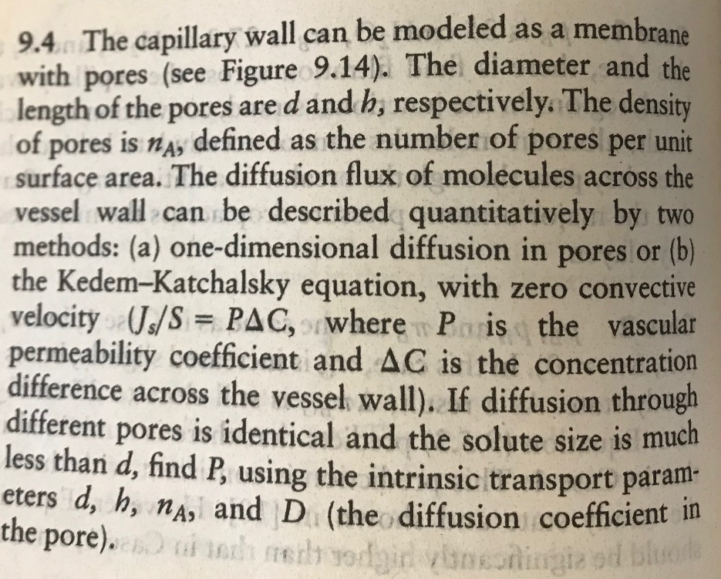
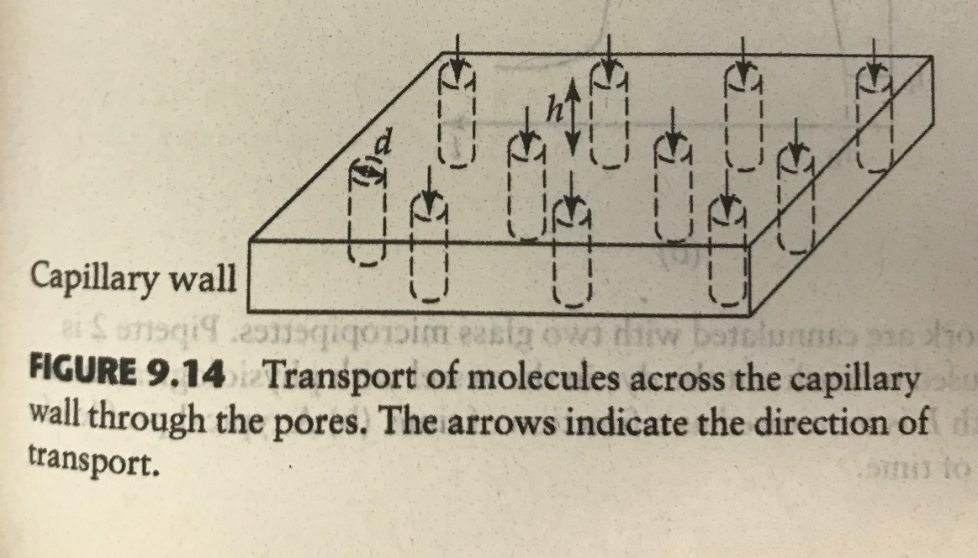

Slide 6
In each pore, the diffusion flux of the solute is:
If all of the pores are similar, the total flux of solute through the vessel wall = diffusion flux in one pore times the surface
Area ratio of the pore…

